Slide 1
Spicy bean burgers
Complexity: medium

Slide 2
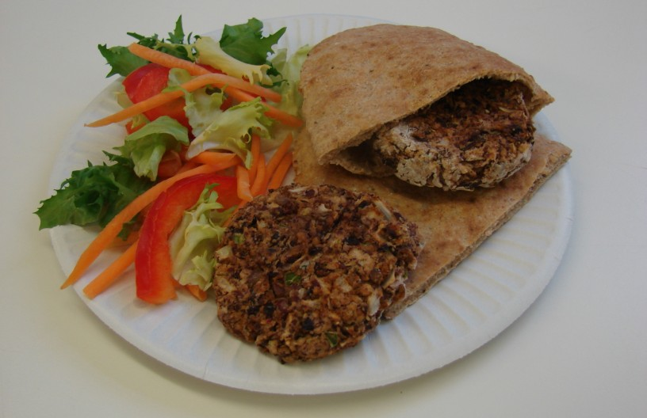

Slide 3
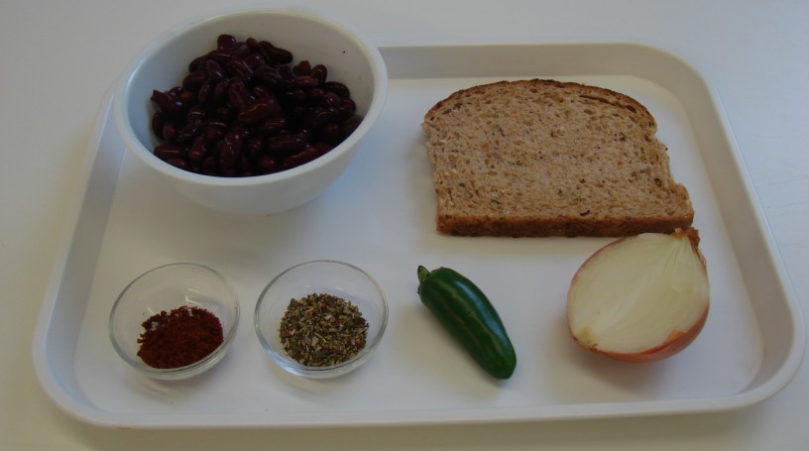
Ingredients
1 slice of bread
½ onion
1 medium green chilli
1 x 400g can red kidney beans
1 x 5ml spoon ground chilli powder
1 x 5ml spoon dried mixed herbs

Slide 4
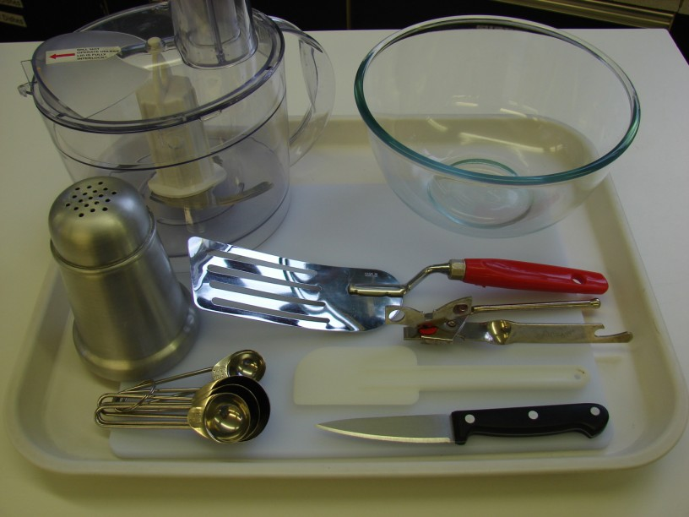
Equipment
Food processor
Mixing bowl
Chopping board
Knife
Can opener
Measuring spoons
Spatula
Flour dredger
Fish slice

Slide 5
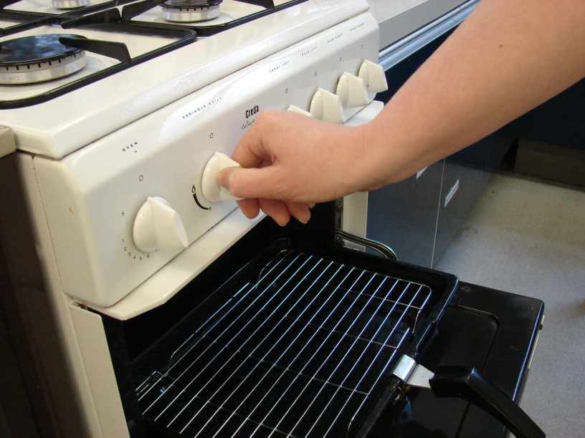
Method
Preheat the grill.

Slide 6
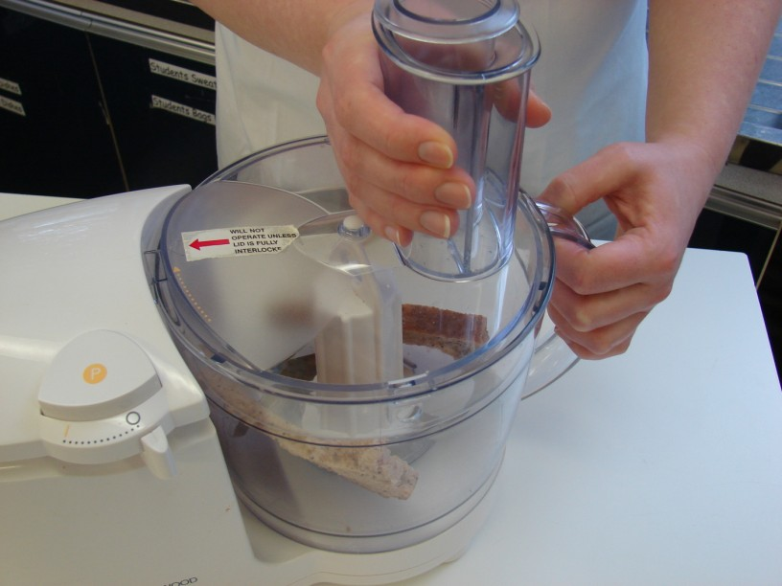
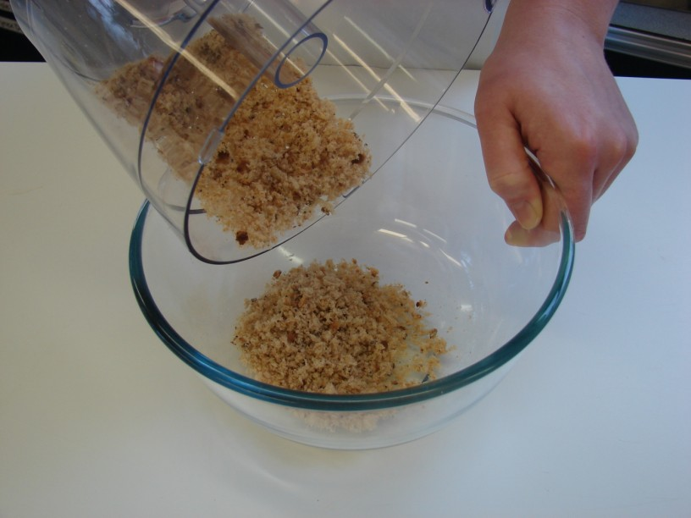
Put the bread in the food processor and blitz until it resembles breadcrumbs. Pour these crumbs into the mixing bowl.

Slide 7
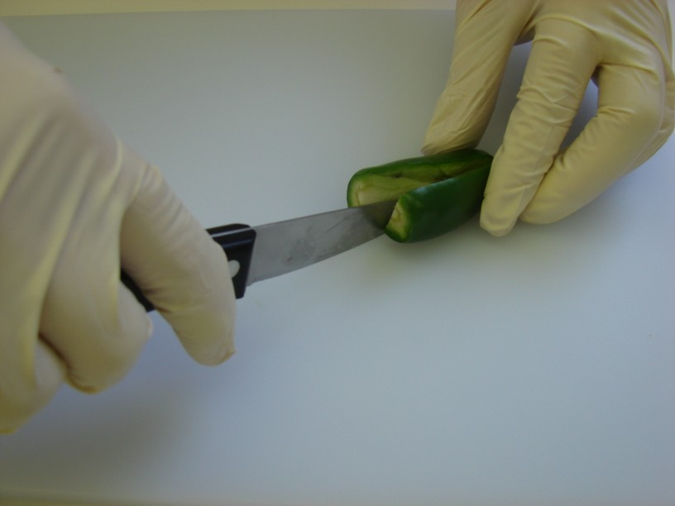
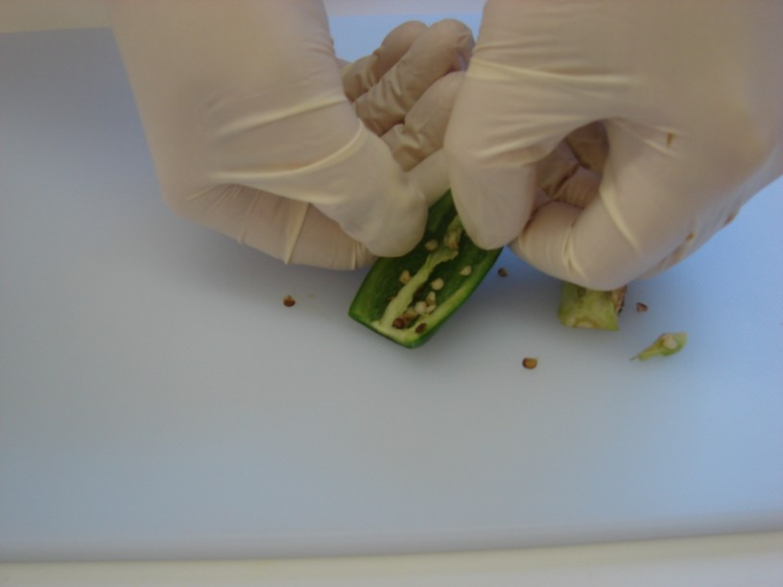
Cut away the top of the chilli, and then de-seed.

Slide 8
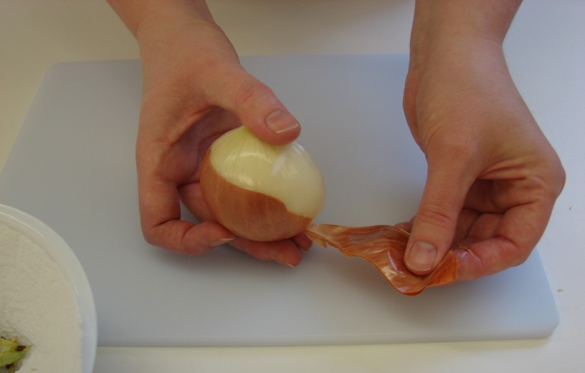
Peel the onion.

Slide 9
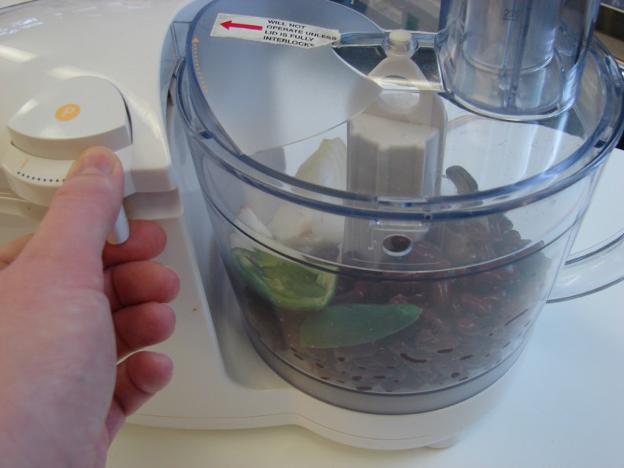
Drain the red kidney beans, then place the red kidney beans, onion, chilli, chilli powder and dried herbs into the food processor. Blitz together to form a thick paste-like mixture .

Slide 10
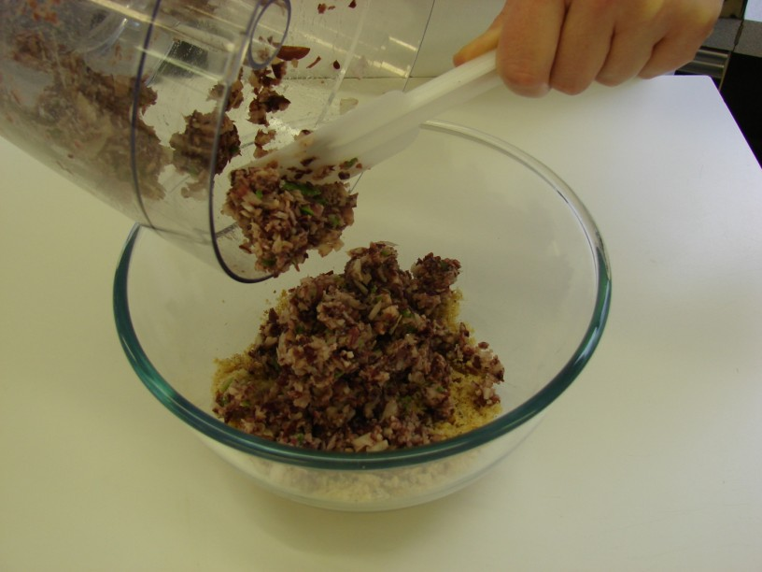
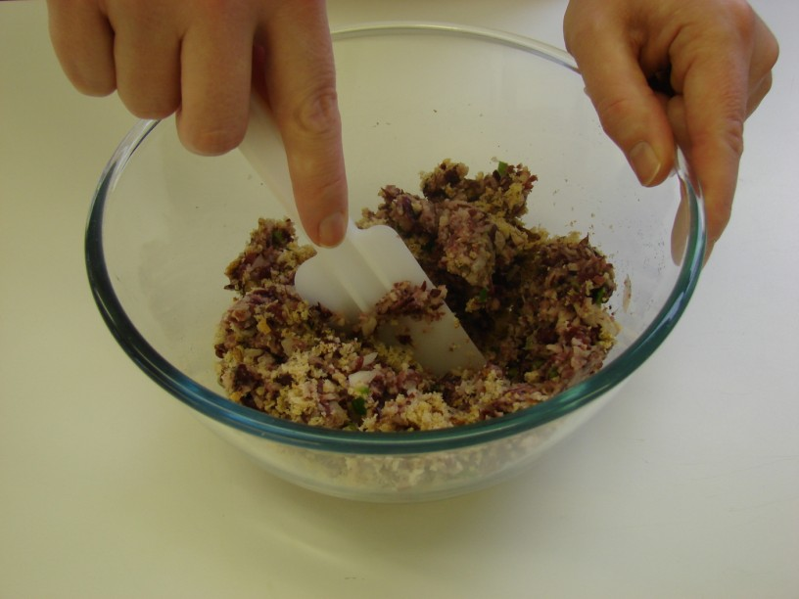
Place the bean mixture into the mixing bowl with the breadcrumbs. Mix everything together thoroughly using the spatula.

Slide 11
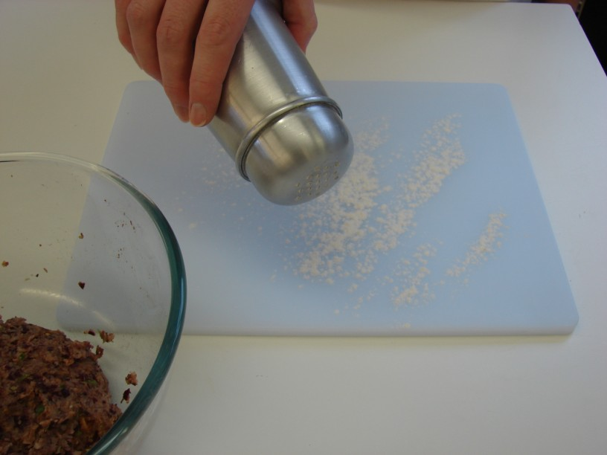
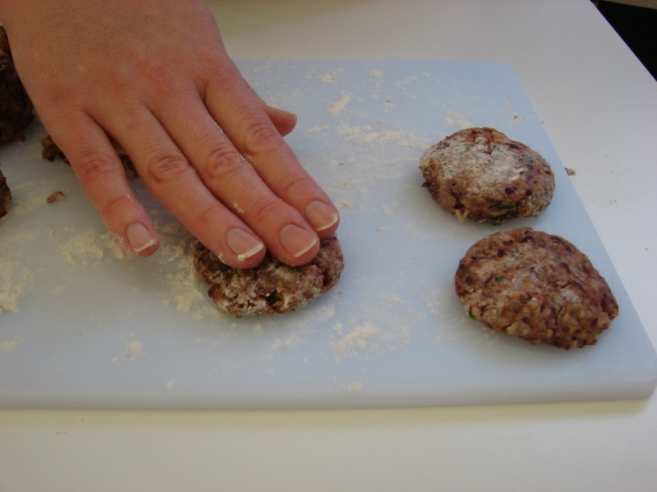
On a lightly floured chopping board, divide and shape the bean mixture into 8 small patties.

Slide 12
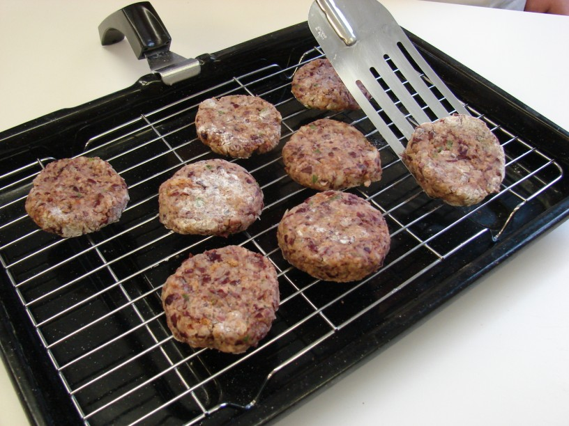
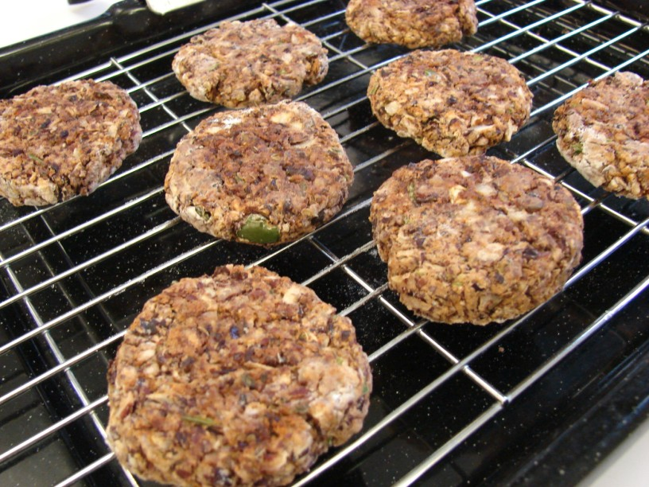
Grill the patties for 8 minutes, turning over after 4 minutes.

Slide 13
Serve in a pitta with salad.

Slide 14
Top tips
Food skills
Try different types of beans or pulses.
Use other herbs, spices and/or lemon instead of chilli.
Eat with a range of different breads and fillings e.g. tomato salsa or tzatziki.
Add vegetables to the mix e.g. sweetcorn, green pepper or grated carrot.
The grill gets hot so remember to wear oven gloves.
Measure.
Blitz.
Cut.
Peel.
Drain.
Mix.
Divide.
Form and shape.
Grill.

Slide 15
Spicy bean burgers
For further information, go to:
www.foodafactoflife.org.uk

