Slide 1
Tuna and broccoli pasta
Complexity: medium-high

Slide 2
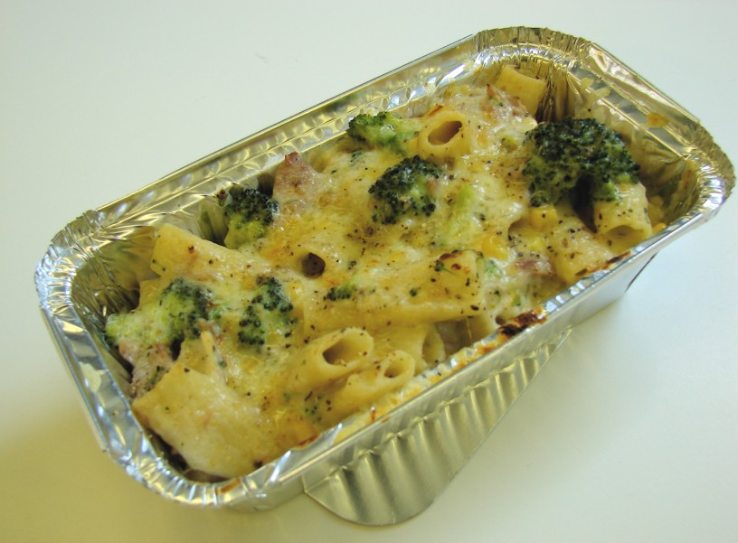

Slide 3
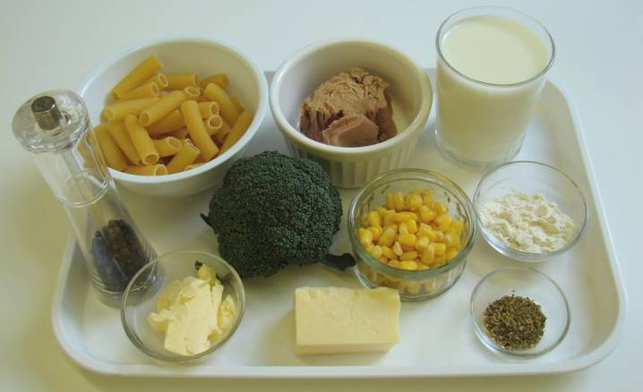
Ingredients
100g rigatoni
40g cheese
100g broccoli
100g canned tuna (in water) drained
25g spread
25g plain flour
250ml semi-skimmed milk
1 x 5ml spoon dried oregano
50g sweetcorn (canned or frozen)
Black pepper

Slide 4
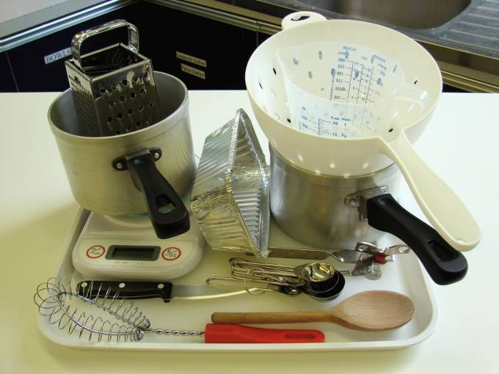
Equipment
Two saucepans
Weighing scales
Grater
Chopping board
Knife
Measuring jug
Whisk
Colander
Wooden spoon
Ovenproof dish (or foil tray)

Slide 5
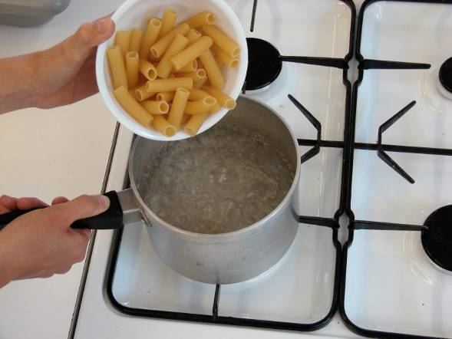
Method
Bring a saucepan of water to the boil, and then add the rigatoni. Cook for about 10 – 12 minutes, until al dente.

Slide 6
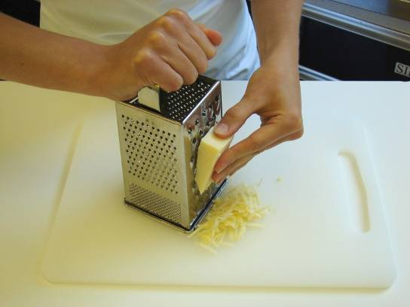
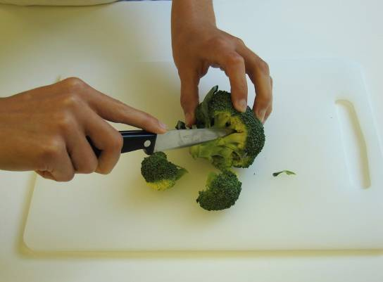
Grate the cheese and cut the broccoli into small pieces.

Slide 7
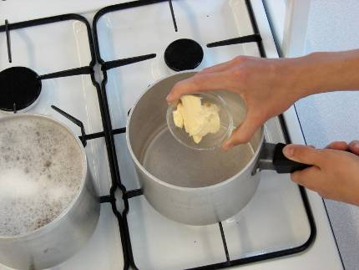
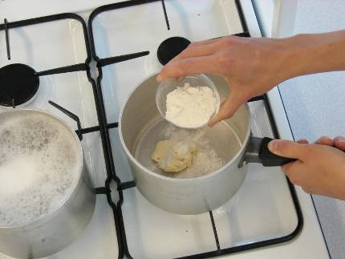
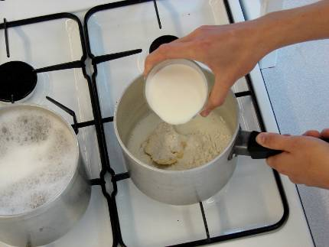
While the pasta is cooking, make the sauce:
place the spread, flour and milk into a small saucepan;

Slide 8
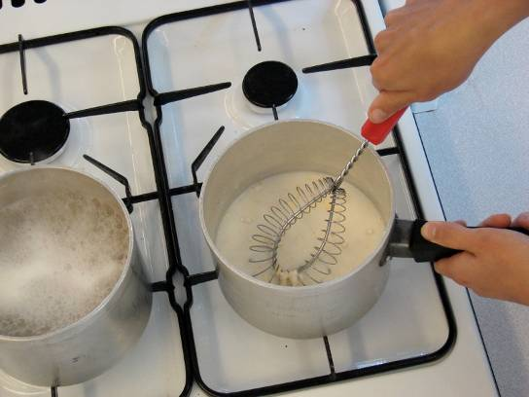
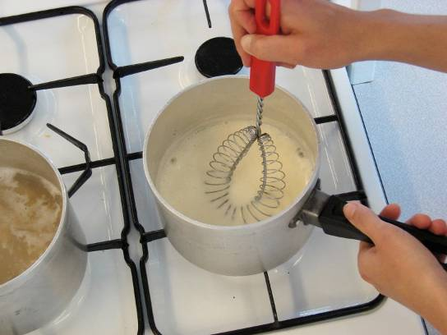
bring the sauce to a simmer, whisking all the time until it has thickened;

Slide 9
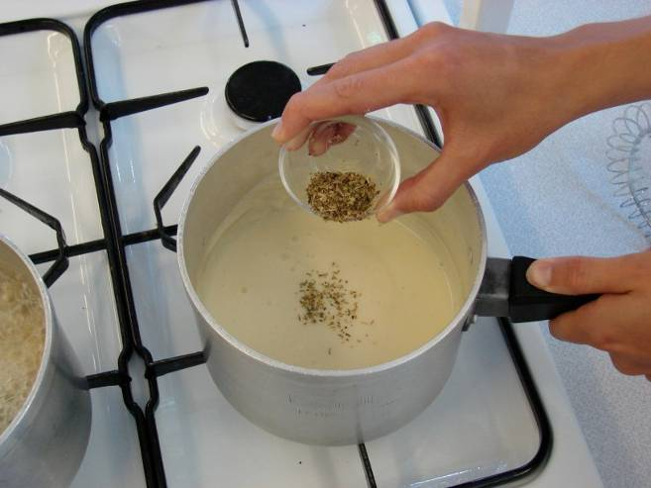
reduce the heat, stir in the oregano, and allow to simmer for 2 minutes.

Slide 10
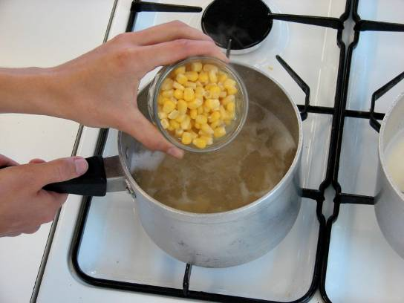
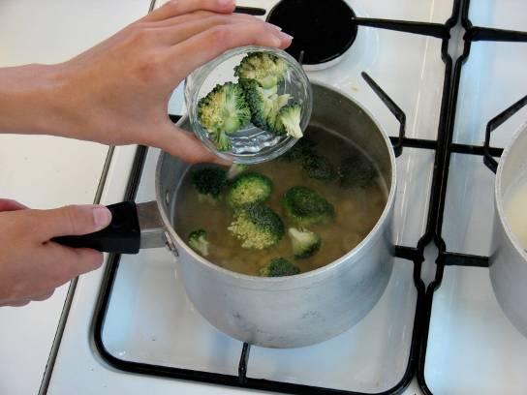
During the last 2 minutes of the pasta boiling, add the sweetcorn and broccoli to the saucepan.

Slide 11
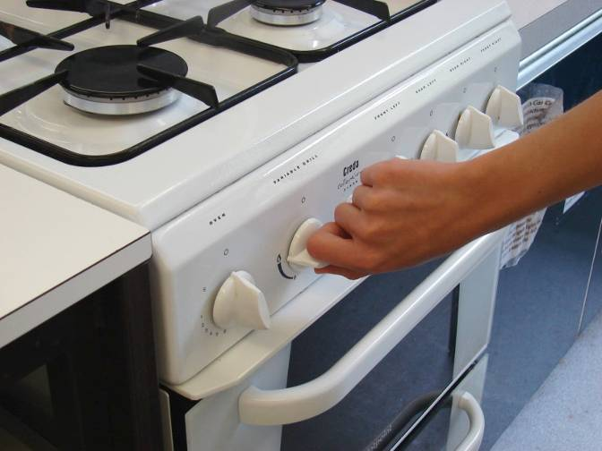
Preheat the grill.

Slide 12
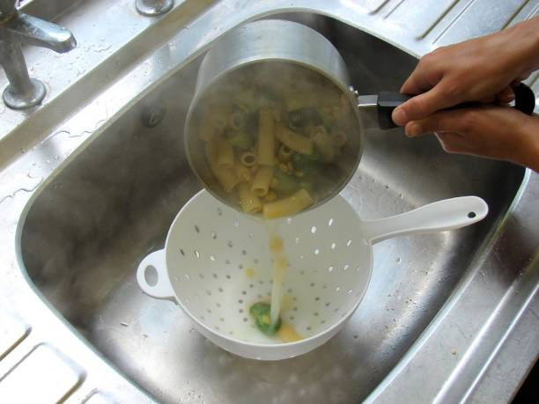
Drain the boiling hot water away from the pasta and vegetables into a colander in the sink.

Slide 13
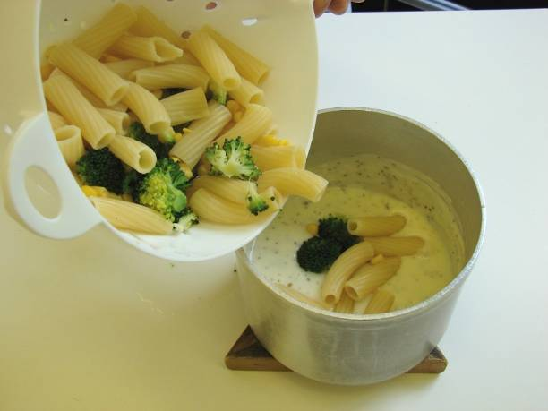
Pour the drained pasta and vegetables into the sauce.

Slide 14
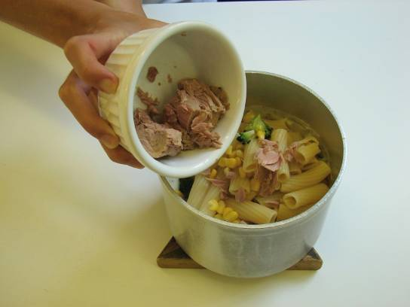
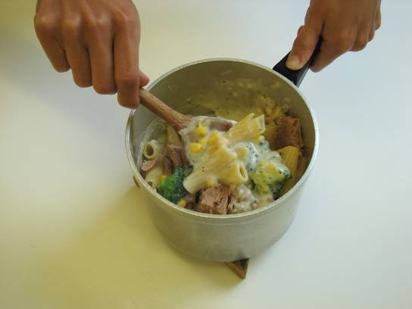
Stir in the canned tuna.

Slide 15
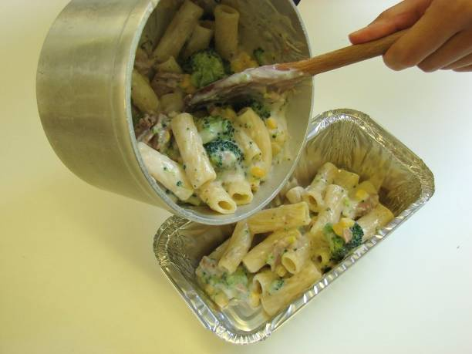
Pour the mixture into an ovenproof dish (or foil tray).

Slide 16
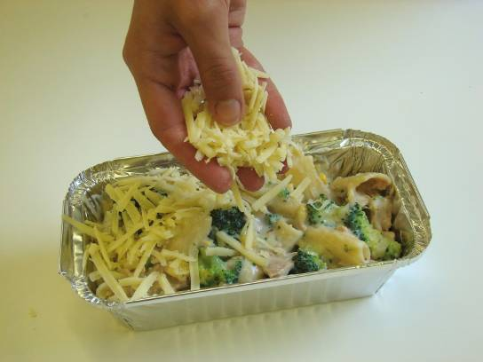
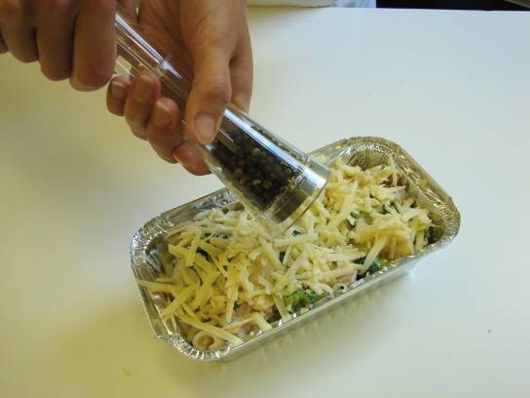
Sprinkle the cheese over the top, and add a few twists of black pepper.

Slide 17
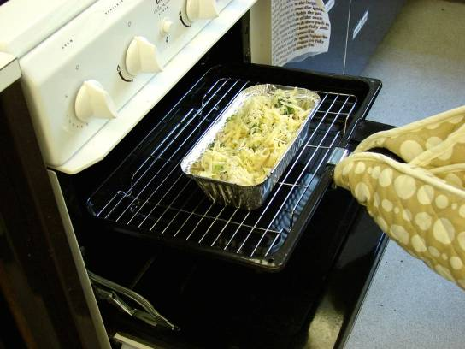
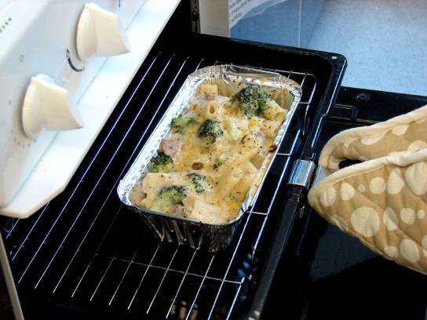
Place under a hot grill until the cheese is bubbling and golden brown.

Slide 18
Serve.

Slide 19
Top tips
Food skills
Try different varieties of pasta shapes, such as macaroni or shells.
Use a different types of vegetables, like leeks, peppers and mushrooms.
Add a spoon of pesto, mustard or tomato puree to the sauce for extra flavour.
The grill pan gets hot so remember to use oven gloves.
Weigh.
Measure.
Boil and simmer.
Grate.
Chop.
Whisk.
Drain.
Grill.

Slide 20
Tuna and broccoli pasta
For further information, go to:
www.foodafactoflife.org.uk

