Slide 1
Cheesy scones
Complexity: medium

Slide 2
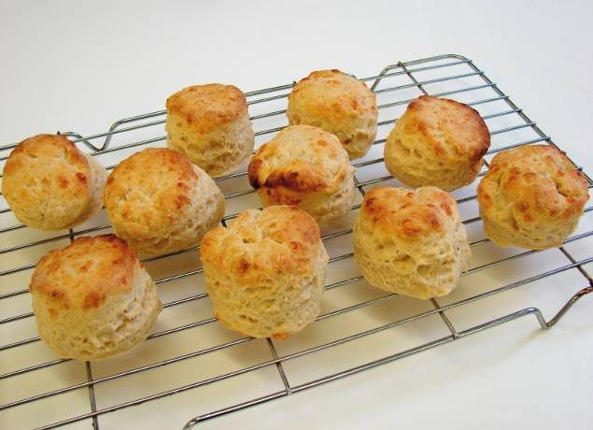

Slide 3
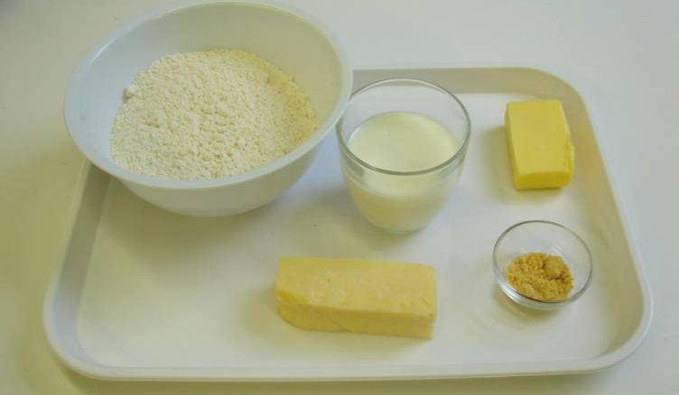
Ingredients
250g self raising flour
1 x 5ml spoon mustard powder
40g butter or hard baking fat
75g hard cheese
125ml semi-skimmed milk

Slide 4
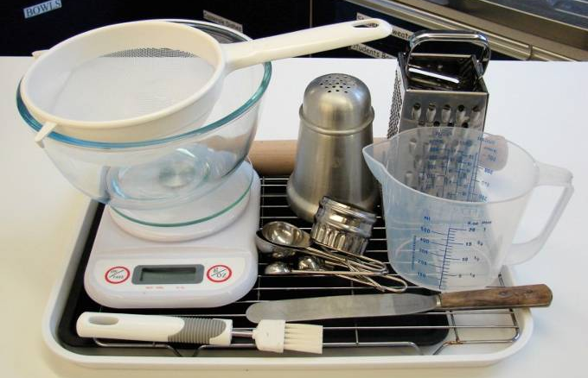
Equipment
Non-stick baking tray
Pastry brush
Weighing scales
Sieve
Mixing bowl
Measuring spoons
Grater
Chopping board
Palette knife
Measuring jug
Flour dredger
Rolling pin
Scone cutter
Cooling rack

Slide 5
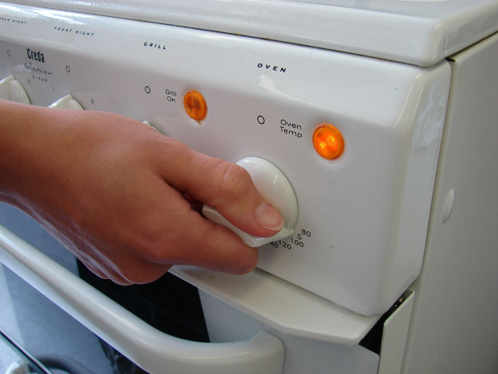
Method
Preheat oven to 220°C or gas mark 7.

Slide 6
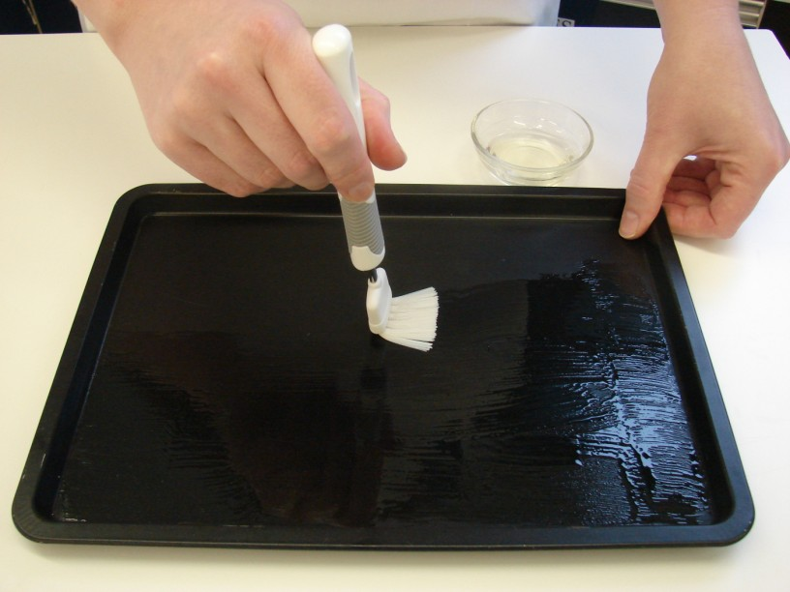
Prepare a baking tray, e.g. greased.

Slide 7
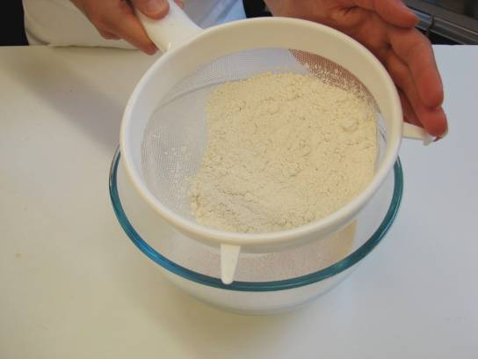
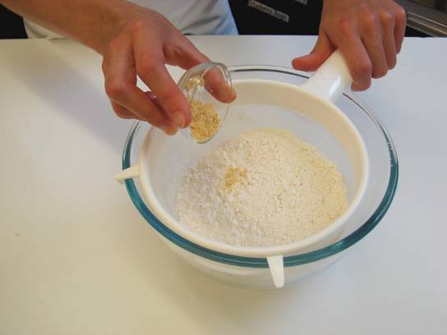
Sieve the flour and mustard into the bowl.

Slide 8
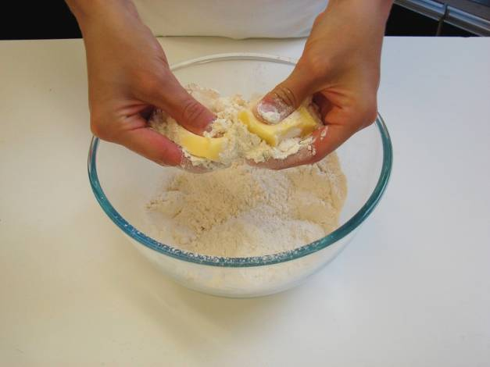
Rub in the butter or baking fat into the flour until it resembles breadcrumbs.

Slide 9
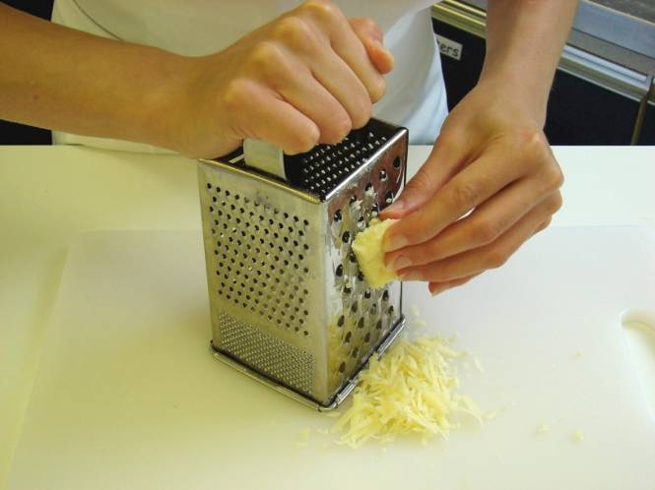
Grate the cheese.

Slide 10
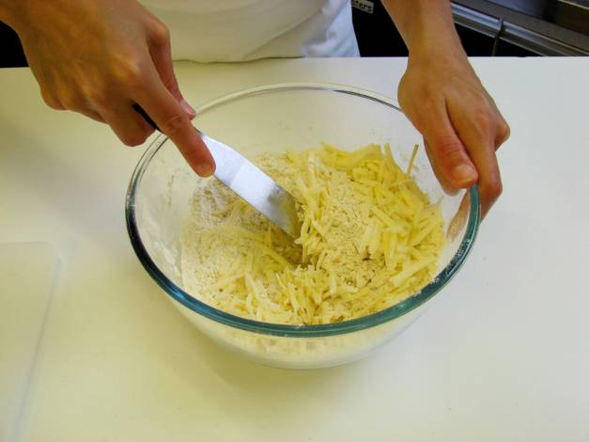
Stir in the cheese.

Slide 11
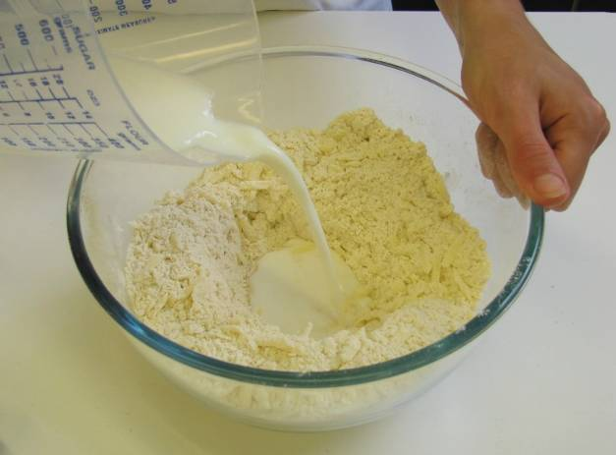
Make a well in the middle of the flour and carefully pour in the milk. (Save just a little of the milk).

Slide 12
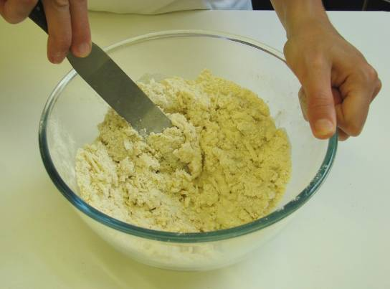
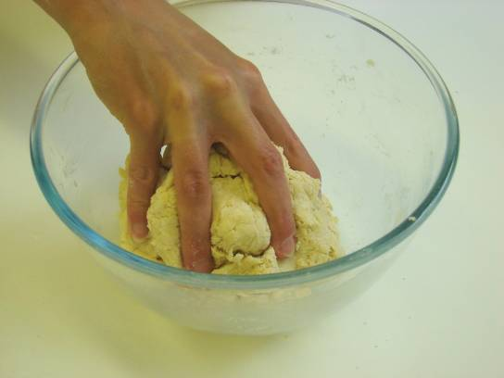
Mix to form a soft dough.

Slide 13
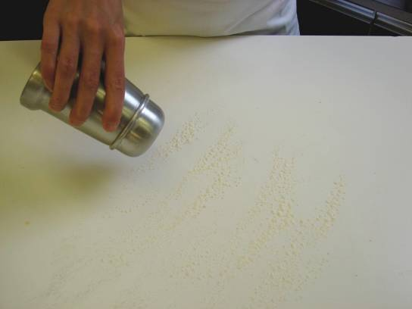
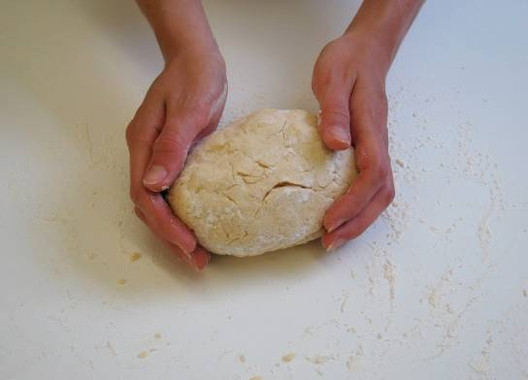
Place the dough on a lightly floured work surface.

Slide 14
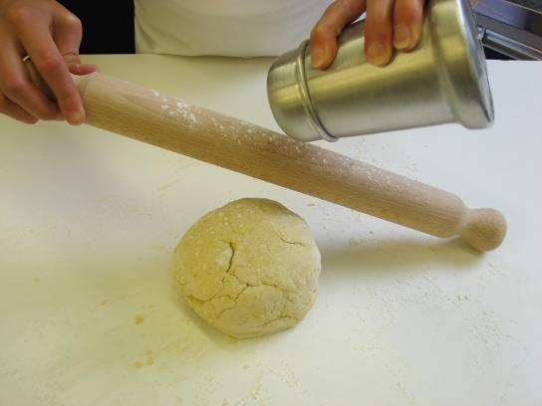
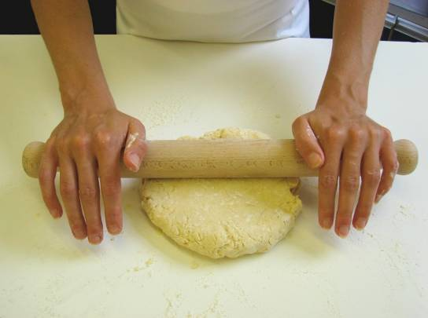
Roll out the dough to about 1½cm thick.

Slide 15
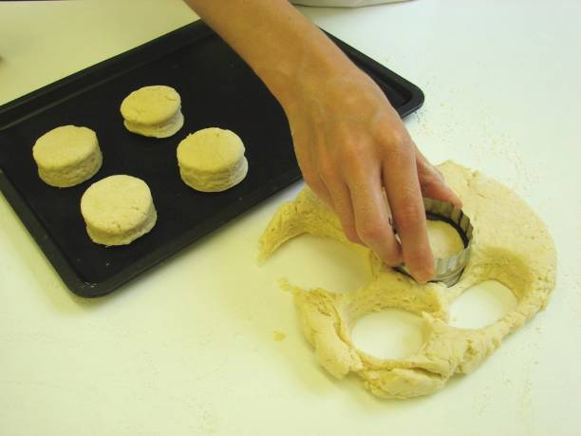
Shape the scones using a cutter.

Slide 16
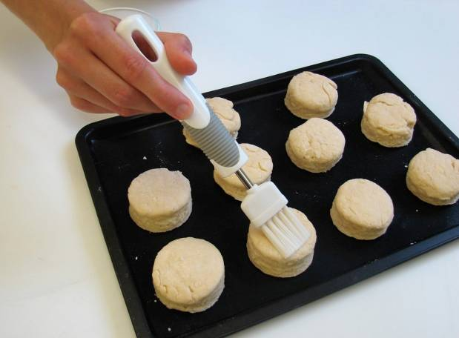
Place the scones on a baking tray and brush each top with a little milk.

Slide 17
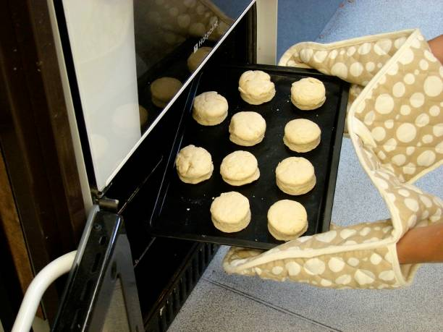
Bake for 12 – 15 minutes, until golden brown.

Slide 18
Allow to cool on a cooling rack.

Slide 19
Top tips
Food skills
To make fruit scones, add 25g sugar and 75g currants or sultanas before the milk and leave out the cheese.
Traditionally, fluted scone cutters are used for sweet scones and plain cutters for savoury scones.
You could experiment with different flavourings by adding herbs or spices.
Weigh.
Measure.
Sift.
Grate.
Mix and stir.
Rub in.
Roll out.
Form and shape.
Bake.

Slide 20
Cheesy scones
For further information, go to:
www.foodafactoflife.org.uk

