Slide 1
Fish and veg stack
Complexity: low-medium

Slide 2
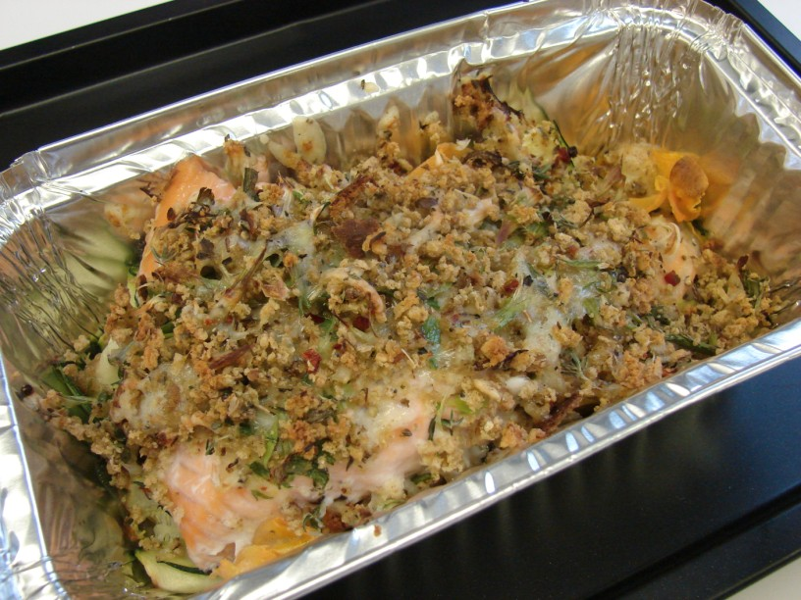

Slide 3
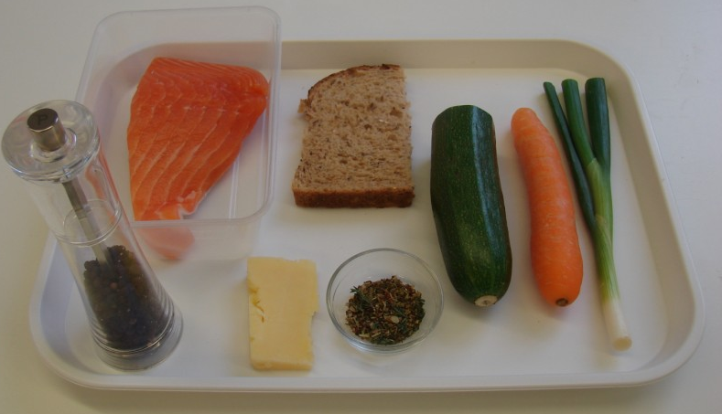
Ingredients
1 carrot
½ a courgette
1 piece of fresh fish
e.g. salmon (approx. 200g)
25g Cheddar cheese
1 spring onion
½ slice bread e.g. granary
1 x 5ml dried mixed herbs
Black pepper

Slide 4
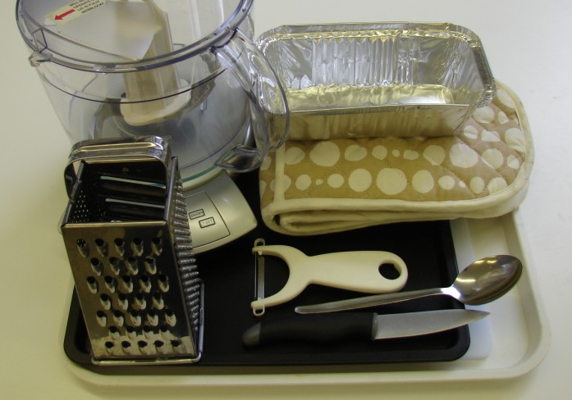
Equipment
Chopping board
Knife
Peeler
Oven proof/foil dish
Baking tray
Food processor
Grater
Spoon
Oven gloves
Weighing scales

Slide 5
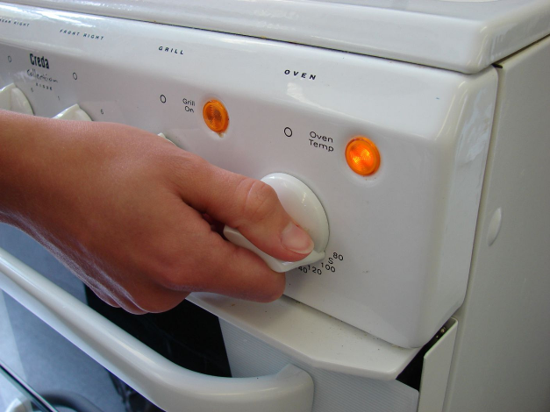
Method
Preheat the oven to 200°C or gas mark 6.

Slide 6
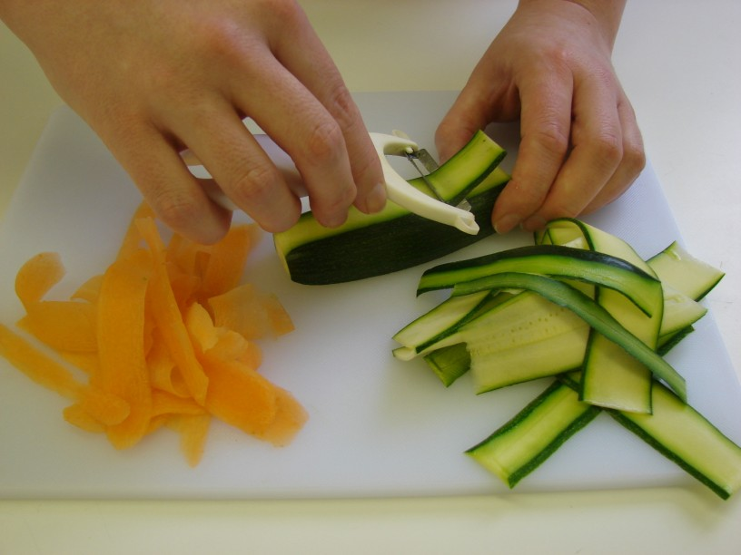
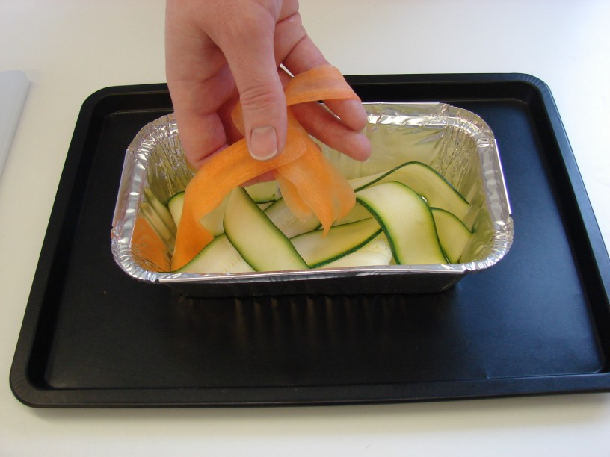
Top and tail the carrot and courgette, then run the vegetable peeler lengthways along each vegetable to make ribbons. Place an oven proof dish or foil tray on a baking tray and place the vegetable ribbons in the bottom.

Slide 7
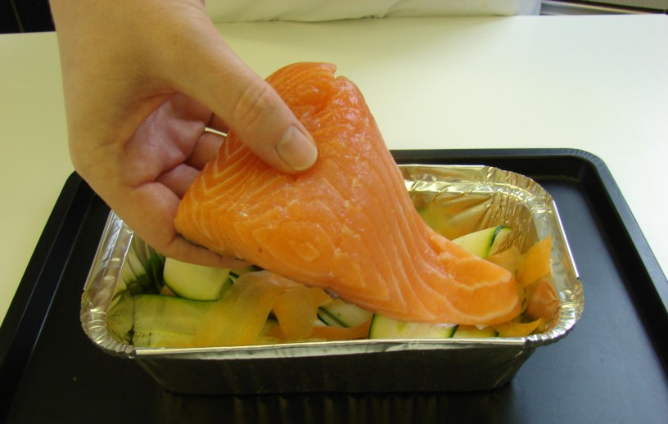
Lay the fish on top of the vegetables.

Slide 8
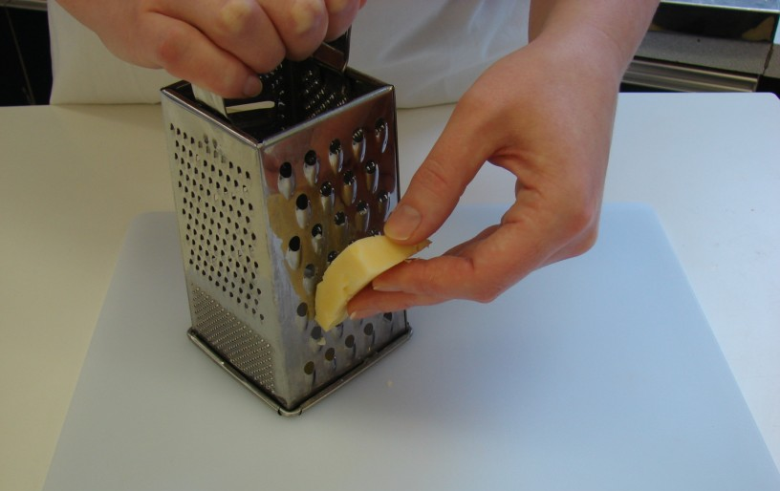
Grate the cheese.

Slide 9
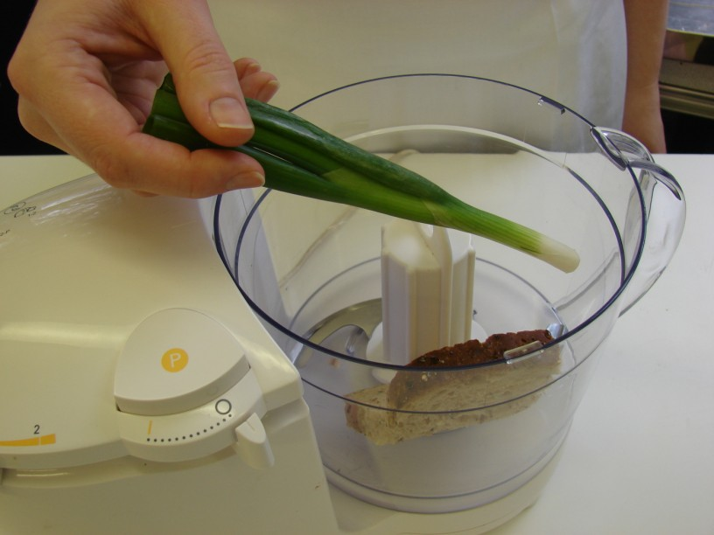
Put spring onion and bread into the food processor and blitz until it resembles breadcrumbs.

Slide 10
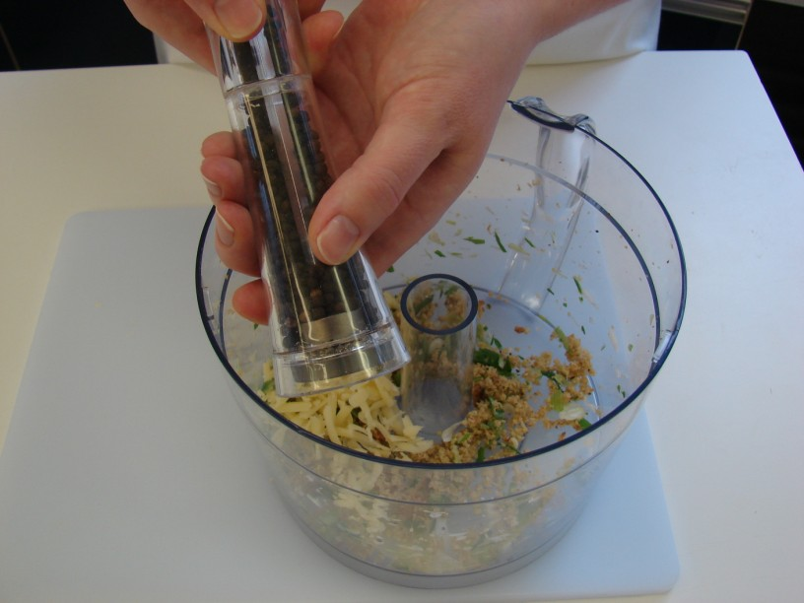
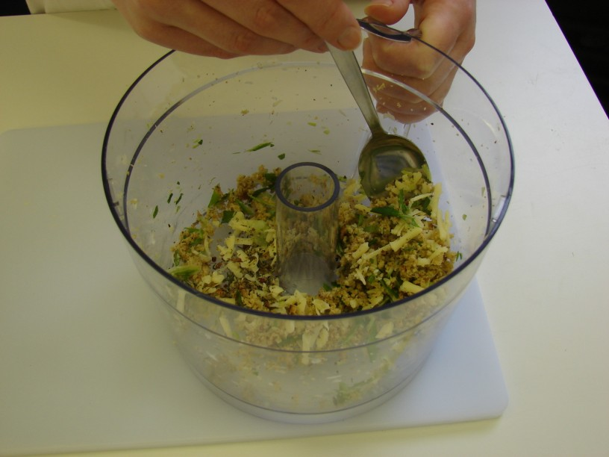
Stir in the cheese, herbs and a few twists of black pepper.

Slide 11
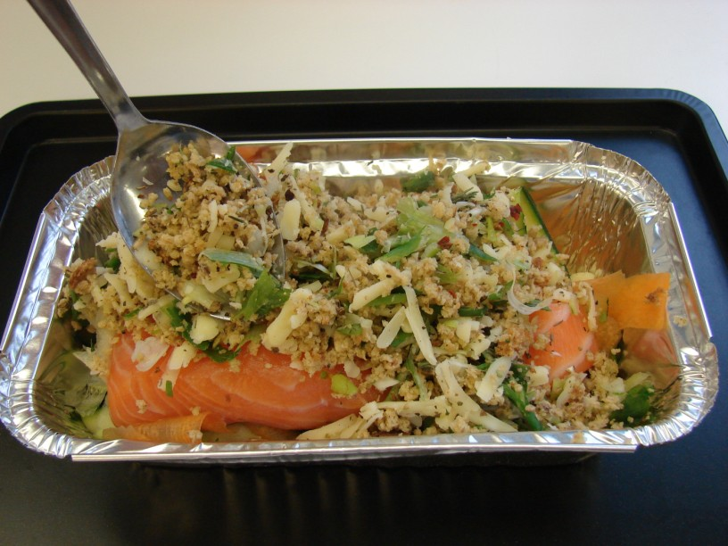
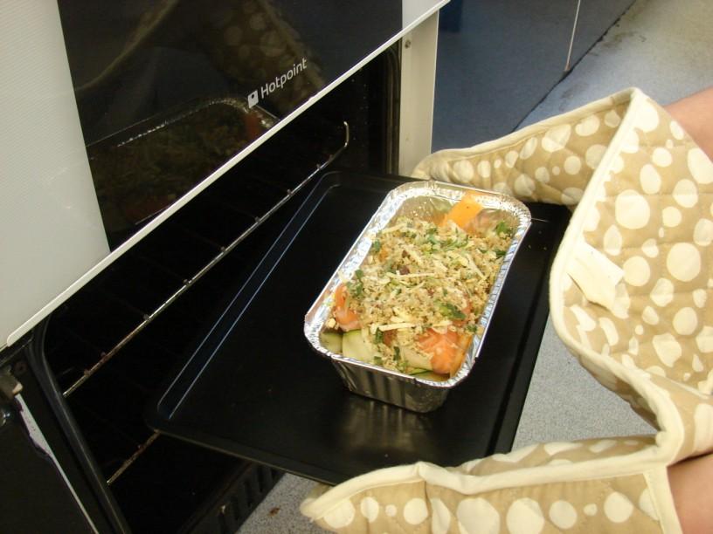
Spoon the mixture on top of the fish and bake in the oven for 20 minutes.

Slide 12
Serve.

Slide 13
Top tips
Food skills
Use different types of vegetables and/or fish.
Mix ready cooked pasta or rice with the vegetables for a complete meal.
Try different herbs and spices e.g. basil, coriander, ginger or chilli
Weigh.
Measure.
Trim.
Peel.
Grate.
Blitz.
Stir.
Bake.

Slide 14
Fish and veg stack
For further information, go to:
www.foodafactoflife.org.uk

