Slide 1
Herby veggie crumble
Complexity: low-medium

Slide 2
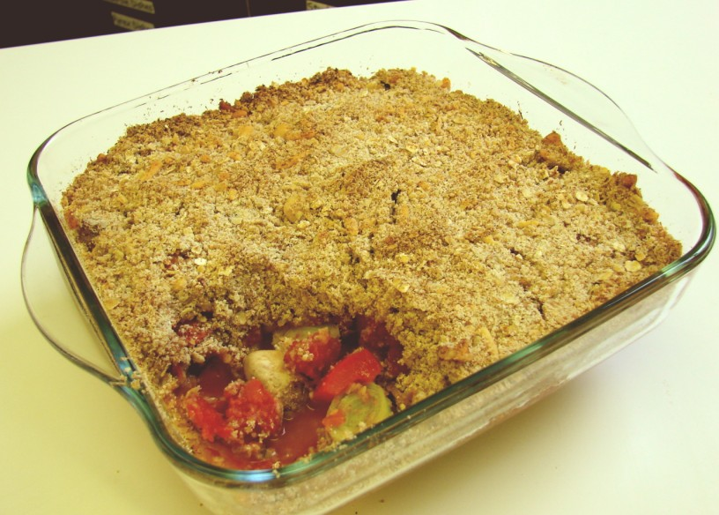

Slide 3
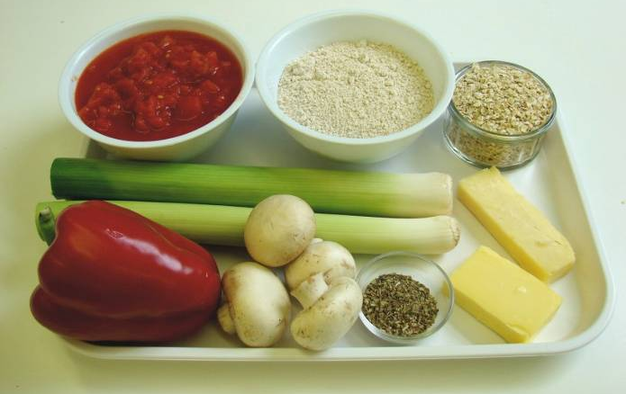
Ingredients
150g wholemeal flour
40g butter or hard baking fat
50g cheese
50g oats
2 x 5ml dried mixed herbs
2 leeks (small)
1 red pepper
4 mushrooms
1 can chopped tomatoes (400g)

Slide 4
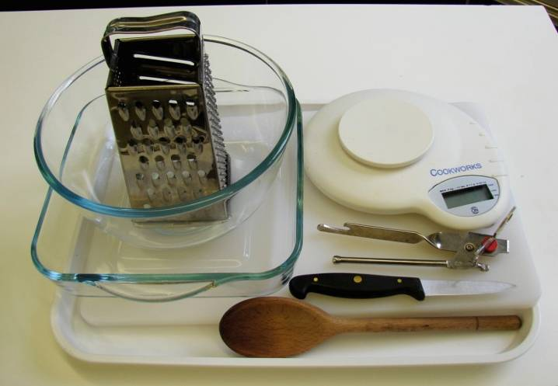
Equipment
Weighing scales
Mixing bowl
Grater
Wooden spoon
Chopping board
Knife
Baking dish (approx. 20cm x 20cm)
Can opener

Slide 5
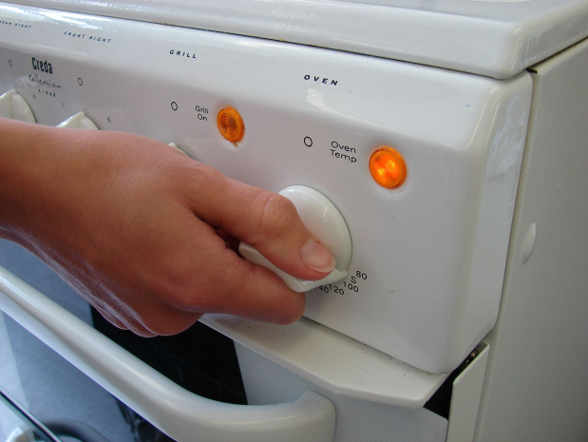
Method
Preheat oven to 200°C or gas mark 6.

Slide 6
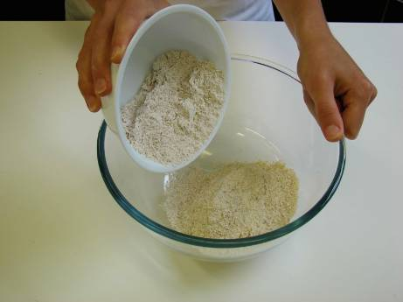
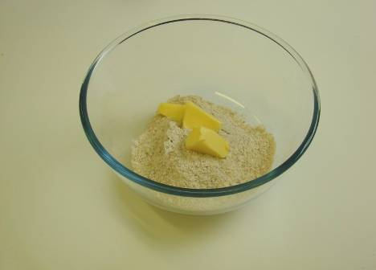
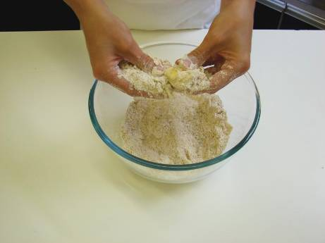
Rub in the butter or baking fat into the flour until it resembles breadcrumbs.

Slide 7
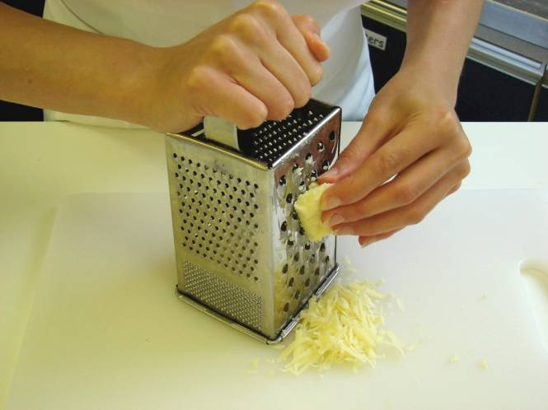
Grate the cheese.

Slide 8
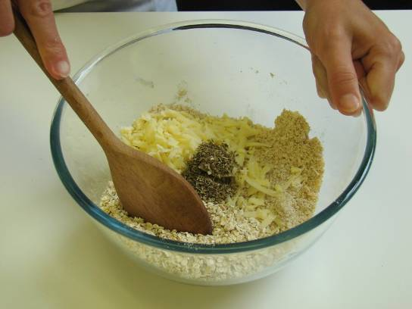
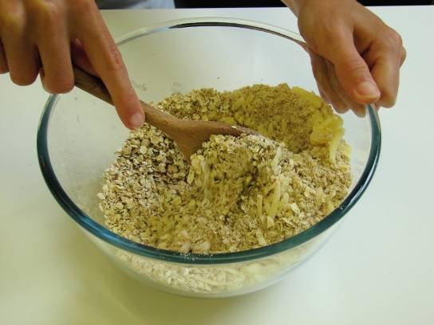
Stir in the grated cheese, oats and 1 x 5 ml spoon mixed herbs.

Slide 9
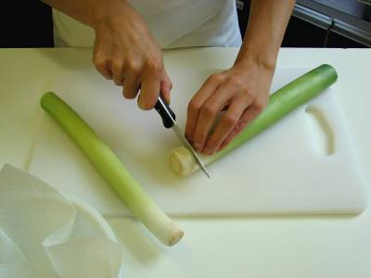
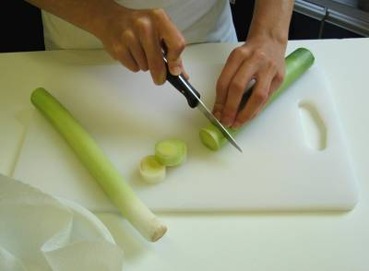
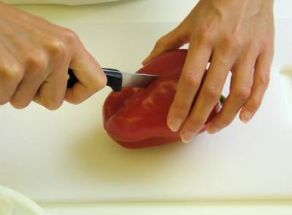
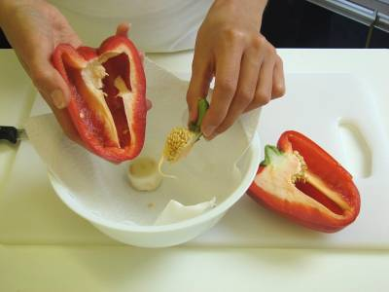
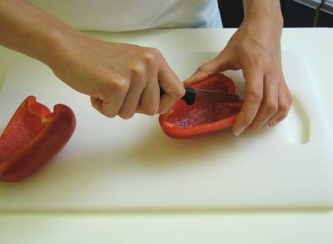
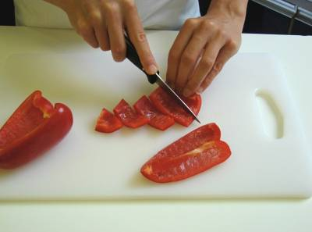
Slice the leeks and red pepper.

Slide 10
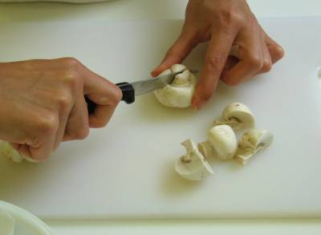
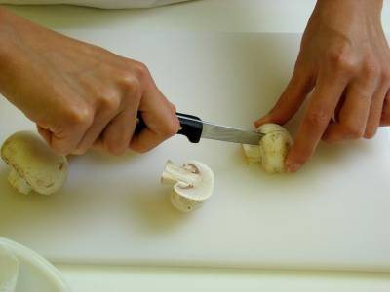
Quarter the mushrooms.

Slide 11
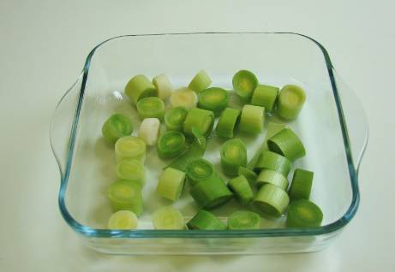
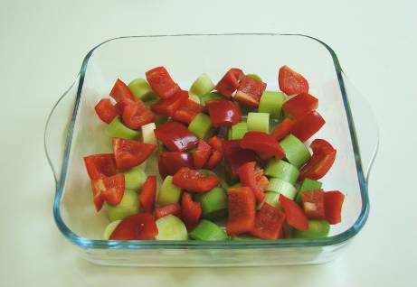
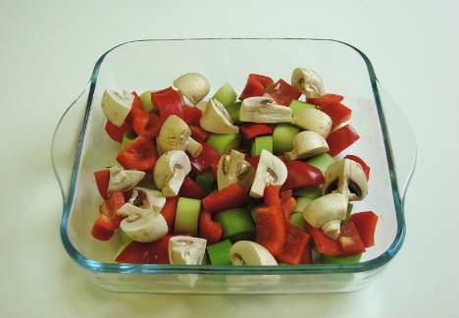
Arrange the vegetables in a baking dish.

Slide 12
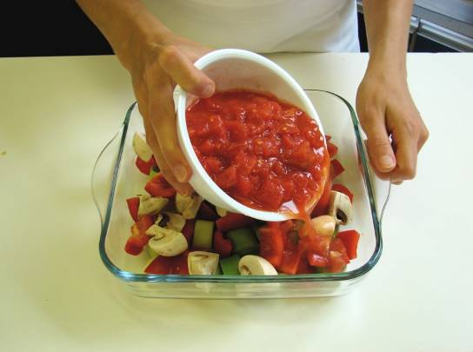
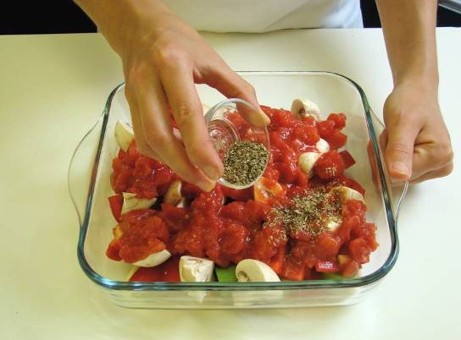
Pour over the canned tomatoes and 1 x 5ml spoon mixed herbs.

Slide 13
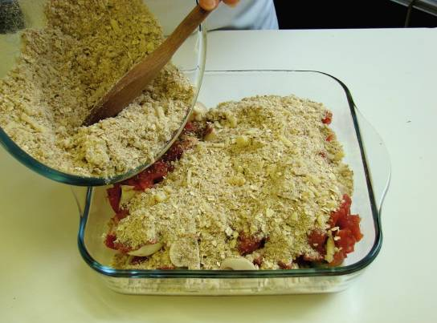
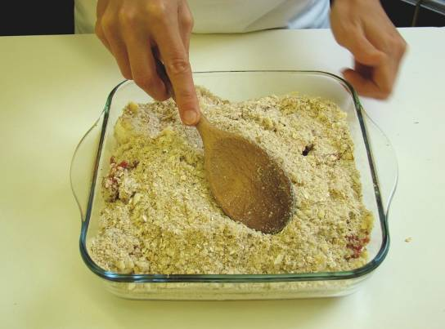
Sprinkle the crumble topping over the vegetables.

Slide 14
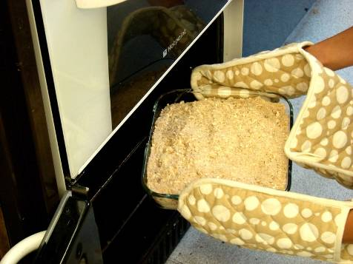
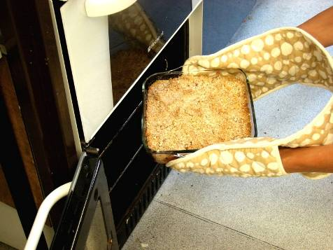
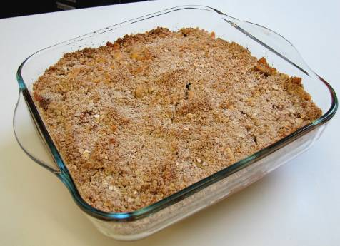
Bake in the oven for 25 – 30 minutes, until golden.

Slide 15
Top tips
Food skills
Try different combinations of vegetables, such as sweetcorn or broccoli.
Use different herbs to vary the flavour e.g. parsley or thyme.
Be creative with your crumble topping. Try different types of cheese e.g. parmesan or feta or add crushed digestive biscuits instead of oats.
Serve the crumble with a side salad.
The baking dish gets hot so remember to wear oven gloves.
Weigh.
Measure.
Rub in.
Grate.
Stir.
Cut and slice.
Bake.

Slide 16
Herby veggie crumble
For further information, go to:
www.foodafactoflife.org.uk

