Slide 1
Koftas
Complexity: medium

Slide 2
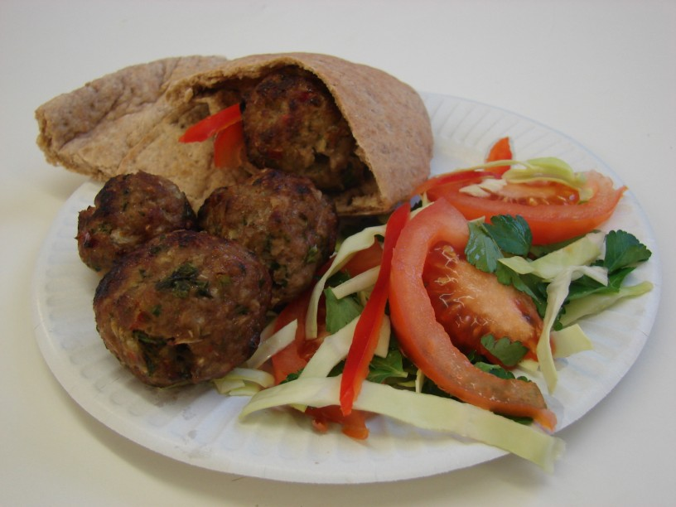

Slide 3
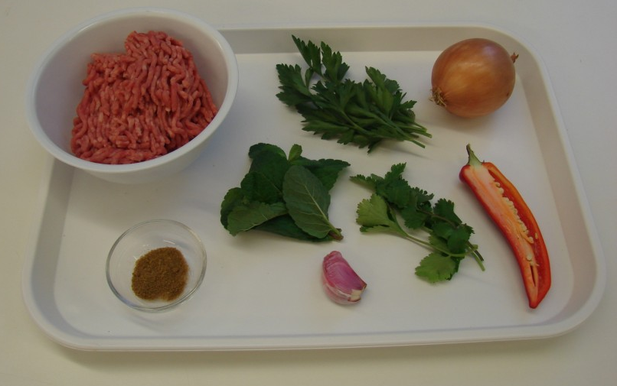
Ingredients
1 small onion
1 clove of garlic
1/2 red chilli
200g lamb mince
1 x 5ml spoon cumin
1 sprig of parsley, mint and coriander

Slide 4
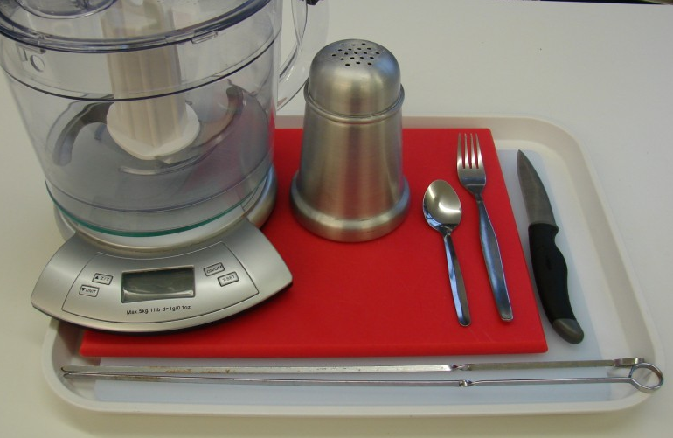
Equipment
2 chopping boards
Knife
Fork
Food processer
Flour dredger
Skewers

Slide 5
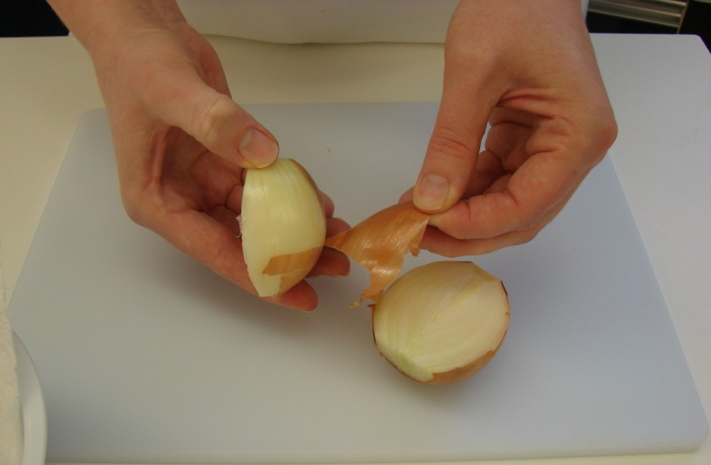
Method
Peel the onion and cut in half.

Slide 6
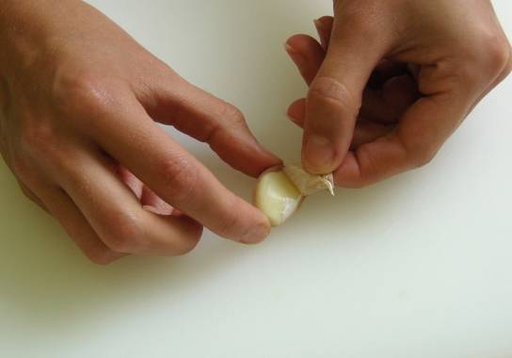
Peel the garlic.

Slide 7
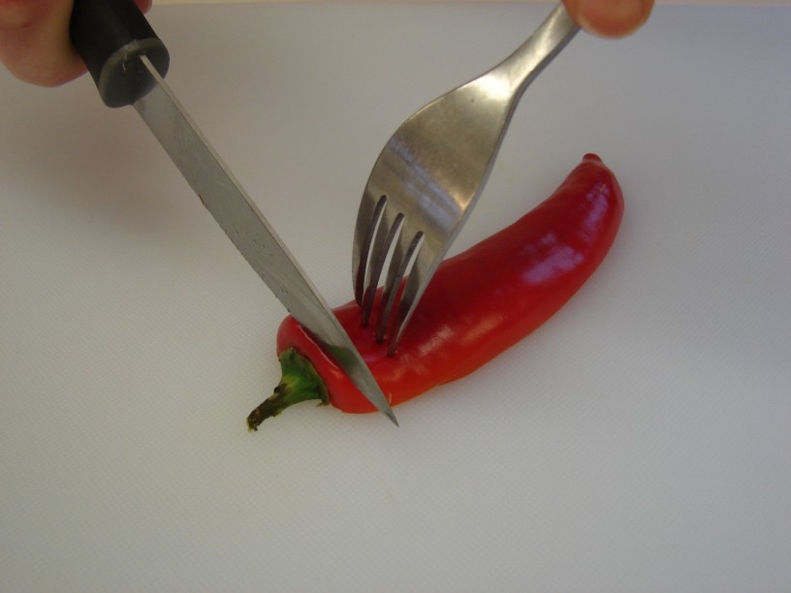
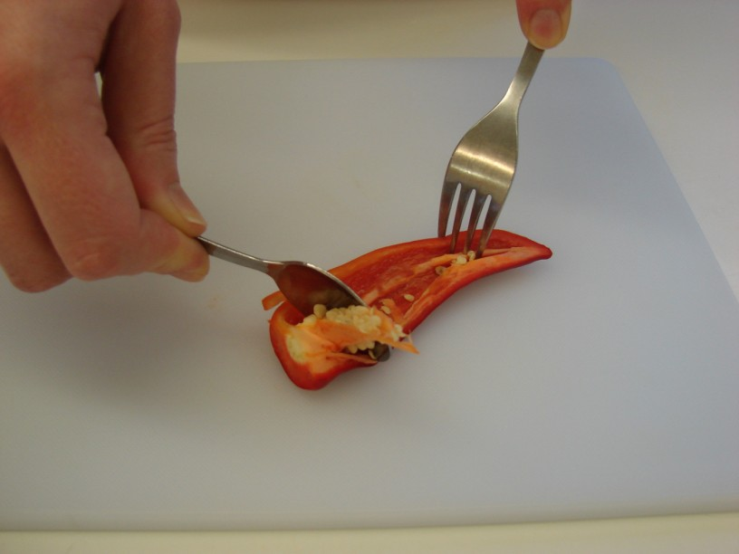
Cut off the top of the chilli and remove the seeds.

Slide 8
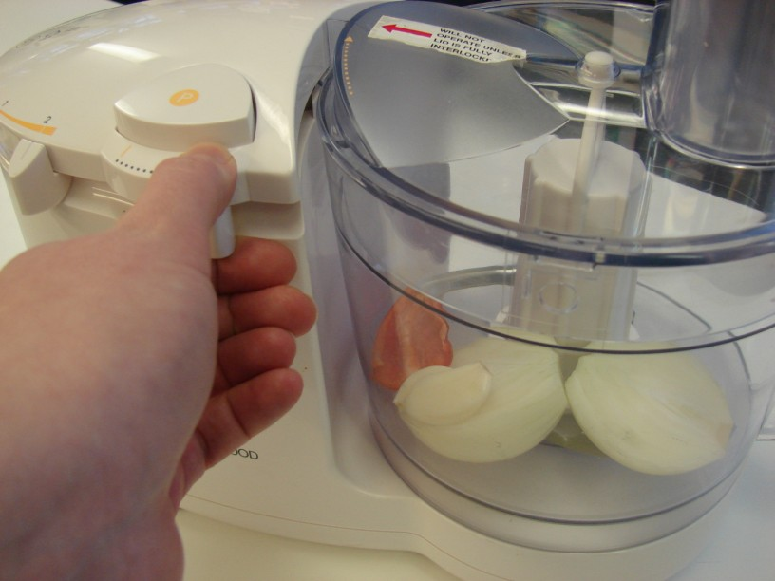
Put the onion, chilli and garlic into the food processor and blitz.

Slide 9
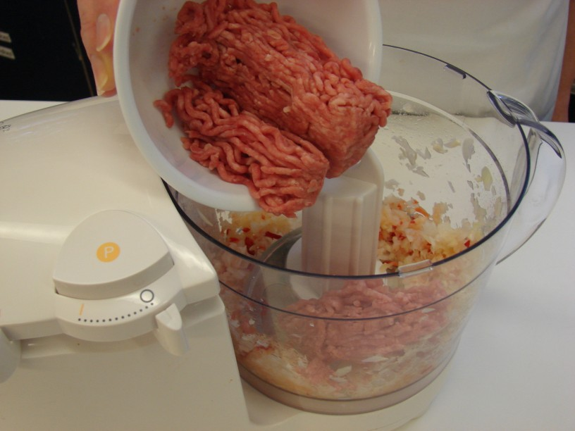
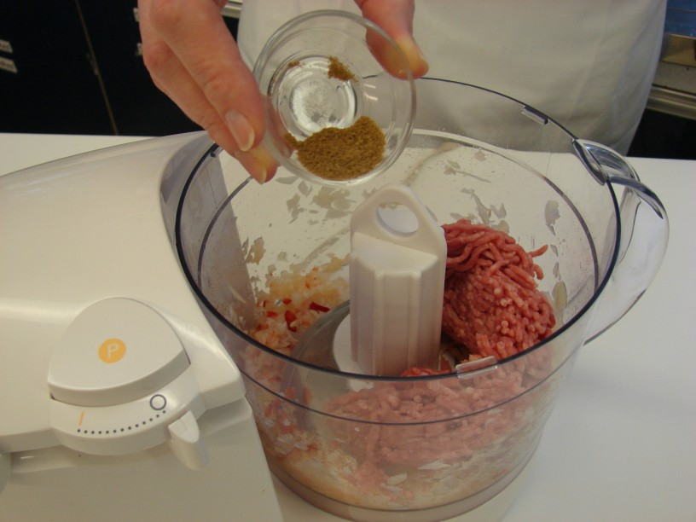
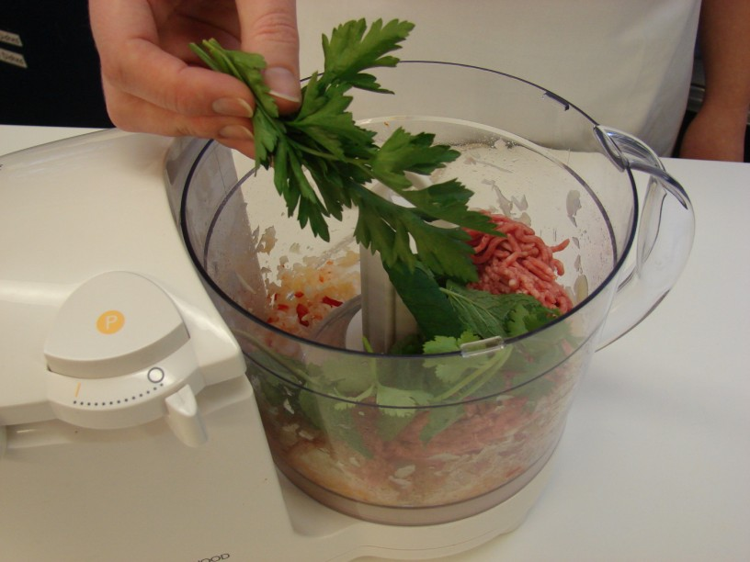
Add the mince, cumin and herbs and blitz together.

Slide 10
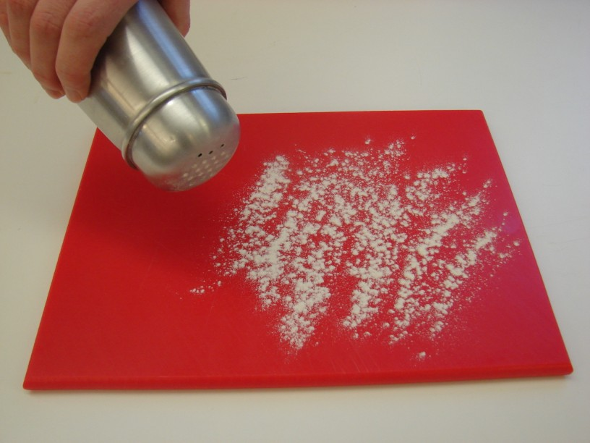
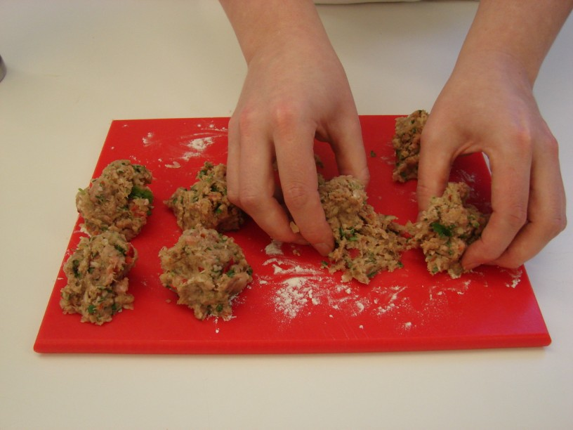
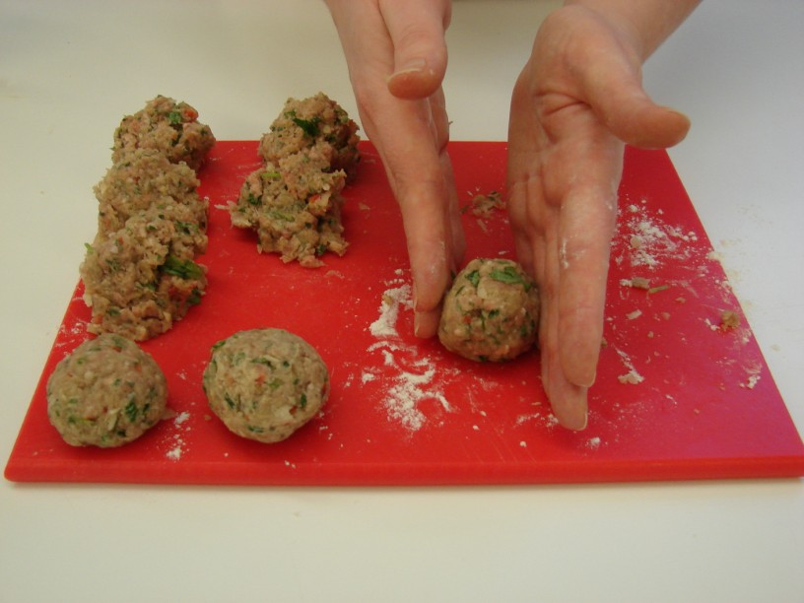
Sprinkle a little flour onto a chopping board, then divide and shape the mixture into 8 balls.

Slide 11
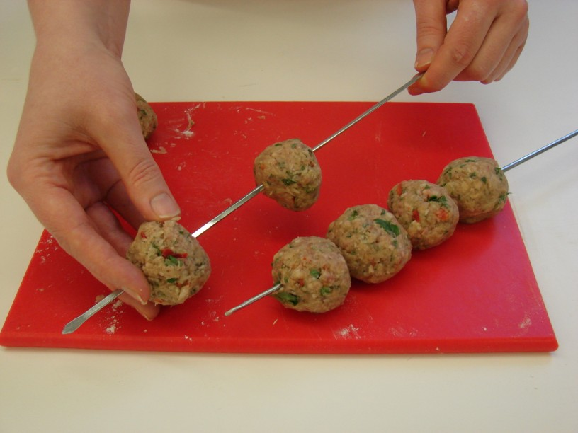
Thread the meatballs onto the skewers.

Slide 12
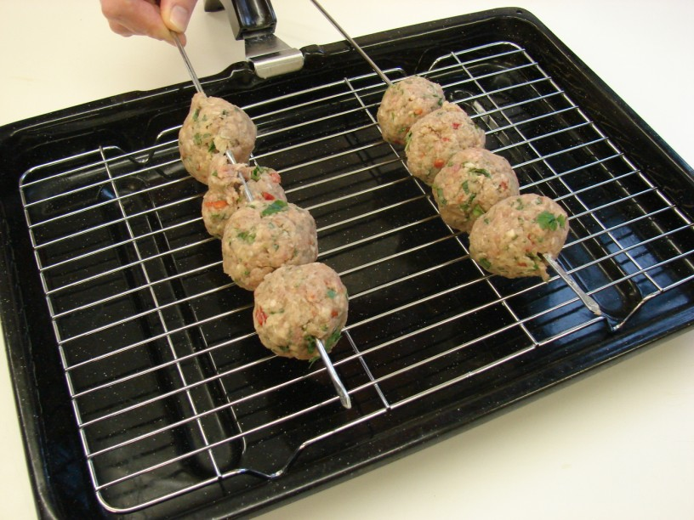
Carefully place the skewers onto a grill pan.

Slide 13
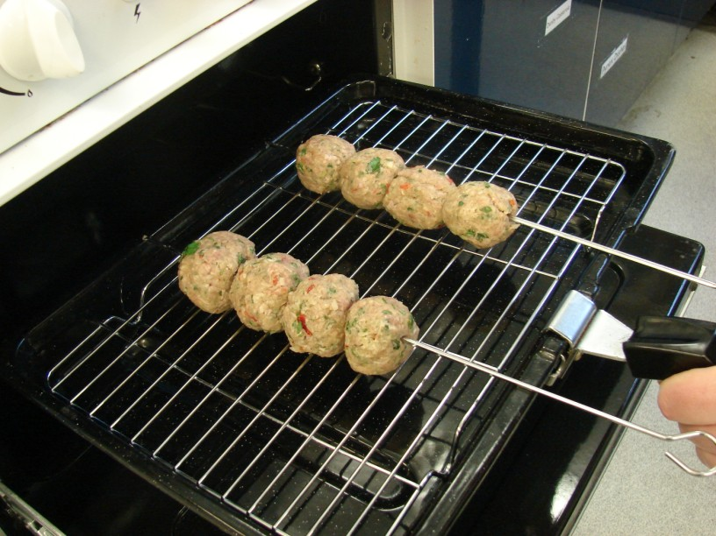
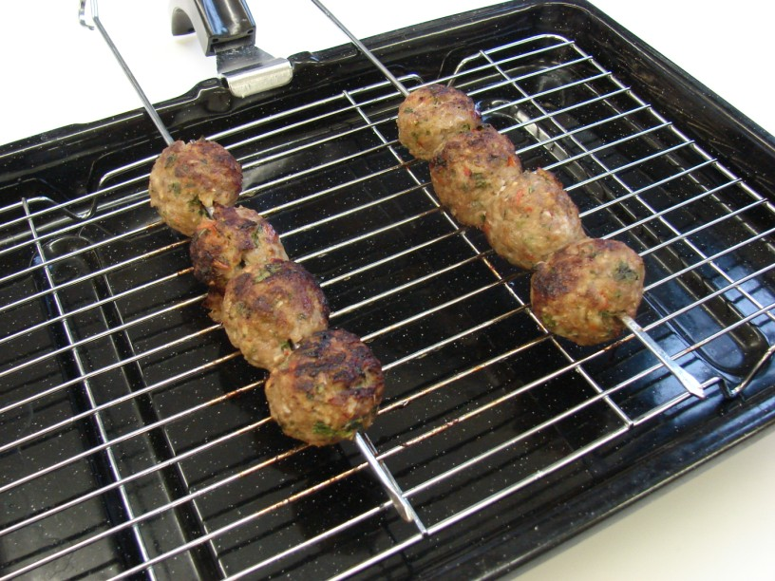
Grill for 10-15 minutes, turning occasionally to ensure even cooking. (The meatballs should be thoroughly cooked – no pink).

Slide 14
Serve in a pitta with salad.

Slide 15
Top tips
Food skills
If you don’t have a food processor, prepare the onion, chilli and garlic by hand. Mix everything together in a mixing bowl.
If you are using wooden skewers, soak them in water before using them so they don’t burn under the grill.
Try serving with low fat hummus or tzatziki.
The grill pan gets hot so remember to use oven gloves
Weigh.
Measure.
Peel.
Cut.
Blitz.
Divide.
Form and shape.
Grill.

Slide 16
Koftas
For further information, go to:
www.foodafactoflife.org.uk

