Slide 1
Layered pasta salad
Complexity: low-medium

Slide 2
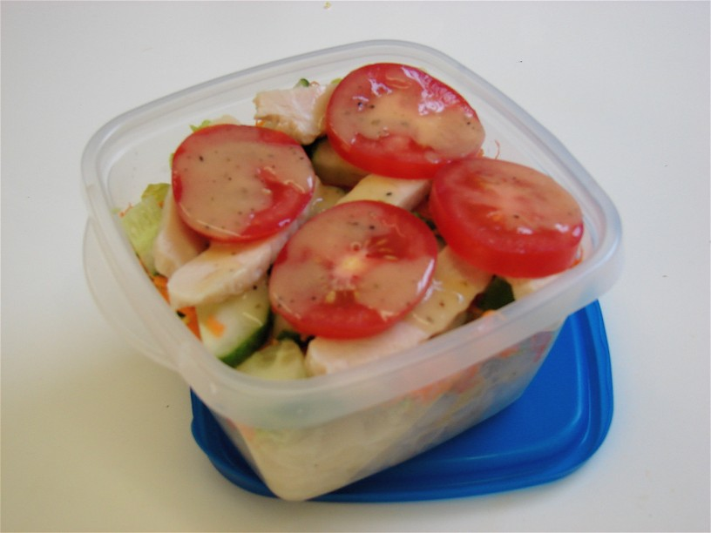

Slide 3
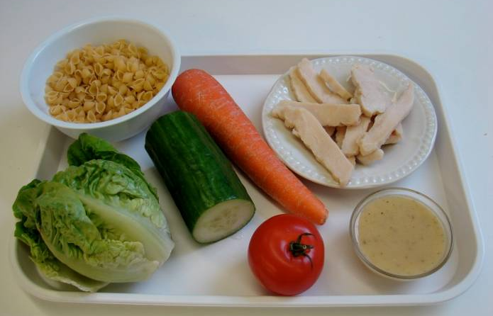
Ingredients
100g pasta shapes
1 carrot
100g cooked sliced chicken
1 baby gem lettuce
1 tomato
¼ cucumber
2 x15ml spoons low fat dressing

Slide 4
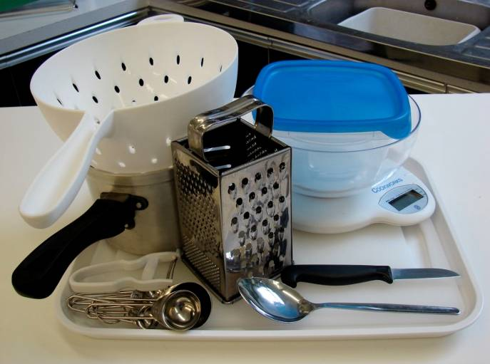
Equipment
Weighing scales
Saucepan
Chopping board
Knife
Vegetable peeler
Grater
Measuring spoons
Tablespoon
Colander
Serving dish

Slide 5
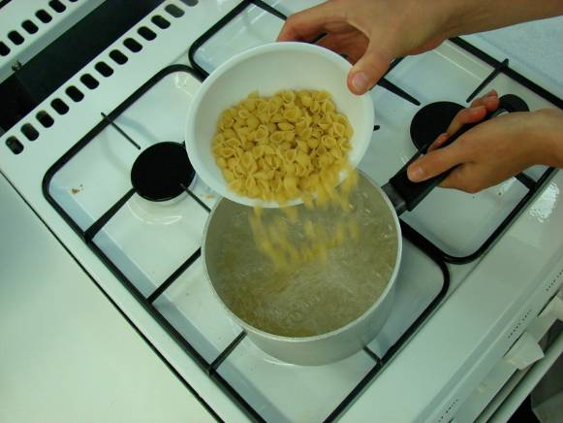
Method
Bring a small saucepan of water to the boil, and then add the pasta. Simmer for about 8 – 10 minutes (check the packet instructions).

Slide 6
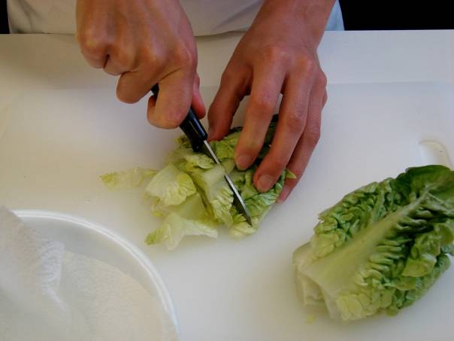
While the pasta is cooking, prepare the other ingredients:
shred the lettuce;

Slide 7
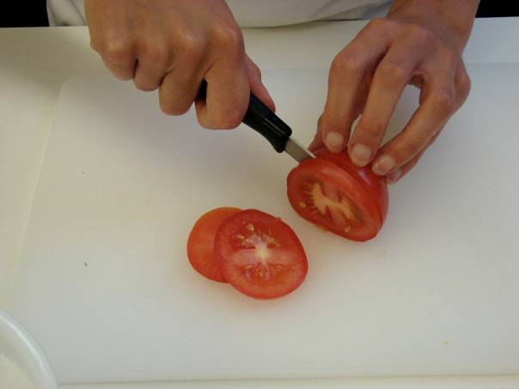
slice the tomato;

Slide 8
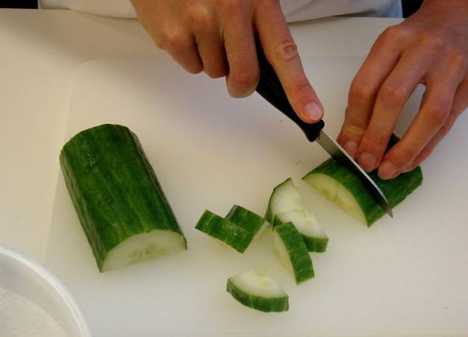
chop the cucumber into small chunks;

Slide 9
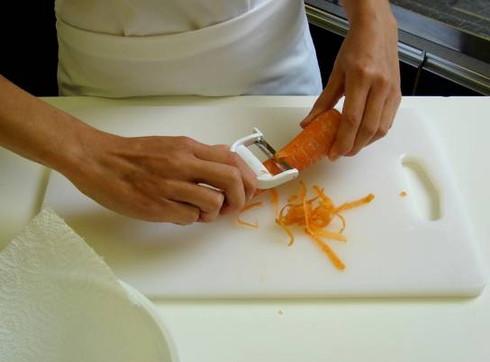
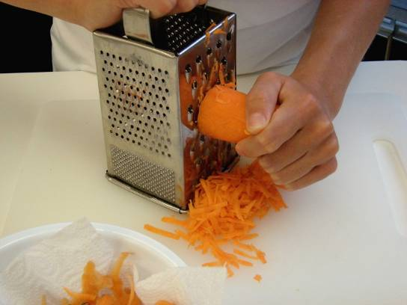
peel and grate the carrot.

Slide 10
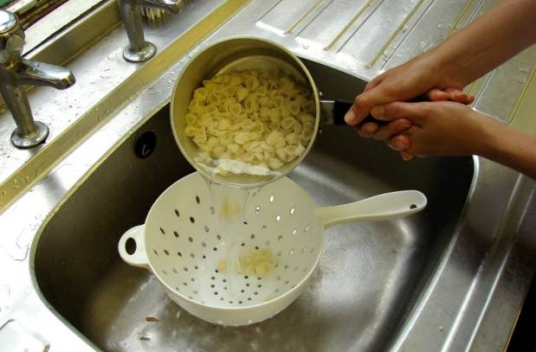
Drain the boiling hot water away from the pasta into a colander in the sink. Cool the pasta by rising it under a cold tap for a few moments. Drain well.

Slide 11
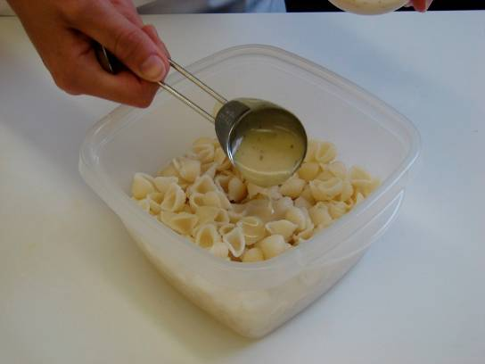
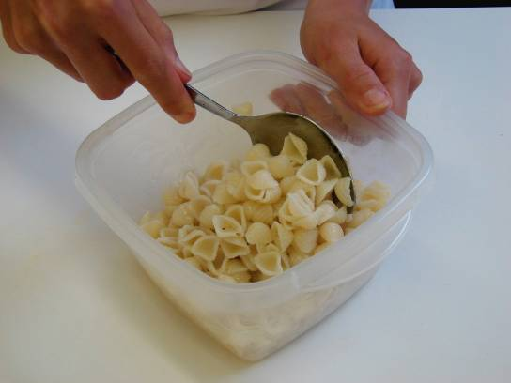
Place the pasta in the serving dish and stir in 1 x 15ml spoon of dressing.

Slide 12
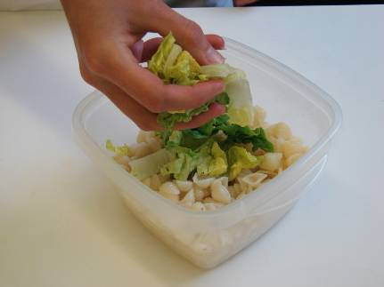
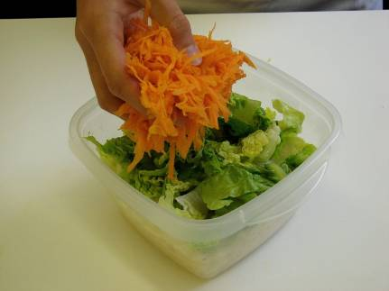
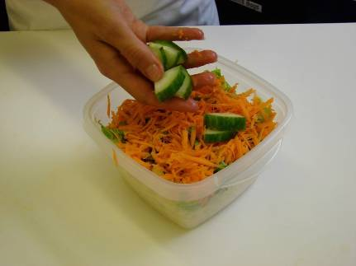
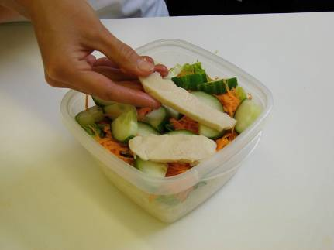
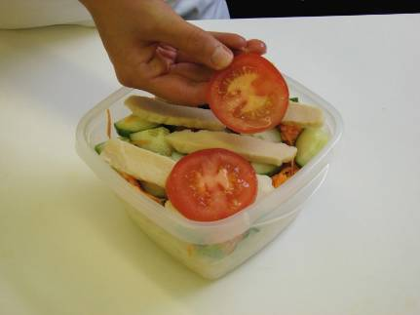
Assemble the remaining ingredients over the pasta in layers.

Slide 13
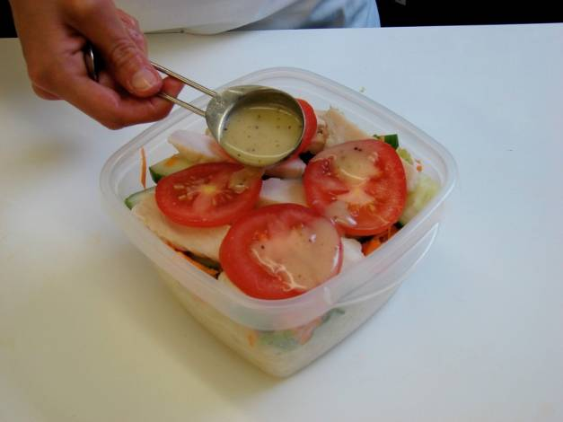
Lastly, drizzle over the remaining dressing.

Slide 14
Top tips
Food skills
Vary the type of pasta and/or vegetables used.
Why not add some fruit, seeds or nuts?
Instead of cooked chicken, why not go for sliced ham, grated cheese, canned tuna, slices of boiled egg, or red kidney beans?
Weigh.
Measure.
Boil and simmer.
Shred, slice and chop.
Peel.
Grate.
Drain.
Layer.

Slide 15
Layered pasta salad
For further information, go to:
www.foodafactoflife.org.uk

