Slide 1
Shepherd’s pie
Complexity: medium-high

Slide 2
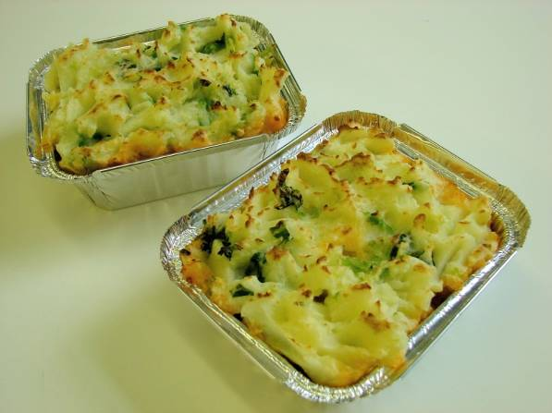

Slide 3
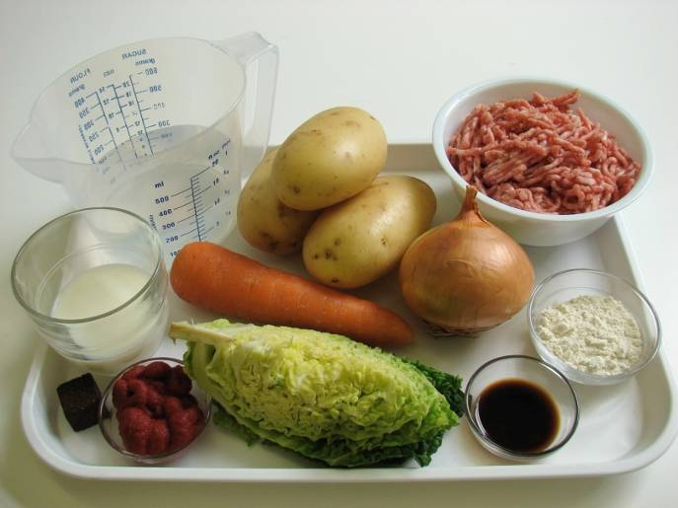
Ingredients
1 onion
1 carrot
3 medium potatoes (700g)
¼ Savoy cabbage
250g lean minced lamb
1 x 15ml spoon plain flour
1 x 15ml spoon tomato purée
1 x 15ml spoon Worcestershire sauce
300ml water, boiling
1 x 5ml stock cube
150ml semi-skimmed milk

Slide 4
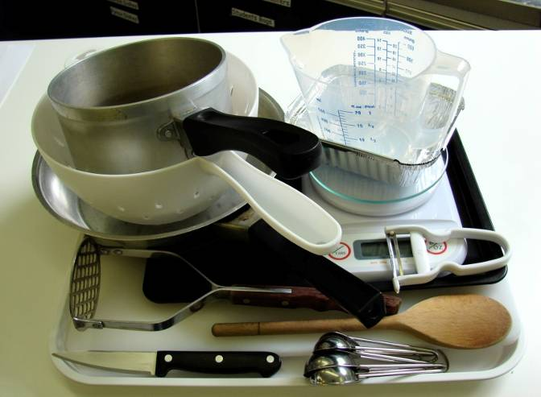
Equipment
Chopping board
Knife
Vegetable peeler
Measuring spoons
Weighing scales
Saucepan
Non-stick frying pan
Wooden spoon
Measuring jug
Colander
Potato masher
Ovenproof dish or foil tray
Baking tray

Slide 5
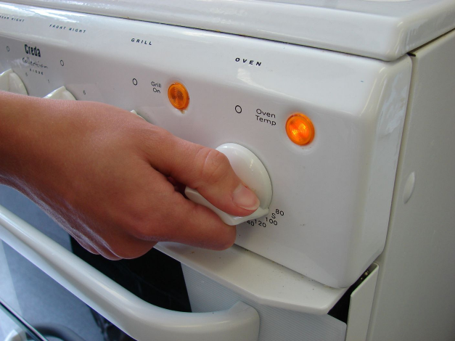
Method
Preheat the oven to 200°C or gas mark 6.

Slide 6
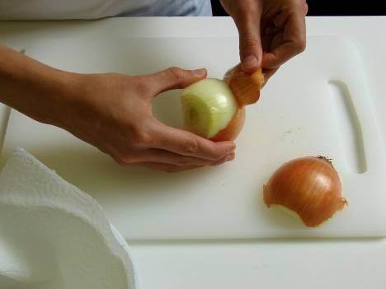
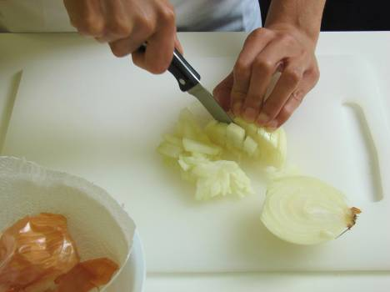
Prepare the vegetables:
peel and chop the onion;

Slide 7
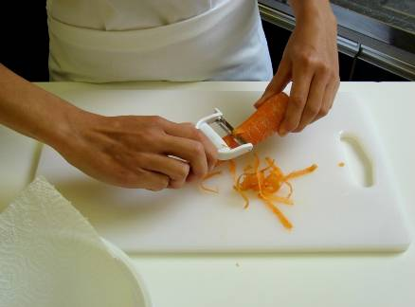
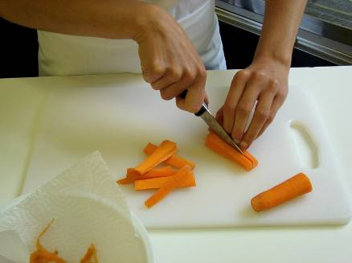
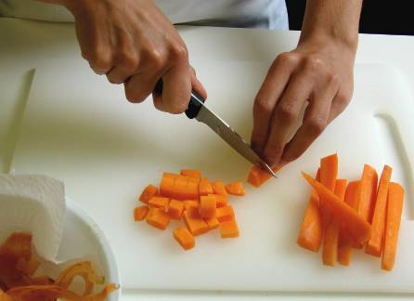
peel and dice the carrots;

Slide 8
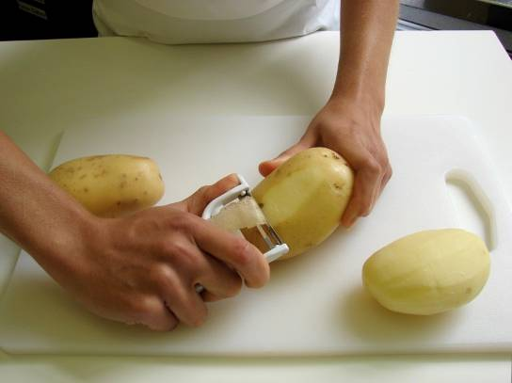
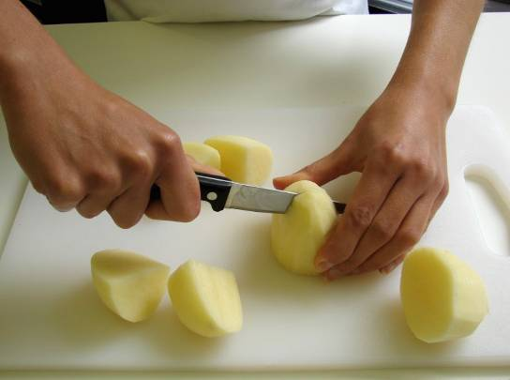
peel and cut the potatoes into chunks;

Slide 9
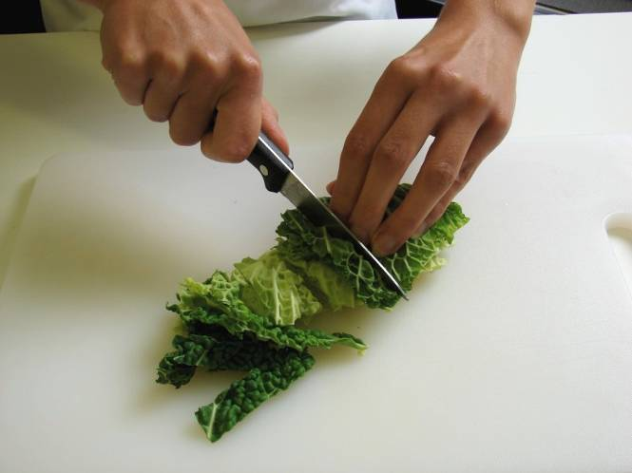
shred the cabbage.

Slide 10
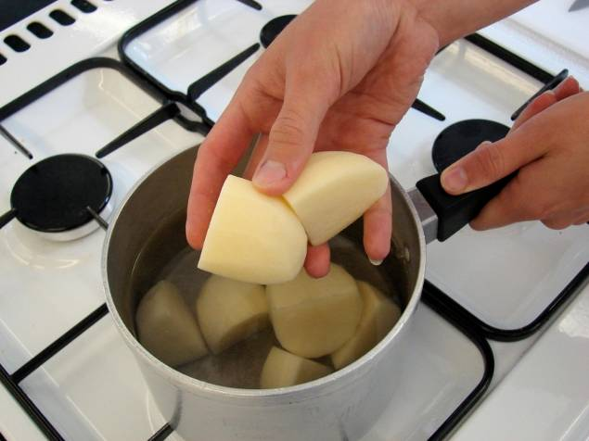
Place the potatoes in a saucepan of water, bring to the boil and simmer for 20 minutes, until soft.

Slide 11
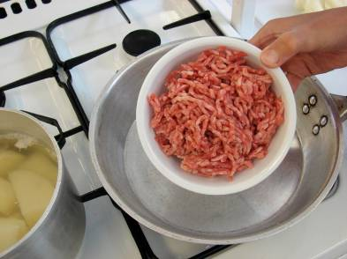
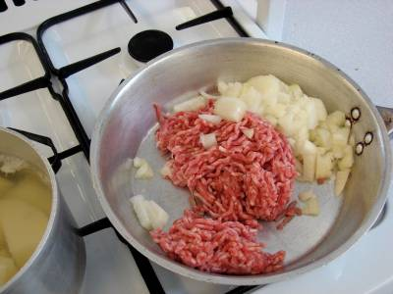
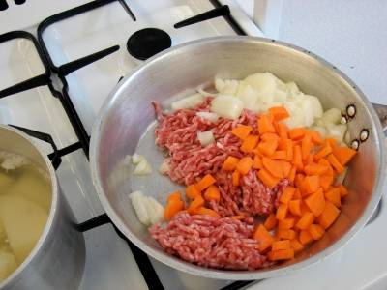
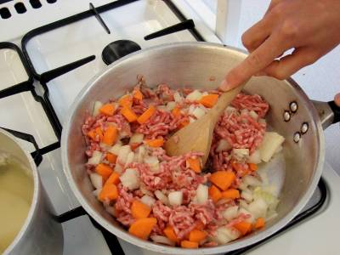
Meanwhile, in a non-stick frying pan, dry fry the lamb with the onion and carrots, until the mince is browned.

Slide 12
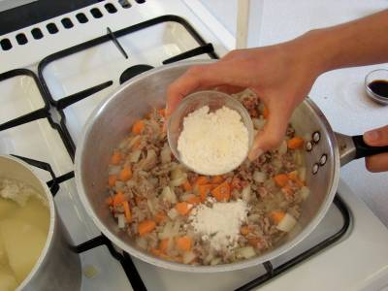
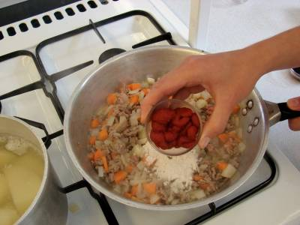
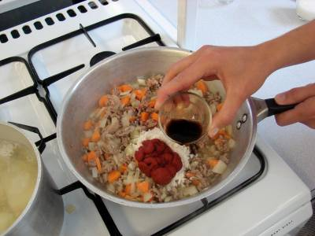
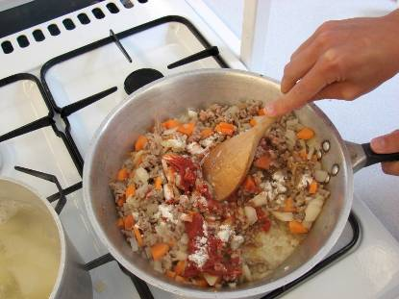
Stir in the flour, tomato purée and Worcestershire sauce.

Slide 13
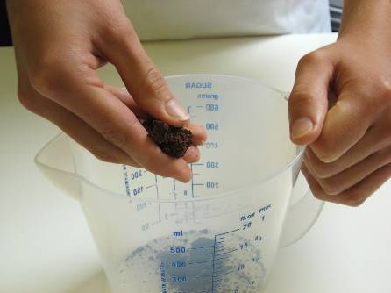
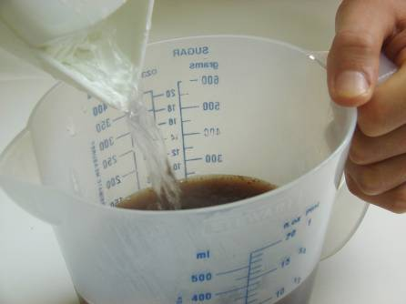
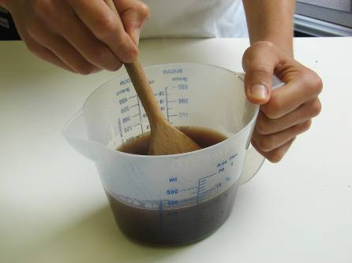
Add the stock cube to the water to make up the stock.

Slide 14
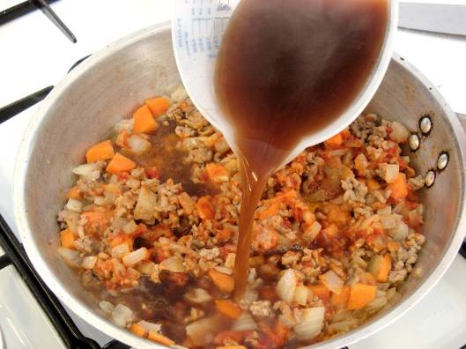
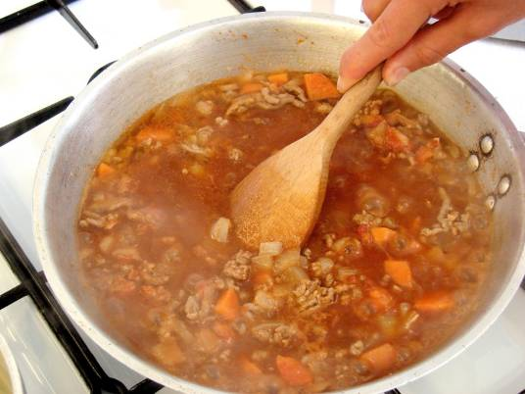
Add the stock to the meat mixture, bring to the boil and then simmer for 5 – 10 minutes, until the carrots are soft.

Slide 15
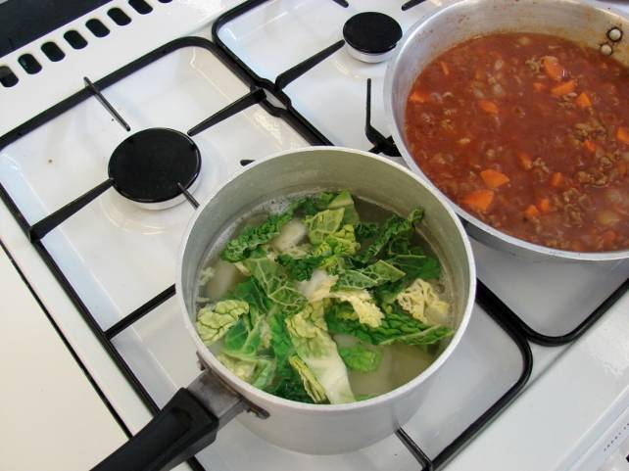
During the last 5 minutes of cooking the potatoes add the cabbage.

Slide 16
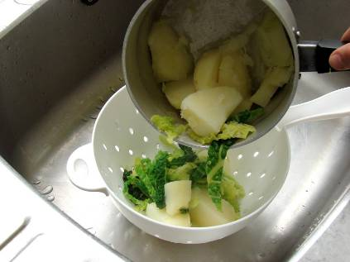
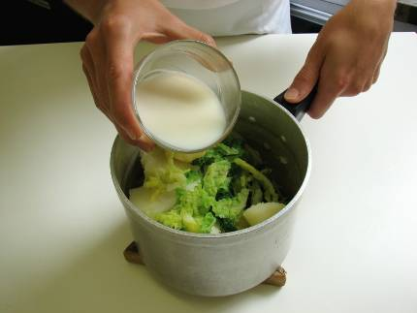
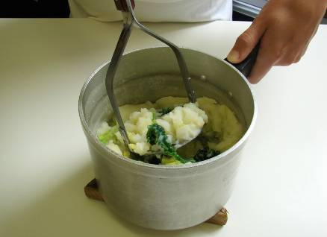
Drain the potatoes and mash with the milk.

Slide 17
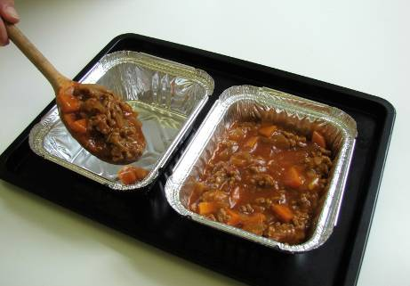
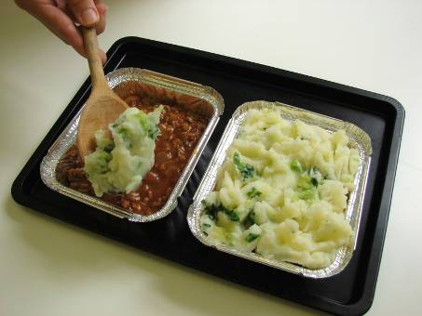
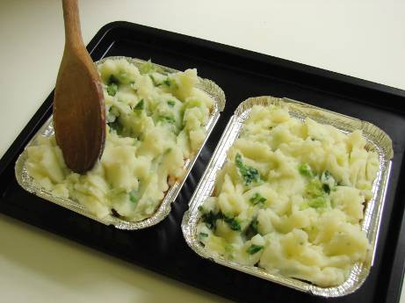
Place the ovenproof dish or foil tray on a baking tray. Spread the meat mixture into an ovenproof dish and spoon the mash over the top.

Slide 18
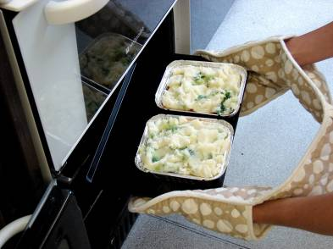
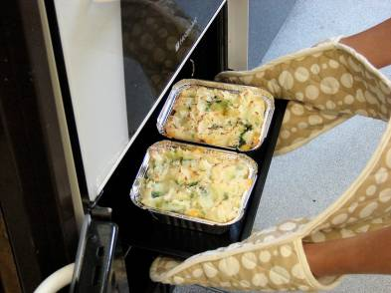
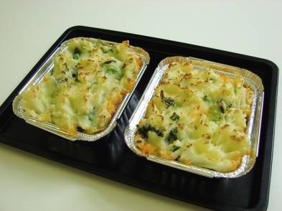
Cook for 20 – 25 minutes, until golden brown, or take home and cook in the oven for this amount of time.

Slide 19
Top tips
Food skills
Add other vegetables to the meat mixture such as frozen peas.
Swap the mince for veggie mince for a vegetarian option.
Add mixed herbs to the mashed potato, or top with a little grated cheese before putting in the oven.
The baking tray gets hot so remember to use oven gloves.
Weigh.
Measure.
Peel.
Cut, chop, dice, trim.
Fry.
Stir.
Simmer and boil.
Drain.
Mash.
Layer.
Bake.

Slide 20
Shepherd’s pie
For further information, go to:
www.foodafactoflife.org.uk

