Slide 1
Spinach, potato and chickpea curry
Complexity: medium

Slide 2
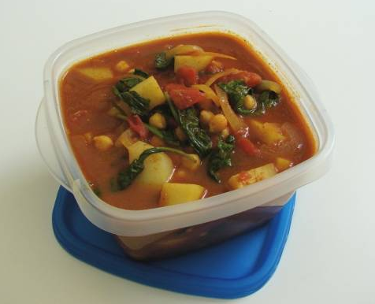

Slide 3
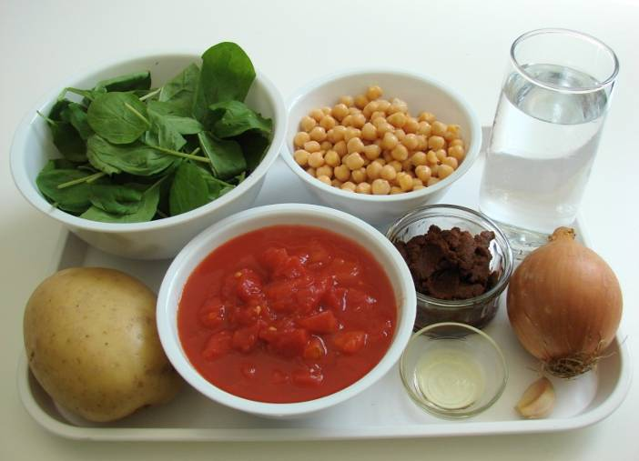
Ingredients
1 onion
1 clove garlic
1 large potato
1 x 5ml spoon oil
2 x 15ml spoons curry paste
300ml water
1 can chopped tomatoes (400g)
1 can chickpeas (410g), drained
3 handfuls of fresh spinach

Slide 4
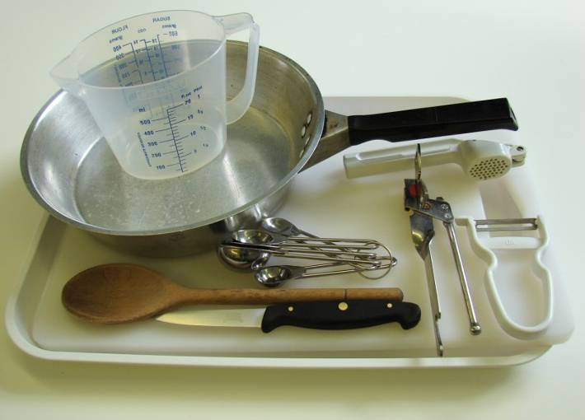
Equipment
Knife
Chopping board
Garlic press
Frying pan
Measuring spoons
Measuring jug
Wooden spoon
Can opener

Slide 5
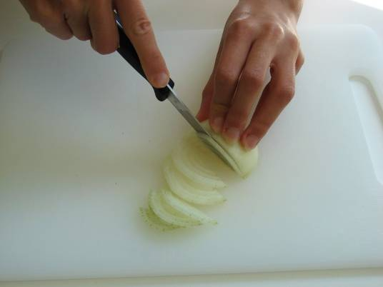
Method
Prepare the onion, garlic and potatoes:
slice the onion;

Slide 6
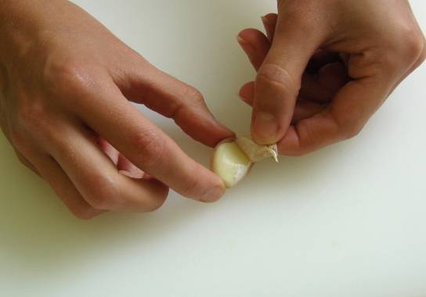
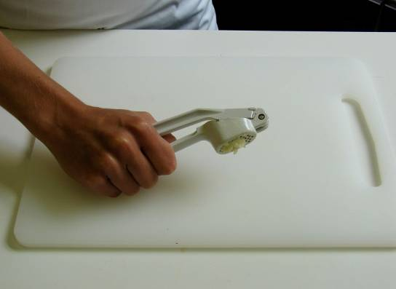
peel and crush the garlic;

Slide 7
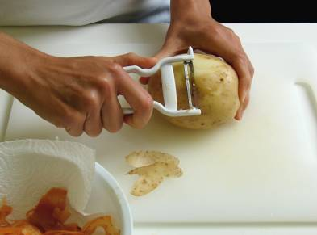
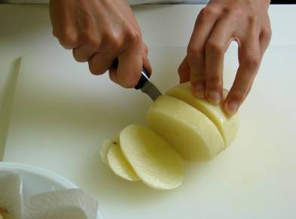
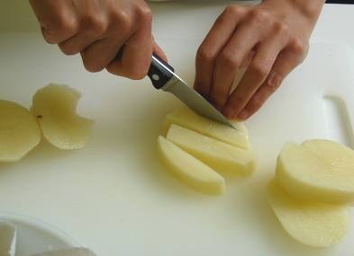
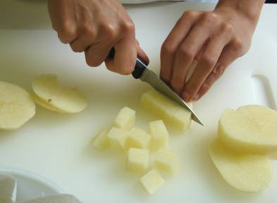
peel and cut the potatoes into 1cm cubes.

Slide 8
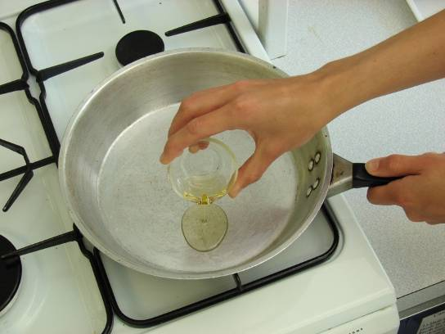
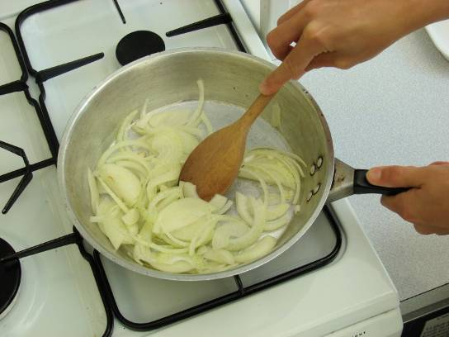
Fry the onion and garlic for 2 minutes in the oil.

Slide 9
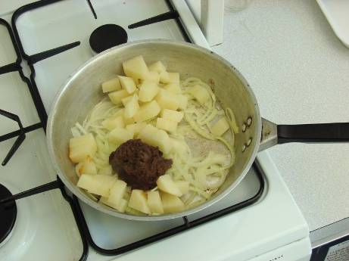
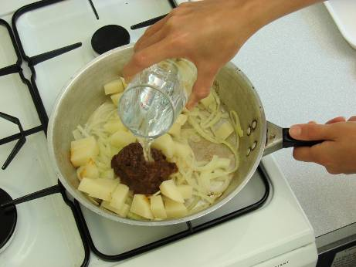
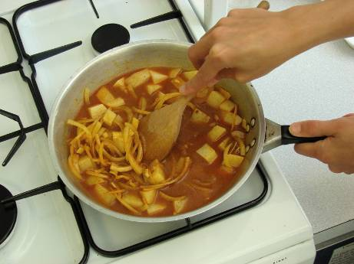
Stir in the curry paste, potatoes and water.

Slide 10
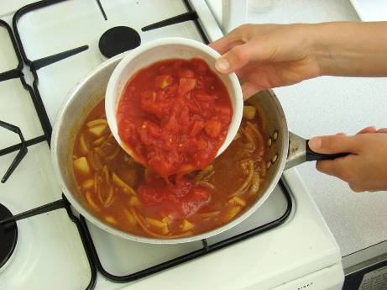
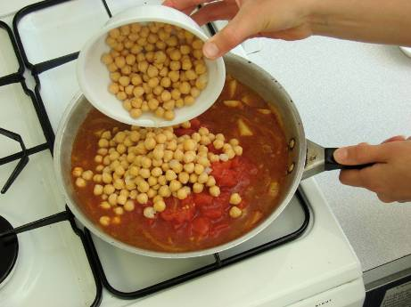
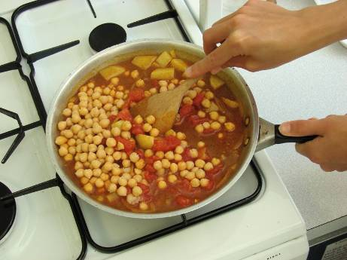
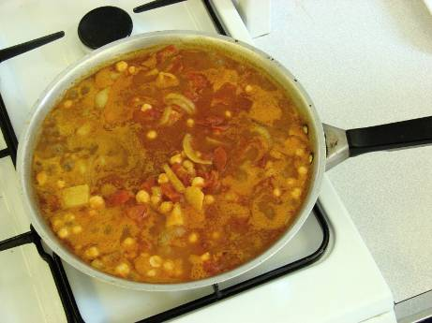
Add the tomatoes and chickpeas, then allow to simmer for 20 minutes, until the potato is tender.

Slide 11
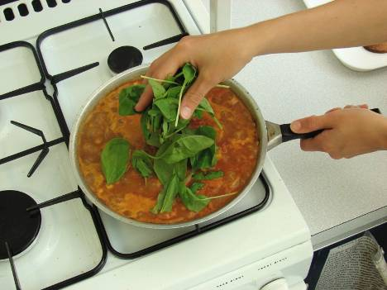
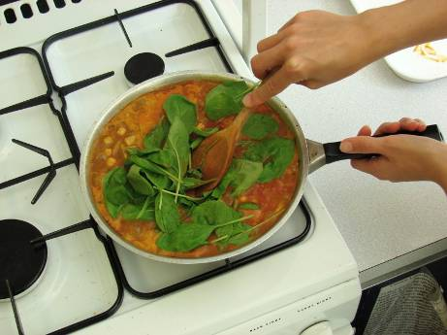
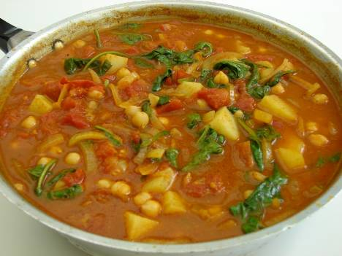
Stir in the fresh spinach, and allow to cook for a further 2 minutes.

Slide 12
Top tips
Food skills
Serve the boiled rice, naan bread and a side salad.
Replace the tomatoes with thinly sliced courgettes, peppers or okra.
Batch cook – freeze portions for a rainy (busy) day.
Measure.
Peel.
Slice.
Crush.
Dice.
Drain.
Fry.
Stir.
Simmer.
Boil (if serving with rice).

Slide 13
Spinach, potato and chickpea curry
For further information, go to:
www.foodafactoflife.org.uk

