Slide 1
Classic tomato ragu
Complexity: low-medium

Slide 2
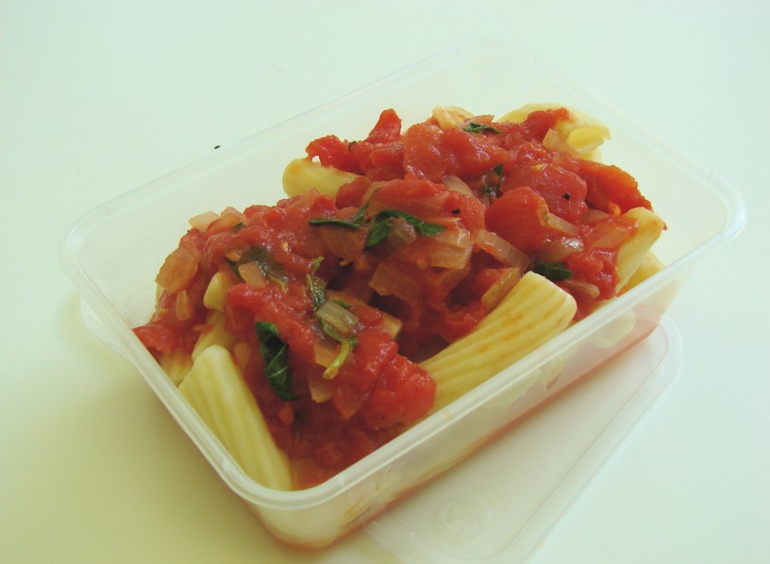

Slide 3
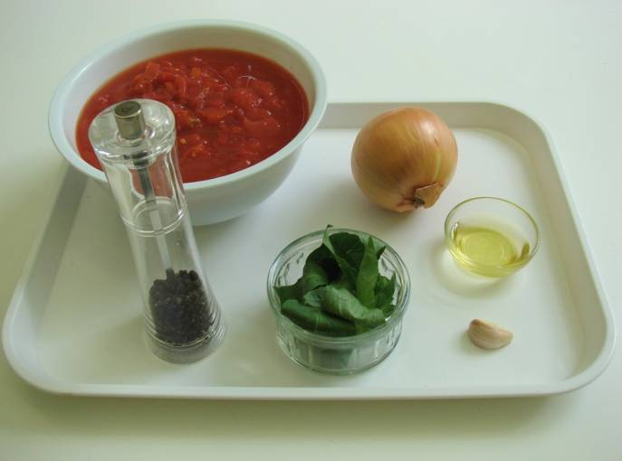
Ingredients
1 onion
1 clove garlic
1 x 15ml spoon oil
2 x 400g canned chopped tomatoes
Handful of fresh basil
Black pepper

Slide 4
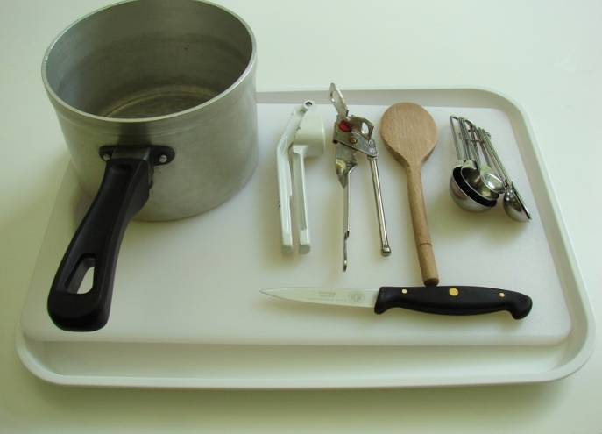
Equipment
Knife
Chopping board
Garlic press
Measuring spoons
Saucepan
Wooden spoon

Slide 5
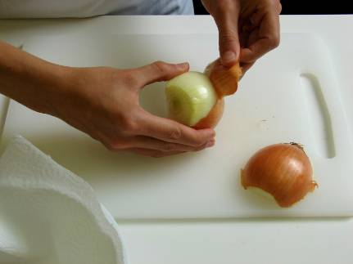
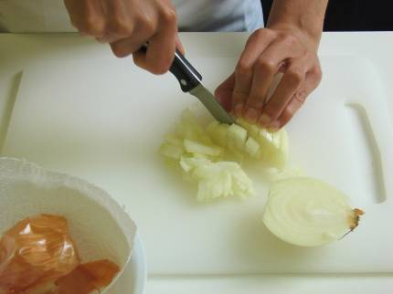
Method
Prepare the onion and garlic:
peel and chop the onion;

Slide 6
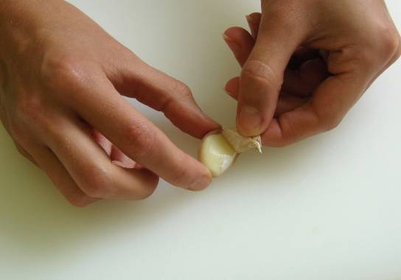
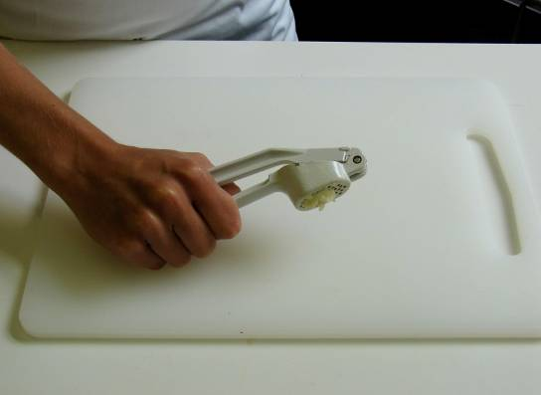
peel and crush the garlic.

Slide 7
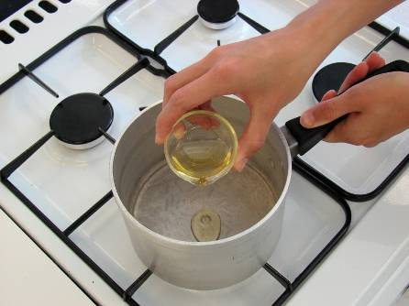
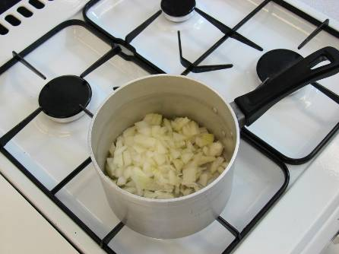
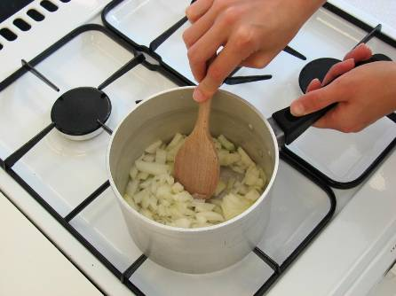
Fry the onion and garlic in the oil for 5 minutes, until soft.

Slide 8
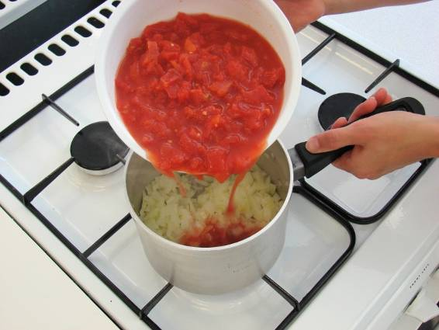
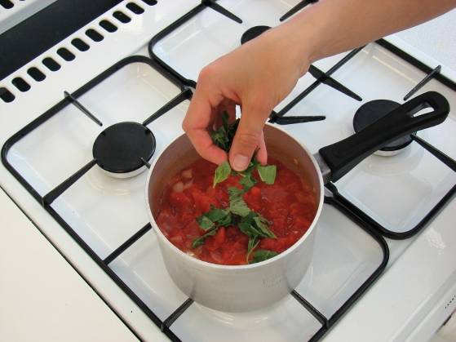
Add the tomatoes and tear in the basil leaves.

Slide 9
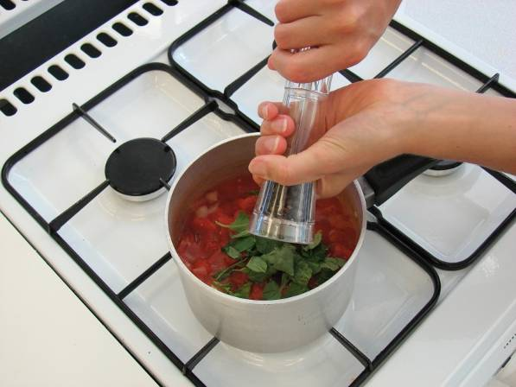
Add a few twists of black pepper, then allow to simmer gently for 30 minutes (longer if possible).

Slide 10
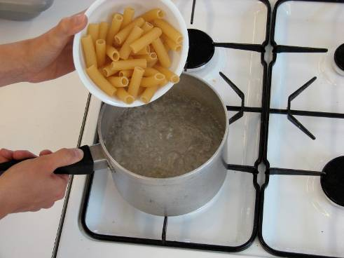
Optional
You may wish to serve the tomato ragu with pasta. If so:
after 15 minutes, put a large saucepan of water on to boil. When rapidly boiling, add the pasta and cook for around 10 minutes until al dente. Drain;

Slide 11
mix the cooked pasta and tomato sauce together.

Slide 12
Top tips
Food skills
Add ½ red chilli, for a sauce with a kick.
Add 75g mushrooms and 75g courgette, after stage 2, for a simple veggie sauce.
Add and brown 200g minced beef after stage 2 for a simple meat sauce.
Stir in black olives and tuna for a fish alternative.
Pour the basic ragu sauce over white fish, sprinkle with cheese and bake for 20 minutes until golden.
Measure.
Peel.
Chop.
Fry.
Simmer.
Boil (if serving with pasta).

Slide 13
Classic tomato ragu
For further information, go to:
www.foodafactoflife.org.uk

