Slide 1
Lamb korma
Complexity: medium

Slide 2
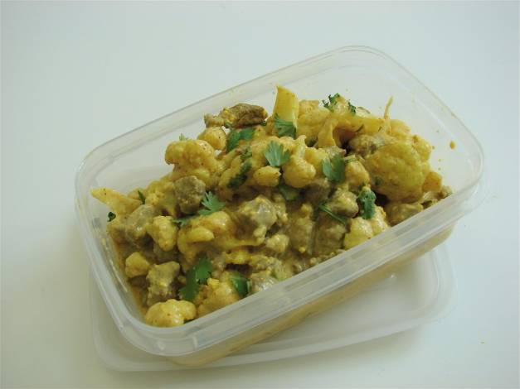

Slide 3
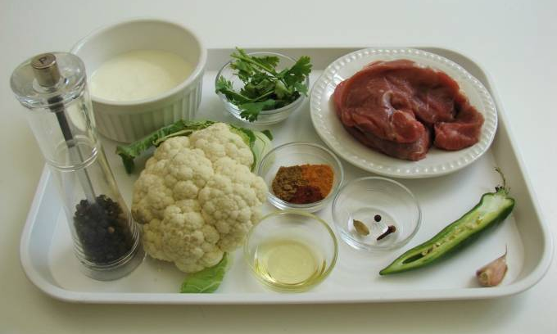
Ingredients
1 clove garlic
½ green chilli
½ small cauliflower
200g lamb
leg steaks
1 clove
1 black peppercorn
1 cardamom pod
1 x 10ml spoon oil
½ x5ml spoon turmeric
½ x5ml spoon
ground cumin
½ x5ml spoon chilli powder
4x15ml spoons plain yogurt
Pinch black pepper
1x15ml spoon coriander

Slide 4
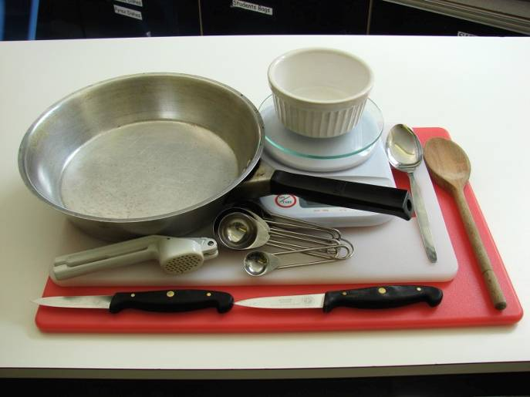
Equipment
2 chopping boards
2 knives
Weighing scales
Frying pan
Measuring spoons
Garlic press
Wooden spoon
Spoon
Small bowl

Slide 5
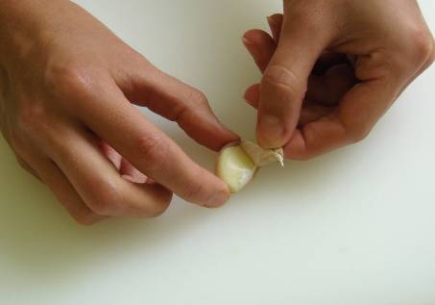
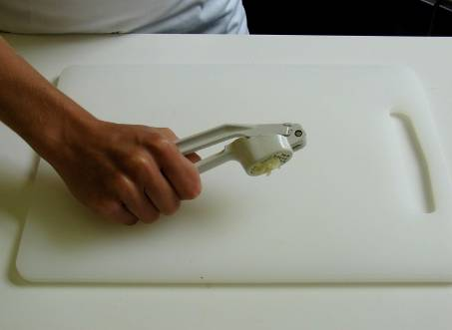
Method
Prepare the garlic, chilli and cauliflower:
peel and crush the garlic;

Slide 6
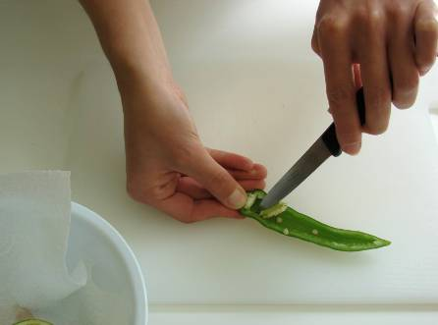
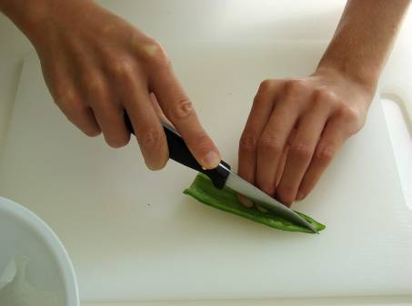
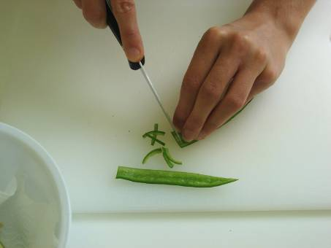
de-seed and slice the chilli;

Slide 7
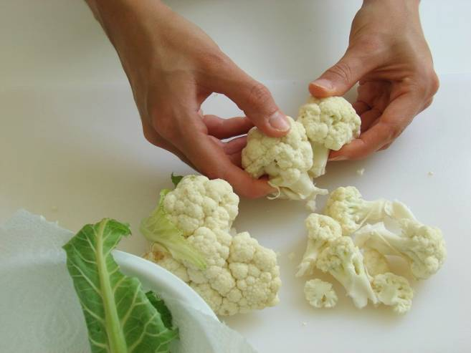
break the cauliflower into florets.

Slide 8
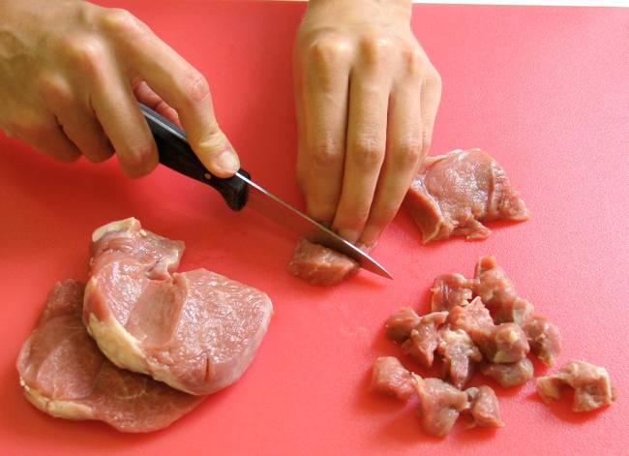
On a different chopping board, using a fresh knife, cut the lamb into cubes.

Slide 9
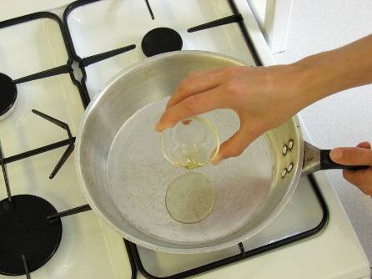
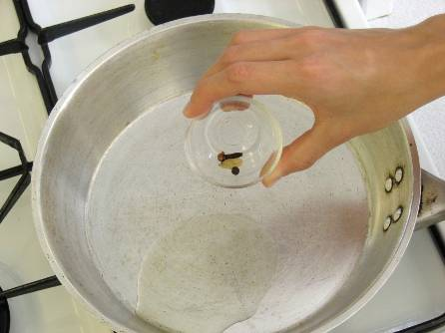
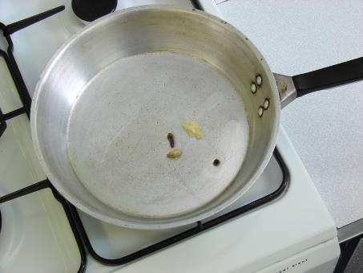
Fry the clove, peppercorn and cardamom in the oil until they sizzle.

Slide 10
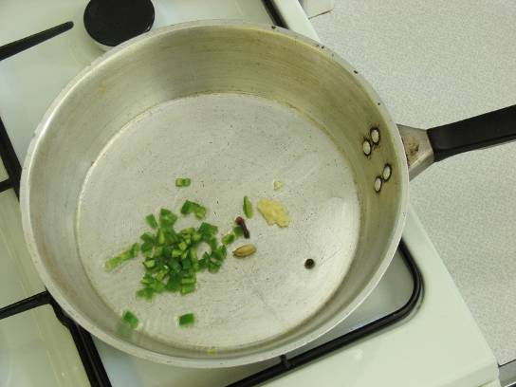
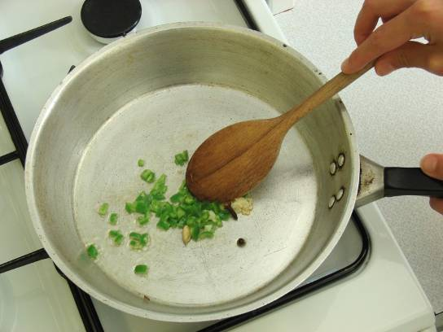
Stir in the garlic and chilli.

Slide 11
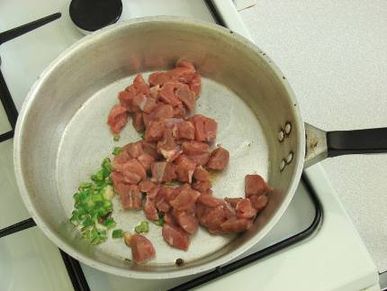
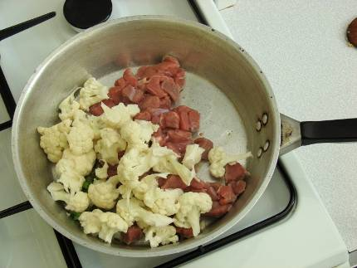
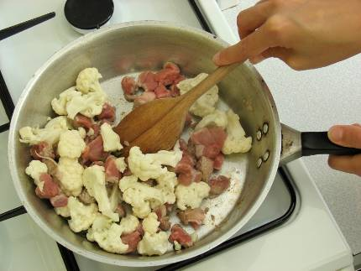
Add the lamb and cauliflower, cover and slowly cook for about 10 minutes.

Slide 12
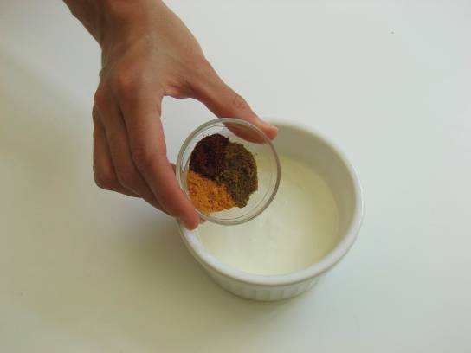
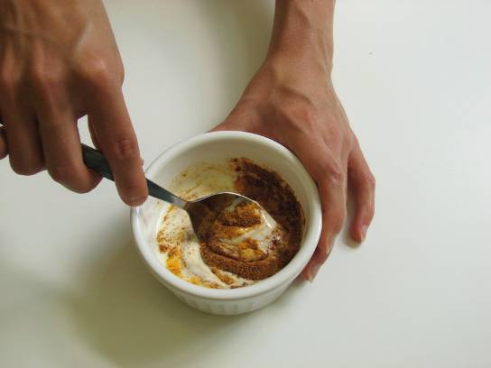
Mix the turmeric, chilli powder, pepper and cumin into the yogurt.

Slide 13
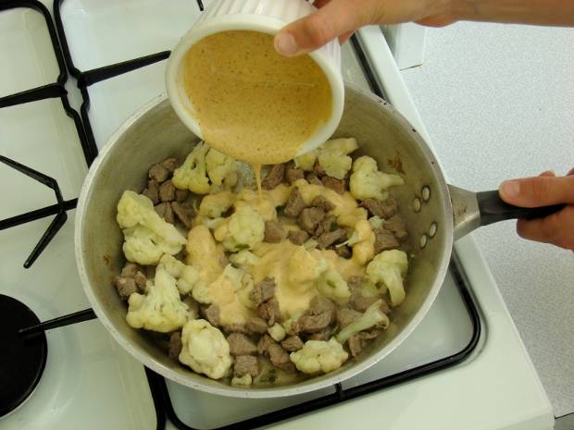
Increase the heat and stir in the yogurt mix to the frying pan.

Slide 14
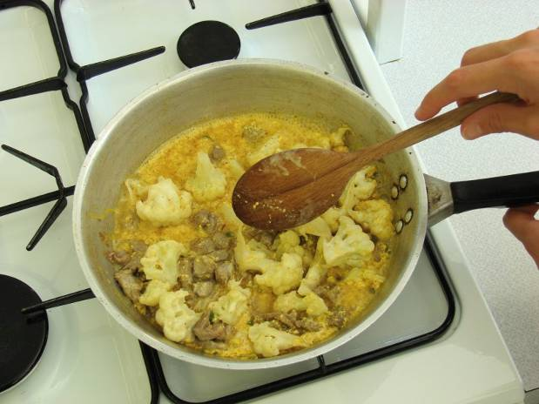
Allow to cook for a further 10 minutes.

Slide 15
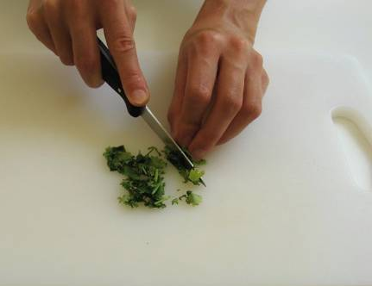
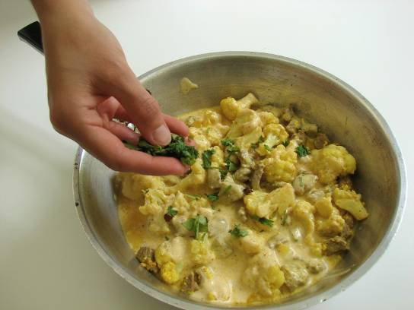
Chop the coriander and stir into the korma.

Slide 16
Top tips
Food skills
Try a variety of vegetables such as broccoli or peas and sweetcorn.
Serve with brown rice for added fibre.
Measure.
Peel.
Crush.
Chop.
Cut.
Fry.
Stir.
Simmer.
Boil (if serving with rice).

Slide 17
Lamb korma
For further information, go to:
www.foodafactoflife.org.uk

