Slide 1
Mushroom risotto
Complexity: medium

Slide 2
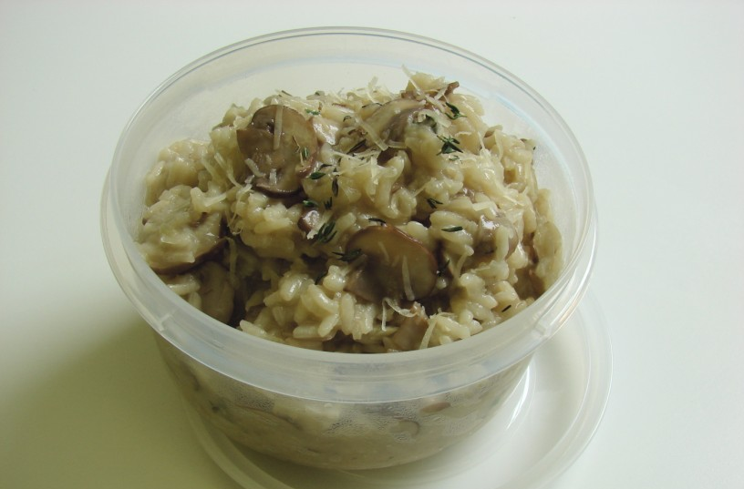

Slide 3
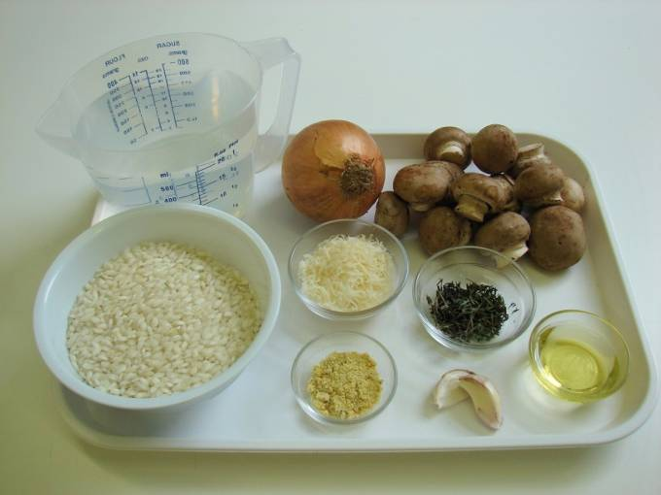
Ingredients
1 onion
150g chestnut mushrooms
2 cloves garlic
1 x 15ml spoon olive oil
250g risotto rice
1 x 5ml spoon vegetable
stock powder or cube
1 – 1.5 litres water, boiling
1 x 15ml spoon parmesan, grated
1 x 10ml spoon thyme, chopped

Slide 4
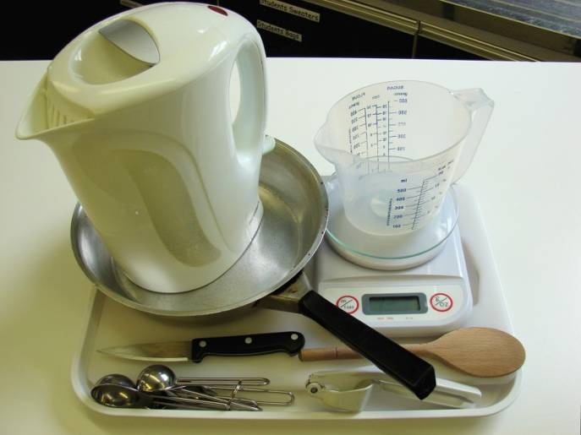
Equipment
Chopping board
Knife
Garlic press
Weighing scales
Measuring spoons
Frying pan
Wooden spoon
Kettle
Measuring jug

Slide 5
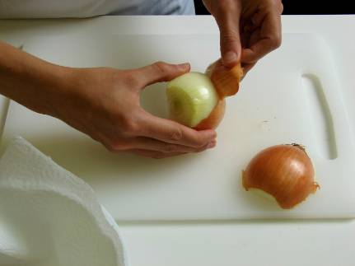
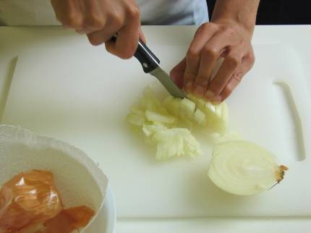
Method
Prepare the vegetables:
peel and chop the onion;

Slide 6
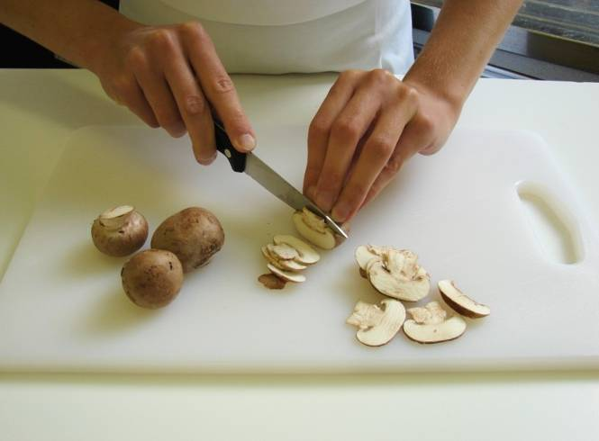
slice the mushrooms;

Slide 7
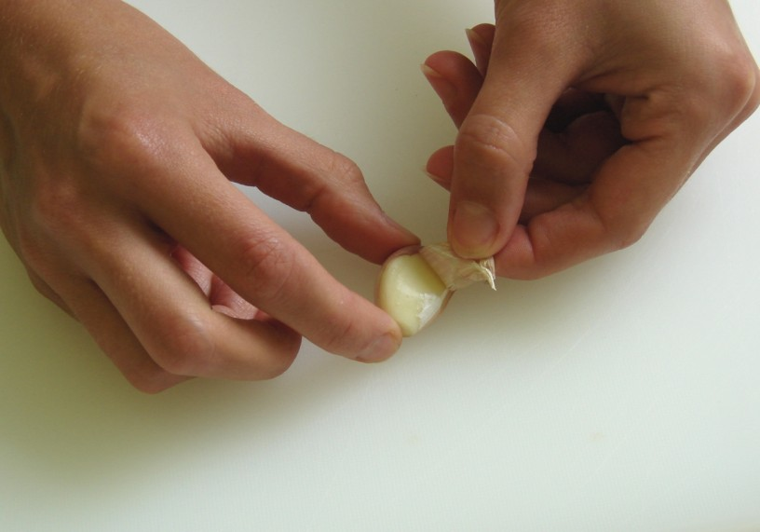
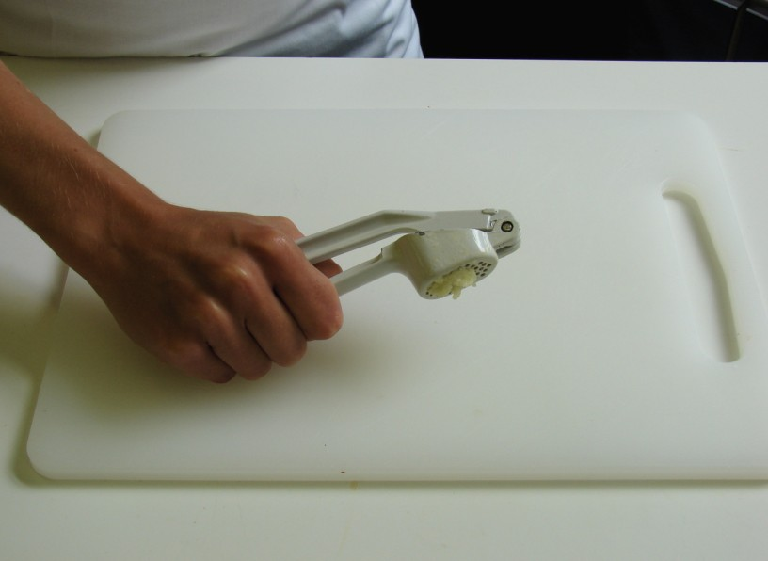
peel and crush the garlic.

Slide 8
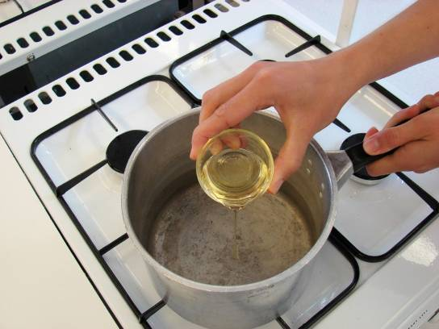
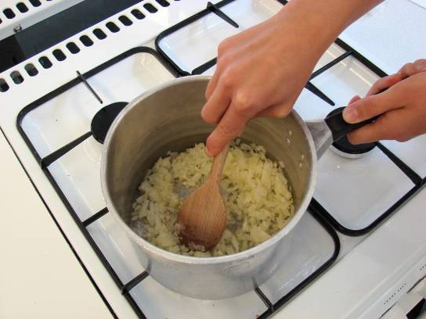
Fry the onion and garlic in the oil until softened.

Slide 9
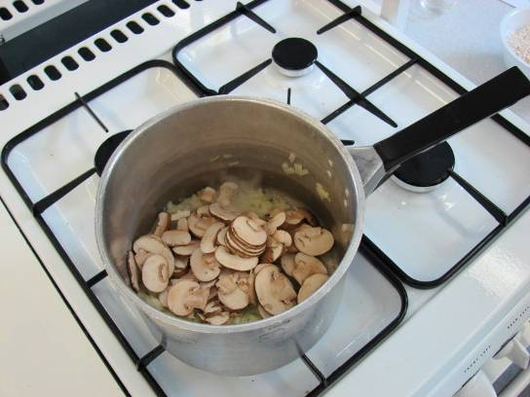
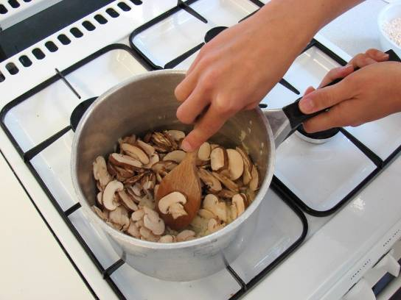
Add the mushrooms, and fry for another 2 minutes.

Slide 10
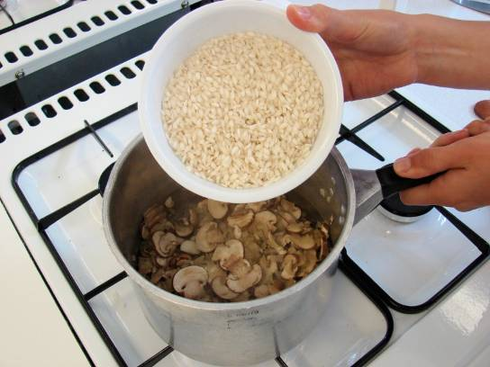
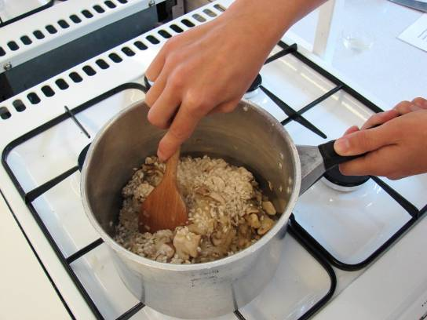
Stir in the rice.

Slide 11
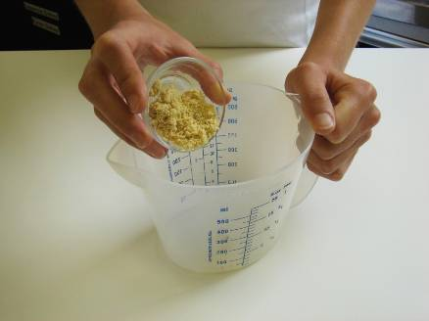
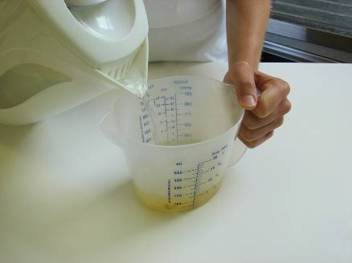
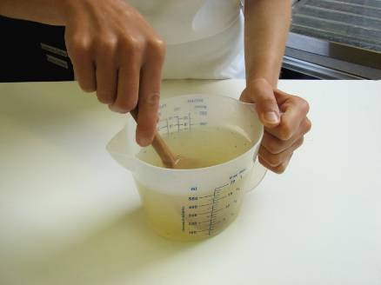
Mix the stock powder with the water.

Slide 12
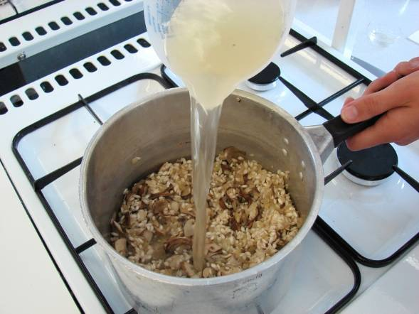
Add a little of the stock into the rice – a little at a time. Wait for the stock to be absorbed, stirring constantly.

Slide 13
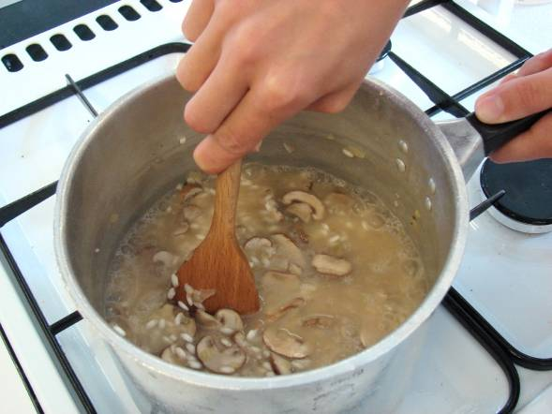
Continue adding the stock until the rice cooks – this will take 20 – 25 minutes. The rice should be soft, but still retain a nutty bite.

Slide 14
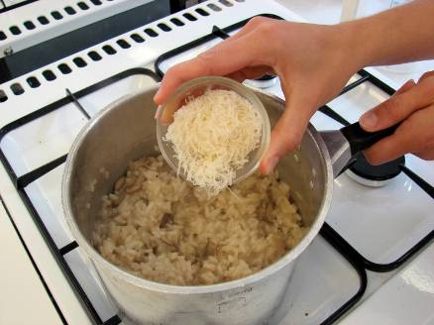
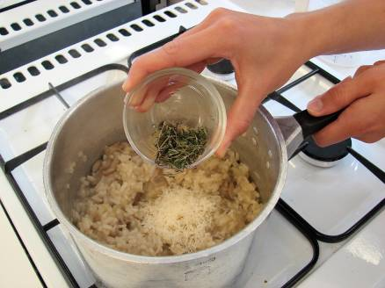
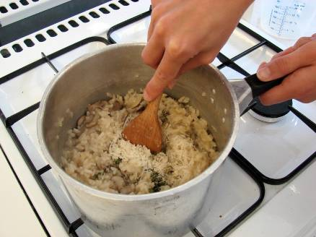
Stir in the parmesan and thyme into the rice.

Slide 15
Top tips
Food skills
Try using different ingredients, such as chicken, prawns or Mediterranean vegetables.
Use different herbs and spices e.g. basil, parsley or chilli.
Ensure that you keep adding liquid otherwise the rice will not cook.
Weigh.
Measure.
Peel.
Chop and slice.
Crush.
Grate.
Fry.
Stir.
Simmer.

Slide 16
Mushroom risotto
For further information, go to:
www.foodafactoflife.org.uk

