Slide 1
Ratatouille
Complexity: medium

Slide 2
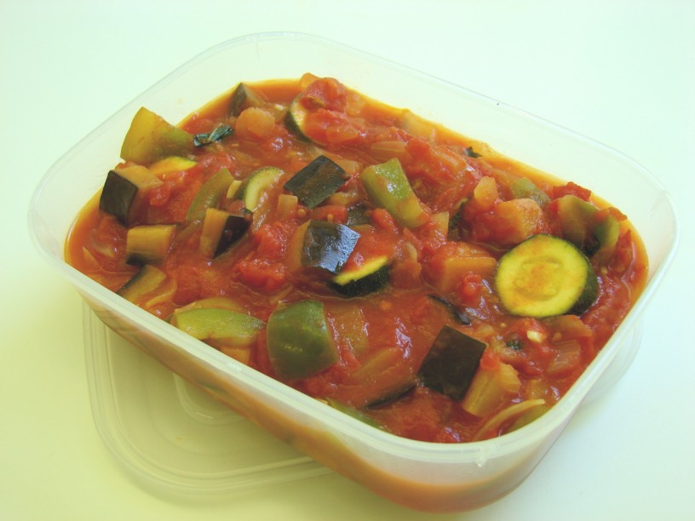

Slide 3
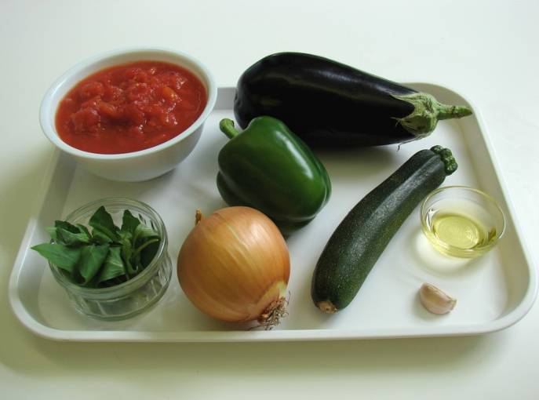
Ingredients
1 onion
1 clove garlic
1 small aubergine
1 green pepper
1 courgette
2 cans chopped tomatoes (800g)
1 x 10ml spoon oil
1 handful fresh basil

Slide 4
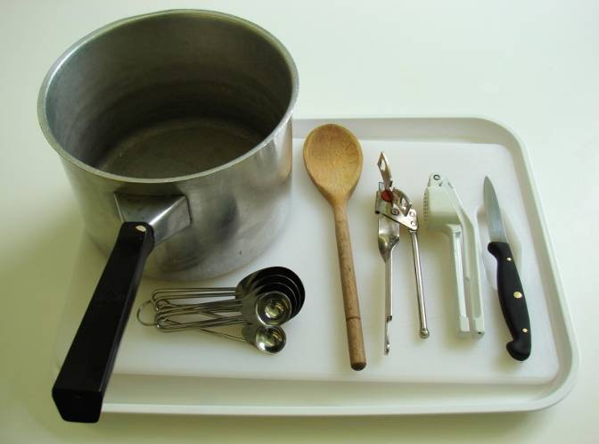
Equipment
Chopping board
Knife
Garlic press
Measuring spoons
Saucepan
Wooden spoon
Can opener

Slide 5
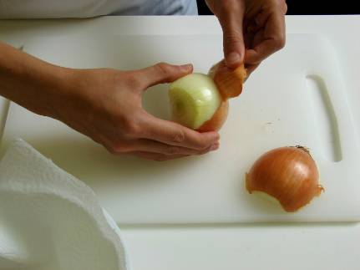
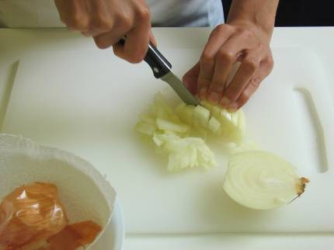
Method
Prepare the vegetables:
peel and chop the onion;

Slide 6
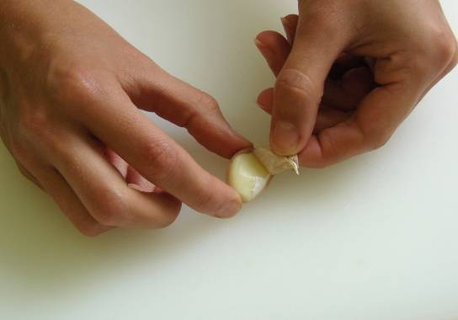
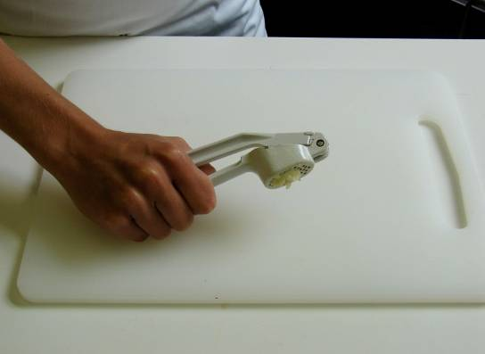
peel and crush the garlic;

Slide 7
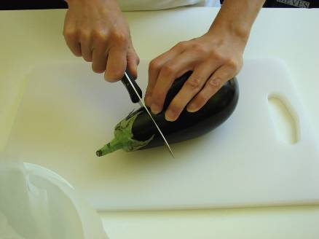
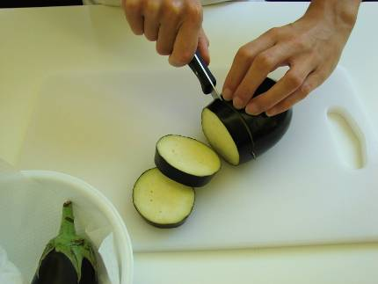
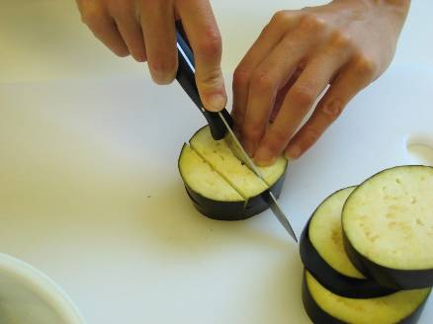
dice the aubergine;

Slide 8
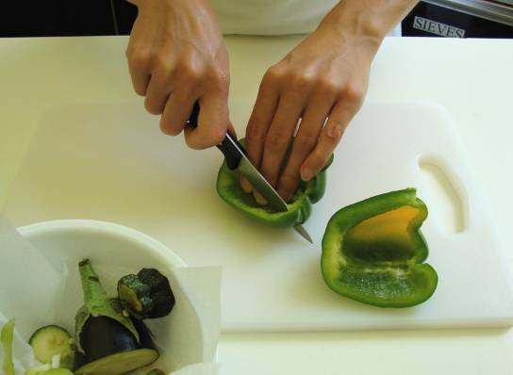
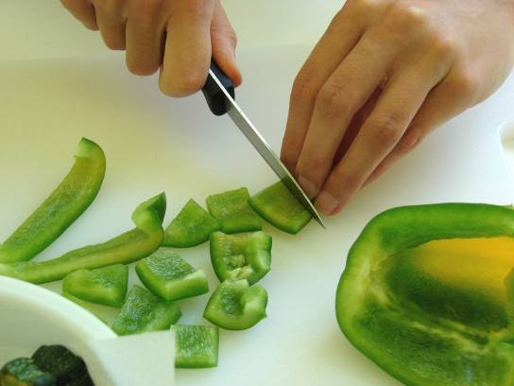
de-seed and chop the green pepper;

Slide 9
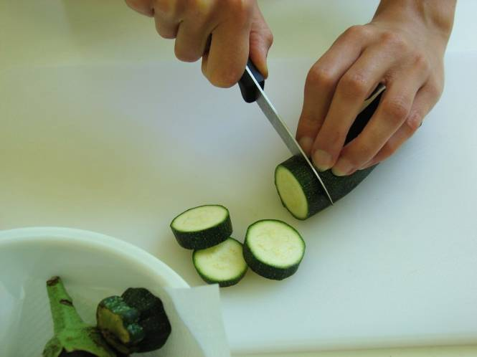
slice the courgette.

Slide 10
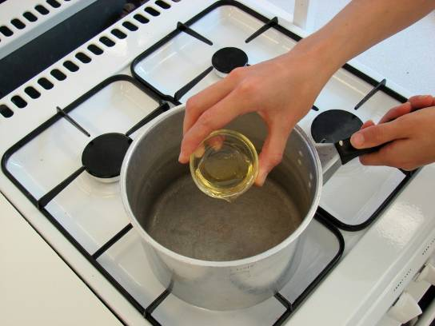
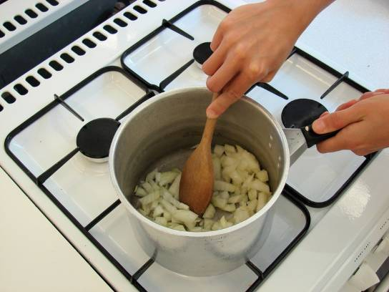
Fry the onion and garlic in the oil for 5 minutes.

Slide 11
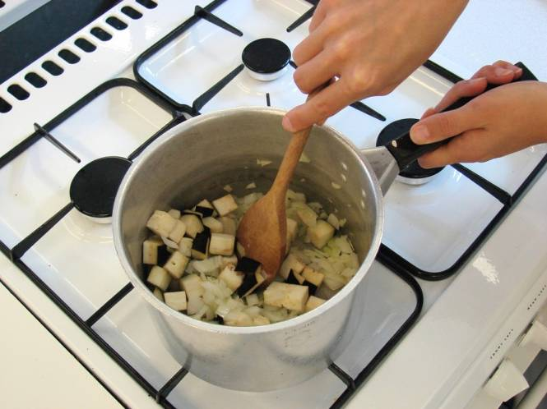
Add the aubergine and fry for a further 5 minutes.

Slide 12
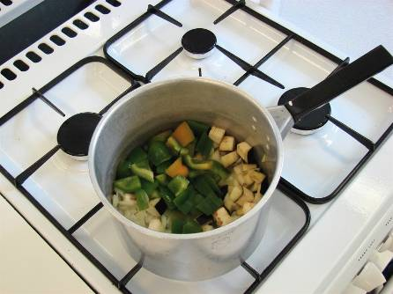
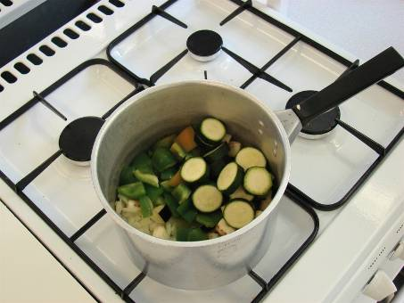
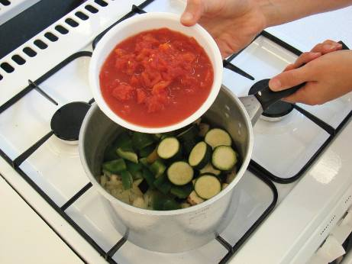
Add the pepper, courgette and tomatoes.

Slide 13
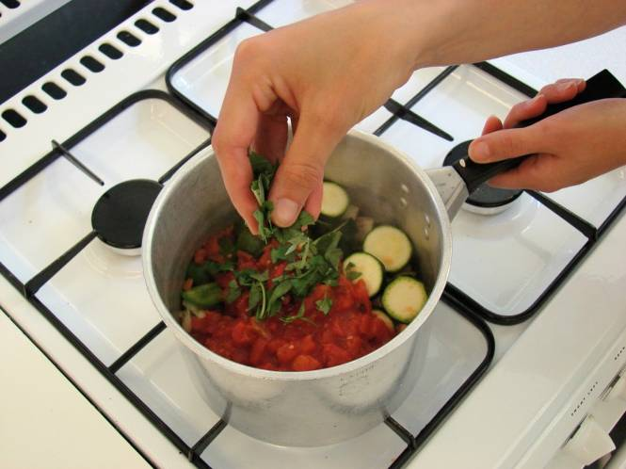
Stir in the torn basil leaves.

Slide 14
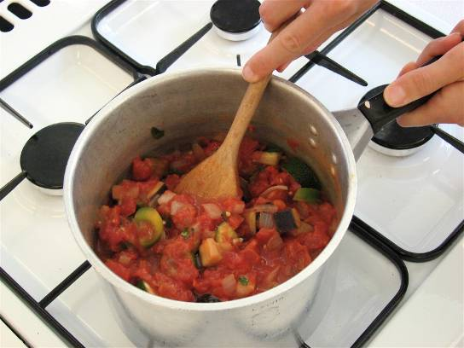
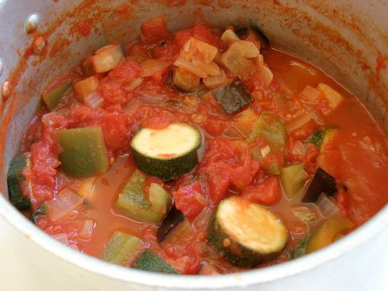
Bring to the boil and then simmer gently, with the lid on the saucepan, for 20 – 30 minutes.

Slide 15
Top tips
Food skills
Use dried herbs if you do not have fresh basil.
Use different colour peppers.
Go for different vegetables – try adding olives, mushrooms, red onions, peas or beans.
Serve with rice, potatoes or bread for a low fat snack.
Measure.
Peel.
Chop, dice and slice.
Crush.
Fry.
Boil and simmer.

Slide 16
Ratatouille
For further information, go to:
www.foodafactoflife.org.uk

