Slide 1
ANZAC biscuits
Complexity: low-medium

Slide 2
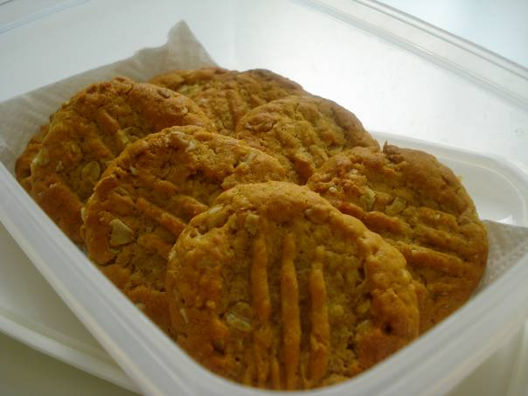

Slide 3
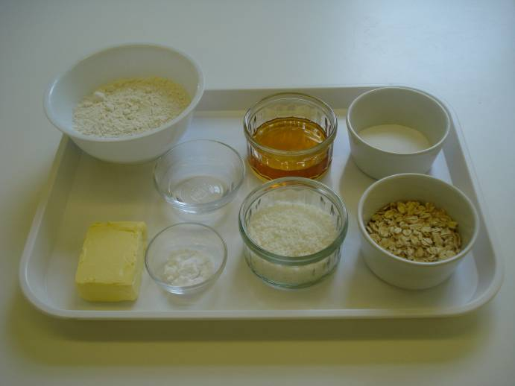
Ingredients
100g plain white flour
25g rolled oats
30g caster sugar
25g desiccated coconut
20ml spoon golden syrup
50g butter or hard baking fat
½ x 5ml spoon bicarbonate of soda
10ml spoon boiling hot water

Slide 4
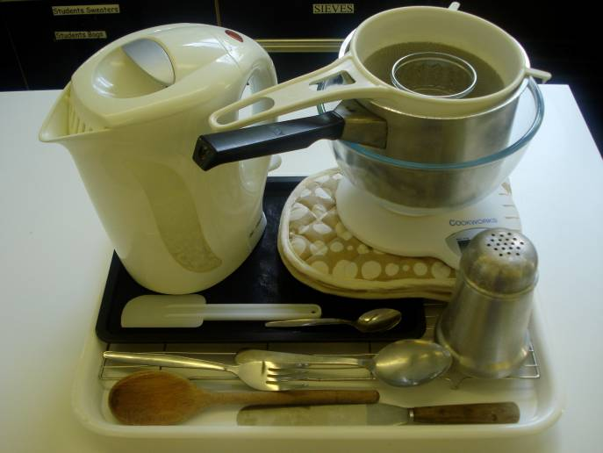
Equipment
Baking tray
Weighing scales
Sieve
Mixing bowl
Saucepan
Wooden spoon
5ml spoon
15ml spoon
Kettle
Small bowl
Spatula
Palette knife
Flour dredger
Fork
Oven gloves
Cooling rack

Slide 5
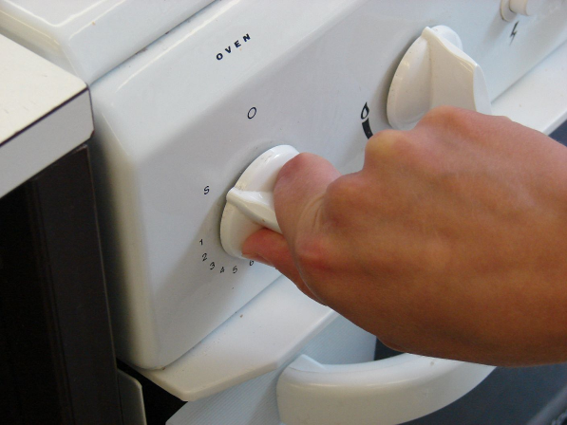
Method
Preheat the oven to 160°C or gas mark 4.

Slide 6
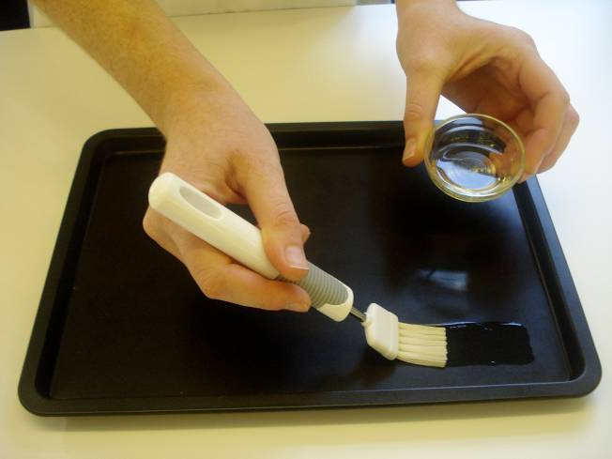
Grease or line the baking tray.

Slide 7
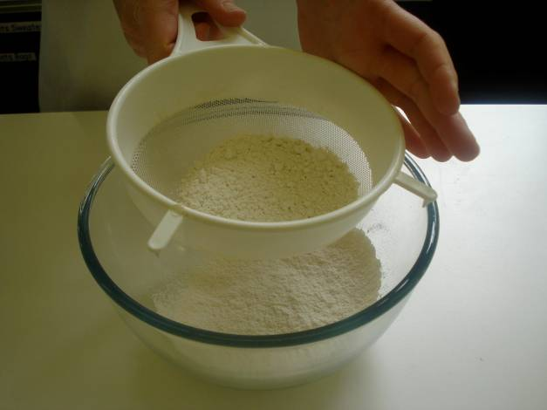
Sift the flour into the bowl.

Slide 8
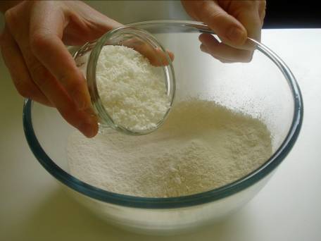
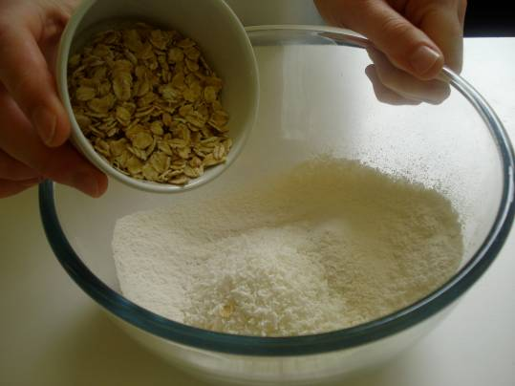
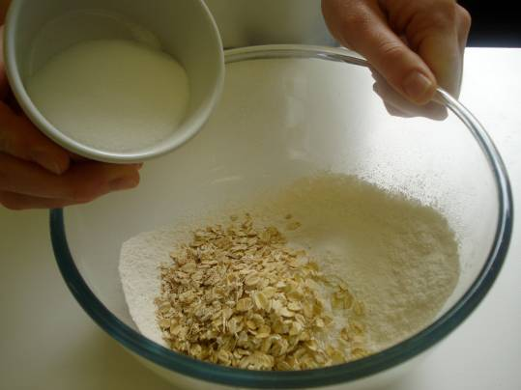
Mix in the coconut, oats, and sugar.

Slide 9
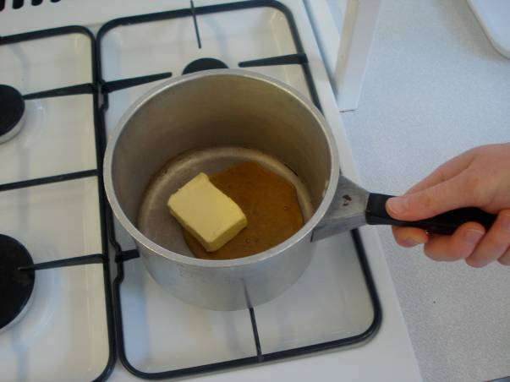
Melt the golden syrup and butter or hard baking fat together on a low heat.

Slide 10
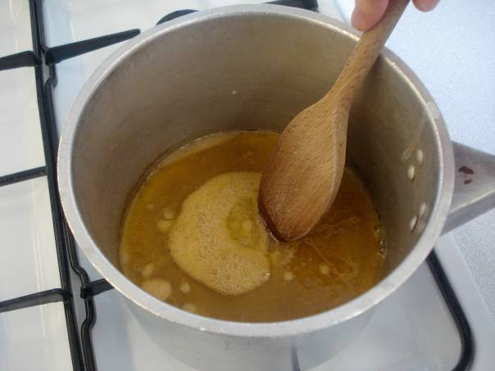
Mix the bicarbonate of soda with boiling hot water and add to the melted butter or baking fat immediately.

Slide 11
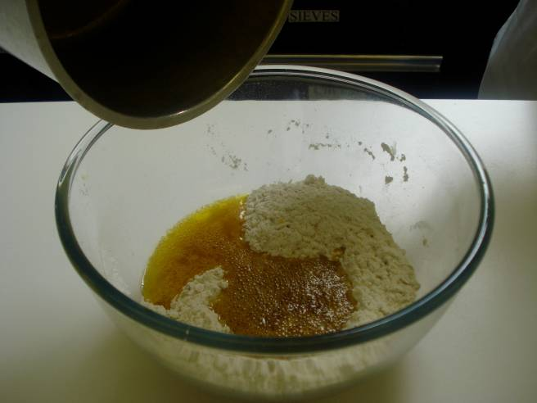
Add the wet mixture to the dry ingredients.

Slide 12
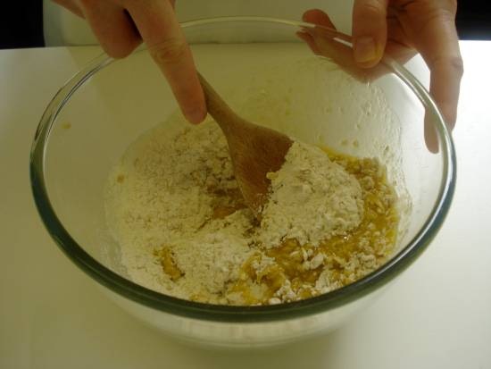
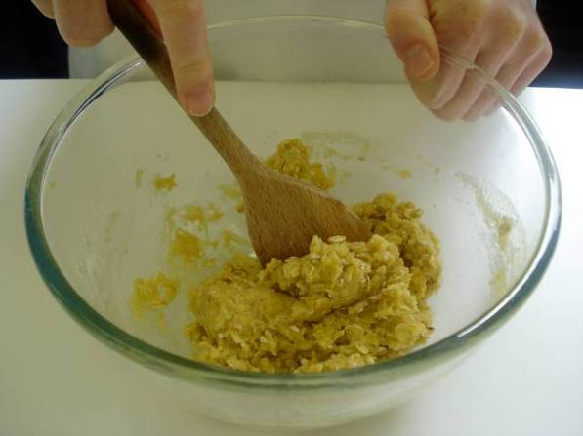
Mix thoroughly until combined.

Slide 13
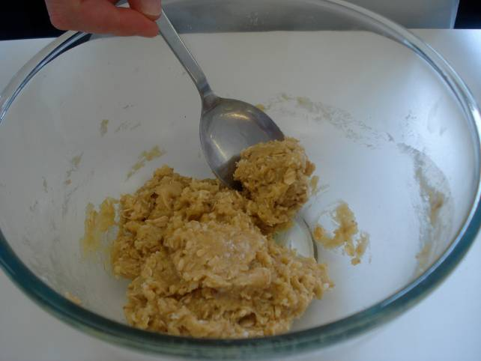
Divide the mixture evenly into 8 portions using the 15ml spoon.

Slide 14
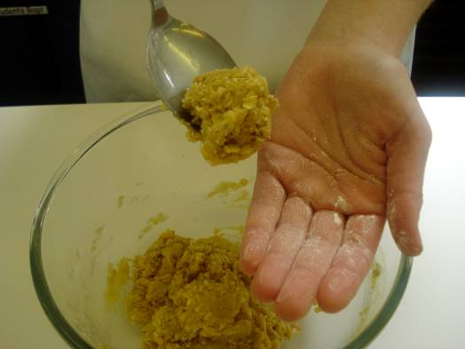
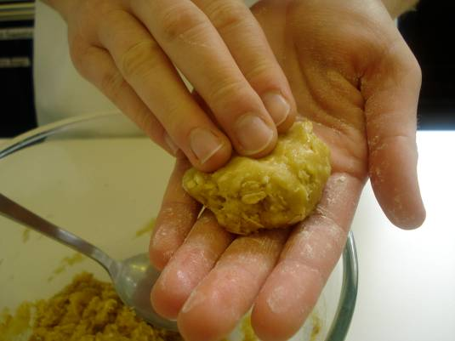
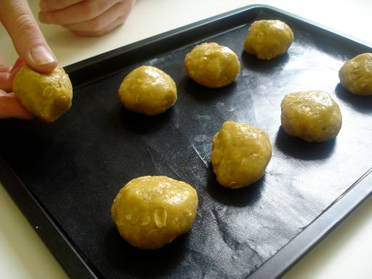
Use lightly floured hands to shape the biscuits into round balls and place onto the prepared baking tray.

Slide 15
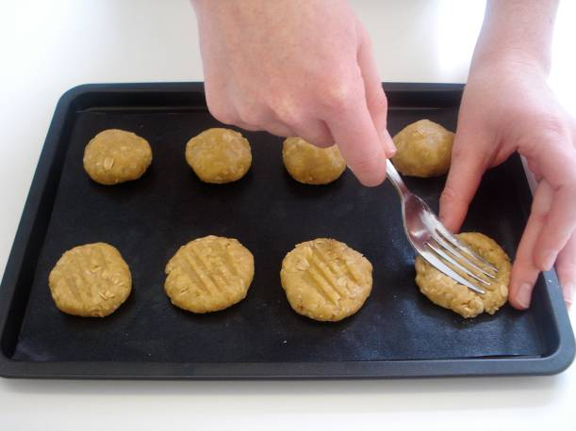
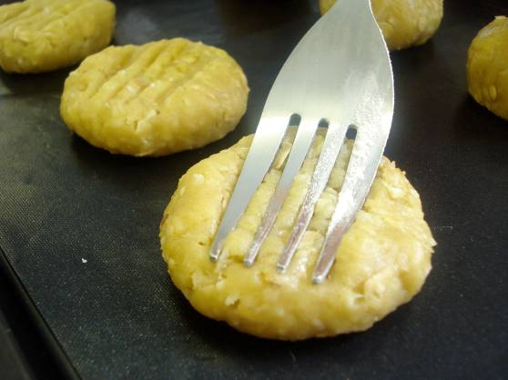
Slightly flatten the biscuits with a lightly floured fork.

Slide 16
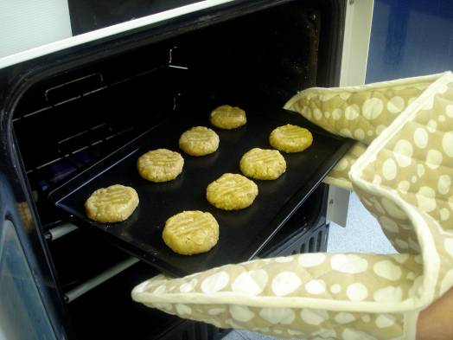
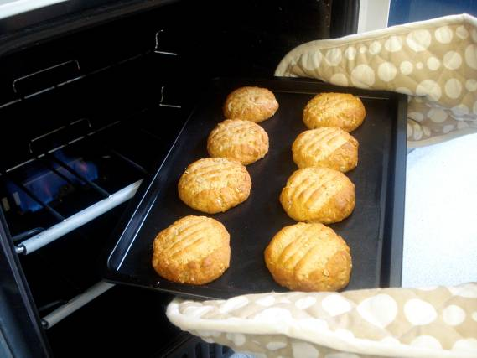
Bake for 15-20 minutes, until golden brown.

Slide 17
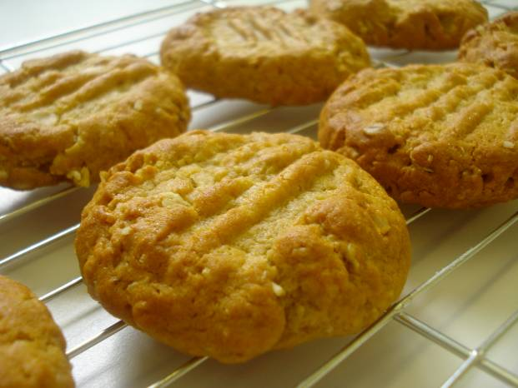
Cool on the baking tray for a few minutes, to allow the biscuits to firm, before transferring them to the cooling rack.

Slide 18
Top tips
Food skills
Try adding some dried fruit to the mixture.
Use a kettle to get the boiling hot water for adding to the bicarbonate of soda.
Weigh.
Measure.
Sift.
Mix.
Melt.
Divide.
Shape.
Bake.

Slide 19
ANZAC biscuits
For further information, go to:
www.foodafactoflife.org.uk

