Slide 1
Pesto pizza
Complexity: medium

Slide 2
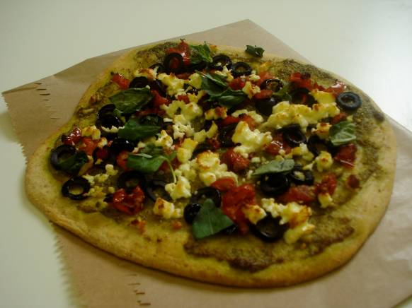

Slide 3
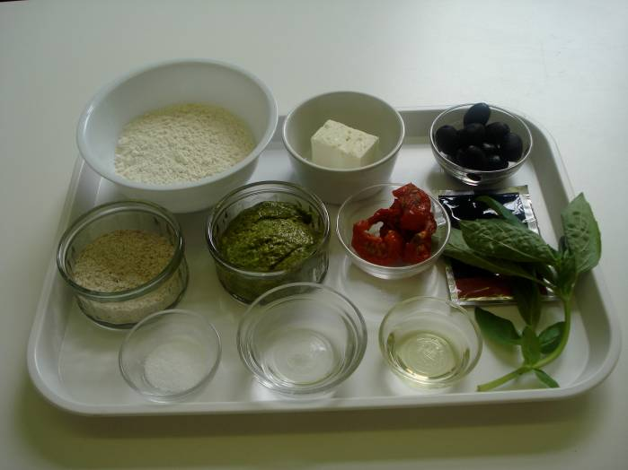
Ingredients
75g strong white flour
25g strong wholemeal flour
½ x 5ml spoon salt
½ sachet quick acting yeast (4g)
1 x 10ml spoon sunflower oil
3 x 15ml spoon warm water
2 x 15ml spoon pesto (level)
25g sundried tomatoes
5 black olives
30g feta cheese
Handful of basil leaves

Slide 4
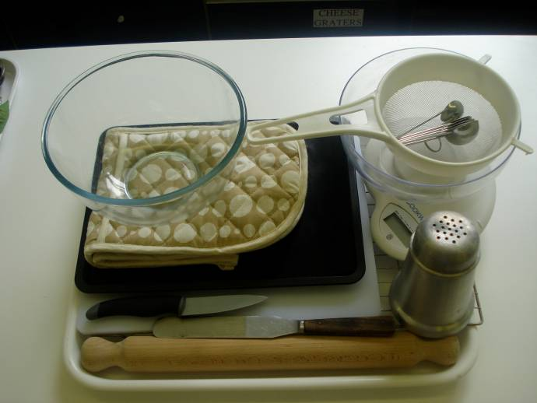
Equipment
Baking tray
Pastry bush
Weighing scales
Sieve
Mixing bowl
Palette knife
Measuring spoons
Measuring jug
Flour dredger
Rolling pin
Chopping board
Sharp knife
Cooling rack

Slide 5
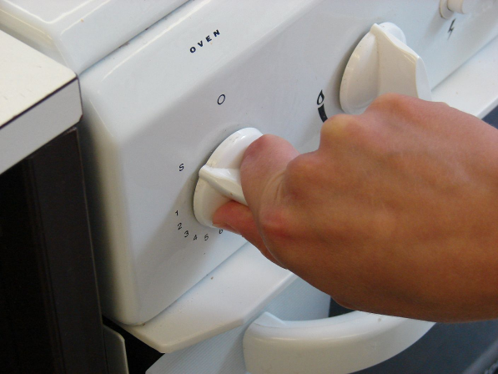
Method
Preheat the oven to 200°C or gas mark 6.

Slide 6
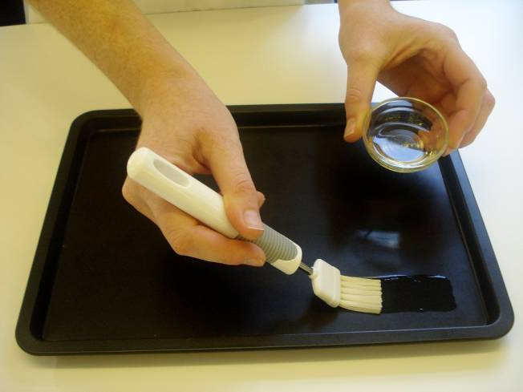
Grease or line the baking tray.

Slide 7
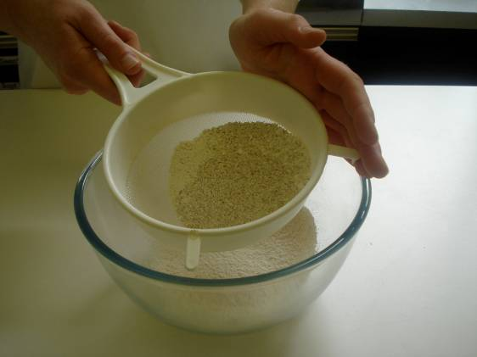
Sift the flour into the mixing bowl and add salt.

Slide 8
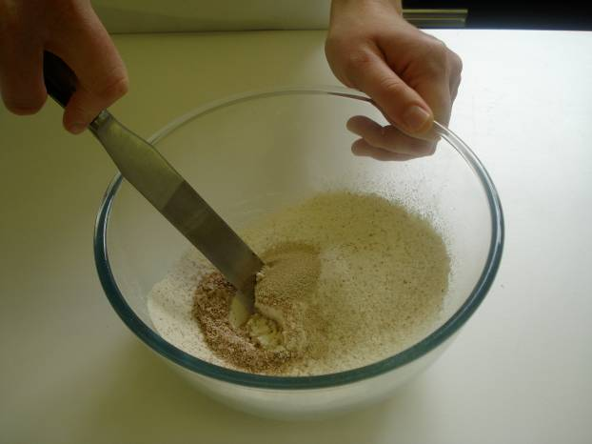
Stir in the yeast and make a well in the middle.

Slide 9
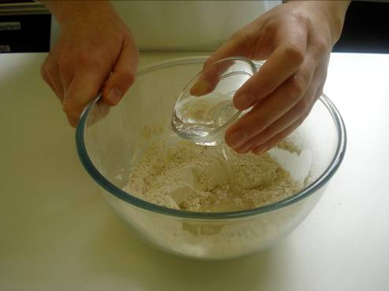
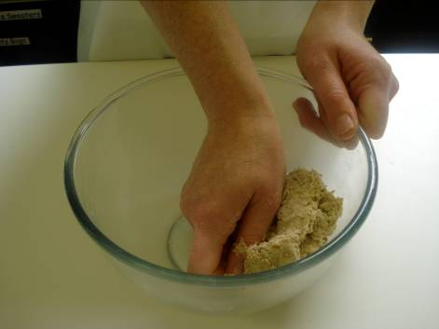
Add the oil and enough warm water to mix into a soft dough with your hands.

Slide 10
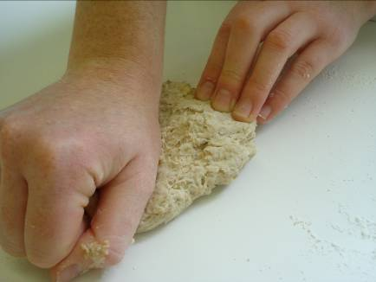
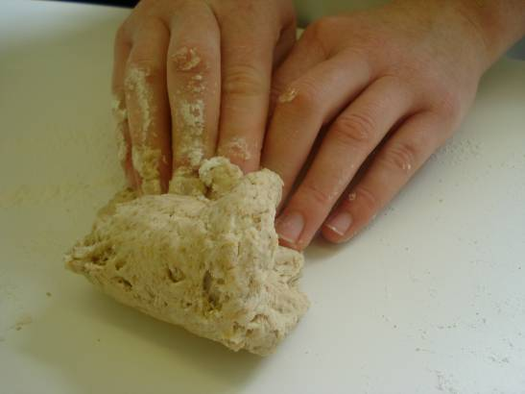
Turn the dough out onto a lightly floured surface and knead for 5-10 minutes.

Slide 11
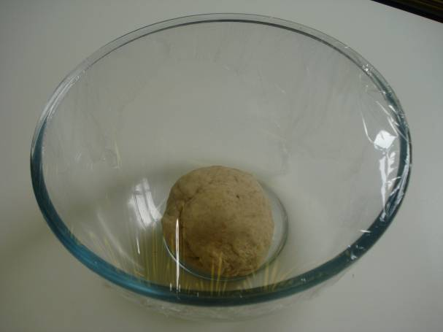
Place the dough in the bowl, cover with cling film and allow to prove in a warm place for 15 minutes.

Slide 12
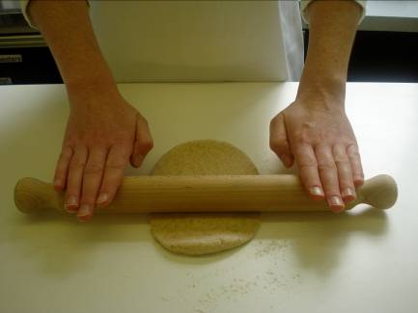
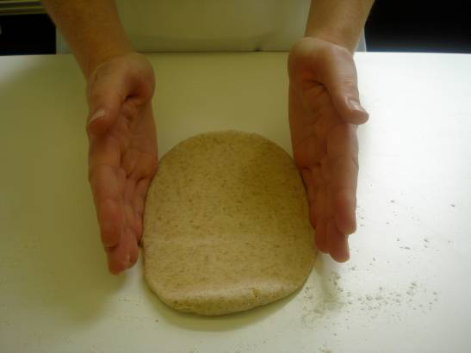
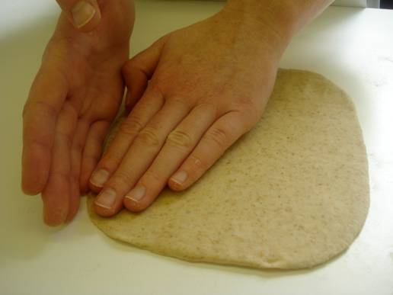
Roll out and shape the dough into a rectangle. Place the dough onto the baking tray.

Slide 13
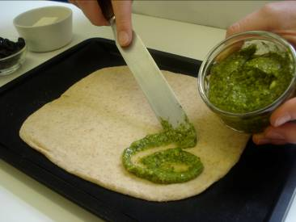
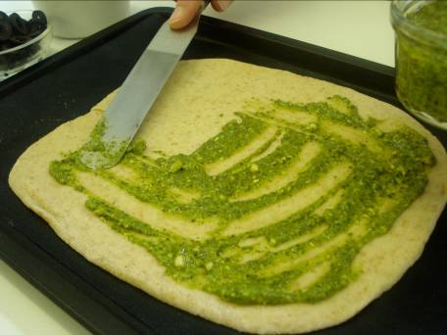
Spread the pesto on the base almost to the edge of the pizza with the palette knife.

Slide 14
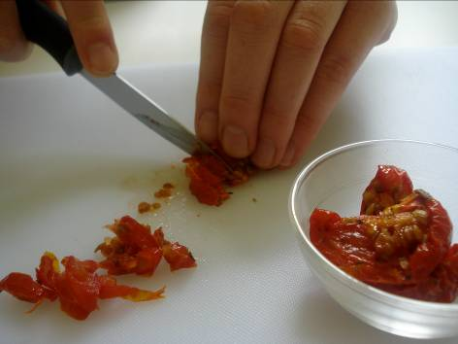
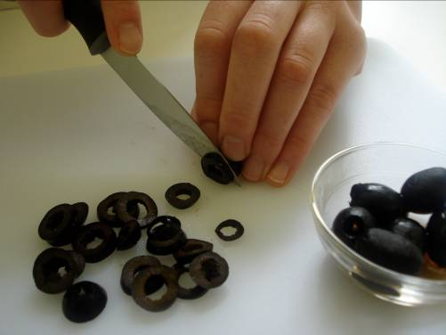
Thinly slice the sundried tomatoes and olives.

Slide 15
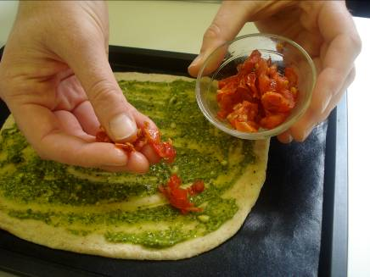
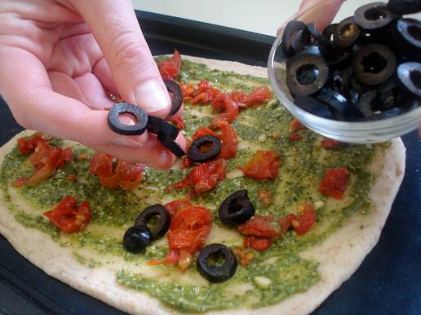
Arrange the tomato and olives on top of the pizza.

Slide 16
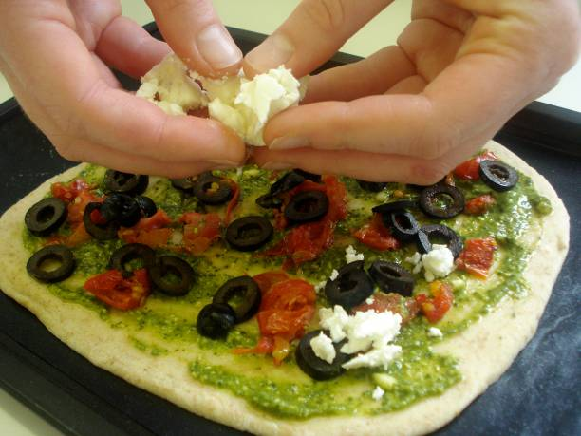
Crumble the feta cheese on top.

Slide 17
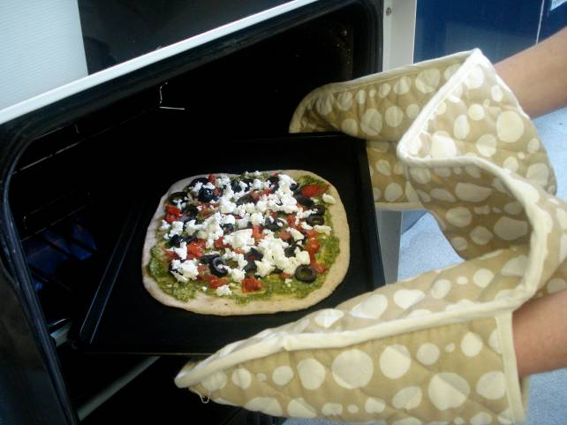
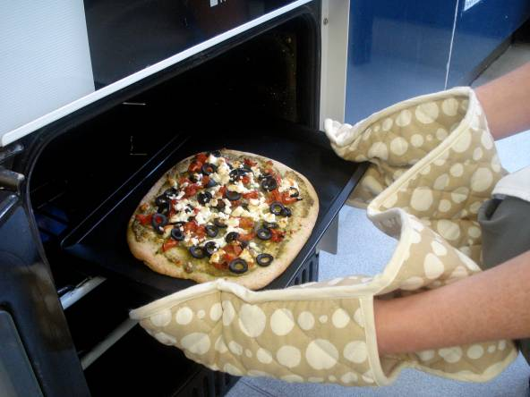
Bake for 10 - 15 minutes.

Slide 18
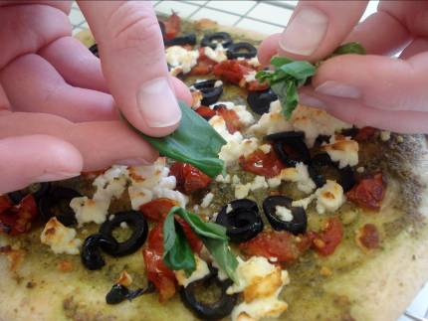
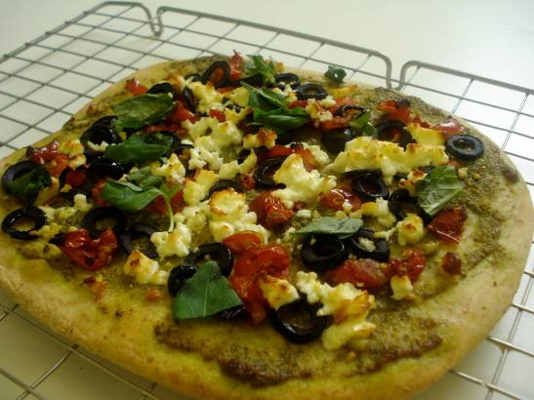
Place the pizza on the cooling rack and roughly tear the basil leaves and sprinkle over the pizza.

Slide 19
Top tips
Food skills
Slice.
Decorate and garnish.
Bake.
Use different types of flour for the base such as wholemeal or maize.
Vary the toppings on the pizza.
Serve with a salad.
Weigh.
Measure.
Sift.
Stir and combine.
Knead.
Prove.
Roll out.
Form and shape.

Slide 20
Pesto pizza
For further information, go to:
www.foodafactoflife.org.uk

