Slide 1
Savoury pancakes
Complexity: medium

Slide 2
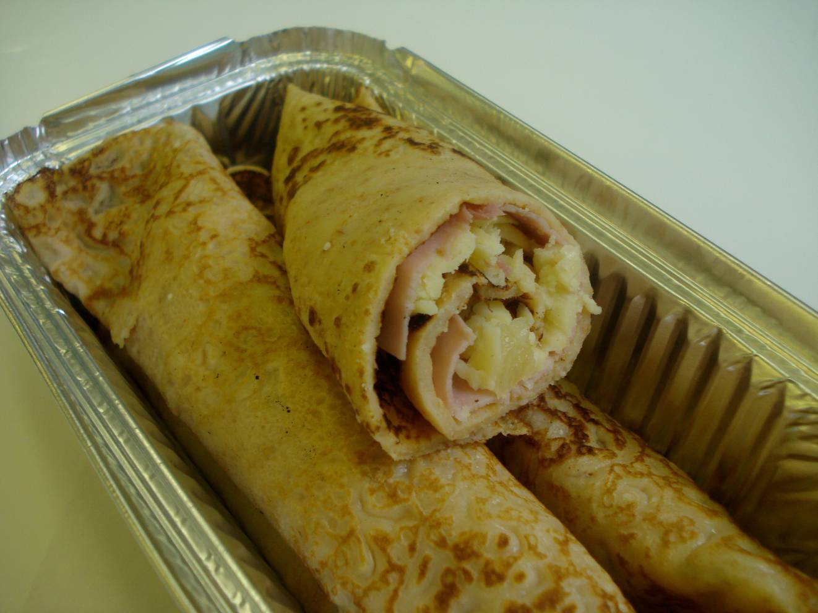

Slide 3
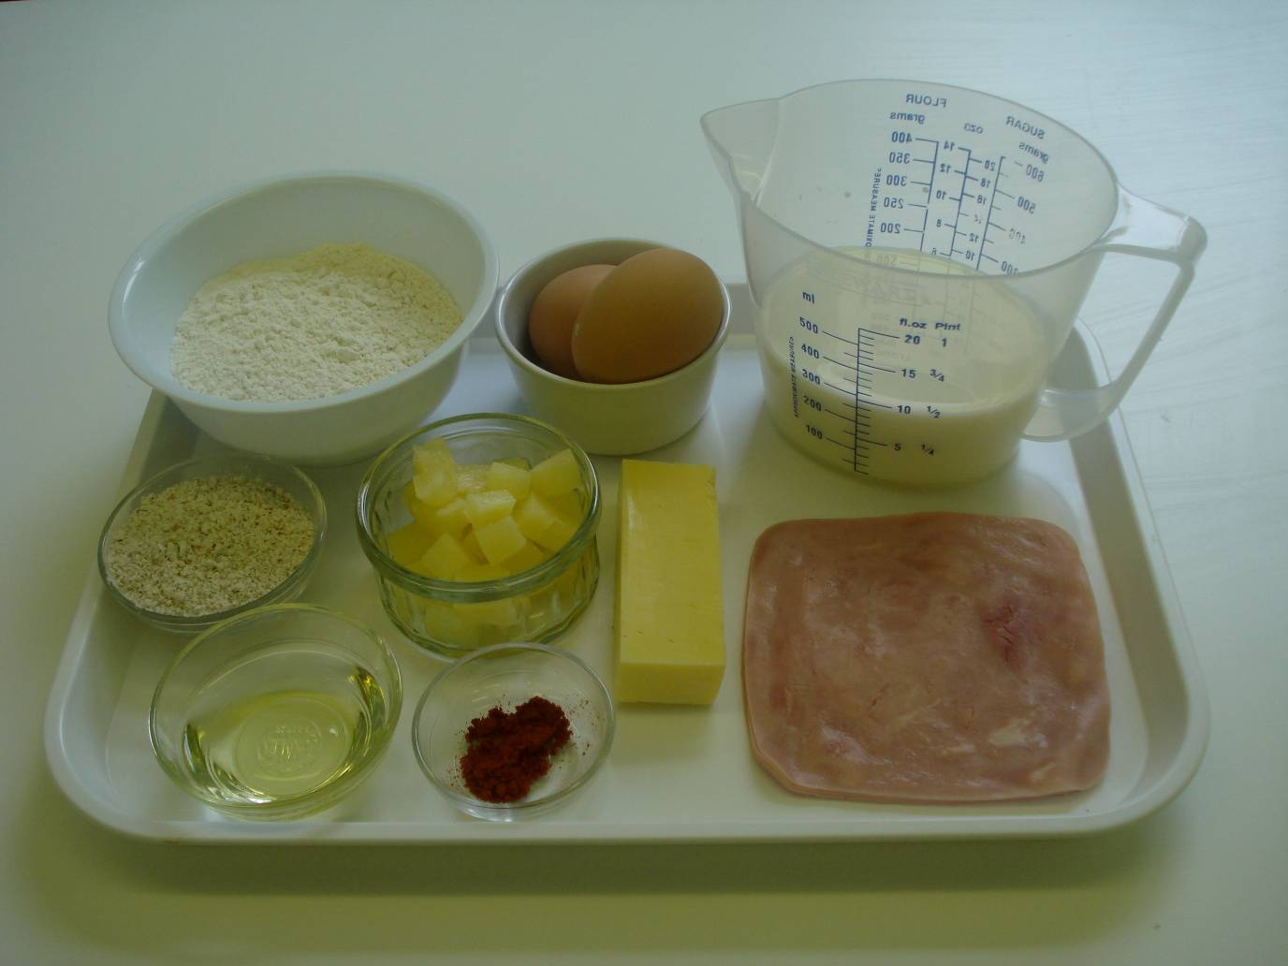
Ingredients
100g white plain flour
25g wholemeal plain flour
2 eggs (medium)
275ml semi skimmed milk
Pinch paprika powder
Oil for frying
6-8 pieces of ham
60g canned pineapple pieces - drained
60g cheddar cheese

Slide 4
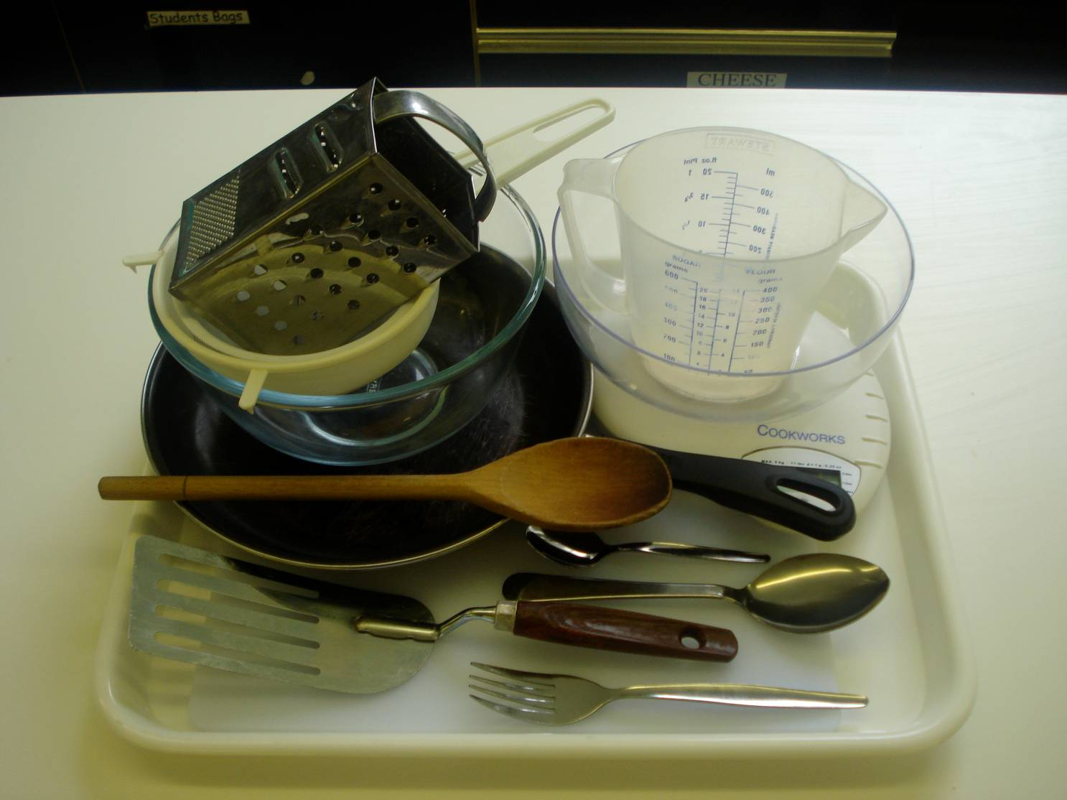
Equipment
Weighing scales
Grater
Chopping board
Sieve
Mixing bowl
Small bowl
Fork
Wooden spoon
Measuring jug
Frying pan
15ml spoon
Fish slice
Large metal spoon

Slide 5
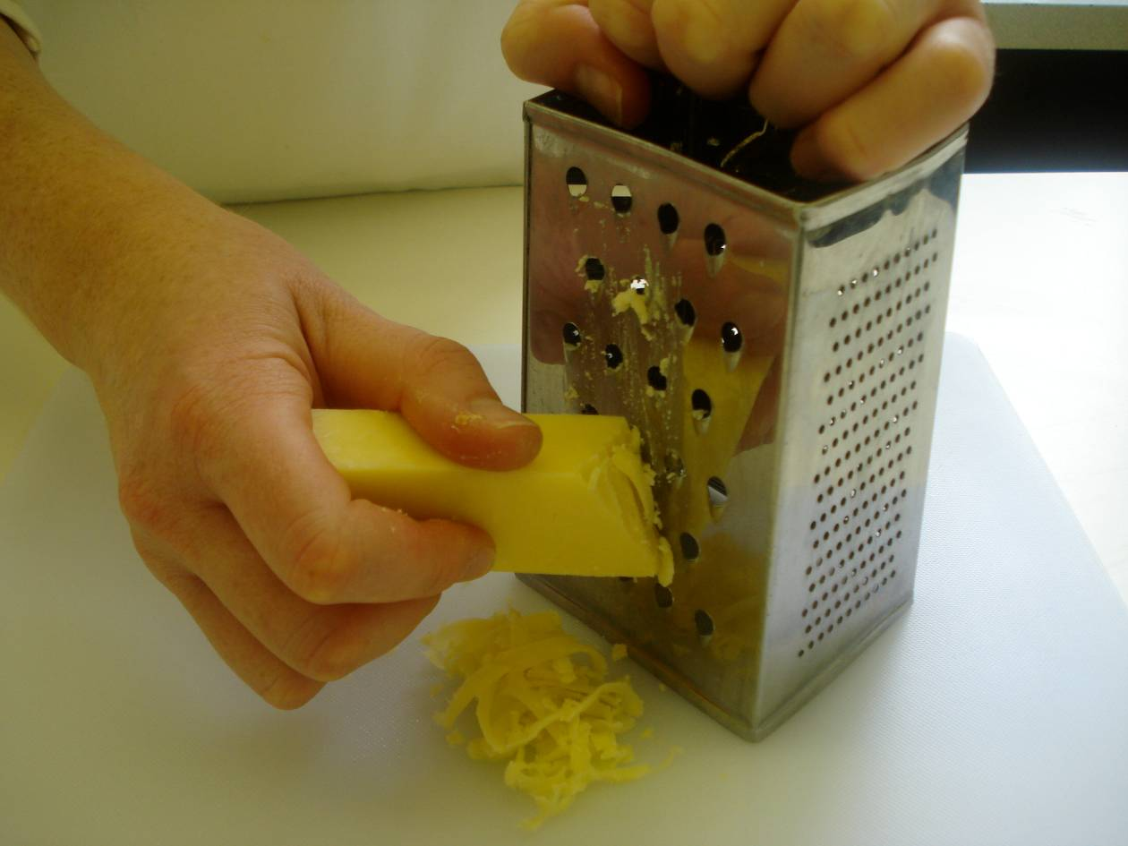
Method
Grate the cheese.

Slide 6
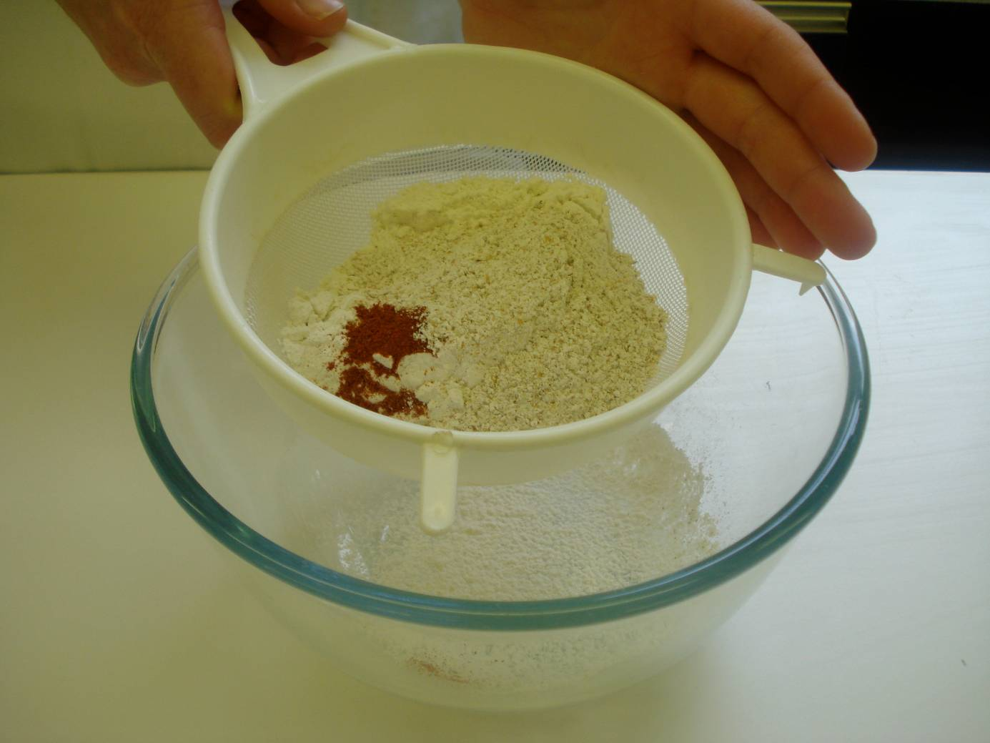
Sift the flours and paprika into the mixing bowl.

Slide 7
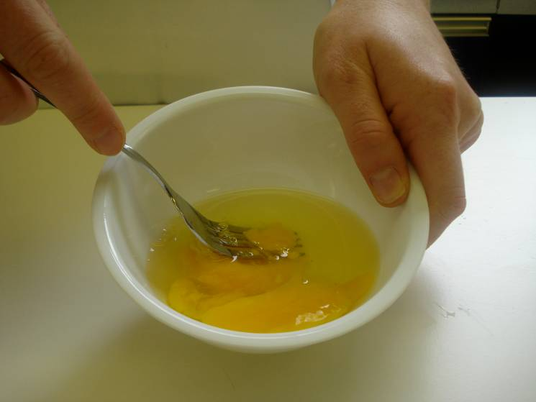
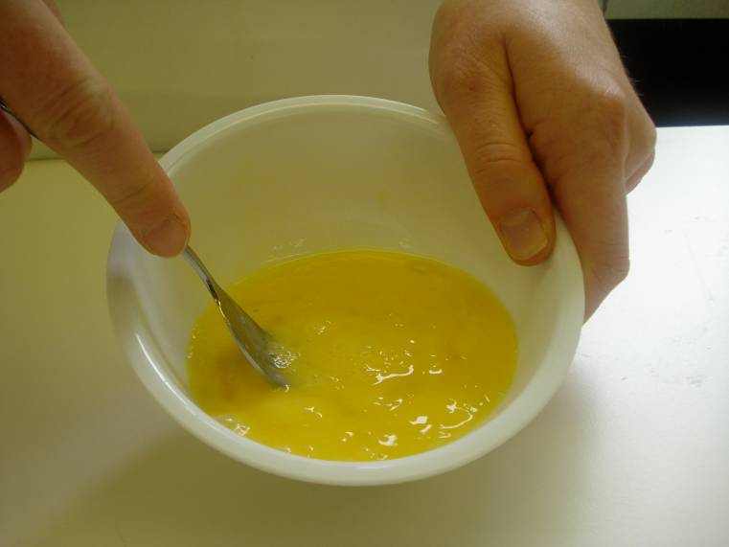
Break the eggs into the separate bowl and beat with the fork.

Slide 8
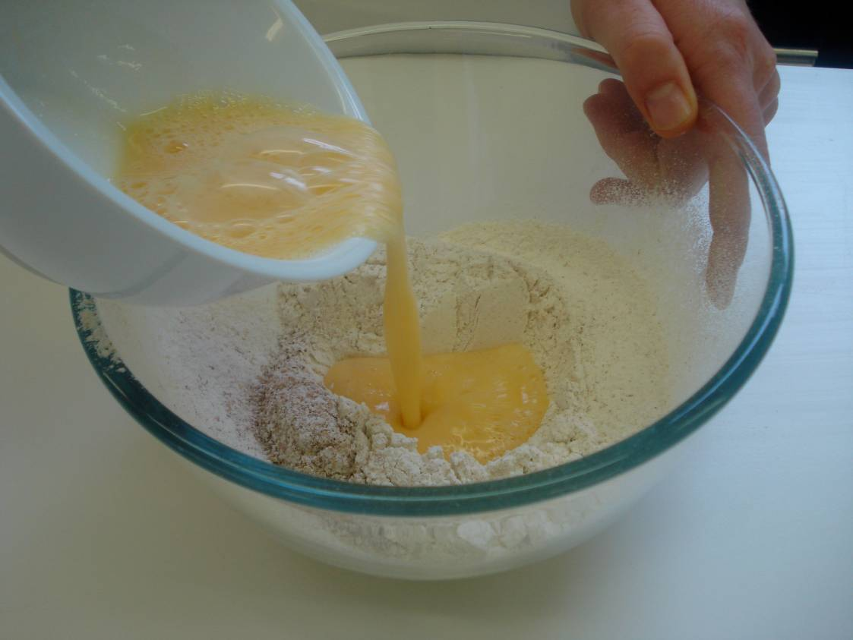
Make a well in the flour and add the eggs, mixing with the wooden spoon.

Slide 9
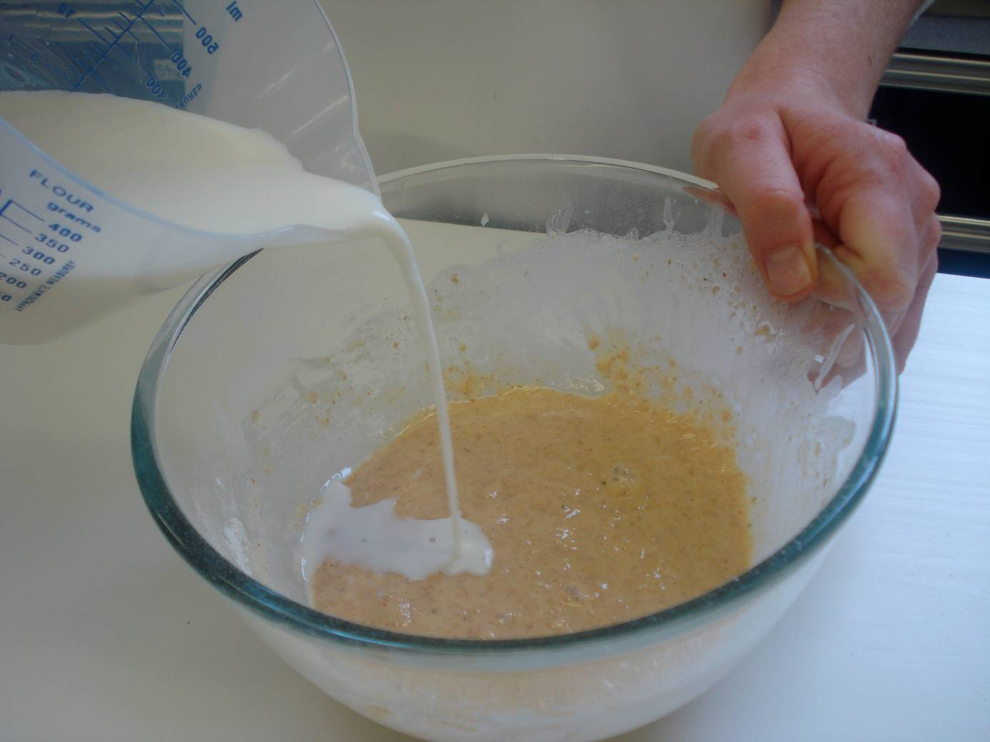
Gradually add the milk, mixing well to remove any lumps.

Slide 10
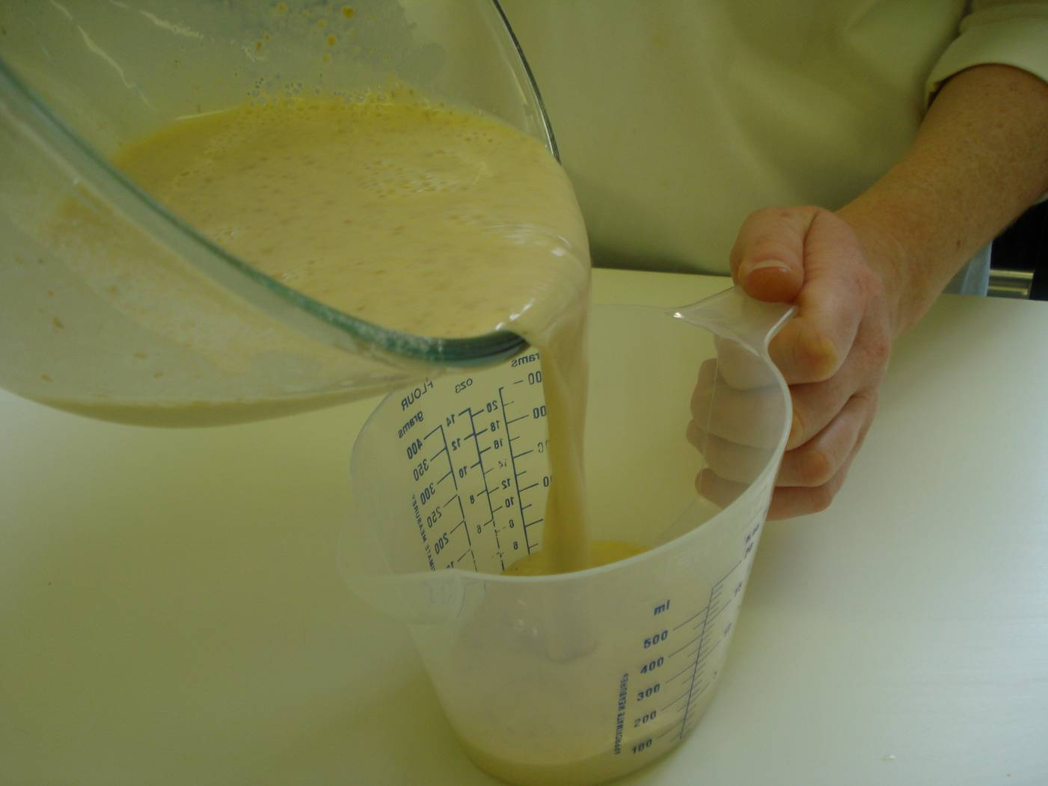
Pour the mixture into the measuring jug.

Slide 11
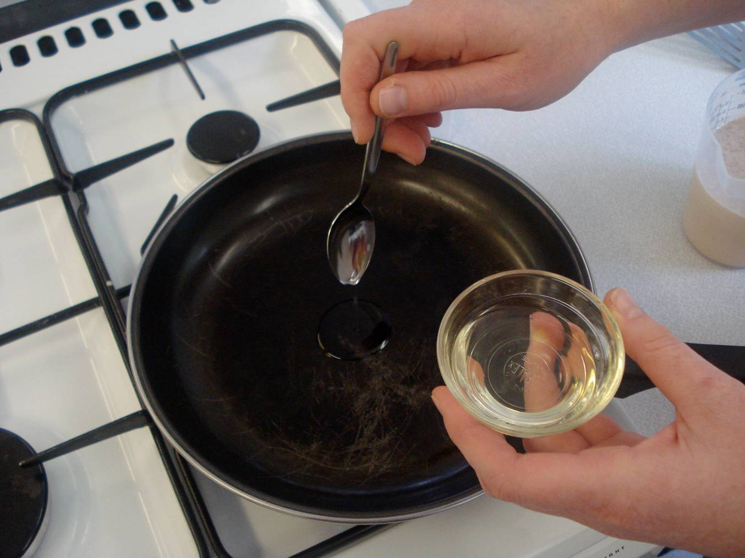
Add a little oil to the frying pan on a medium heat.

Slide 12
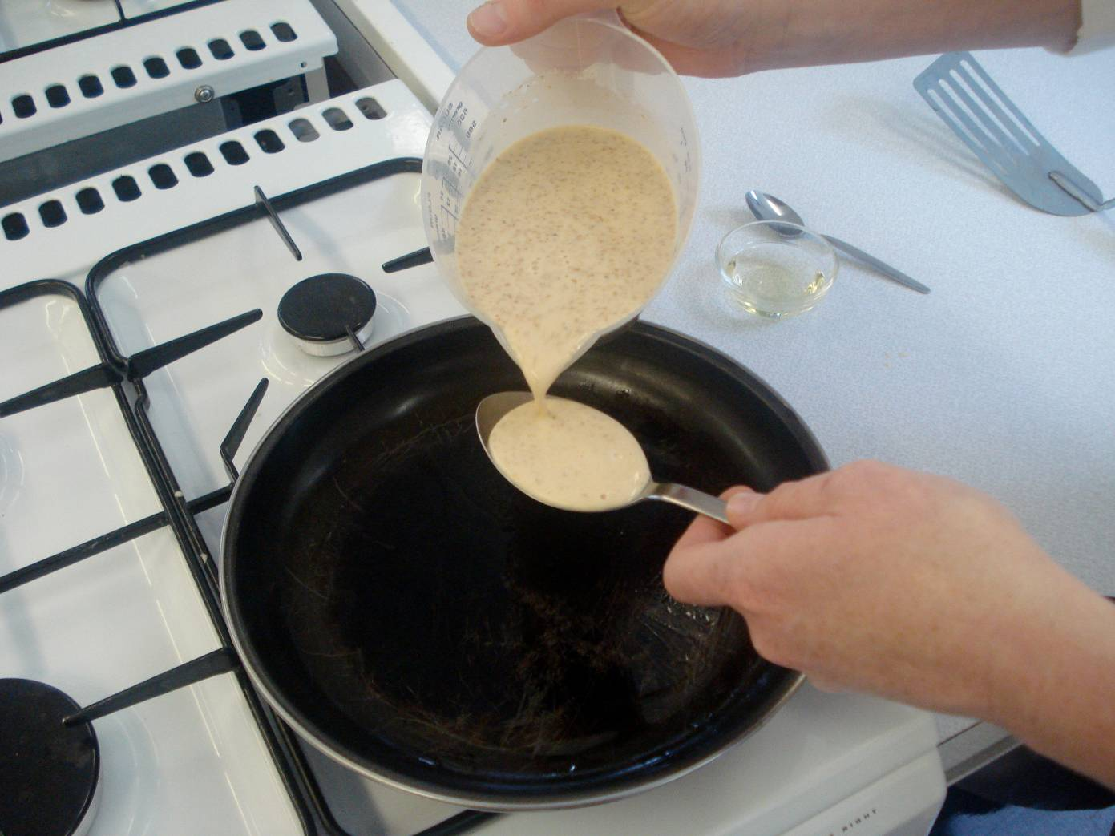
Pour three 15ml spoons of the mixture in the centre of the frying pan.

Slide 13
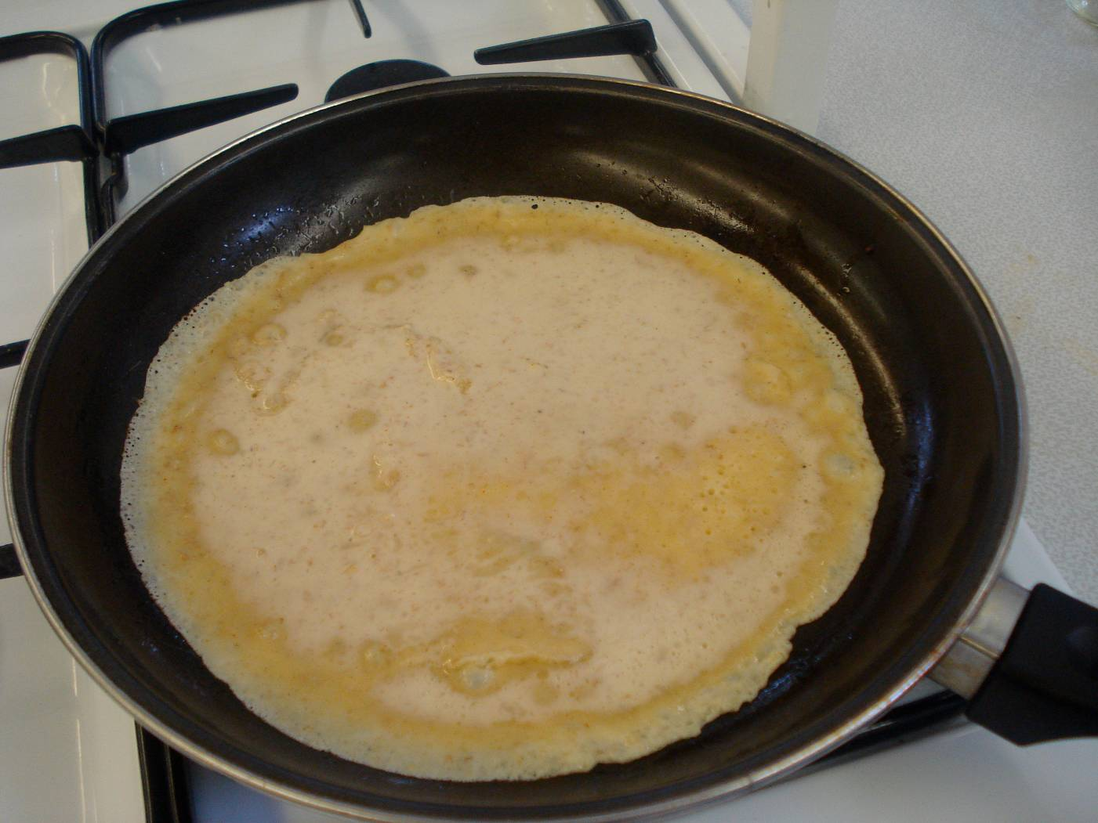
Cook until bubbles appear on the surface and then turn using the fish slice.

Slide 14
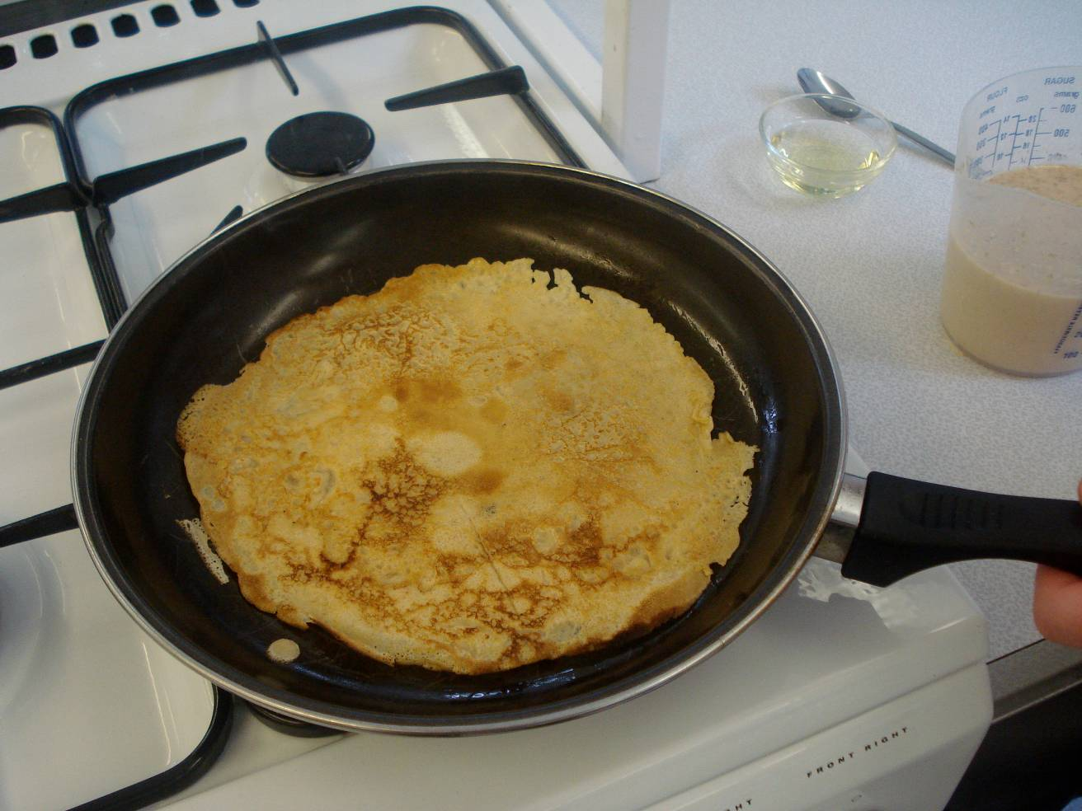
Cook the underside of the pancake for one minute or until golden brown.

Slide 15
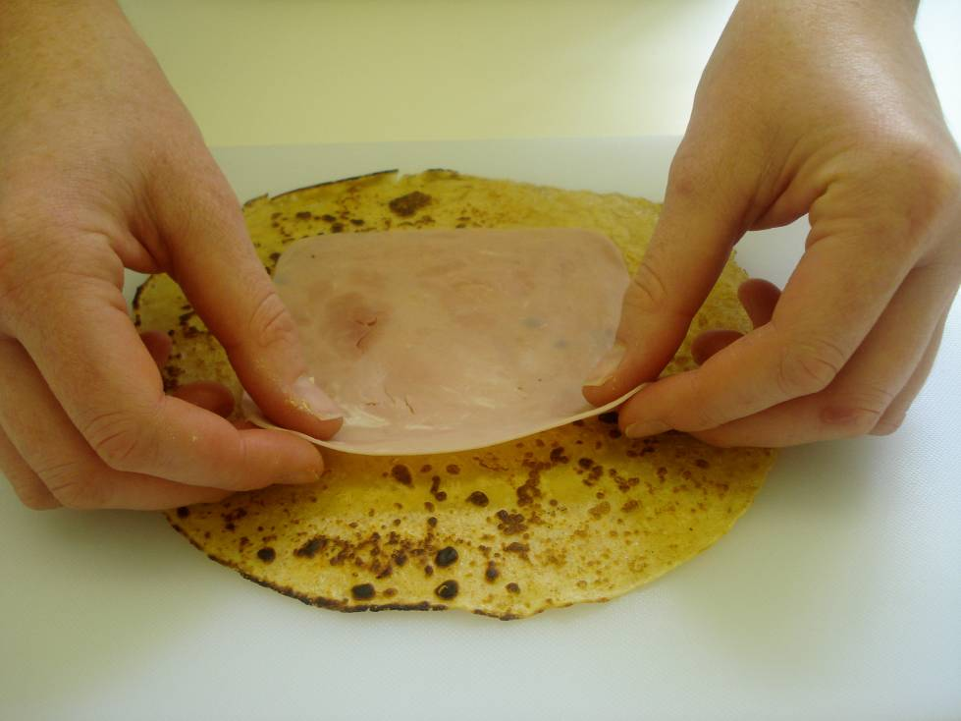
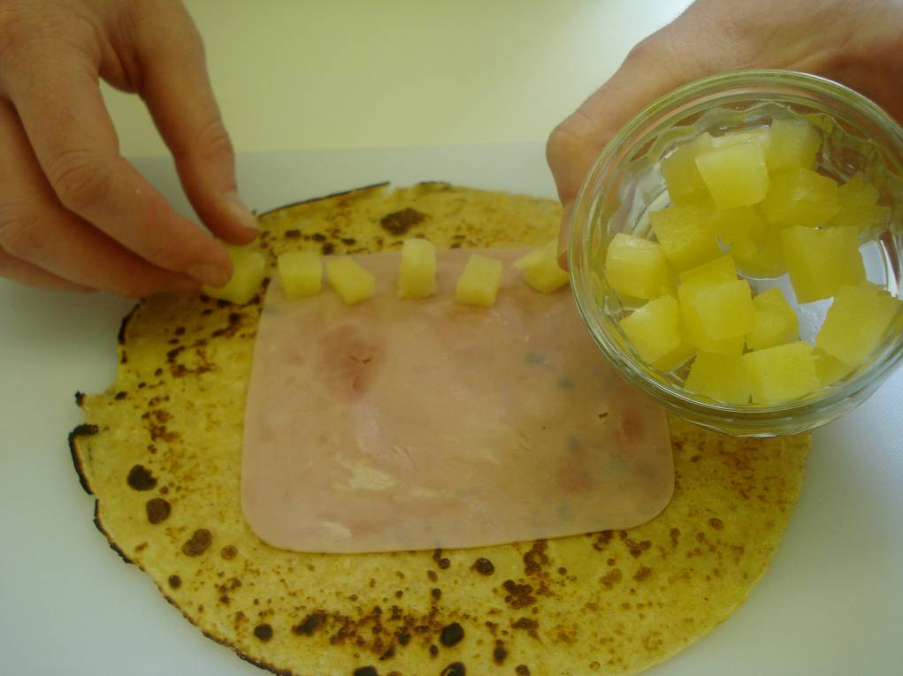
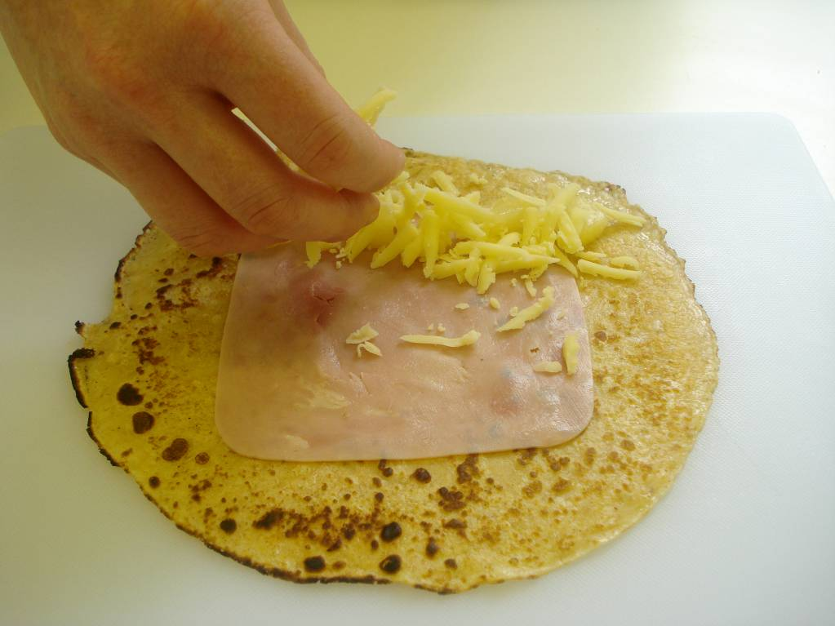
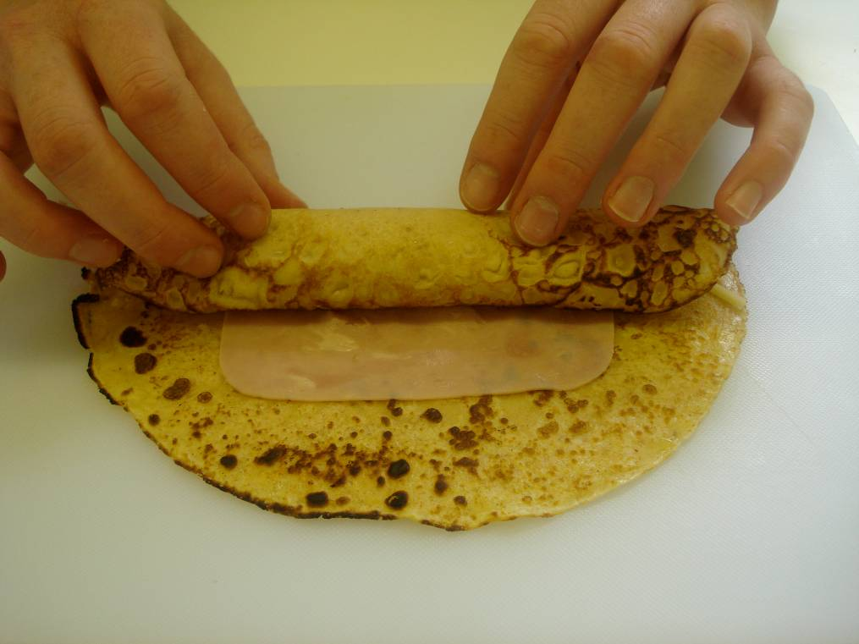
Roll up pancakes with the ham, pineapple and cheese.

Slide 16
Top tips
Food skills
Transfer the pancake batter to a jug or use a ladle to reduce the spills as the mixture is placed into the frying pan.
Stack the pancakes as you make them between sheets of greaseproof paper on a plate kept in a warm place.
Different herbs, spices or fillings can be added to the pancake recipe for a different taste.
Weigh.
Measure.
Sift.
Beat.
Mix, stir and combine.
Fry.
Grate.

Slide 17
Savoury pancakes
For further information, go to:
www.foodafactoflife.org.uk

