Slide 1
Principles of home food preservation

Slide 2
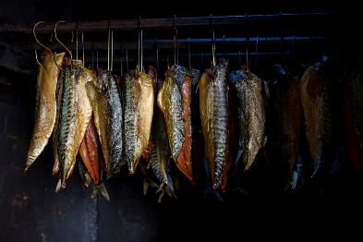
Traditional methods of preservation
Traditional methods of food preservation began from the essential need to store supplies when they were plentiful and to keep the food fresh for as long as possible to last through the winter months.
Although food preservation has been in use for thousands of years, it is only in the last two centuries that many of the ‘new’ food processing techniques have been developed.

Slide 3
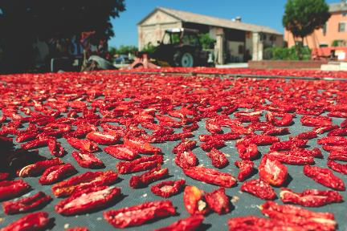
Principles of food preservation
The principles underlying methods of preservation used in the past are still the same as today.
The aim of preservation is to prevent food spoilage as a result of growth of micro-organisms and breakdown of food by enzymes.
This prevents food waste.

Slide 4
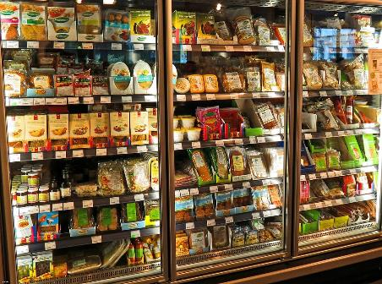
Food preservation and food waste
Preservation prevents food waste by extending the shelf life of perishable items, allowing them to be consumed long after they would otherwise spoil.
Methods such as canning, freezing, and drying inhibit the growth of bacteria and other microorganisms that cause food to deteriorate.
By maintaining the nutritional value and edibility of food for longer periods, preservation techniques reduce the likelihood of discarding food, thereby minimising waste and improving food security.

Slide 5
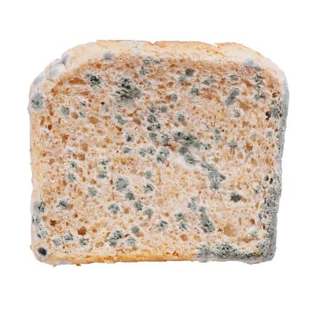
Food spoilage
As soon as food is harvested, slaughtered or manufactured into a product it starts to change. This is caused by two main processes:
autolysis – self destruction, caused by enzymes present in the food;
microbial spoilage – caused by the growth of bacteria, yeasts and moulds.

Slide 6
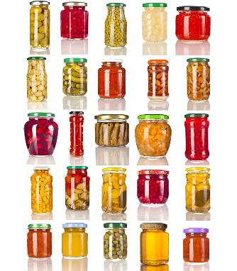
Factors that promote enzymes and microbial activity
Micro-organisms and enzymes need certain conditions to survive and reproduce.
These include:
temperature;
oxygen;
food;
time;
moisture;
pH level.

Slide 7
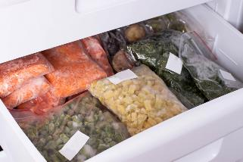
Principles of food preservation
Some of the factors affecting the growth of micro - organisms can be manipulated in different ways to prolong the life of the food product.
Temperature
Chilling or freezing the food to retard growth of micro-organisms and inhibit enzyme activity. Alternatively, heating the food to destroy micro-organisms and prevent enzyme activity.
Oxygen
Food kept in an airtight container will deprive micro-organisms of oxygen and prevent contamination.

Slide 8
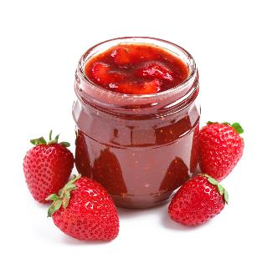
Principles of food preservation
Moisture
Reducing the moisture content of the food to make water, (which is essential for growth), unavailable to micro-organisms. Alternatively, placing food in a sugary solution will make water unavailable for the growth of micro-organisms.
pH level
Placing food in an acidic or alkaline solution will inhibit the growth of micro-organisms.

Slide 9

Methods of food preservation - Chilling
Over the past 50 years chilling and freezing has become the most popular domestic method of preserving food. This is mainly due to wider ownership of domestic refrigerators and freezers and developments in technology, rather than the discovery of new preservation principles.
Chilling reduces the temperature to between 1ºC -4ºC. Chilling food cannot preserve a food indefinitely but can reduce spoilage caused by micro-organisms and enzymes. Moulds can still grow in cold temperatures.

Slide 10
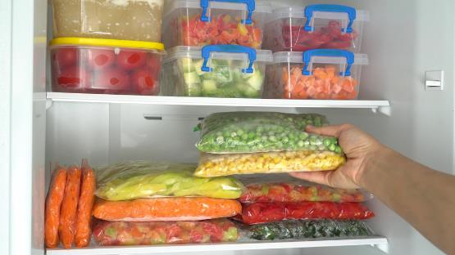
Methods of food preservation - Freezing
Reducing the temperature of the food to below – 18ºC reduces the activity of the micro-organisms and enzymes.
Freezing also reduces the availability of water because ice crystals are formed.
In China, freezing has been a method of preservation for hundreds of years, dating back to 1800 _{BC}.

Slide 11
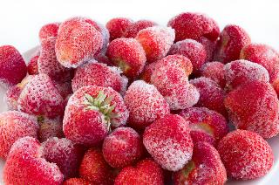
Disadvantages of freezing
Most food contains large amounts of water. When water is frozen, ice is formed. Large ice crystals are formed when food is slowly frozen, this can damage the cell structure of the food.
When the food defrosts, the water enclosed within the cells is released, e.g. cell damage in soft fruits (strawberries) and the collapse of some colloidal systems in food products, e.g. cream. Freezing food quickly can reduce the size of ice crystals.
When frozen, micro-organisms do not die, they simply become dormant, retarding their growth.

Slide 12
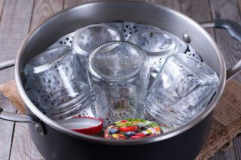
Methods of food preservation - Sugar preserves
The initial boiling of the fruit will destroy the enzymes and micro-organisms (but not spores), preventing spoilage later on.
The high concentration of sugar added during the jam making process makes the water unavailable thus reducing the microbial activity through dehydration effect.
Jam jars are normally heated before the jam is added which destroys the micro-organisms found in the jars.

Slide 13
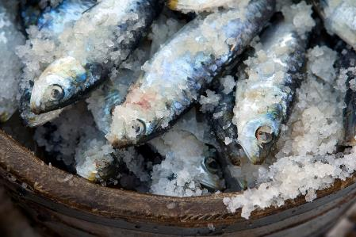
Methods of food preservation - Salting
Coating food in salt or placing it in a salt solution (brine) reduces the moisture content of the food, i.e. reduces the availability of water.
With little moisture, micro-organism growth is retarded.
However, the taste of the food may change considerably.

Slide 14
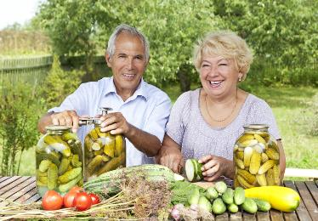
Methods of food preservation - Pickling
The initial boiling of the ingredients will destroy enzymes and micro-organisms (but not spores), preventing spoilage later on.
Vegetables and fruits are covered in vinegar and other ingredients, often including spices. The high concentration of acid inhibits bacterial growth and multiplication. The acidic nature of the solution prevents growth of micro-organisms.
Pickle/or chutney jars are normally heated before the product is added to destroy micro-organisms found in the jars.

Slide 15
Principles of home food preservation
For further information, go to:
www.foodafactoflife.org.uk
This resource meets the Guidelines for producers and users of school education resources about food.

