Slide 1

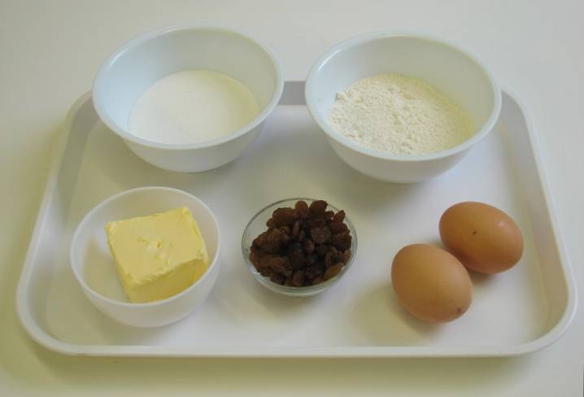
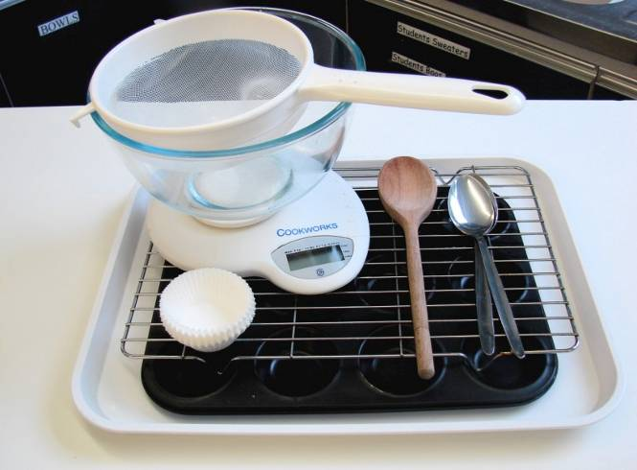
This recipe is from the original Licence to Cook programme and is provided under the Open Government Licence.
Mini fruit cakes
Ingredients
100g self raising flour
100g caster sugar
100g butter or soft baking spread
2 eggs
50g dried fruit, e.g. sultanas
Equipment
12 cake cases
Cake tin
Weighing scales
Sieve
Mixing bowl
Wooden spoon
2 spoons
Cooling rack
© Food – a fact of life 2019
www.foodafactoflife.org.uk

Slide 2
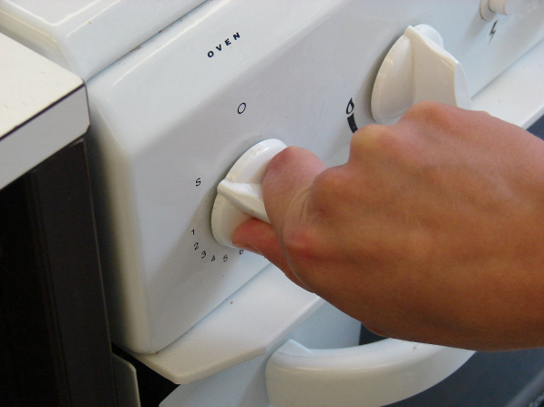
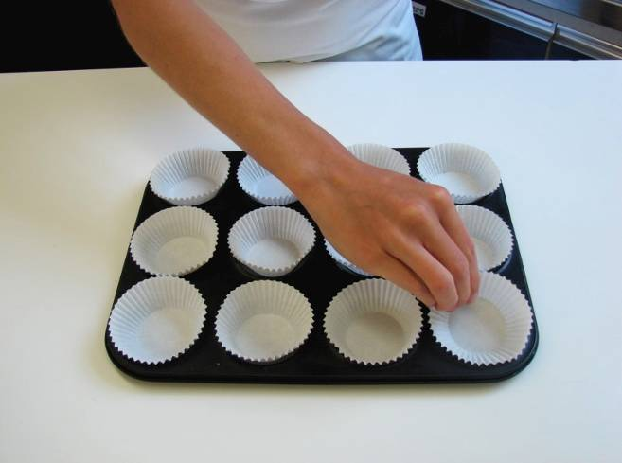
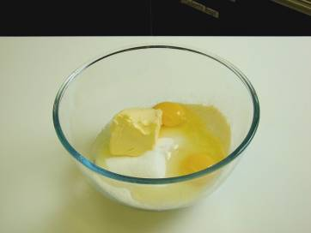
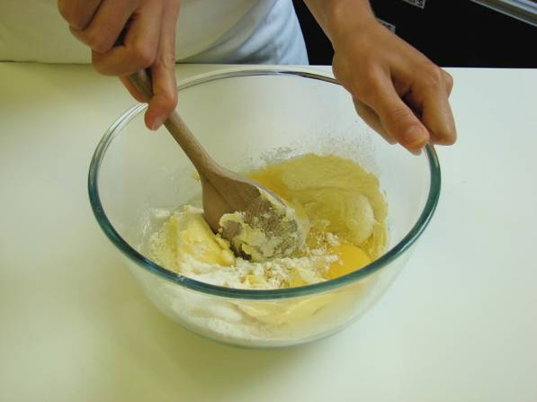
This recipe is from the original Licence to Cook programme and is provided under the Open Government Licence.
Method
Preheat oven to 200°C or gas mark 6.
Place the cake cases in the cake tin.
Sieve the flour into the mixing bowl and then add all the other ingredients.
Mix everything together until light and fluffy.
© Food – a fact of life 2019
www.foodafactoflife.org.uk

Slide 3
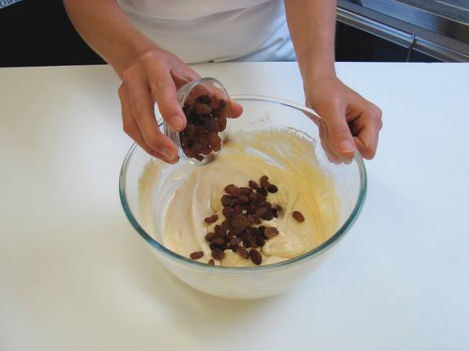
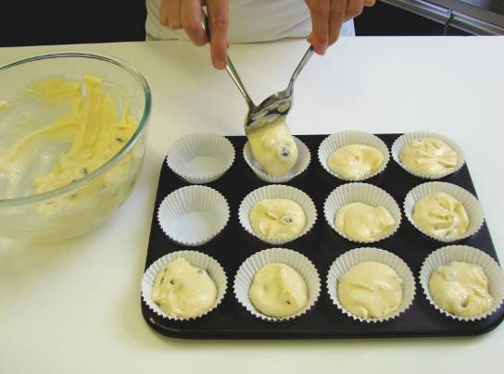
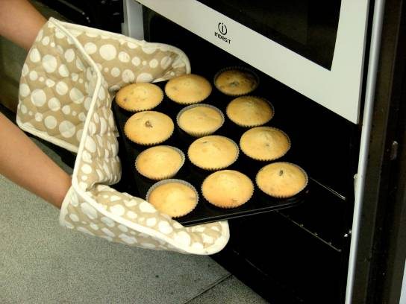
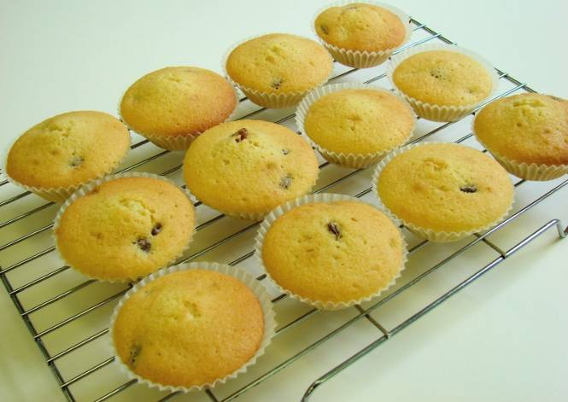
This recipe is from the original Licence to Cook programme and is provided under the Open Government Licence.
Method
Stir in the dried fruit.
Divide the mixture equally between the cake cases using 2 spoons.
Bake for 15-20 minutes, until golden.
Allow to cool on a cooling rack.
© Food – a fact of life 2019
www.foodafactoflife.org.uk

