Slide 1

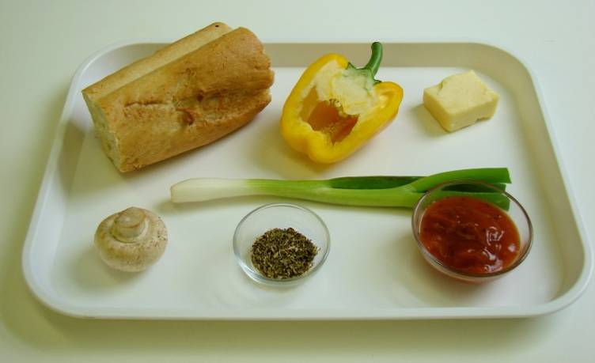
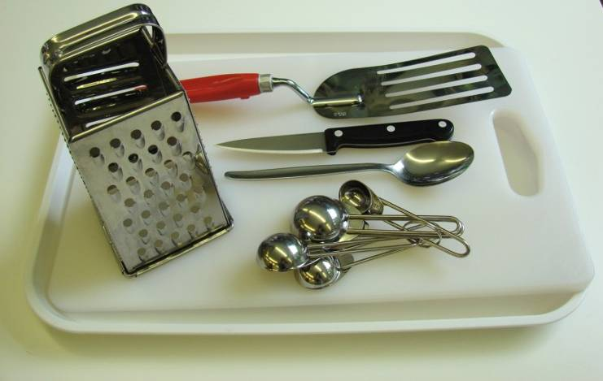
This recipe is from the original Licence to Cook programme and is provided under the Open Government Licence.
Pizza toast
Ingredients
½ yellow pepper
1 spring onion 1 mushroom 30g hard cheese, e.g. Cheddar, Edam, Gruyere
2 slices bread (or a bagel or a piece of French stick sliced in half)
2 x 15ml spoons tomato pizza sauce
½ x 5ml spoon mixed herbs
Equipment
Chopping board
Knife
Grater
Fish slice
Measuring spoons
Spoon
© Food – a fact of life 2019
www.foodafactoflife.org.uk

Slide 2
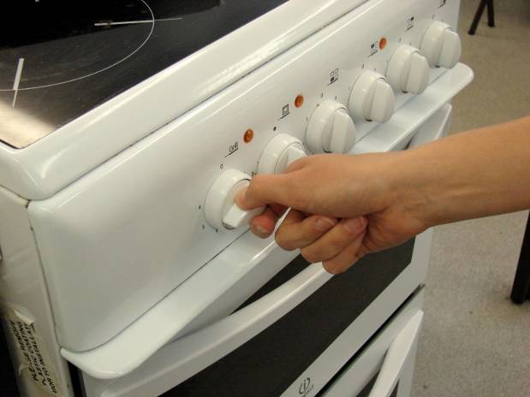
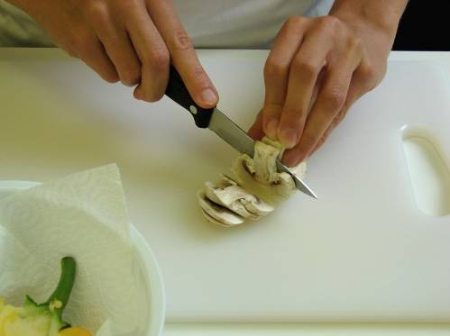
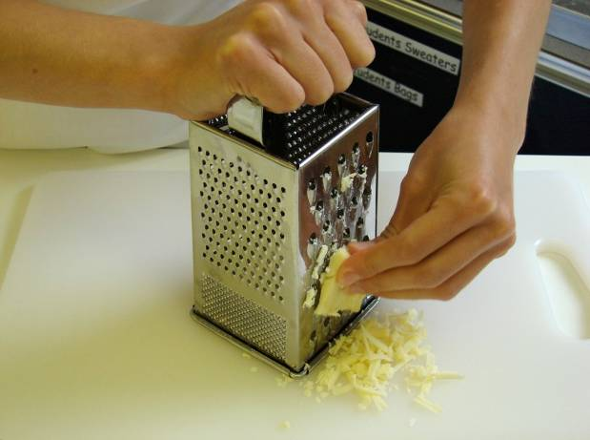
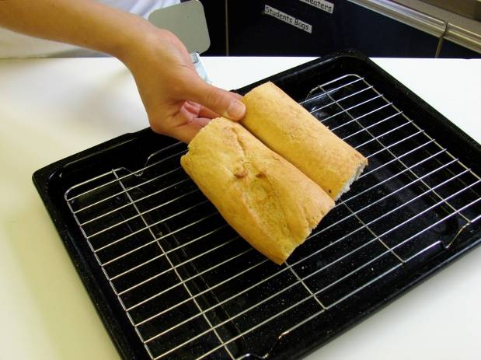
This recipe is from the original Licence to Cook programme and is provided under the Open Government Licence.
Method
Preheat the grill.
Slice the pepper, spring onion and mushroom.
Grate the cheese.
Place the bread under the grill and toast one side.
© Food – a fact of life 2019
www.foodafactoflife.org.uk

Slide 3
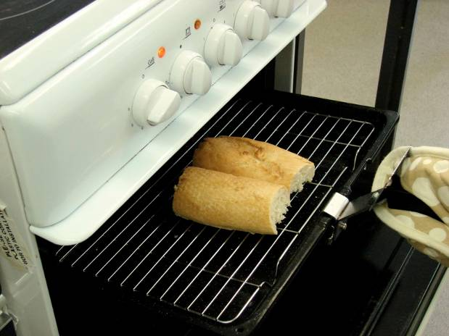
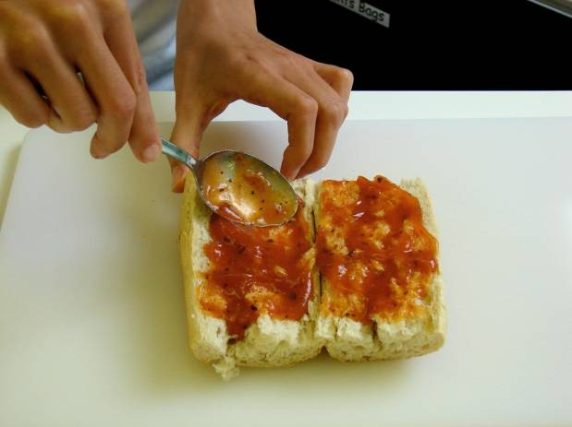
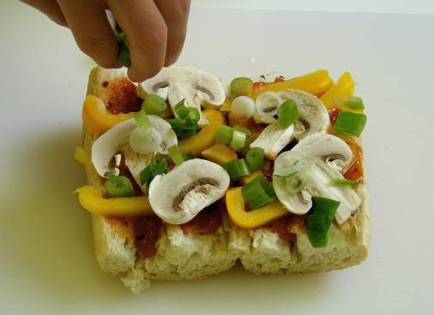
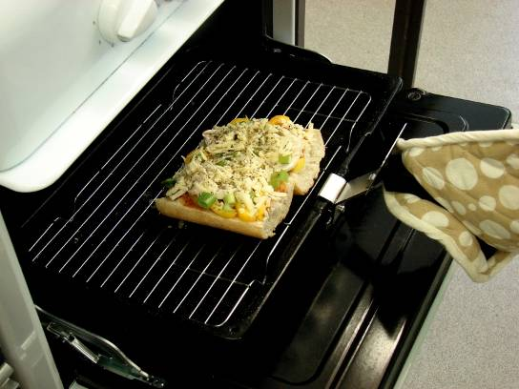
This recipe is from the original Licence to Cook programme and is provided under the Open Government Licence.
Method
Remove the bread from the grill and place on the chopping board uncooked side-up.
Spread the tomato sauce over the bread using the back of the spoon.
Arrange the pepper, mushroom and onion over the slices.
Place under the grill until the cheese bubbles.
© Food – a fact of life 2019
www.foodafactoflife.org.uk

