Slide 1

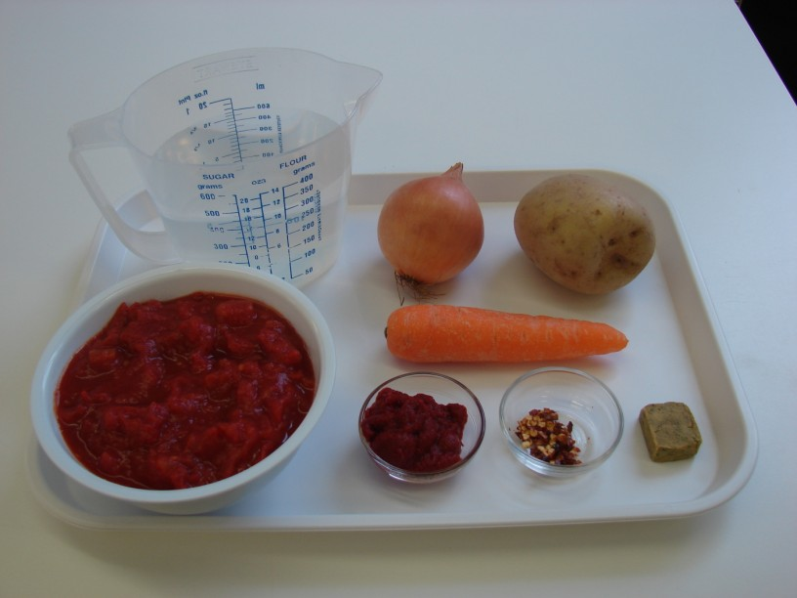
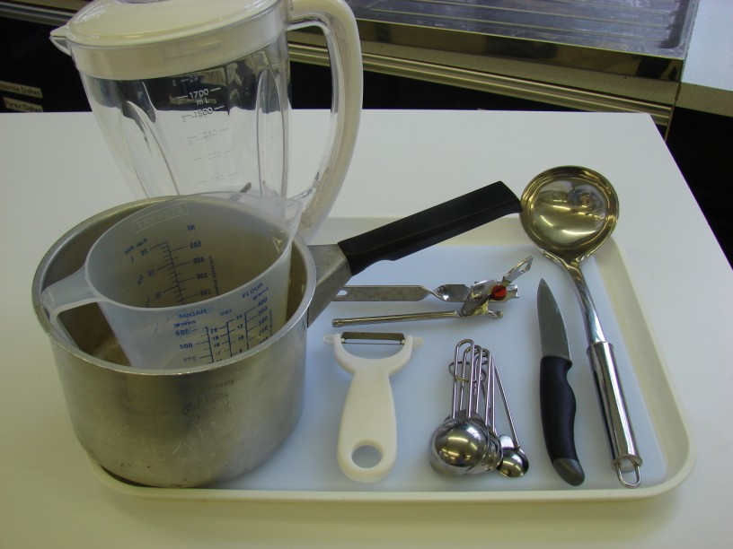
This recipe is from the original Licence to Cook programme and is provided under the Open Government Licence.
Spicy tomato soup
Ingredients
1 onion
1 carrot
1 potato
1 x can chopped tomatoes (400g)
500ml water
1 stock cube
1/2 x 5ml spoon dried chilli flakes
1 x 15ml spoon tomato puree
Equipment
Chopping board
Knife
Vegetable peeler
Saucepan
Can opener
Measuring spoons
Wooden spoon
Liquidiser/blender
Ladle
© Food – a fact of life 2019
www.foodafactoflife.org.uk

Slide 2
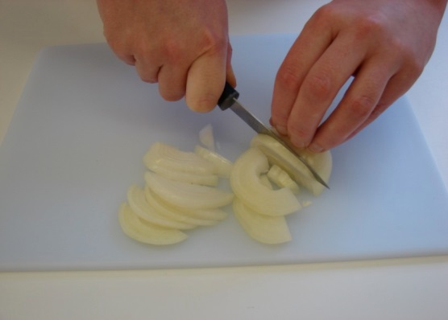
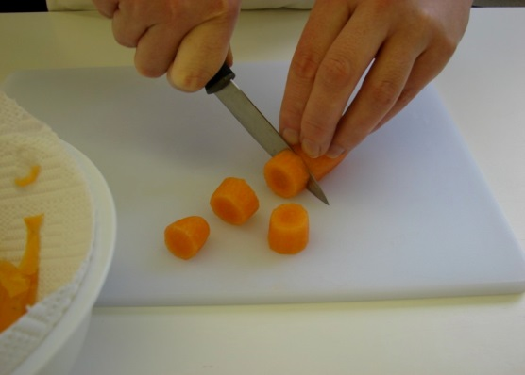
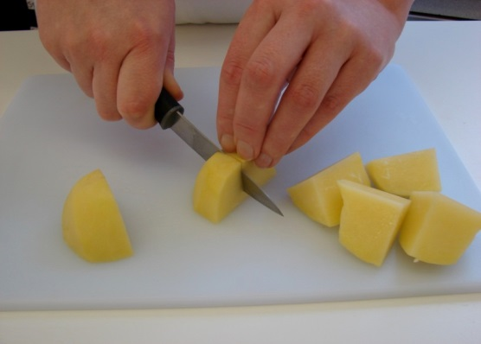
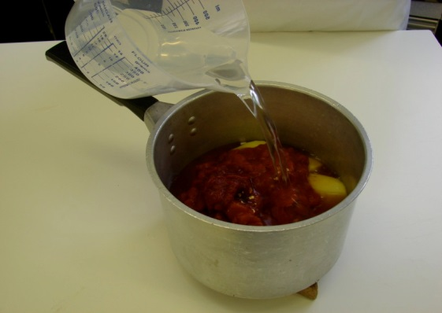
This recipe is from the original Licence to Cook programme and is provided under the Open Government Licence.
Method
Prepare the vegetables and bacon:
  peel and slice the onion;
  top and tail, peel and slice the carrot;
  peel and cut the potato into 8.
Put all the ingredients into a saucepan.
© Food – a fact of life 2019
www.foodafactoflife.org.uk

Slide 3
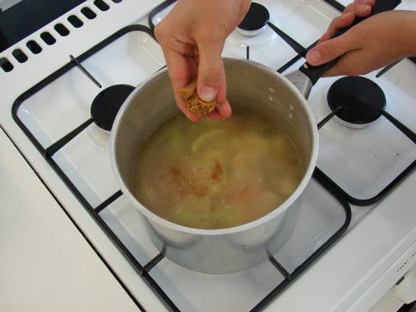
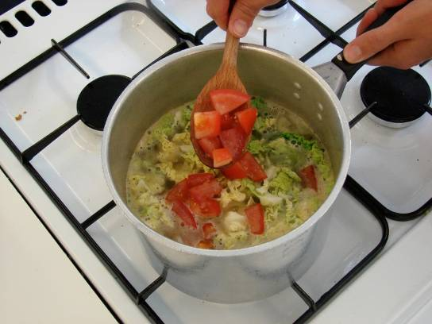
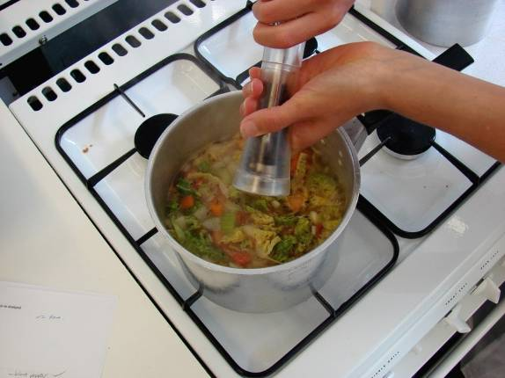
This recipe is from the original Licence to Cook programme and is provided under the Open Government Licence.
Method
Stir everything together, bring to the boil and then simmer for 20 minutes.
Ladle the mixture into a liquidiser and blend until smooth.
Serve.
© Food – a fact of life 2019
www.foodafactoflife.org.uk

