Slide 1

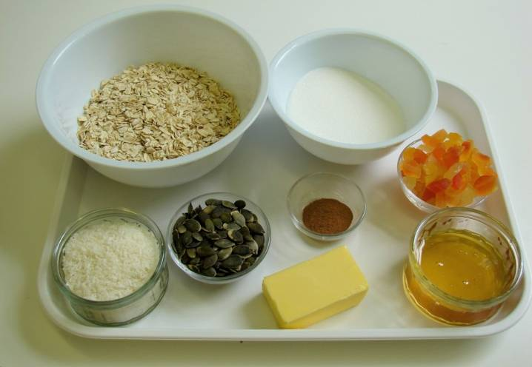
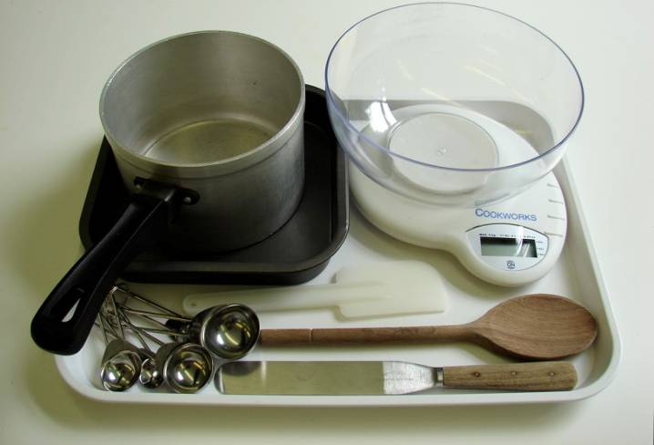
This recipe is from the original Licence to Cook programme and is provided under the Open Government Licence.
Tropical granola bars
Ingredients
50g butter or soft spread
2 x 15ml spoon honey
100g sugar
150g jumbo oats
1x 5ml spoon cinnamon
40g pumpkin seeds
40g desiccated coconut
75g tropical dried fruit
Equipment
Weighing scales
Measuring spoons
Saucepan
Wooden spoon
Baking tin
Spatula
Palette knife
© Food – a fact of life 2019
www.foodafactoflife.org.uk

Slide 2
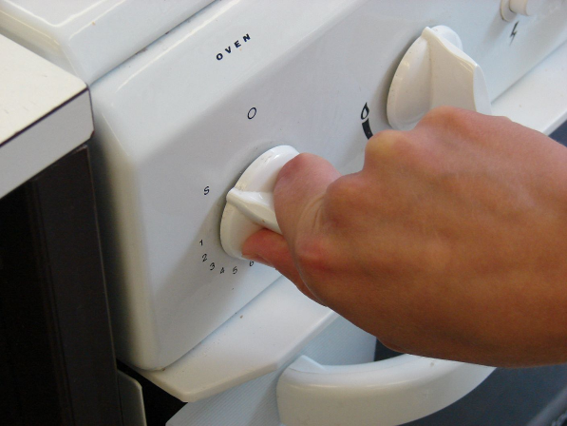
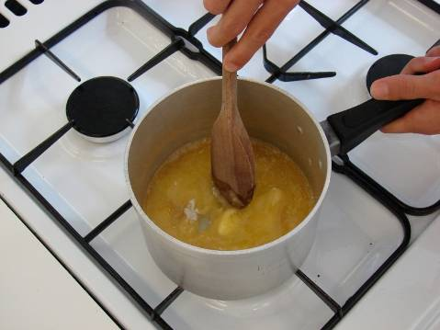
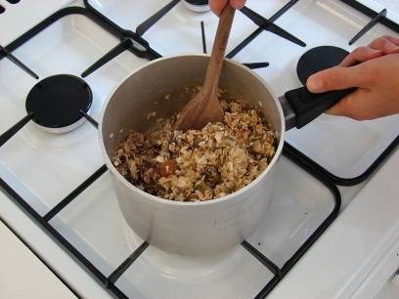
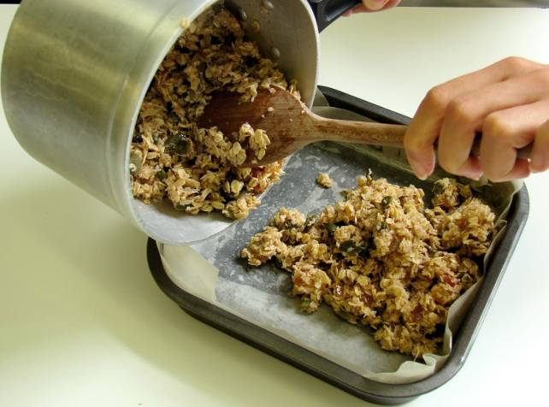
This recipe is from the original Licence to Cook programme and is provided under the Open Government Licence.
Method
Preheat the oven to 180°C or gas mark 4.
Place the fat, sugar and syrup into a saucepan and gently heat until the fat has melted.
Stir in all the other ingredients.
Pour the mixture into a non-stick (or lined) baking tin.
© Food – a fact of life 2019
www.foodafactoflife.org.uk

Slide 3
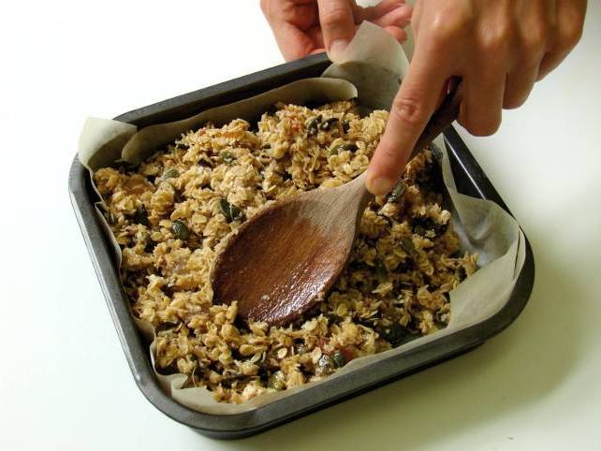
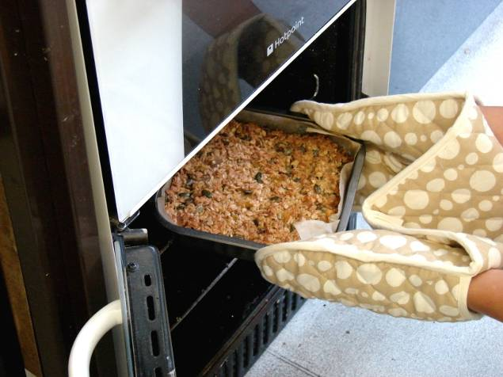
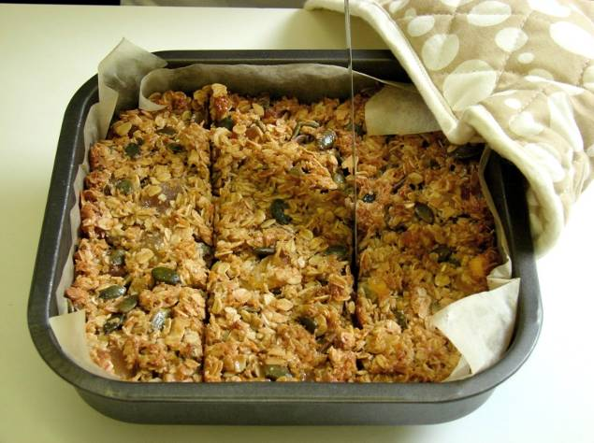
This recipe is from the original Licence to Cook programme and is provided under the Open Government Licence.
Method
Pat down the mixture in the baking tin.
Bake for 20 minutes, until lightly browned.
Remove from the oven and cut into ‘bars’ in the baking tin while hot.
© Food – a fact of life 2019
www.foodafactoflife.org.uk

