Slide 1

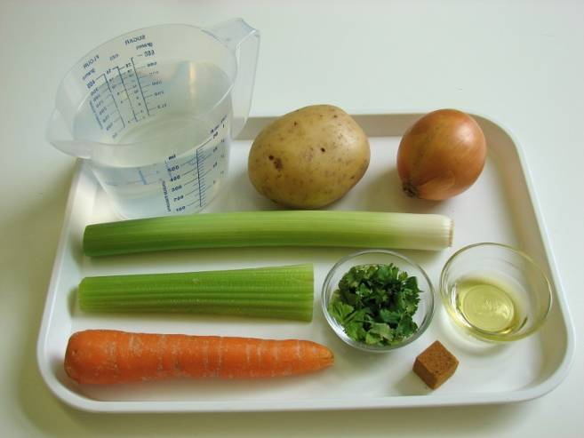
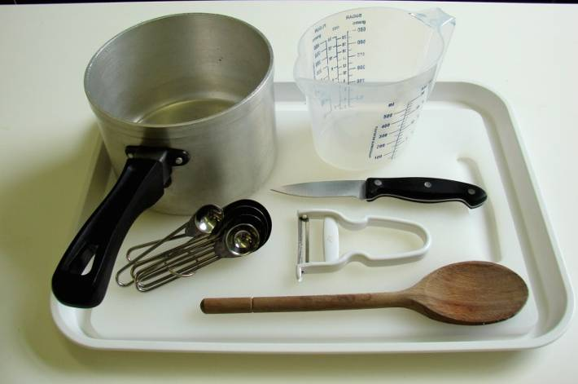
This recipe is from the original Licence to Cook programme and is provided under the Open Government Licence.
Vegetable soup
Ingredients
1 onion
1 carrot
1 leek
1 potato
1 celery stick
1 x 10ml spoon oil
600ml stock (water and stock cube)
1 x 15ml spoon coriander, chopped
Equipment
Chopping board
Knife
Vegetable peeler
Measuring spoons
Saucepan
Measuring jug
© Food – a fact of life 2019
www.foodafactoflife.org.uk

Slide 2
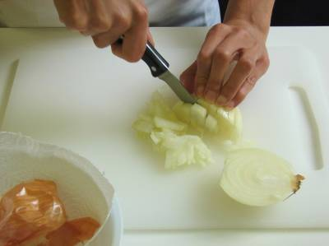
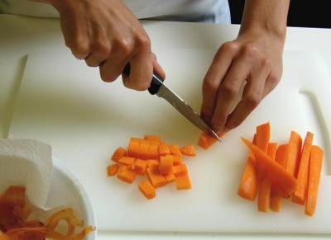
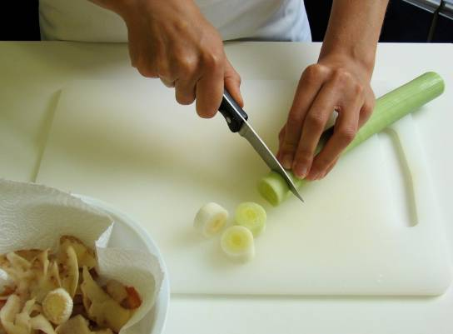
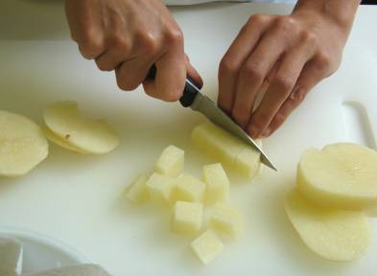
This recipe is from the original Licence to Cook programme and is provided under the Open Government Licence.
Method
Peel and chop the onion.
Top and tail the carrot, then peel and dice.
Top and tail the leek, then slice.
Peel and cube the potato.
© Food – a fact of life 2019
www.foodafactoflife.org.uk

Slide 3
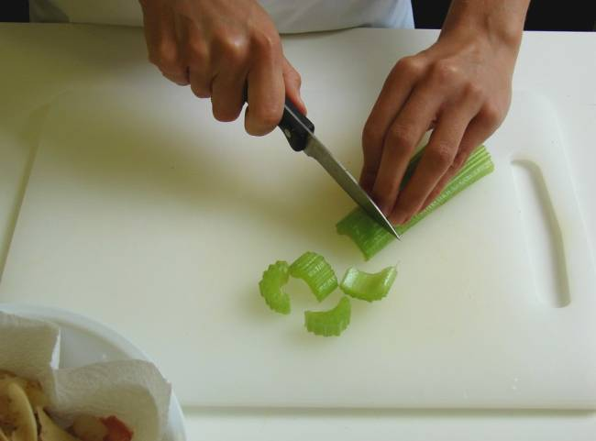
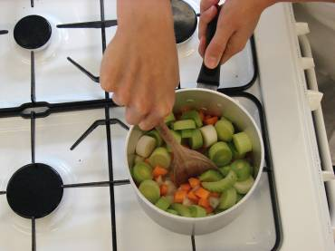
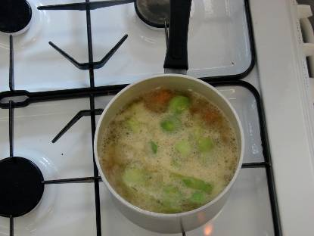
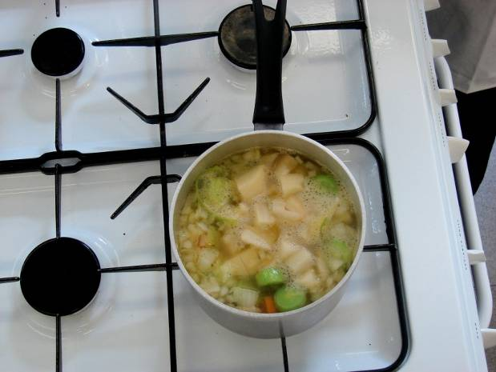
This recipe is from the original Licence to Cook programme and is provided under the Open Government Licence.
Method
Slice the celery.
Heat the oil in a saucepan and fry all the vegetables, except the potatoes, for 5 minutes.
Add the stock to the saucepan and bring to the boil.
Add the potatoes and simmer for 20 minutes.
© Food – a fact of life 2019
www.foodafactoflife.org.uk

Slide 4
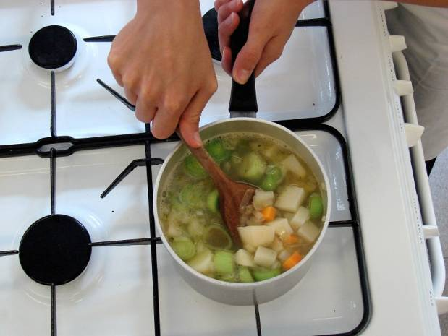
This recipe is from the original Licence to Cook programme and is provided under the Open Government Licence.
Method
Stir in the chopped coriander and serve.
© Food – a fact of life 2019
www.foodafactoflife.org.uk

