Slide 1

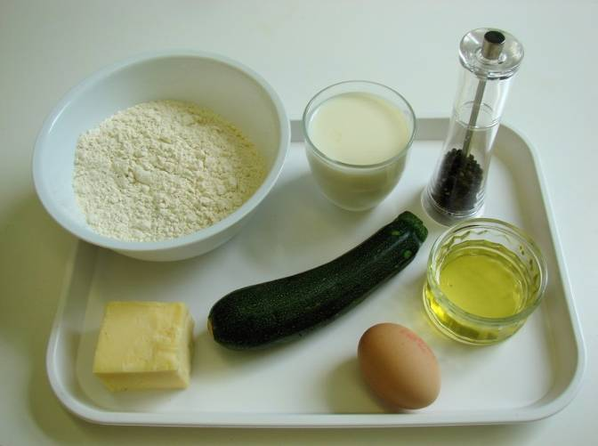
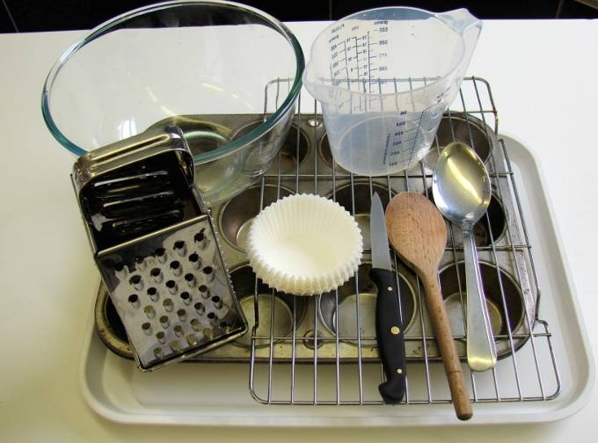
This recipe is from the original Licence to Cook programme and is provided under the Open Government Licence.
Courgette and cheese muffins
Ingredients
1 small courgette
100g cheddar cheese
225g self raising flour
50ml oil
175ml semi-skimmed milk
1 egg
Black pepper
Equipment
12 muffin cases
Muffin tin
Chopping board
Knife
Grater
Measuring jug
Mixing bowl
Wooden spoon
2 spoons
Cooling rack
© Food – a fact of life 2019
www.foodafactoflife.org.uk

Slide 2
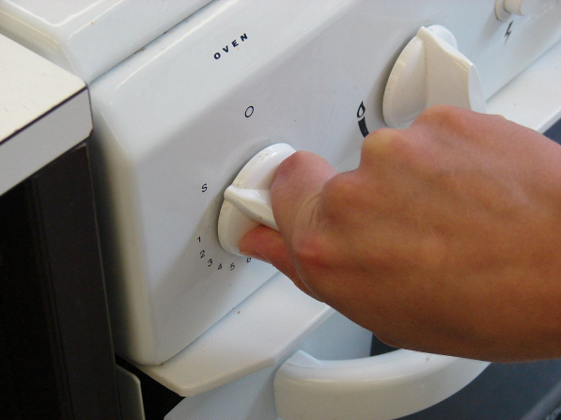
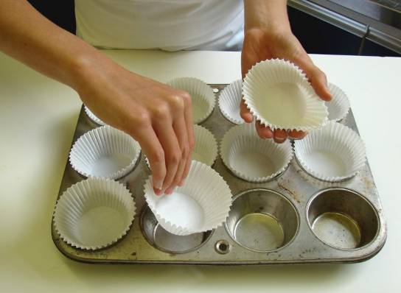
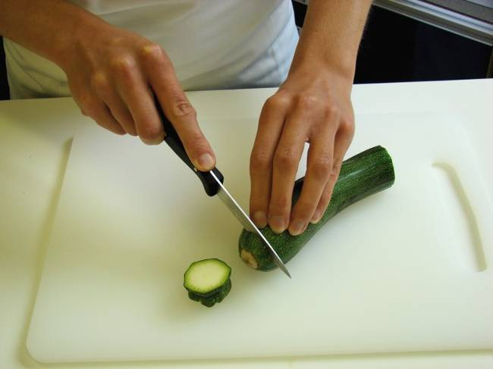
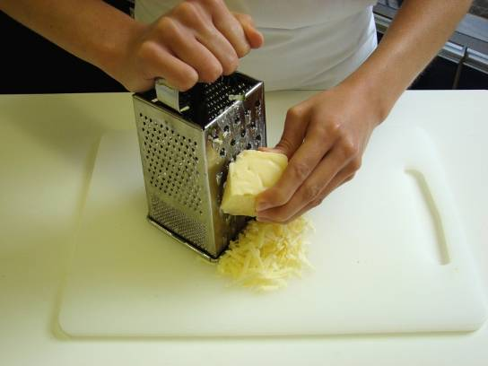
This recipe is from the original Licence to Cook programme and is provided under the Open Government Licence.
Method
Preheat oven to 200°C or gas mark 6.
Place the muffin cases in the muffin tin.
Cut the ends off the courgette.
Grate the courgette and cheese.
© Food – a fact of life 2019
www.foodafactoflife.org.uk

Slide 3
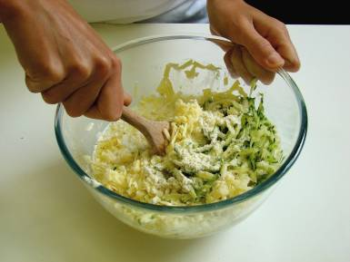
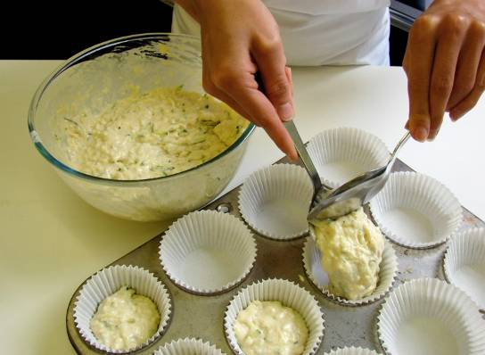
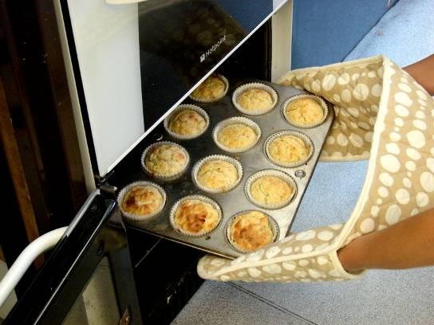
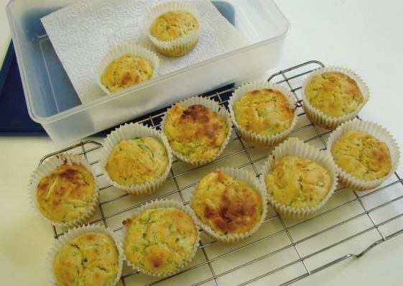
This recipe is from the original Licence to Cook programme and is provided under the Open Government Licence.
Method
Mix all the ingredients together to form a smooth batter.
Divide the mixture equally between the muffin cases using 2 spoons.
Bake for 20 minutes, until golden.
Allow to cool on a cooling rack.
© Food – a fact of life 2019
www.foodafactoflife.org.uk

