Slide 1

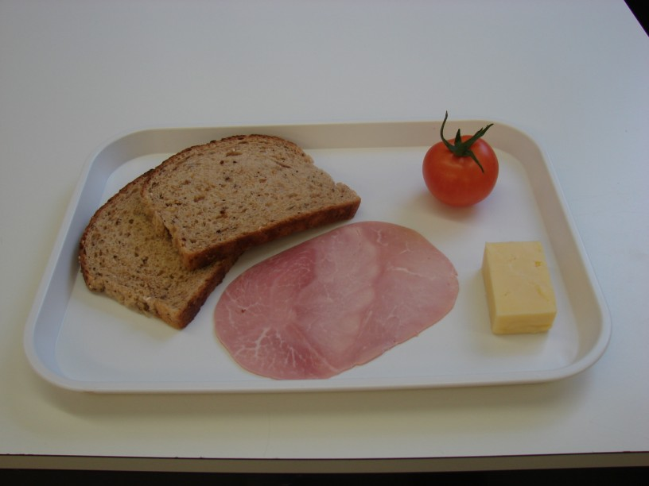
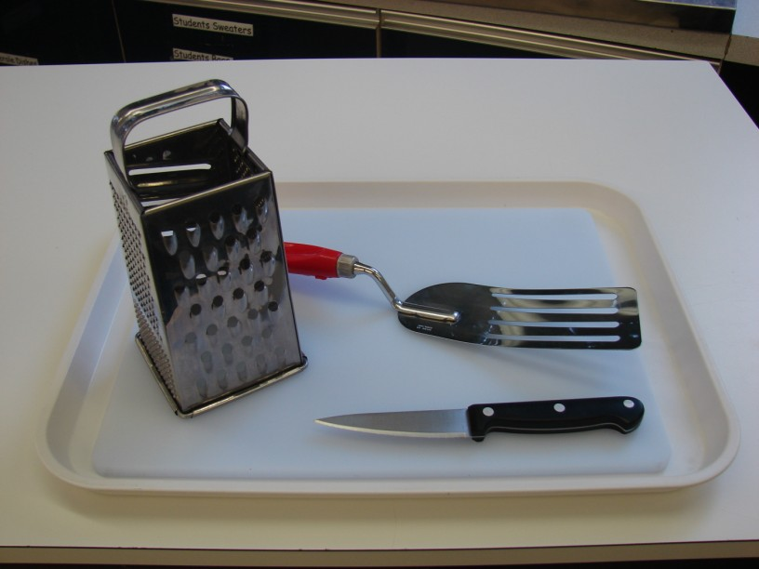
This recipe is from the original Licence to Cook programme and is provided under the Open Government Licence.
Croque-monsieur
Ingredients
30g hard cheese,
e.g. Cheddar, Edam, Gruyere
1 tomato
2 slices bread,
preferably wholegrain
1 slice ham
Equipment
Chopping board
Grater
Knife
Fish slice
© Food – a fact of life 2019
www.foodafactoflife.org.uk

Slide 2
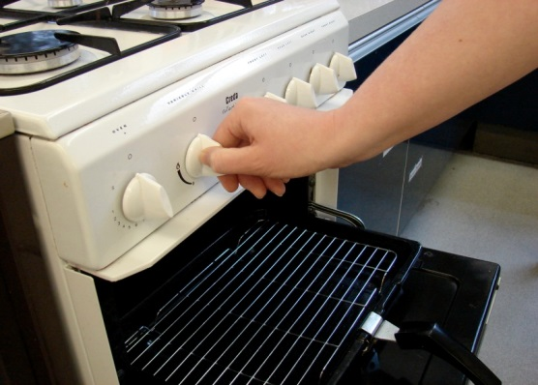
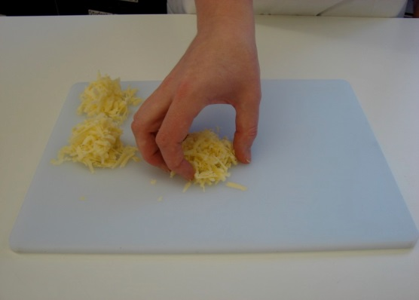
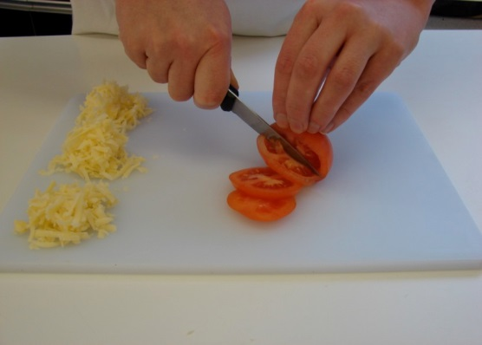
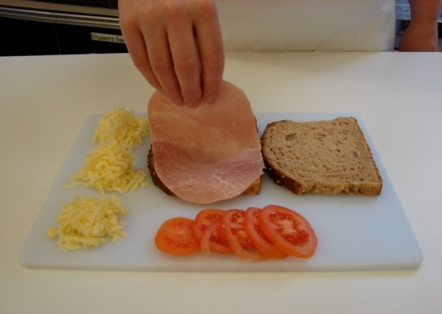
This recipe is from the original Licence to Cook programme and is provided under the Open Government Licence.
Method
Preheat the grill.
Grate cheese on a chopping board – divide into 3.
Slice the tomato.
Place the bread on the chopping board and lay the ham over one slice of bread.
© Food – a fact of life 2019
www.foodafactoflife.org.uk

Slide 3
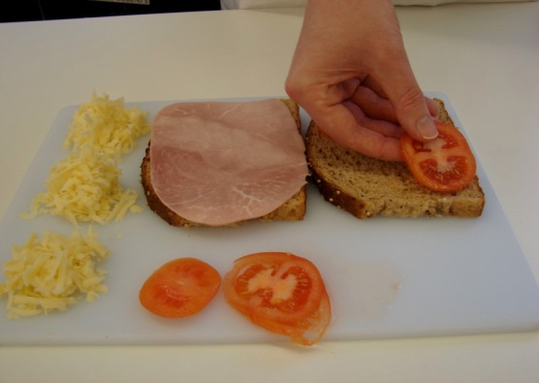
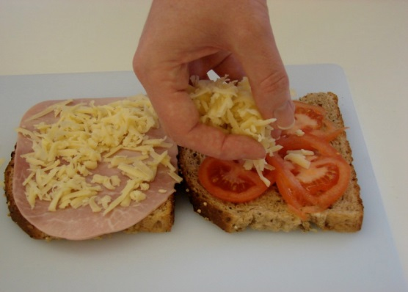
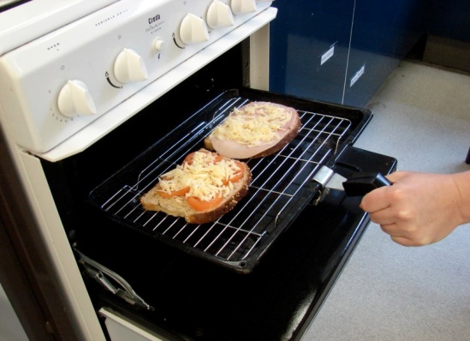
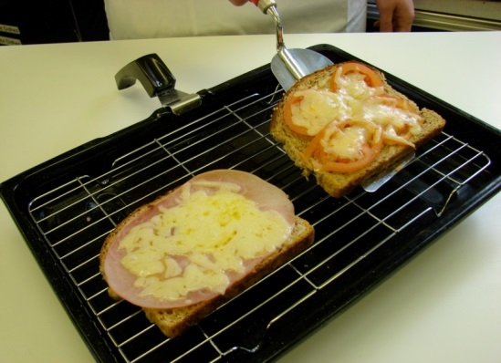
This recipe is from the original Licence to Cook programme and is provided under the Open Government Licence.
Method
Arrange the tomato over the other slice of bread.
Sprinkle a portion of cheese over both slices of bread.
Place the sandwich under the hot grill.
When the cheese is bubbling hot, remove from the grill.
© Food – a fact of life 2019
www.foodafactoflife.org.uk

Slide 4
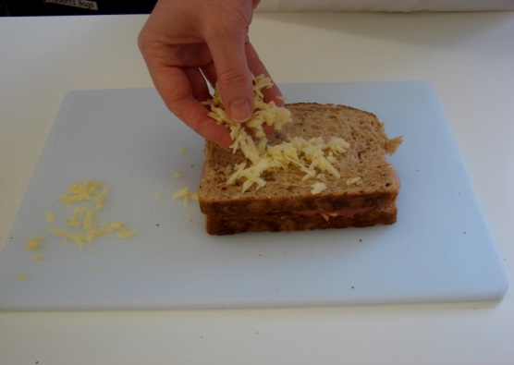
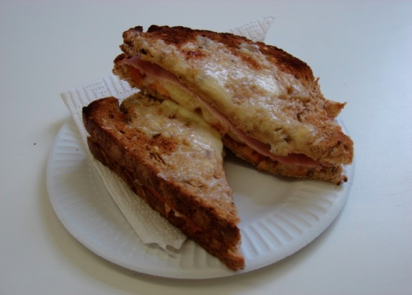
This recipe is from the original Licence to Cook programme and is provided under the Open Government Licence.
Method
Press the 2 slices of bread together, and sprinkle the remaining cheese on top.
Place under the grill until the cheese is melted and golden.
© Food – a fact of life 2019
www.foodafactoflife.org.uk

