Slide 1

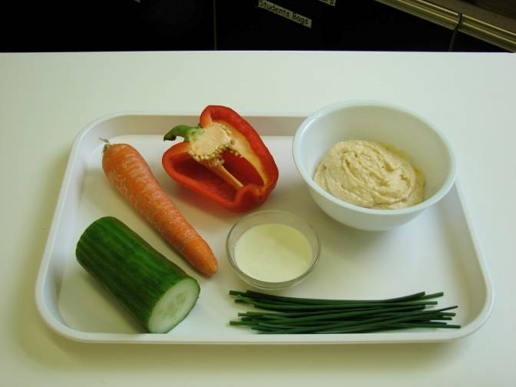
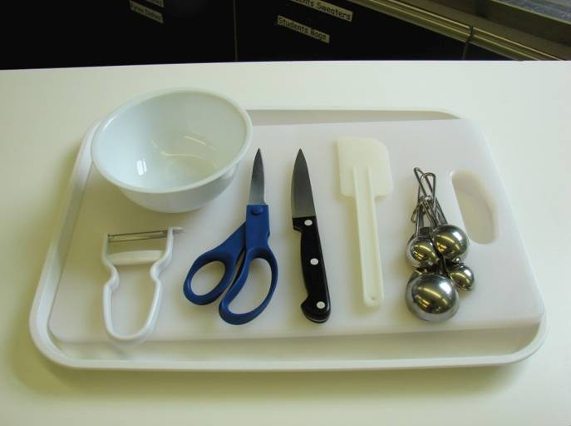
This recipe is from the original Licence to Cook programme and is provided under the Open Government Licence.
Dippy divers
Ingredients
1 carrot
½ red or yellow pepper
¼ cucumber
4 x 15ml spoons hummus
1 x 15 ml spoon plain yogurt
Handful of fresh chives
Equipment
Knife
Chopping board
Vegetable peeler
Measuring spoons
Small bowl
Kitchen scissors
Spatula
© Food – a fact of life 2019
www.foodafactoflife.org.uk

Slide 2
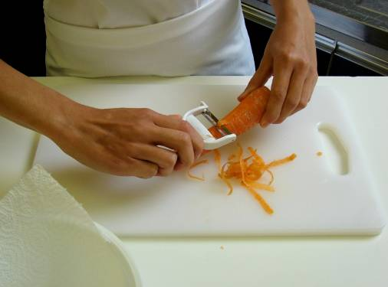
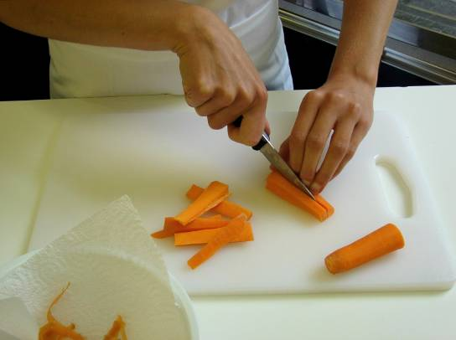
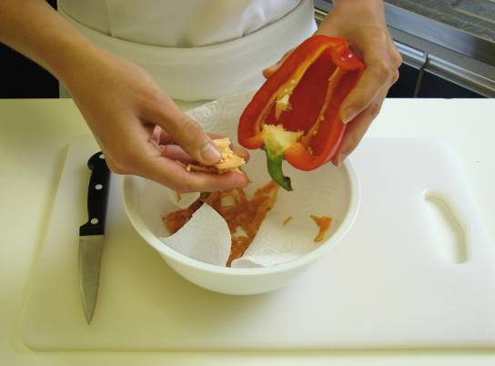
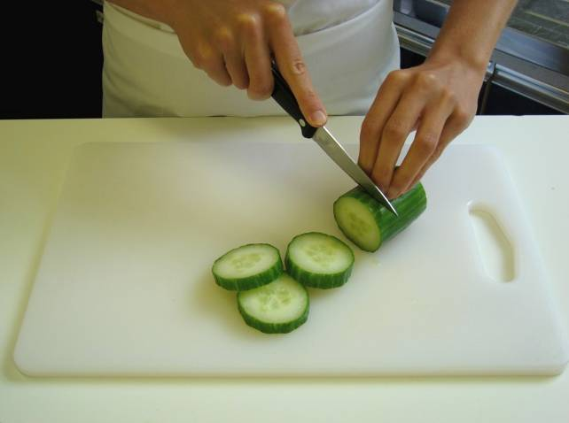
This recipe is from the original Licence to Cook programme and is provided under the Open Government Licence.
Method
Top and tail the carrot, then peel.
Slice the carrot into sticks.
Remove the seeds from the pepper, and slice intro strips.
Cut the cucumber into thick slices.
© Food – a fact of life 2019
www.foodafactoflife.org.uk

Slide 3
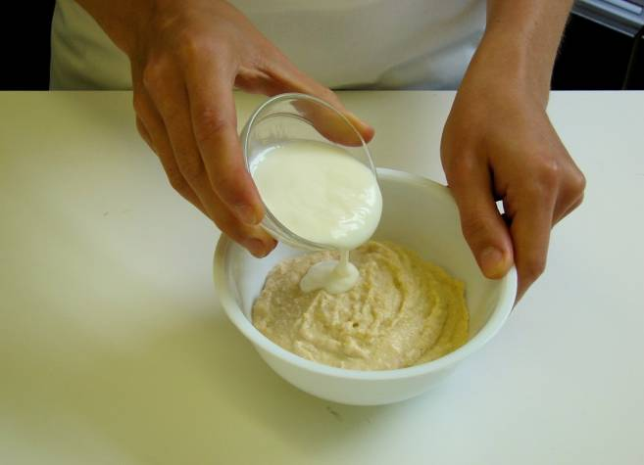
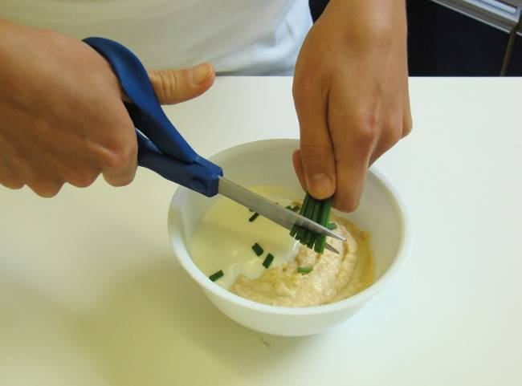
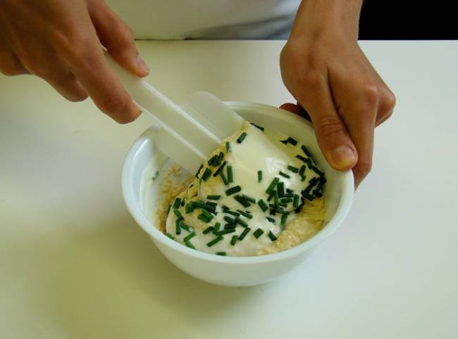
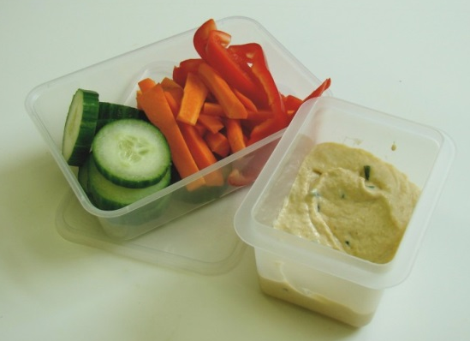
This recipe is from the original Licence to Cook programme and is provided under the Open Government Licence.
Method
Place the hummus and yogurt together in the small bowl.
Snip the chives into the bowl.
Stir everything together.
Serve the dip, surrounded by the vegetables.
© Food – a fact of life 2019
www.foodafactoflife.org.uk

