Slide 1

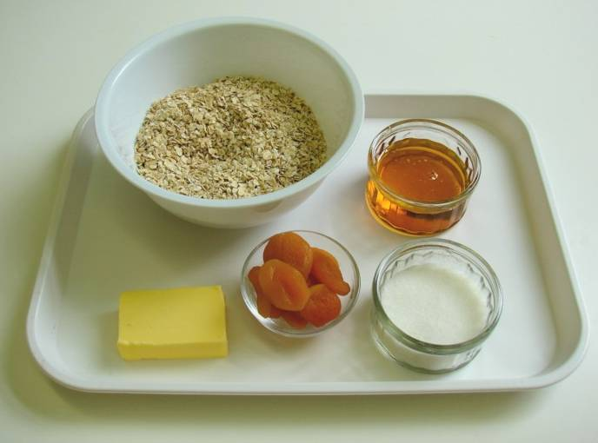
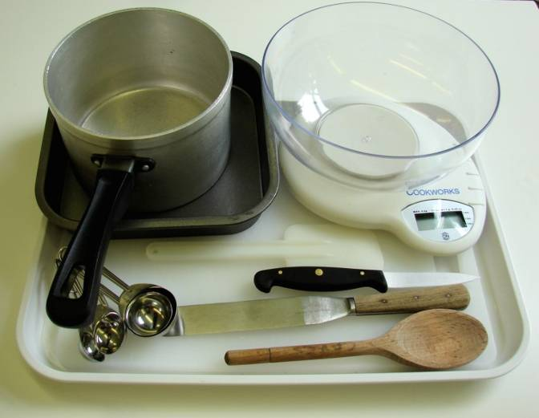
This recipe is from the original Licence to Cook programme and is provided under the Open Government Licence.
Fruit flapjacks
Ingredients
75g dried apricots
150g oats
50g sugar
50g butter or soft spread
2 x 15ml spoons golden syrup
Equipment
Chopping board
Knife
Weighing scales
Measuring spoons
Saucepan
Wooden spoon
Spatula
Non-stick baking tin
Palette knife
© Food – a fact of life 2019
www.foodafactoflife.org.uk

Slide 2
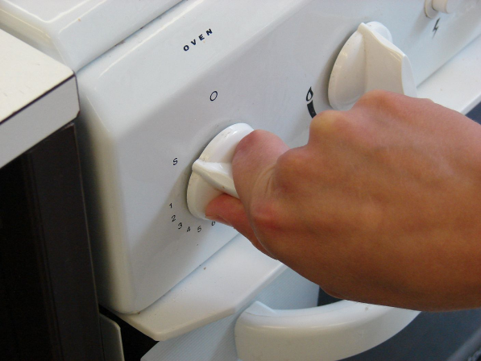
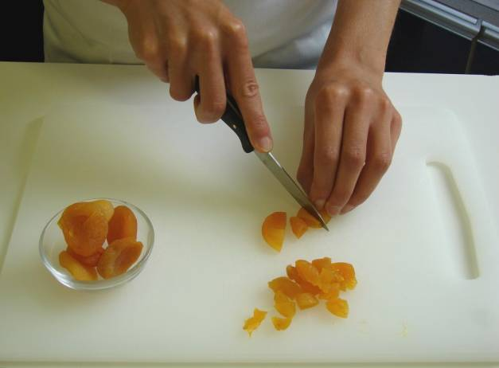
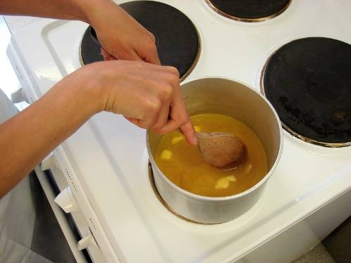
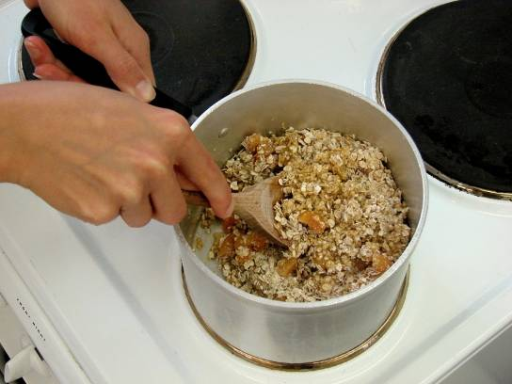
This recipe is from the original Licence to Cook programme and is provided under the Open Government Licence.
Method
Preheat the oven to 180°C or gas mark 4.
Chop the apricots into small pieces.
Place the fat, sugar and syrup into a saucepan and gently heat until the fat has melted.
Stir in the oats and apricots.
© Food – a fact of life 2019
www.foodafactoflife.org.uk

Slide 3
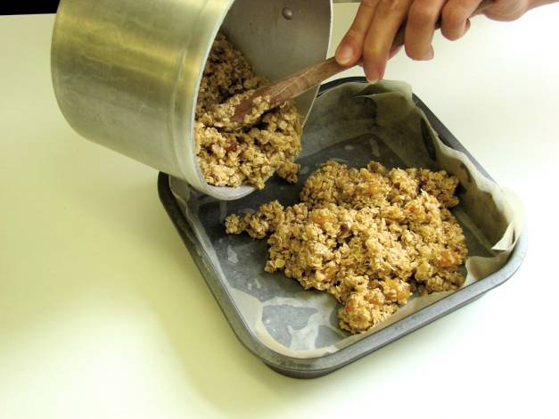
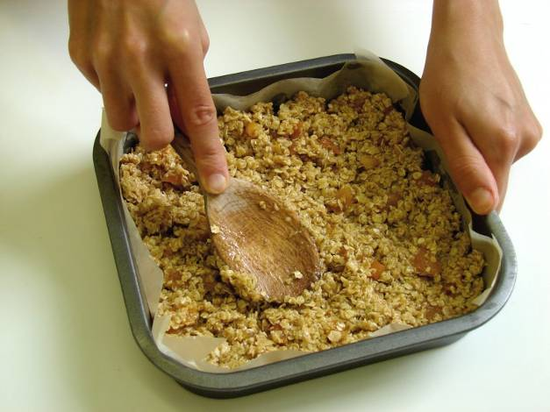
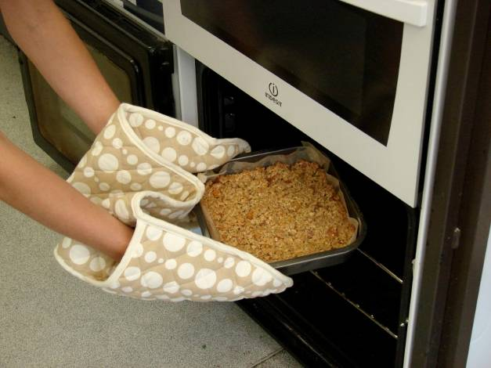
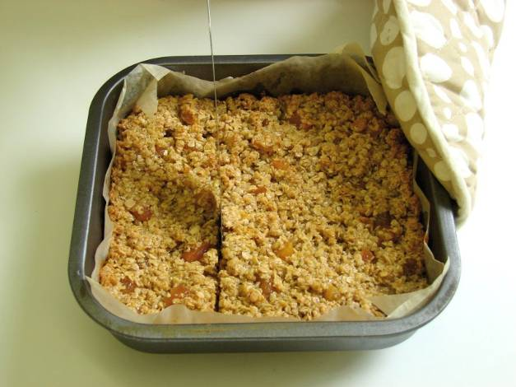
This recipe is from the original Licence to Cook programme and is provided under the Open Government Licence.
Method
Pour the mixture into a non-stick (or lined) baking tray.
Pat down the mixture in the baking tin.
Bake for 15-20 minutes, until lightly browned.
Remove from the oven and cut into ‘bars’ in the baking tin while hot.
© Food – a fact of life 2019
www.foodafactoflife.org.uk

