Slide 1

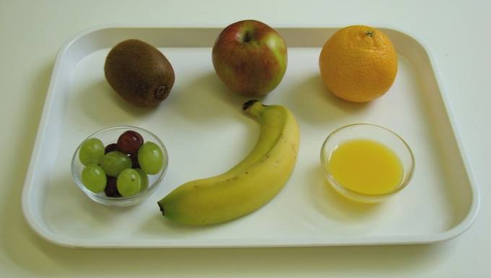
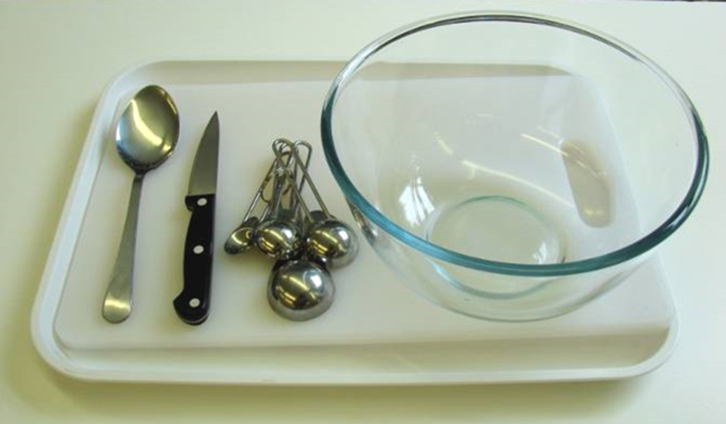
This recipe is from the original Licence to Cook programme and is provided under the Open Government Licence.
Fruit fusion
Ingredients
1 clementine
6 red grapes
6 green grapes
1 kiwi fruit
1 banana
1 apple
2 x 15ml spoons orange juice
Equipment
Knife
Chopping board
Bowl
Measuring spoons
Spoon
© Food – a fact of life 2019
www.foodafactoflife.org.uk

Slide 2
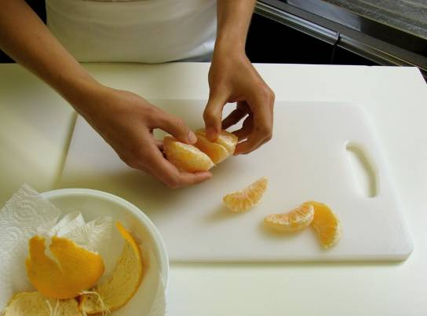
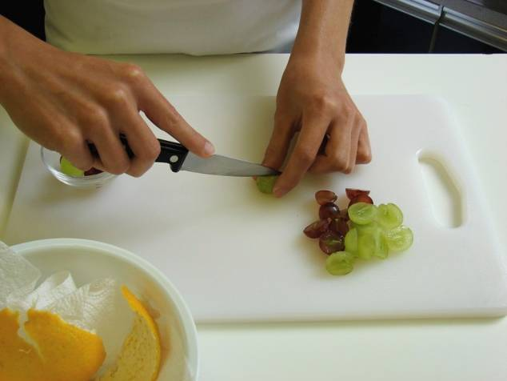
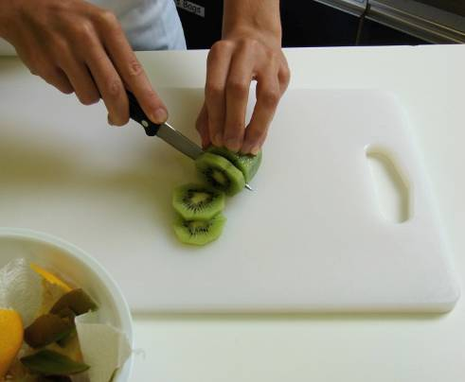
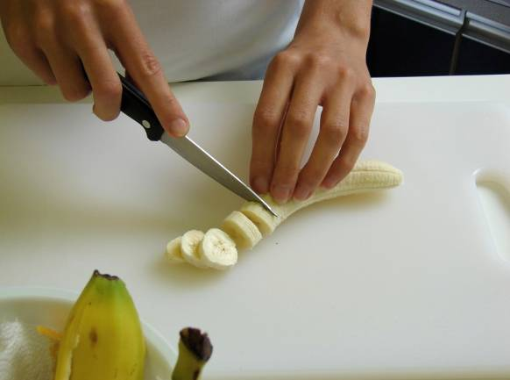
This recipe is from the original Licence to Cook programme and is provided under the Open Government Licence.
Method
Peel the clementine and separate into segments.
Cut the grapes in half and remove any seeds.
Peel the kiwi fruit and slice.
Peel the banana and slice.
© Food – a fact of life 2019
www.foodafactoflife.org.uk

Slide 3
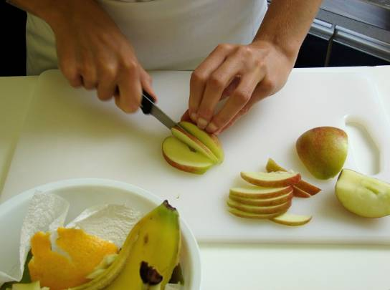
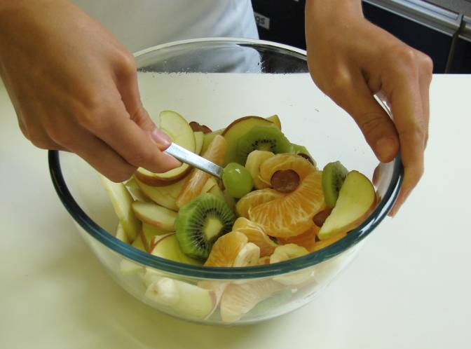
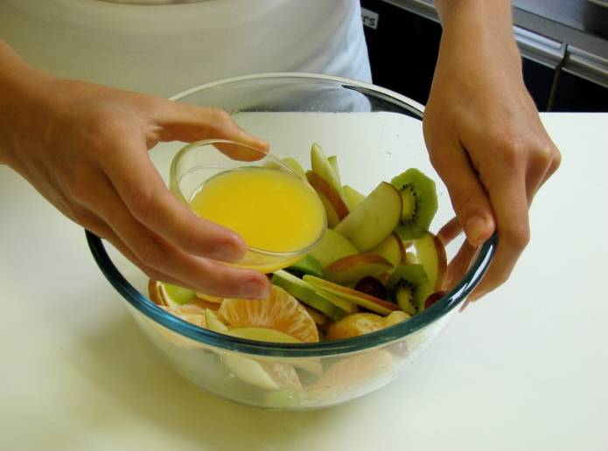
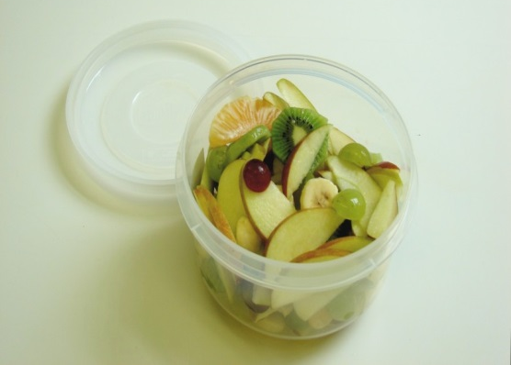
This recipe is from the original Licence to Cook programme and is provided under the Open Government Licence.
Method
Quarter the apple, remove the core and slice.
Place all the fruit in a bowl.
Add the orange juice and mix together.
Serve.
© Food – a fact of life 2019
www.foodafactoflife.org.uk

