Slide 1

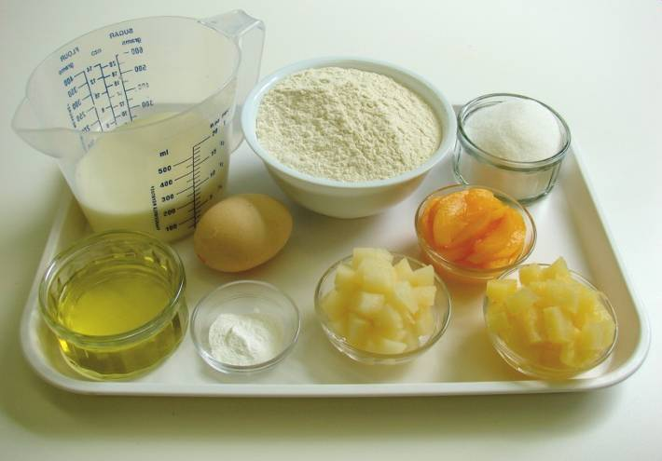
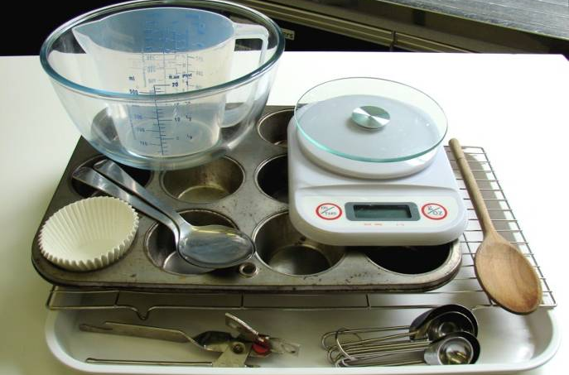
This recipe is from the original Licence to Cook programme and is provided under the Open Government Licence.
Fruity muffins
Ingredients
250g self raising flour
2 x 5ml spoons baking powder
100g caster sugar
230ml semi-skimmed milk
1 egg
60ml oil
150g canned fruit, drained
Equipment
12 muffin cases
Muffin tin
Weighing scales
Measuring spoons
Measuring jug
Mixing bowl
Wooden spoons
Can opener
2 spoons
Cooling rack
© Food – a fact of life 2019
www.foodafactoflife.org.uk

Slide 2
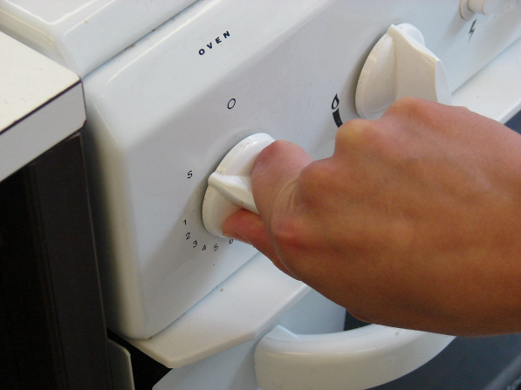
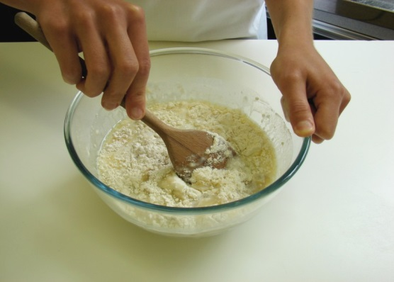
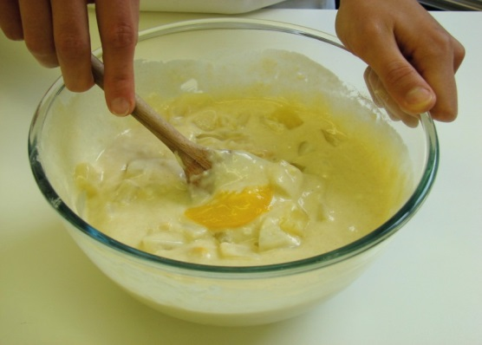
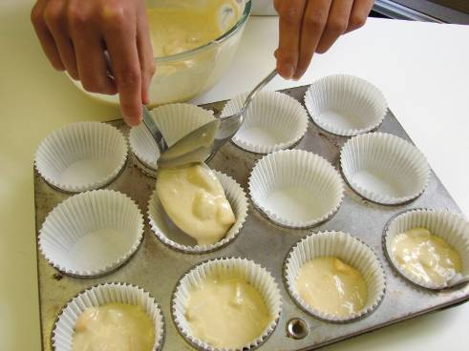
This recipe is from the original Licence to Cook programme and is provided under the Open Government Licence.
Method
Preheat oven to 180°C or gas mark 4.
Mix all the ingredients together to form a smooth batter.
Stir in the fruit.
Divide the mixture equally between the muffin cases using 2 spoons.
© Food – a fact of life 2019
www.foodafactoflife.org.uk

Slide 3
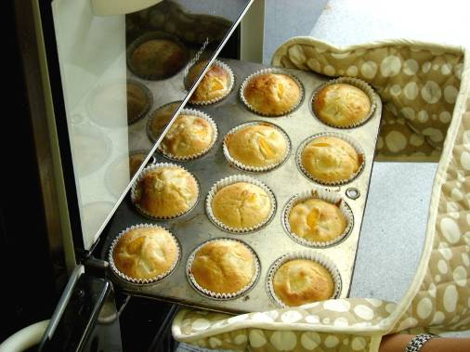
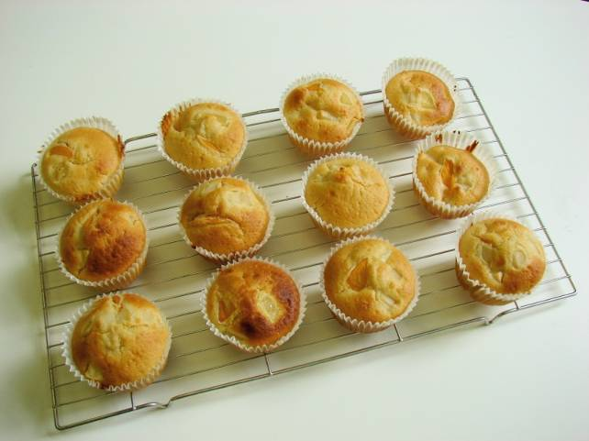
This recipe is from the original Licence to Cook programme and is provided under the Open Government Licence.
Method
Bake for 20-25 minutes, until golden.
Allow to cool on a cooling rack.
© Food – a fact of life 2019
www.foodafactoflife.org.uk

