Slide 1

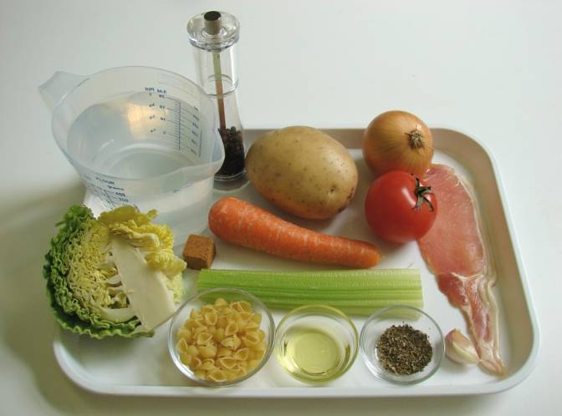
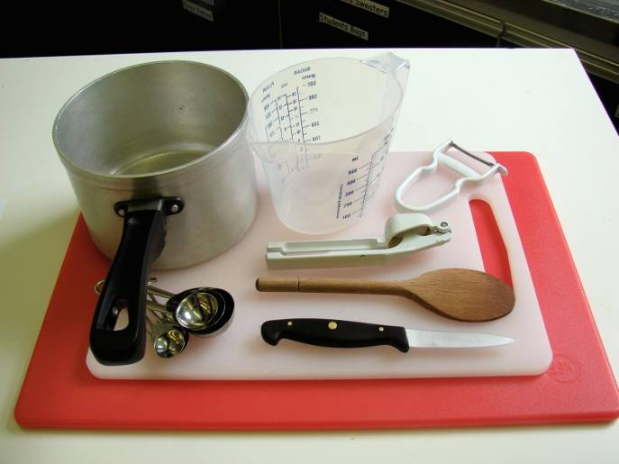
This recipe is from the original Licence to Cook programme and is provided under the Open Government Licence.
Minestrone soup
Ingredients
1 clove of garlic
¼ cabbage
1 onion
1 rasher of bacon
1 carrot
1 stick of celery
1 potato
1 stock cube
800ml boiling water
1 x 5ml mixed herbs
Black pepper
25g small pasta shapes
or broken spaghetti
Equipment
Garlic press
2 chopping boards
2 knives
measuring spoons
saucepan
peeler
wooden spoon
measuring jug
© Food – a fact of life 2019
www.foodafactoflife.org.uk

Slide 2
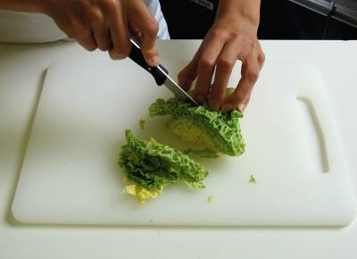
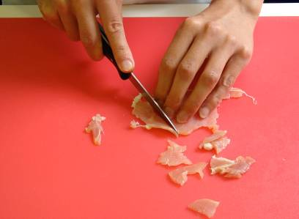
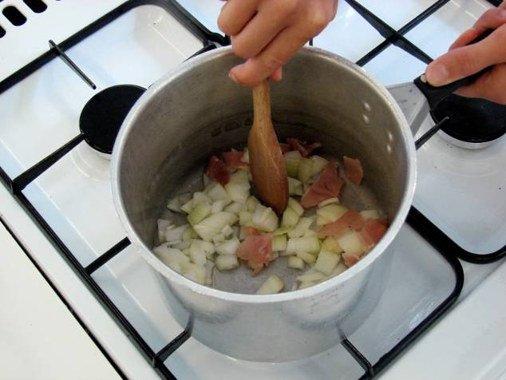
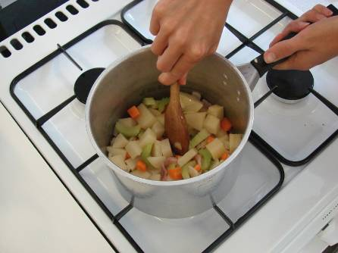
This recipe is from the original Licence to Cook programme and is provided under the Open Government Licence.
Method
Prepare the vegetables and bacon:
  peel and crush the garlic and shred the cabbage;
  peel and chop the onion;
  chop the bacon, with a clean knife on a clean chopping board.
Fry the onion, garlic and bacon in the oil for 2 minutes.
Stir in the potato, celery and carrot.
© Food – a fact of life 2019
www.foodafactoflife.org.uk

Slide 3
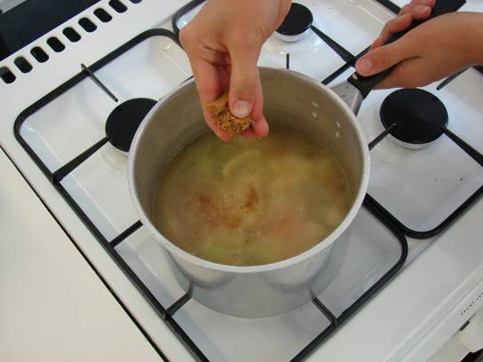
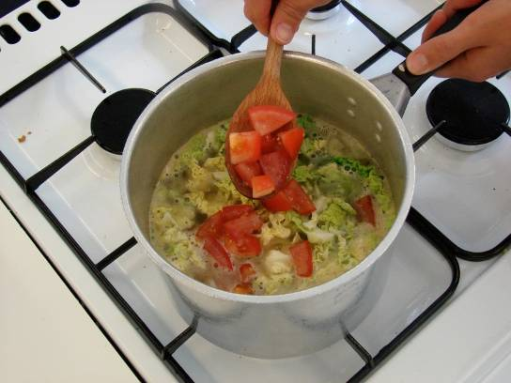
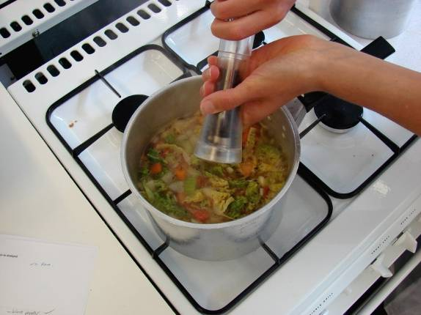
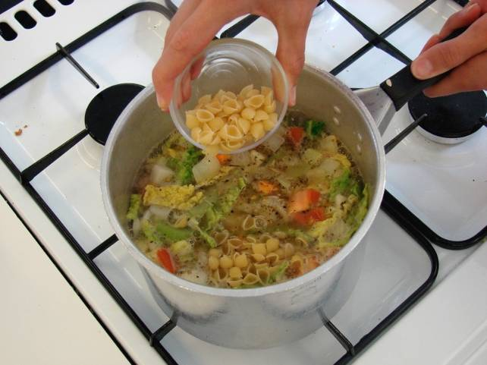
This recipe is from the original Licence to Cook programme and is provided under the Open Government Licence.
Method
Add the stock.
Stir in the finely shredded cabbage and sliced tomato.
Add the mixed herbs and black pepper, bring to the boil and then simmer for 10 minutes.
Add the pasta and allow to simmer for a further 10 minutes.
© Food – a fact of life 2019
www.foodafactoflife.org.uk

Slide 4
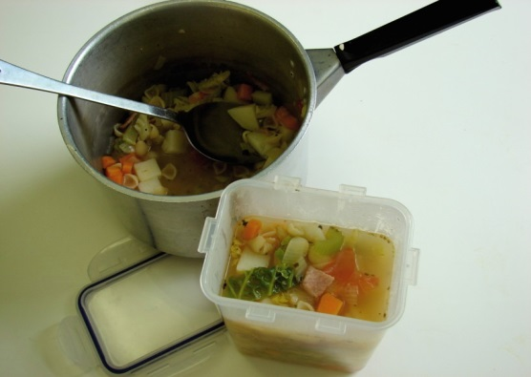
This recipe is from the original Licence to Cook programme and is provided under the Open Government Licence.
Method
Serve.
© Food – a fact of life 2019
www.foodafactoflife.org.uk

