Slide 1

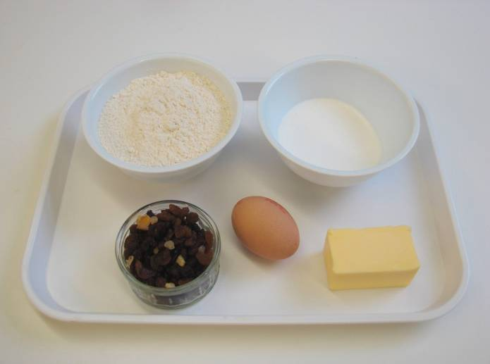
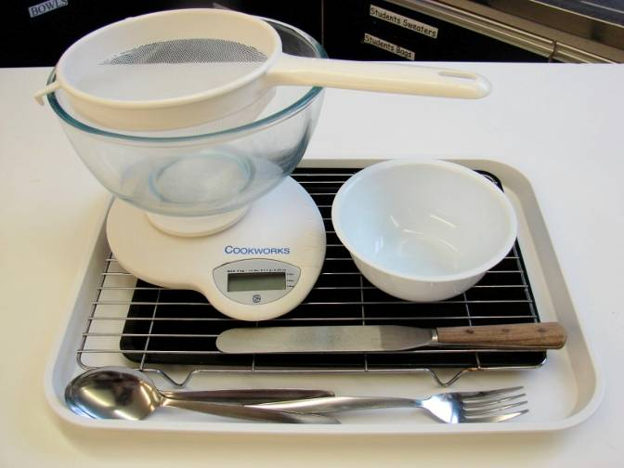
This recipe is from the original Licence to Cook programme and is provided under the Open Government Licence.
Rocking rock cakes
Ingredients
200g self-raising flour
75g butter or baking fat/block
75g sugar
75g mixed dried fruit
1 egg
Equipment
Sieve
Mixing bowl
Weighing scales
Palette knife
Small bowl
Fork
2 spoons
Non-stick baking tray (lined)
Cooling rack
© Food – a fact of life 2019
www.foodafactoflife.org.uk

Slide 2
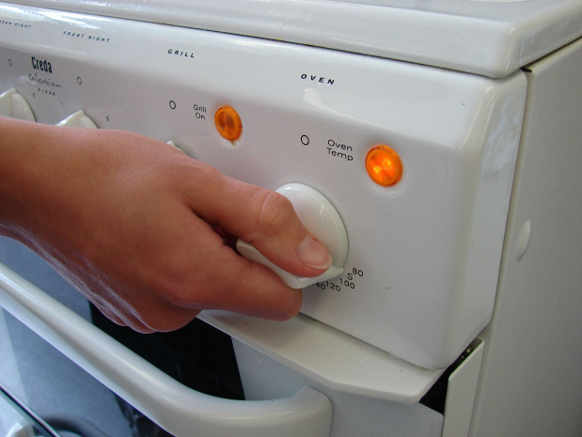
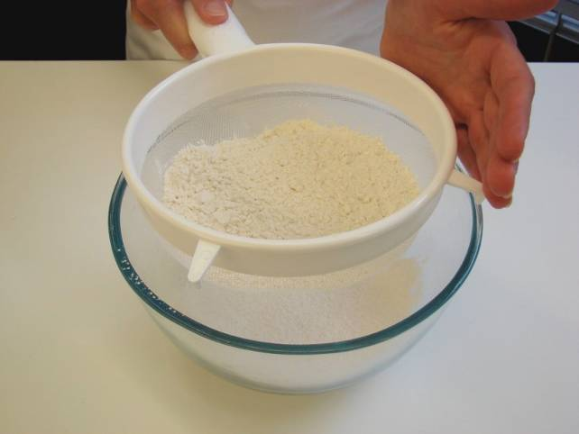
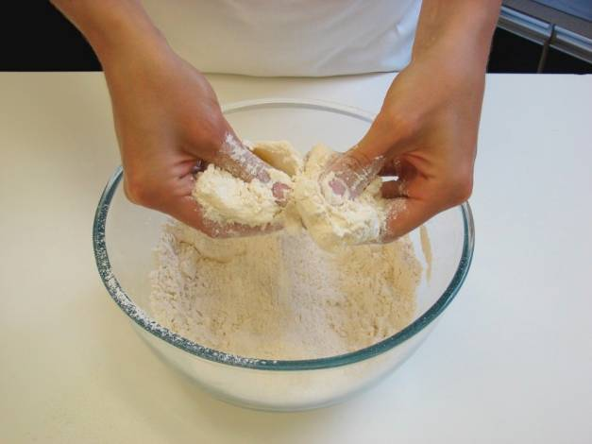
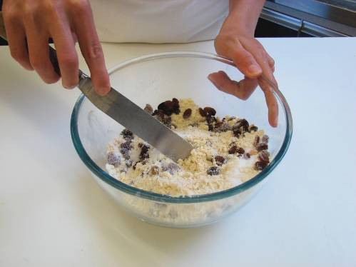
This recipe is from the original Licence to Cook programme and is provided under the Open Government Licence.
Method
Preheat the oven to 220°C or gas mark 7.
Sieve the flour into the bowl.
Rub in the fat into the flour until it resembles breadcrumbs.
Stir in the sugar and dried fruit.
© Food – a fact of life 2019
www.foodafactoflife.org.uk

Slide 3
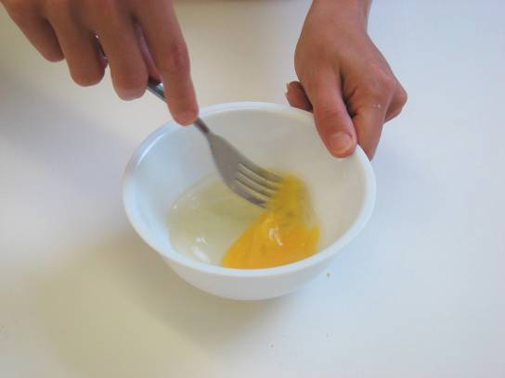
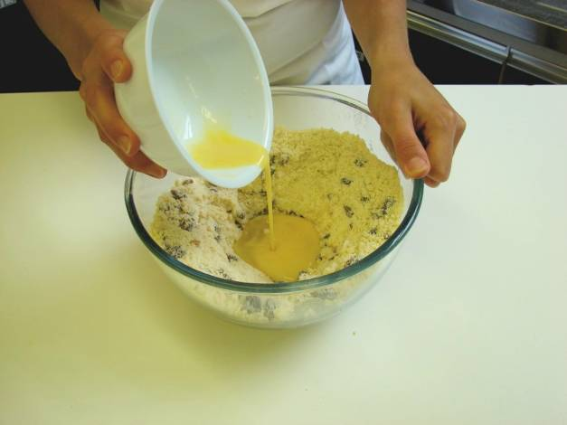
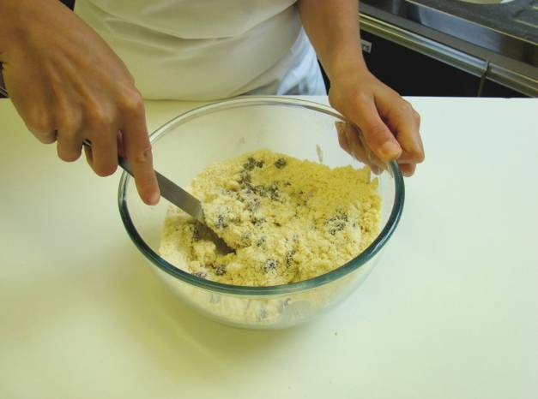
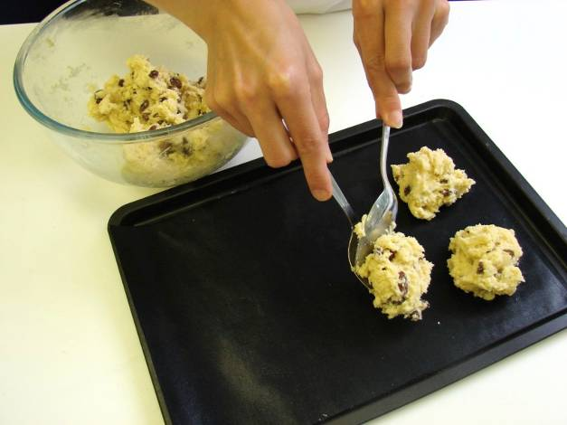
This recipe is from the original Licence to Cook programme and is provided under the Open Government Licence.
Method
Whisk the egg lightly in a small bowl.
Make a well in the middle of the flour and carefully add the egg.
Mix to form a soft, yet firm dough.
Using 2 spoons, divide the dough into 8 ‘rocks’ and place on the baking tray.
© Food – a fact of life 2019
www.foodafactoflife.org.uk

Slide 4
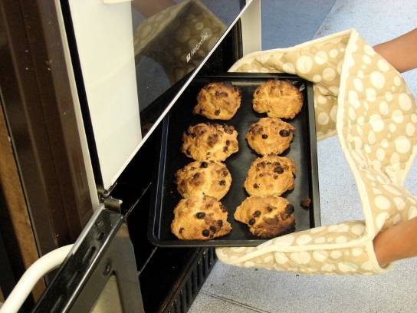
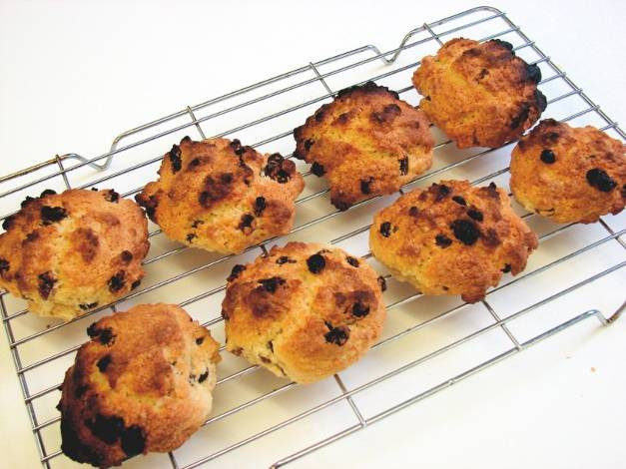
This recipe is from the original Licence to Cook programme and is provided under the Open Government Licence.
Method
Bake for 12-15 minutes, until golden brown.
Allow to cool on a cooling rack.
© Food – a fact of life 2019
www.foodafactoflife.org.uk

