Slide 1

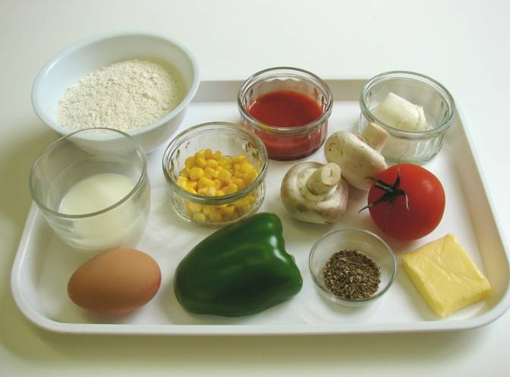
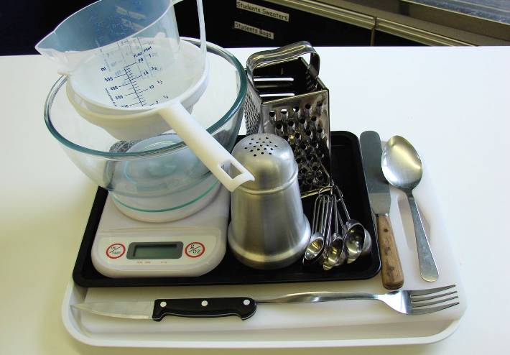
This recipe is from the original Licence to Cook programme and is provided under the Open Government Licence.
Scone-based pizza
Ingredients
150g self-raising flour
25g butter or baking fat/block
1 egg
50ml milk semi-skimmed
3 x 15ml spoons of passata
2 mushrooms
1 tomato
½ green pepper
25g sweetcorn
50g cheese, e.g. Mozzarella
1 x 5ml spoon of dried herbs
Equipment
Baking tray
Weighing scales
Sieve
Mixing bowl
Measuring jug
Small bowl
Fork
Palette knife
Flour dredger
Spoon
Chopping board
Knife
Measuring spoons
Grater
© Food – a fact of life 2019
www.foodafactoflife.org.uk

Slide 2
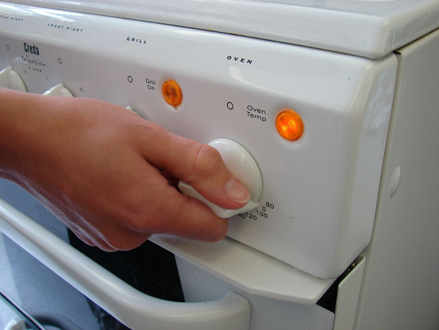
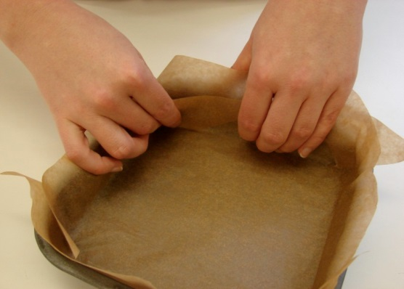
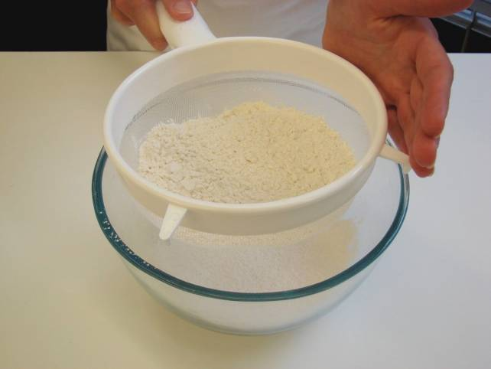
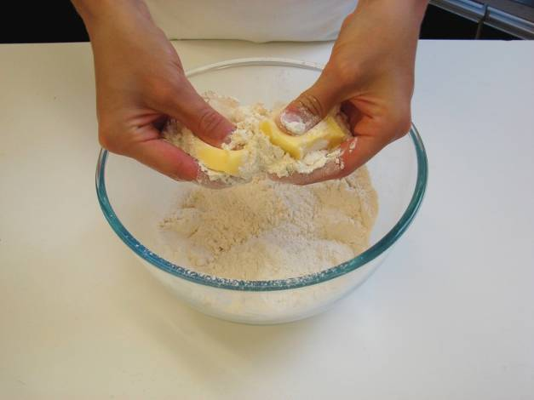
This recipe is from the original Licence to Cook programme and is provided under the Open Government Licence.
Method
Preheat the oven to 200°C or gas mark 6.
Line a baking tray.
Sift the flour into a bowl.
Rub in the fat into the flour until it resembles breadcrumbs.
© Food – a fact of life 2019
www.foodafactoflife.org.uk

Slide 3
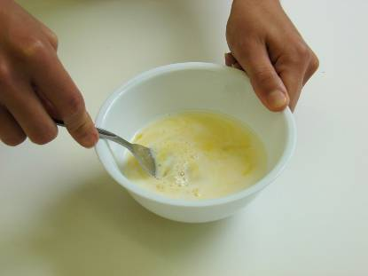
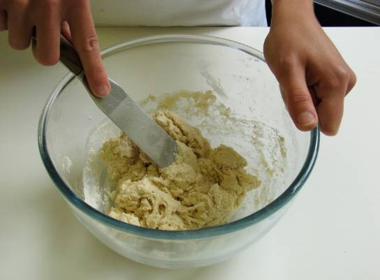
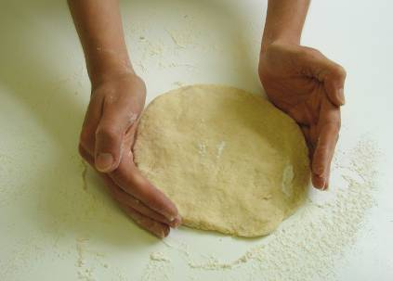
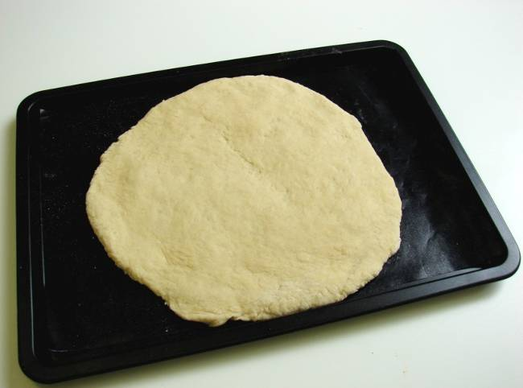
This recipe is from the original Licence to Cook programme and is provided under the Open Government Licence.
Method
Whisk the egg and milk together in a small bowl with a fork.
Add the egg mixture to the flour and mix together to form a soft dough.
Flatten out the dough on a floured surface to form a large circle.
Transfer the dough to the baking tray.
© Food – a fact of life 2019
www.foodafactoflife.org.uk

Slide 4
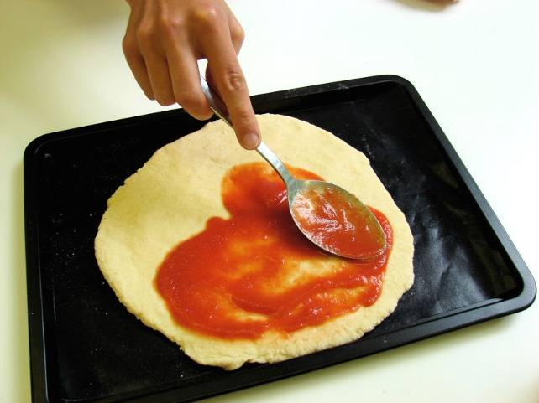
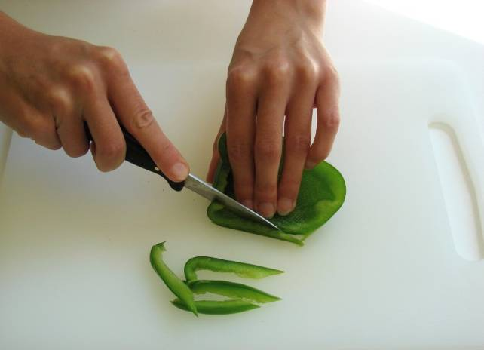
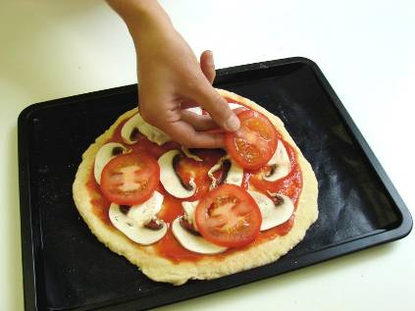
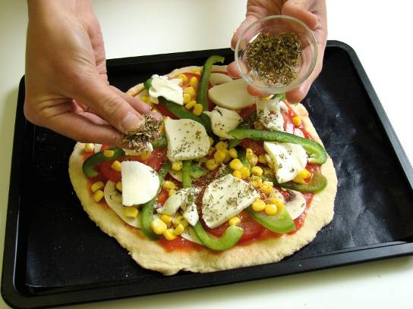
This recipe is from the original Licence to Cook programme and is provided under the Open Government Licence.
Method
Spread the passata over the dough using the back of a spoon.
Prepare the vegetables:
  slice the mushrooms;
  slice the tomato;
  remove the core from the pepper and slice into thin strips.
Arrange the mushrooms, tomato, green pepper and sweetcorn over the base.
Sprinkle or place the cheese and herbs over the top of the pizza.
© Food – a fact of life 2019
www.foodafactoflife.org.uk

Slide 5
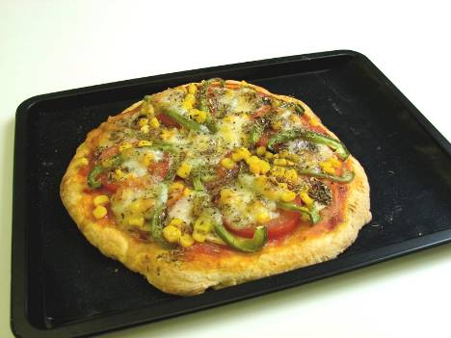
This recipe is from the original Licence to Cook programme and is provided under the Open Government Licence.
Method
Place the pizza in the oven and bake for 10-15 minutes, until golden brown.
© Food – a fact of life 2019
www.foodafactoflife.org.uk

