Slide 1

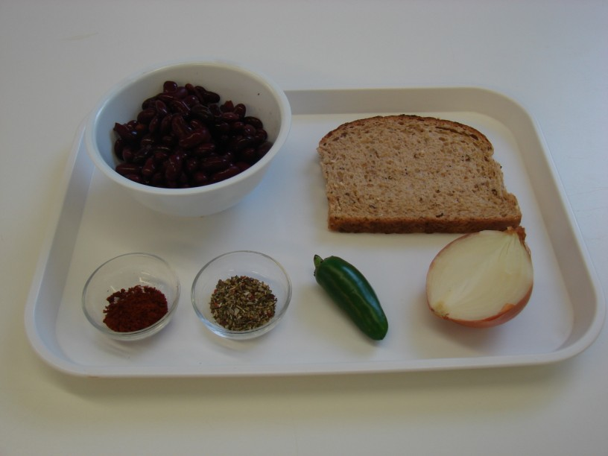
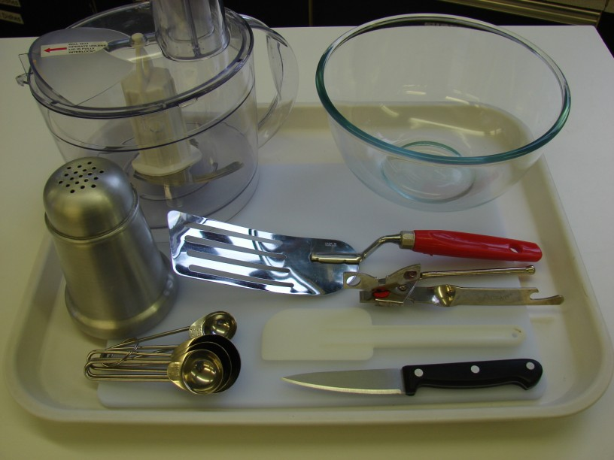
This recipe is from the original Licence to Cook programme and is provided under the Open Government Licence.
Spicy bean burgers
Ingredients
1 slice of bread
1/2 onion
1 medium green chilli
1 x 400g can red kidney beans
1 x 5ml spoon ground chilli powder
1 x 5ml spoon dried mixed herbs
Equipment
Food processor
Mixing bowl
Chopping board
Knife
Can opener
Measuring spoons
Spatula
Flour dredger
Fish slice
© Food – a fact of life 2019
www.foodafactoflife.org.uk

Slide 2
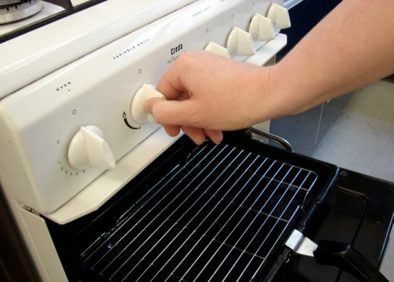
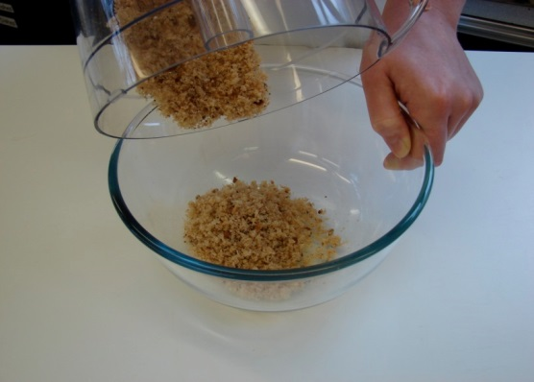
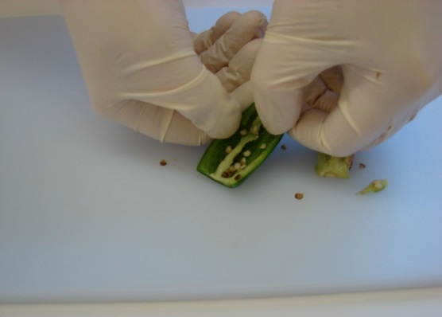
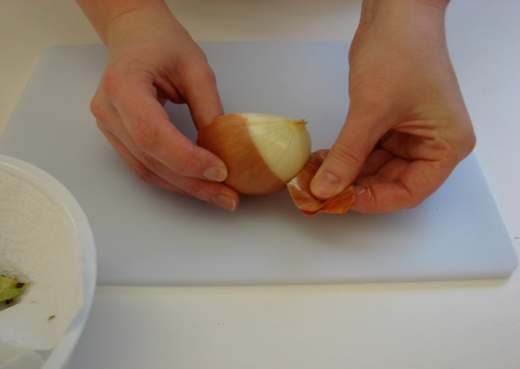
This recipe is from the original Licence to Cook programme and is provided under the Open Government Licence.
Method
Preheat the grill.
Put the bread in the food processor and blitz until it resembles breadcrumbs. Pour these crumbs into the mixing bowl.
Cut away the top of the chilli, and then de-seed.
Peel the onion.
© Food – a fact of life 2019
www.foodafactoflife.org.uk

Slide 3
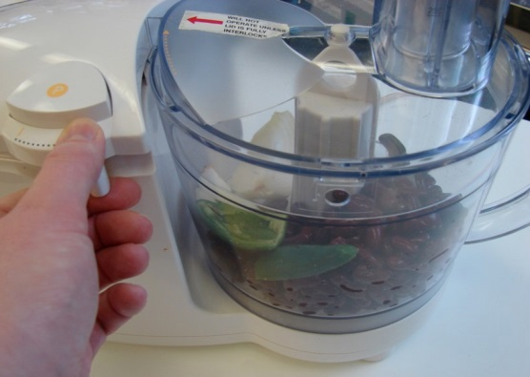
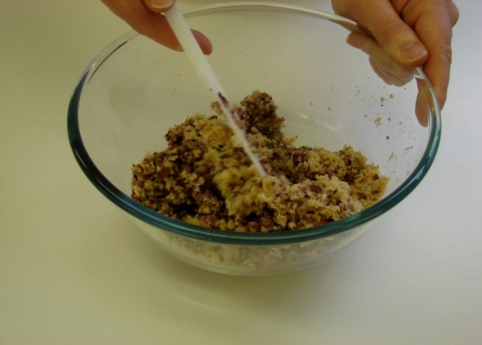
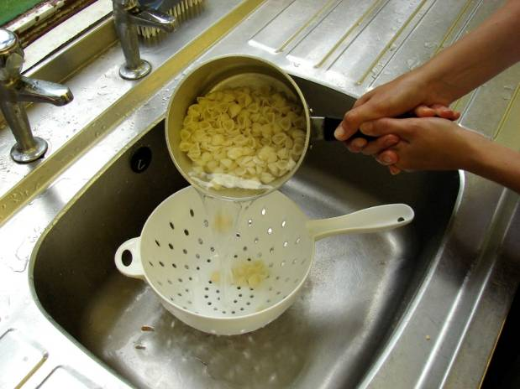
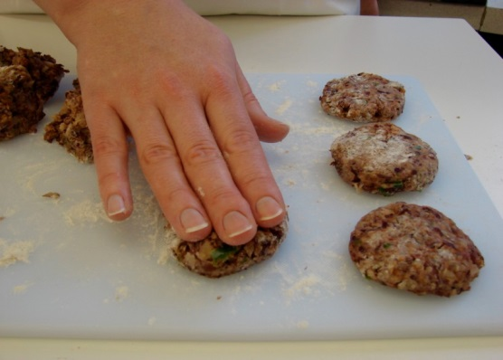
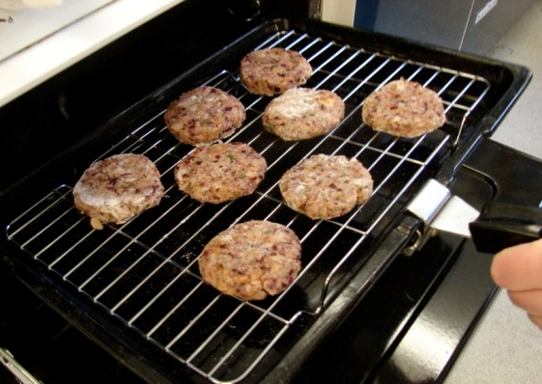
This recipe is from the original Licence to Cook programme and is provided under the Open Government Licence.
Method
Drain the kidney beans, then place with the onion, chilli, chilli powder and dried herbs into a food processor. Blitz to form a thick, paste-like mixture.
Place the bean mixture into the mixing bowl with the breadcrumbs. Mix everything together thoroughly using the spatula.
Slice the pepper into small strips.
On a lightly floured chopping board, divide and shape the mixture into 8 small patties.
Grill the patties for 8 minutes, turning over after 4 minutes.
© Food – a fact of life 2019
www.foodafactoflife.org.uk

Slide 4
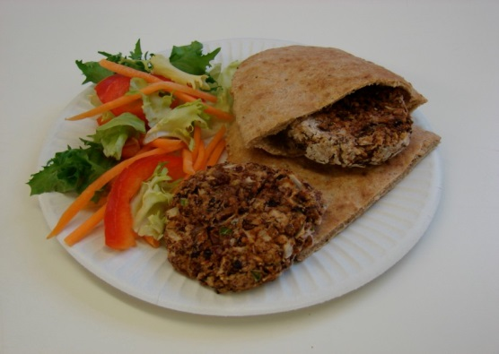
This recipe is from the original Licence to Cook programme and is provided under the Open Government Licence.
Method
Serve in a pitta with salad.
© Food – a fact of life 2019
www.foodafactoflife.org.uk

