Slide 1

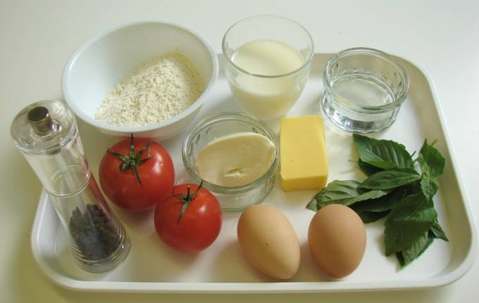
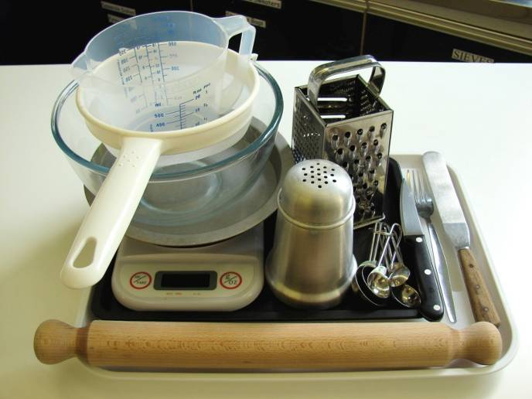
This recipe is from the original Licence to Cook programme and is provided under the Open Government Licence.
Tomato and basil tart
Ingredients
100g plain flour
50g butter or baking fat/block
2-3 x 15ml spoons cold water
2 tomatoes
50g cheese, e.g. Mozzarella, Gruyere or Cheddar
Handful of basil leaves
2 eggs
125ml semi-skimmed milk Black pepper
Equipment
Weighing scales
Sieve
Mixing bowl
Measuring spoons
Palette knife
Flour dredger
Rolling pin
Sandwich tin or 18cm flan ring
Fork
Chopping board
Knife
Grater
Measuring jug
Baking tray
© Food – a fact of life 2019
www.foodafactoflife.org.uk

Slide 2
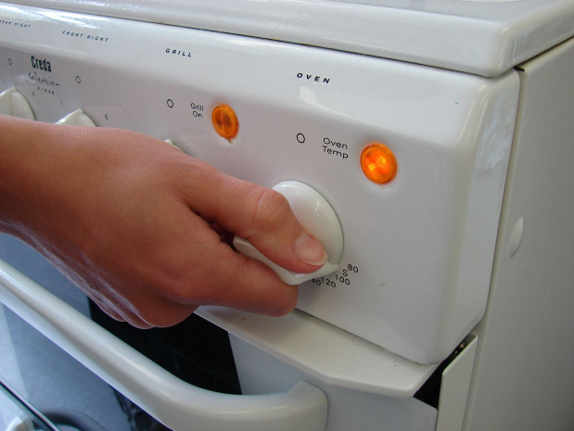
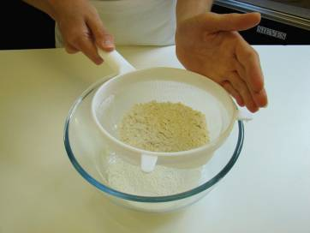
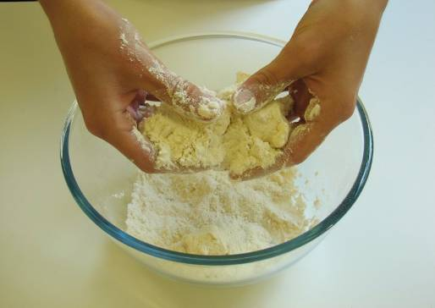
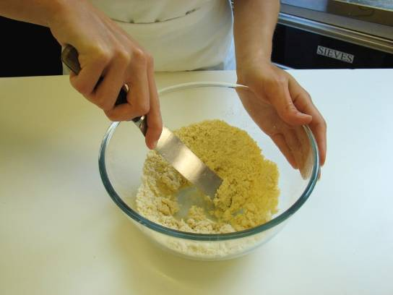
This recipe is from the original Licence to Cook programme and is provided under the Open Government Licence.
Method
Preheat the oven to 180°C or gas mark 4.
Make up the shortcrust pastry:
  sift the flour into the bowl;
  rub the fat into the flour using your fingertips, until it resembles breadcrumbs;
  add the cold water and start to mix together;
© Food – a fact of life 2019
www.foodafactoflife.org.uk

Slide 3
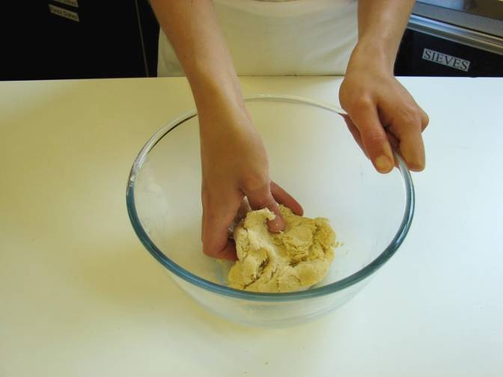
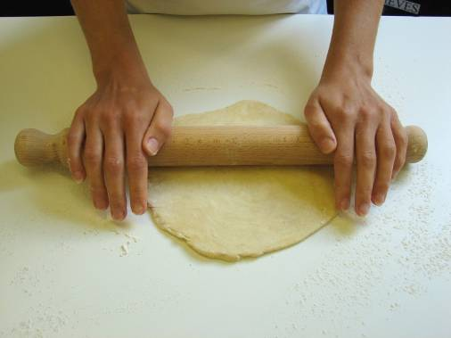
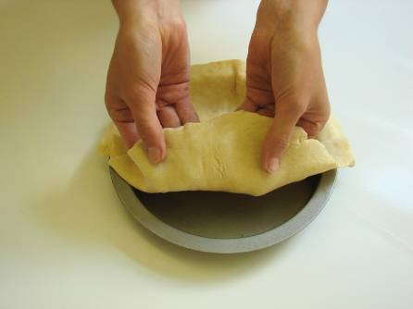
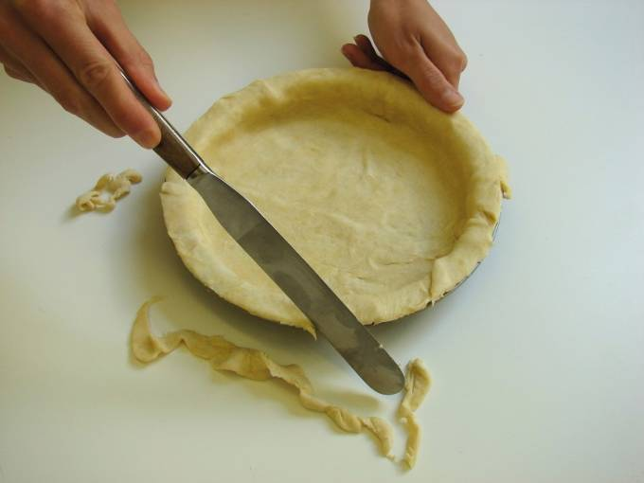
This recipe is from the original Licence to Cook programme and is provided under the Open Government Licence.
Method
  mix to form a firm, smooth dough.
Roll out the pastry, on a lightly floured surface.
Line the flan ring or sandwich tin.
Trim the edges of the pastry using the palette knife.
© Food – a fact of life 2019
www.foodafactoflife.org.uk

Slide 4
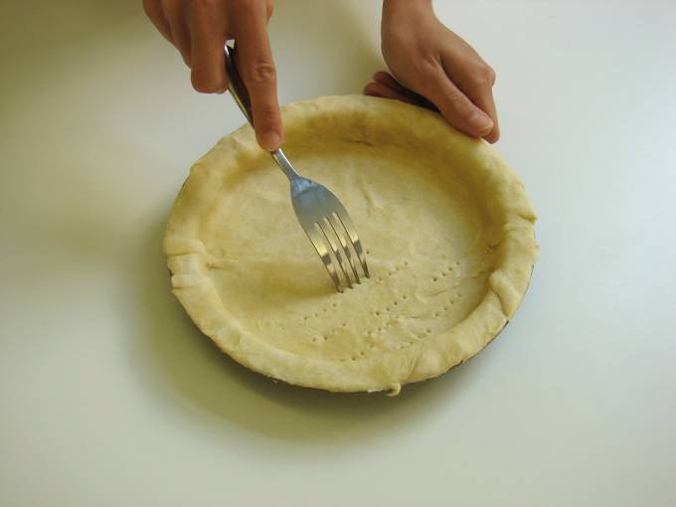
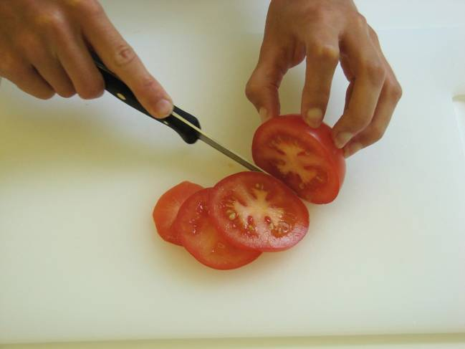
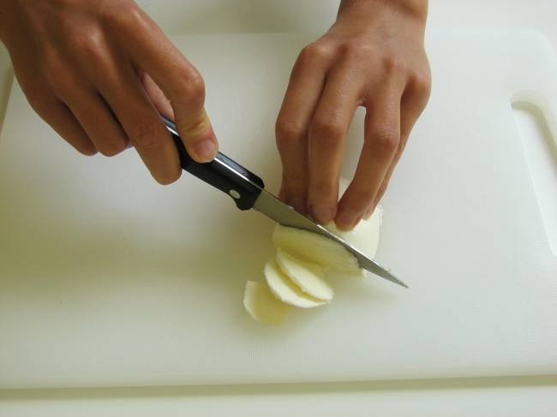
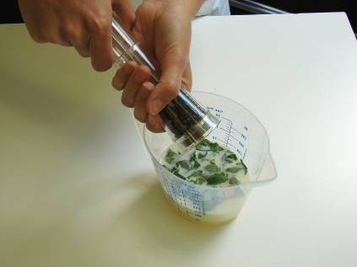
This recipe is from the original Licence to Cook programme and is provided under the Open Government Licence.
Method
Prick the bottom of the pastry with a fork.
Slice the tomatoes.
Slice the cheese.
Whisk the eggs and milk together in the measuring jug using the form. Teat the basil into the mixture, then add a few twists of black pepper.
© Food – a fact of life 2019
www.foodafactoflife.org.uk

Slide 5
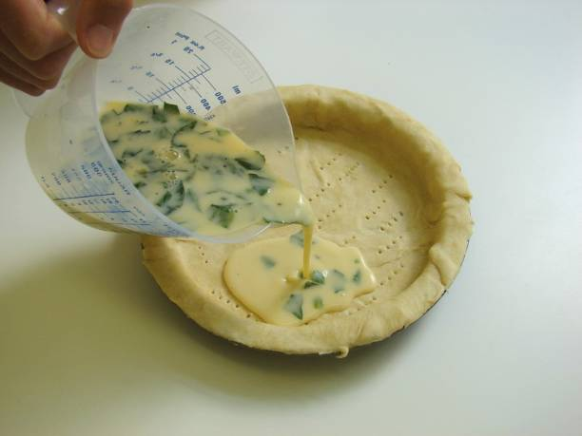
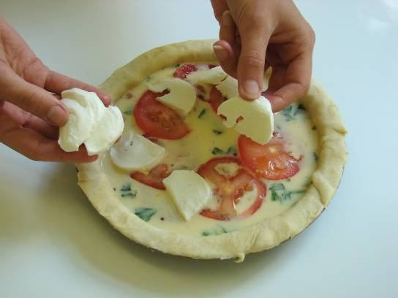
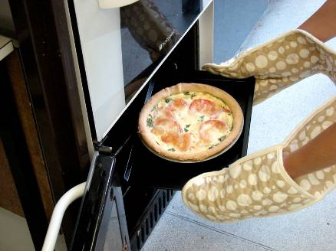
This recipe is from the original Licence to Cook programme and is provided under the Open Government Licence.
Method
Pour the egg mixture into the pastry shell.
Arrange the tomato slices and cheese over the top.
Place on a baking tray and bake for 30 minutes, until golden and firm.
© Food – a fact of life 2019
www.foodafactoflife.org.uk

