Slide 1

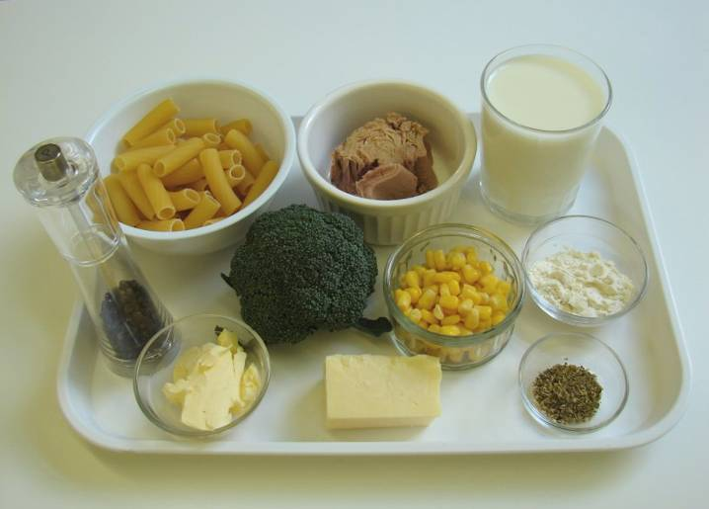
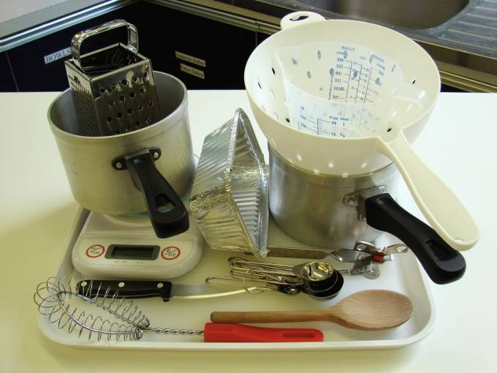
This recipe is from the original Licence to Cook programme and is provided under the Open Government Licence.
Tuna and broccoli pasta
Ingredients
100g rigatoni
40g cheese
100g broccoli
100g canned tuna (in water) drained
25g butter or soft spread
25g plain flour
250ml semi-skimmed milk
1 x 5ml spoon dried oregano
50g sweetcorn (canned or frozen)
Black pepper
Equipment
Two saucepans
Weighing scales
Grater
Chopping board
Knife
Measuring jug
Whisk
Measuring spoons
Colander
Wooden spoon
Ovenproof dish or foil tray
© Food – a fact of life 2019
www.foodafactoflife.org.uk

Slide 2
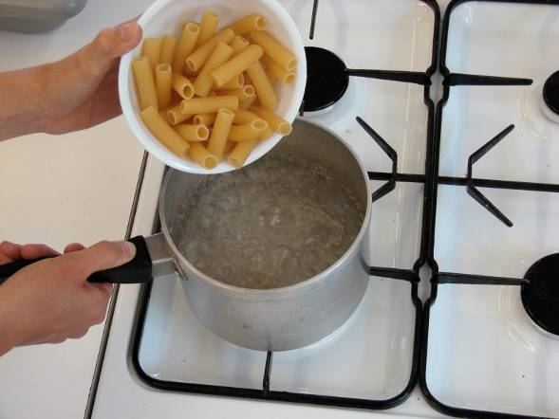
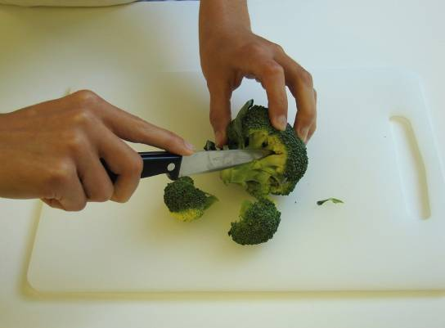
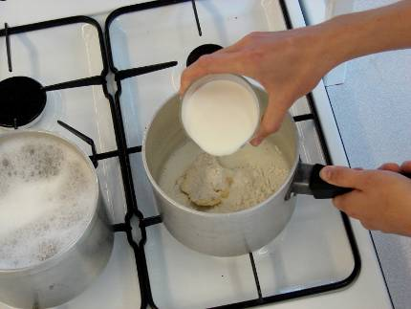
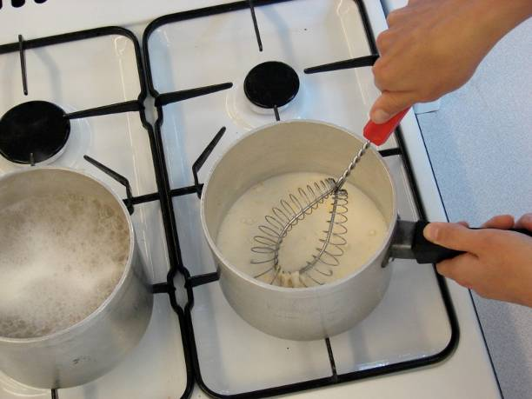
This recipe is from the original Licence to Cook programme and is provided under the Open Government Licence.
Method
Bring a saucepan of water to the boil, then add the pasta. Cook for about 10-12 minutes, until al dente.
Grate the cheese and cut the broccoli into small pieces.
While the pasta is cooking, make the sauce:
place the fat, flour and milk into a small saucepan;
bring the sauce to a simmer, whisking all the time until it has thickened;
© Food – a fact of life 2019
www.foodafactoflife.org.uk

Slide 3
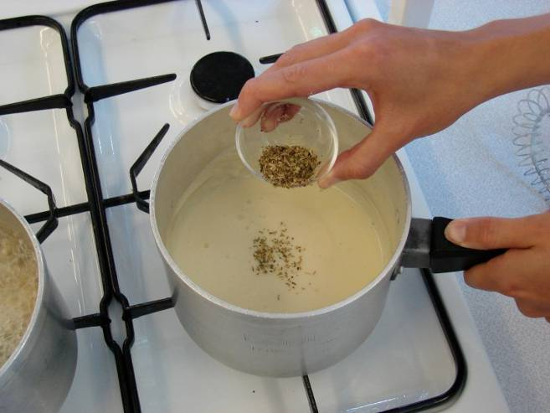
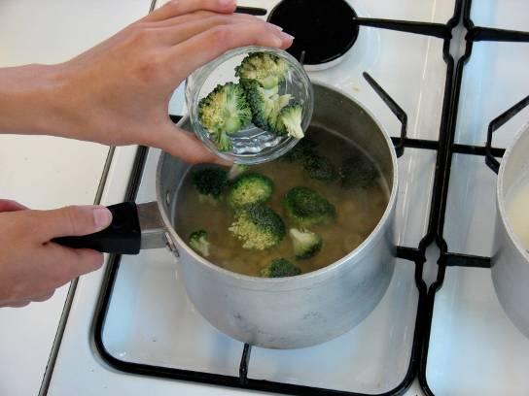
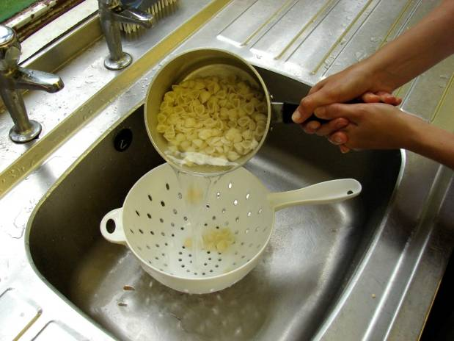
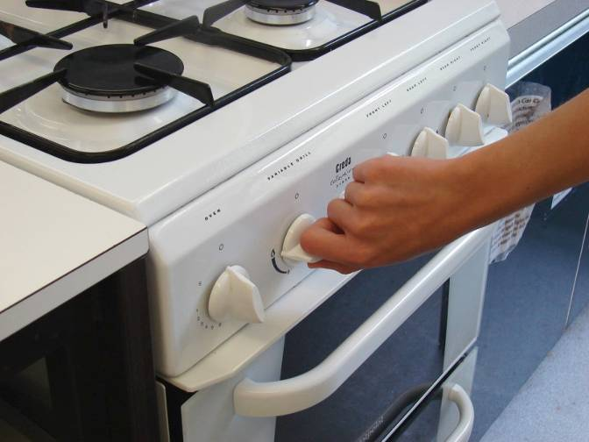
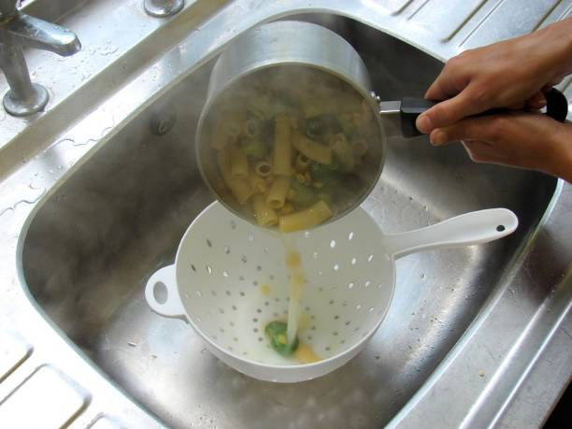
This recipe is from the original Licence to Cook programme and is provided under the Open Government Licence.
Method
reduce the heat, stir in the oregano and allow to simmer for 2 minutes.
During the last 2 minutes of the pasta boiling, add the sweetcorn and broccoli to the saucepan.
Slice the pepper into small strips.
Preheat the grill.
Drain the boiling water away from the pasta and vegetables into a colander in the sink.
© Food – a fact of life 2019
www.foodafactoflife.org.uk

Slide 4
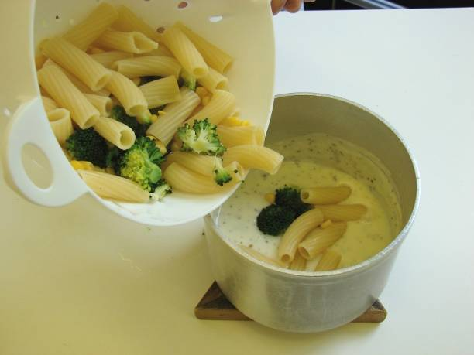
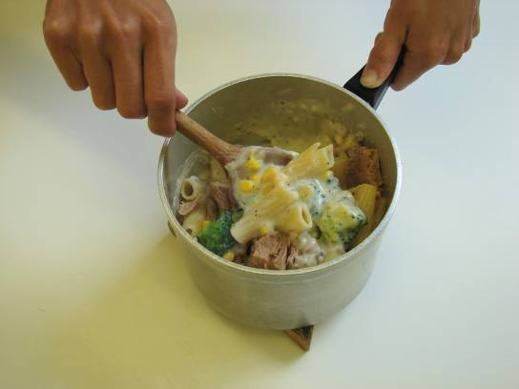
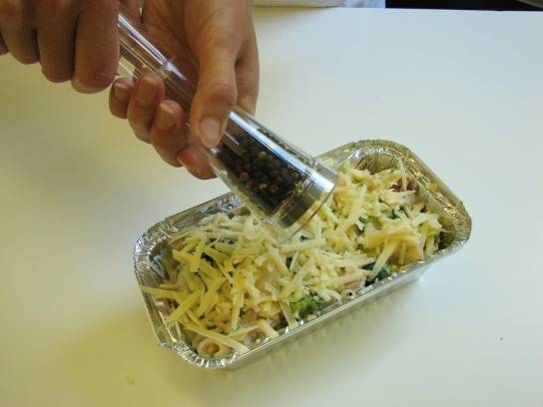
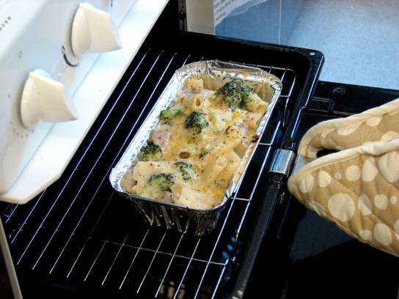
This recipe is from the original Licence to Cook programme and is provided under the Open Government Licence.
Method
Pour the drained pasta and vegetables into the sauce.
Stir in the canned tuna.
Sprinkle the cheese over the top and add a few twists of black pepper.
Place under the hot grill until the cheese is bubbling and golden brown.
© Food – a fact of life 2019
www.foodafactoflife.org.uk

