Slide 1

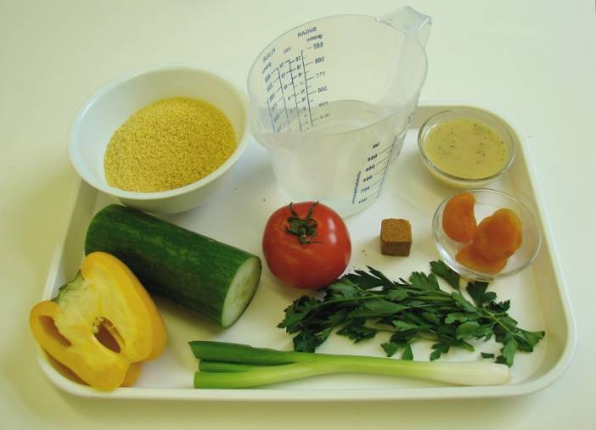
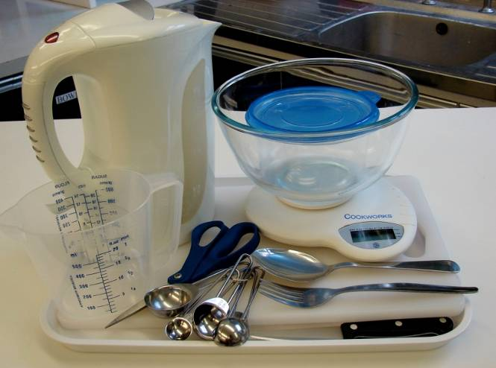
This recipe is from the original Licence to Cook programme and is provided under the Open Government Licence.
Vegetable couscous salad
Ingredients
175ml water, boiling
1 vegetable stock cube
100g couscous
1 medium tomato
1 spring onion
½ cucumber
½ yellow pepper
4 dried apricots
1 small bunch parsley
2 x 15ml spoons low fat dressing
Equipment
Kettle
Measuring jug
Measuring spoons
Weighing scales
Large bowl
Fork
Chopping board
Knife
Kitchen scissors
Spoon
Container
© Food – a fact of life 2019
www.foodafactoflife.org.uk

Slide 2
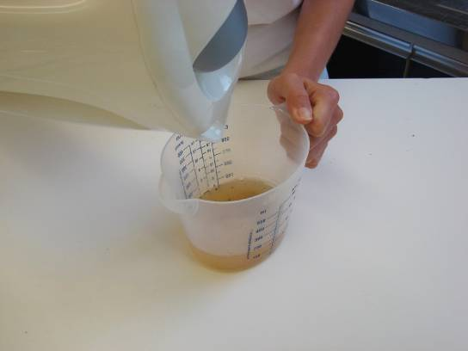
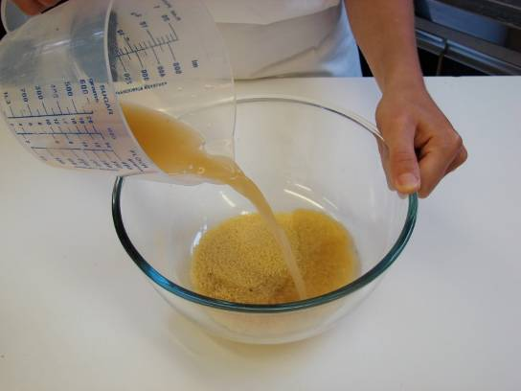
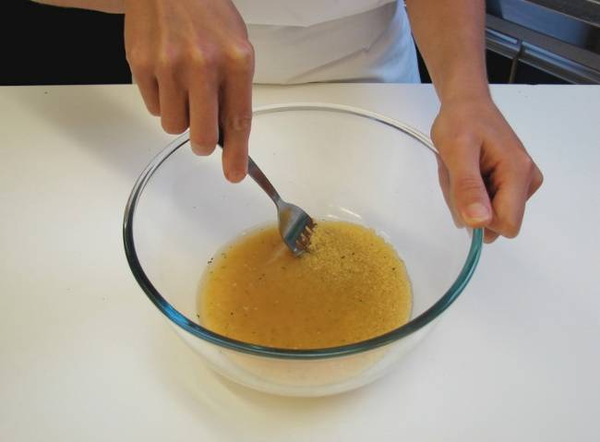
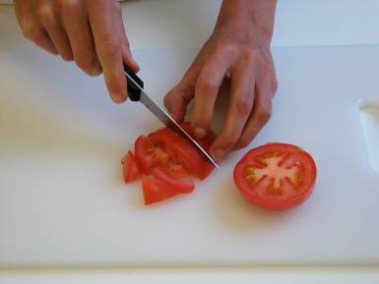
This recipe is from the original Licence to Cook programme and is provided under the Open Government Licence.
Method
Make up the stock by dissolving the stock cube in the boiling water.
Pour the stock over the couscous in a large bowl.
Stir with a fork and leave to stand for 5 minutes.
Chop the tomato into small chunks
© Food – a fact of life 2019
www.foodafactoflife.org.uk

Slide 3
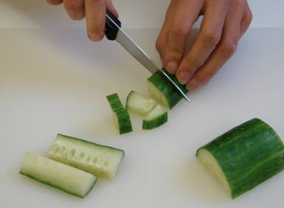
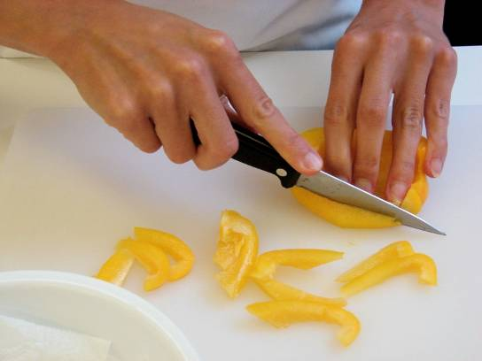
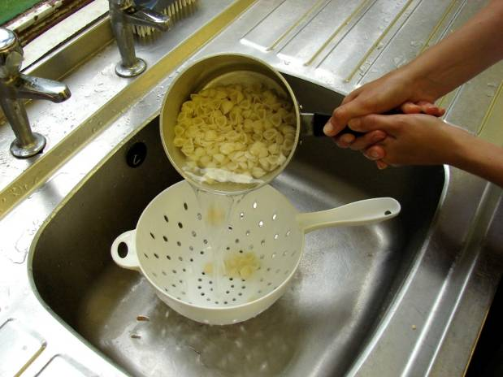
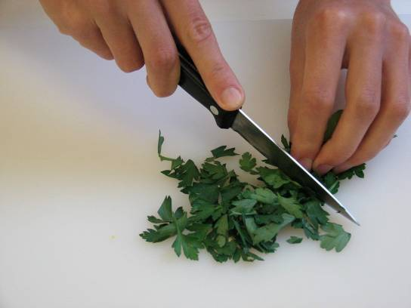
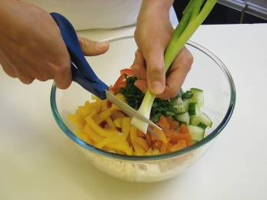
This recipe is from the original Licence to Cook programme and is provided under the Open Government Licence.
Method
Chop the cucumber into small chunks.
Slice the pepper into small strips.
Slice the pepper into small strips.
Slice the dried apricots and parsley into small pieces.
Fluff up the couscous with a form and then add all the vegetables and snip the spring onions into the bowl using the scissors.
© Food – a fact of life 2019
www.foodafactoflife.org.uk

Slide 4
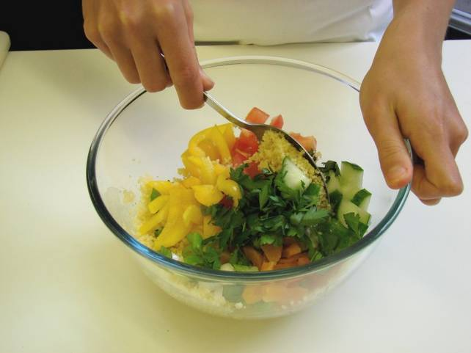
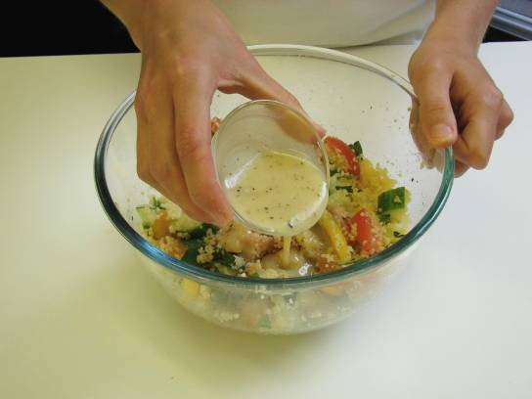
This recipe is from the original Licence to Cook programme and is provided under the Open Government Licence.
Method
Stir everything together.
Add the dressing.
© Food – a fact of life 2019
www.foodafactoflife.org.uk

