Slide 1

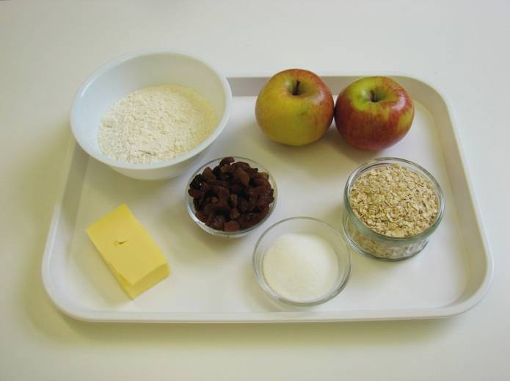
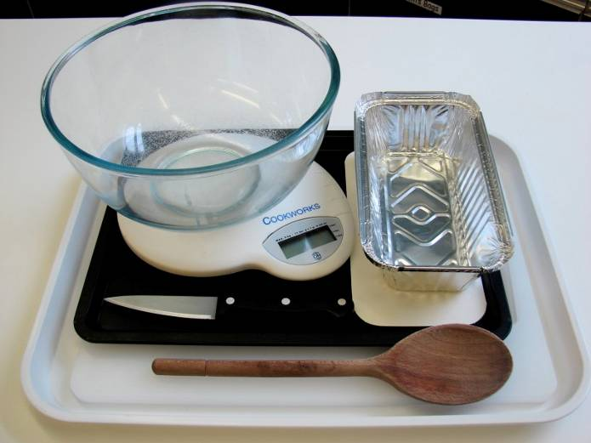
This recipe is from the original Licence to Cook programme and is provided under the Open Government Licence.
Apple and sultana crumble
Ingredients
100g plain flour
50g butter or baking fat/block
50g oats
25g sugar
2 eating apples
50g sultanas
Equipment
Weighing scales
Mixing bowl
Wooden spoon
Chopping board
Knife
Ovenproof dish or foil tray Baking tray
© Food – a fact of life 2019
www.foodafactoflife.org.uk

Slide 2
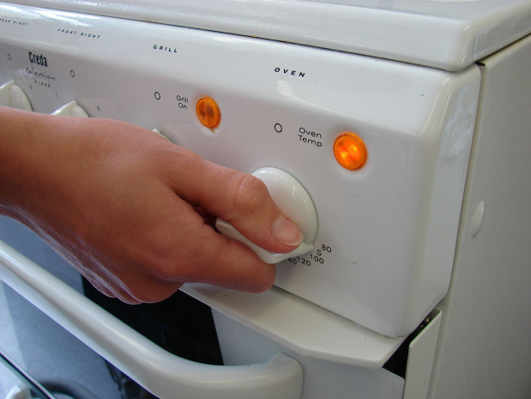
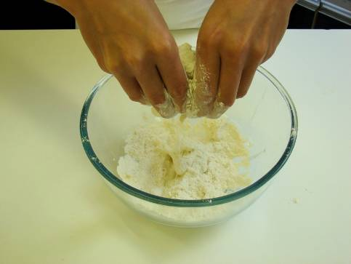
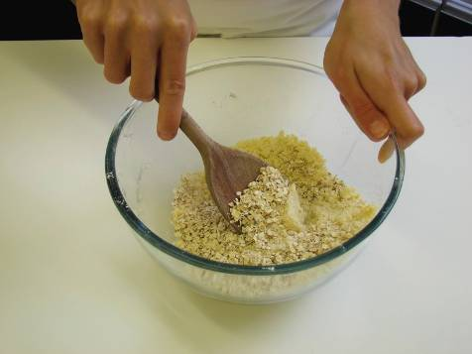
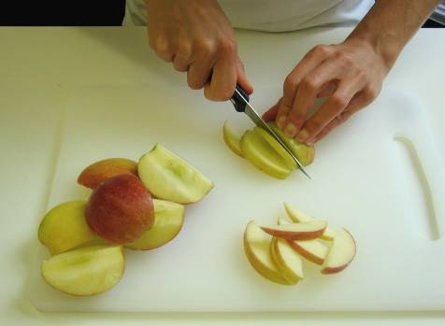
This recipe is from the original Licence to Cook programme and is provided under the Open Government Licence.
Method
Preheat the oven to 190°C or gas mark 5.
Rub in the fat into the flour until it resembles breadcrumbs.
Stir in the oats and sugar.
Cut the apples into quarters and remove the core. Slice thinly.
© Food – a fact of life 2019
www.foodafactoflife.org.uk

Slide 3
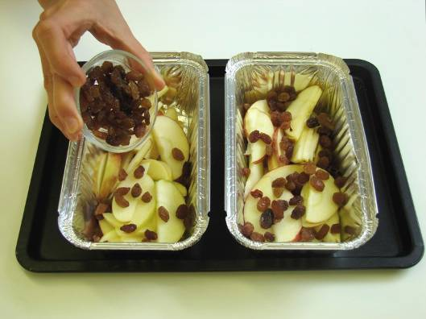
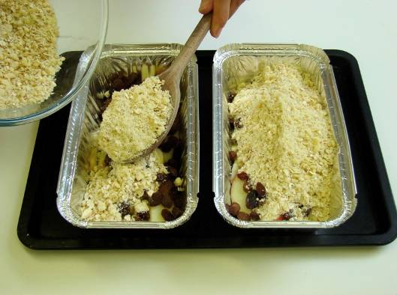
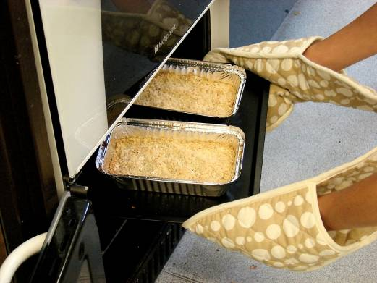
This recipe is from the original Licence to Cook programme and is provided under the Open Government Licence.
Method
Arrange the apple slices in an oven proof/foil tray dish on a baking tray, and then add the sultanas.
Sprinkle the crumble topping over the apple slices.
Bake for 25-30 minutes, until the apples are soft and the crumble is golden.
© Food – a fact of life 2019
www.foodafactoflife.org.uk

