Slide 1

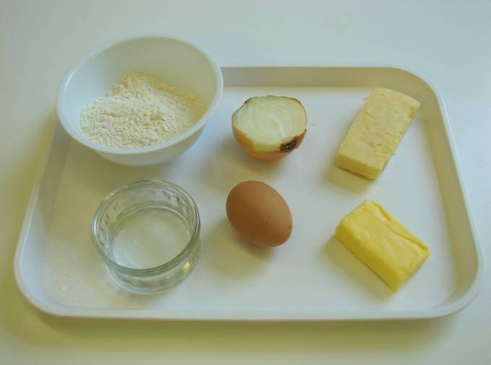
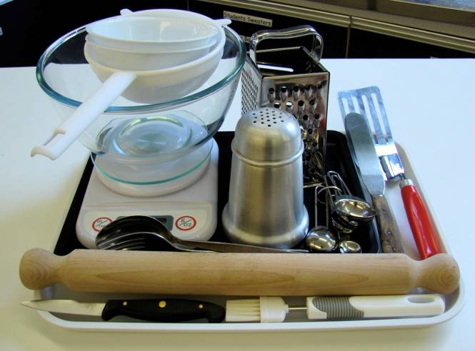
This recipe is from the original Licence to Cook programme and is provided under the Open Government Licence.
Cheese and onion triangles
Ingredients
50g Cheddar cheese
½ small onion
100g plain flour
50g butter or baking fat/block
2 – 3 x 15ml spoons cold water
1 egg
Equipment
Weighing scales
Chopping board
Grater
Knife
Mixing bowl
Sieve
Measuring spoons
Palette knife
Flour dredger
Rolling pin
Spoon
Fork
2 small bowls
Pastry brush
Fish slice
Baking tray
© Food – a fact of life 2019
www.foodafactoflife.org.uk

Slide 2
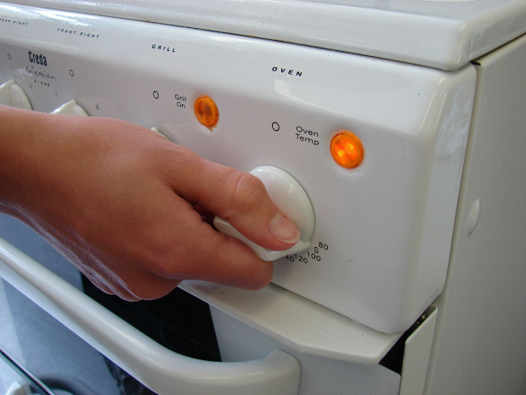
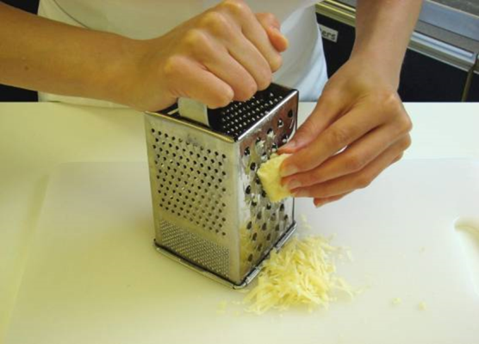
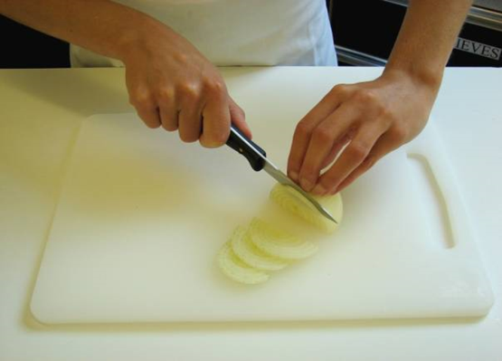
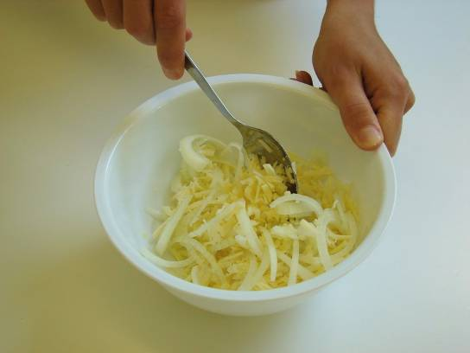
This recipe is from the original Licence to Cook programme and is provided under the Open Government Licence.
Method
Preheat oven to 180°C or gas mark 4.
Prepare the cheese and onion filling:
grate the cheese;
slice the onion;
mix the cheese and onion together.
© Food – a fact of life 2019
www.foodafactoflife.org.uk

Slide 3
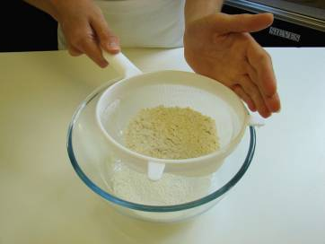
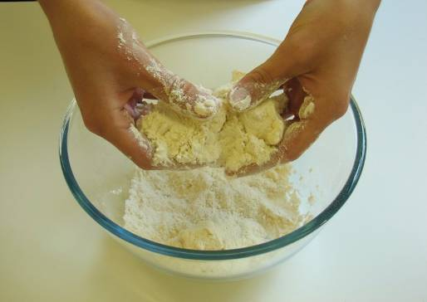
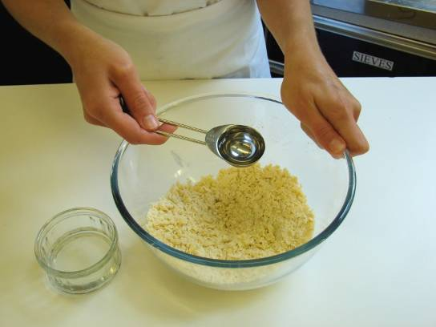
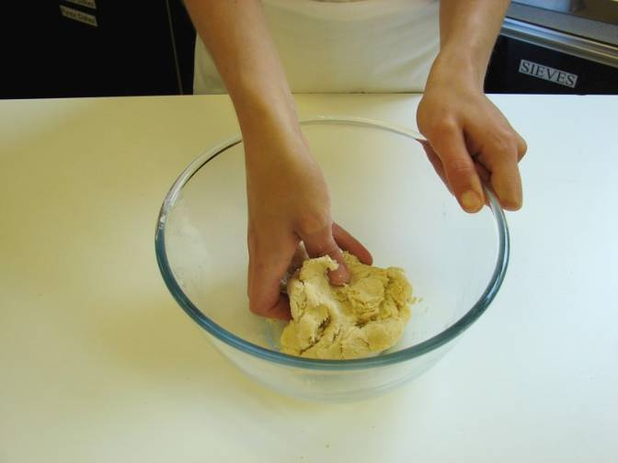
This recipe is from the original Licence to Cook programme and is provided under the Open Government Licence.
Method
Make up the shortcrust pastry:
sift the flour into the bowl;
rub the fat into the flour, using your fingertips, until it resembles breadcrumbs;
add the cold water and start to mix together;
mix to form a firm, smooth dough.
© Food – a fact of life 2019
www.foodafactoflife.org.uk

Slide 4
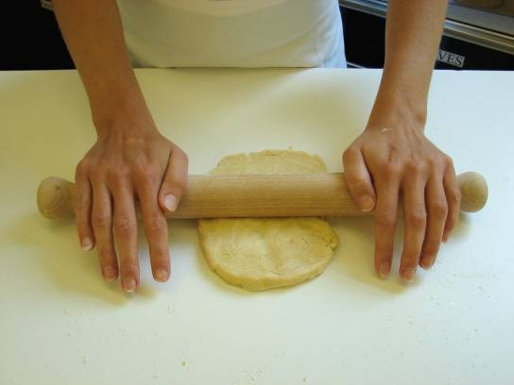
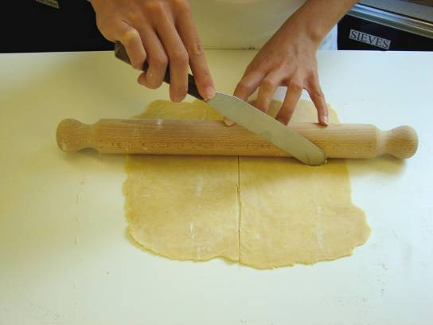
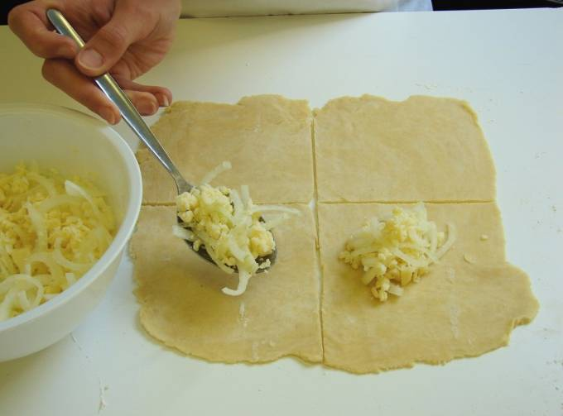
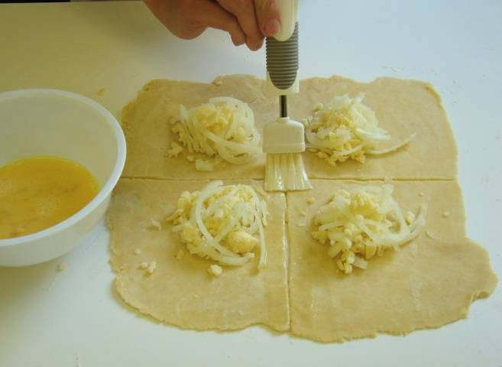
This recipe is from the original Licence to Cook programme and is provided under the Open Government Licence.
Method
Roll out the pastry into a square, on a floured surface.
Cut the square into quarters using the palette knife.
Spoon some cheese filling in the middle of the square.
Next, break the egg into a small bowl and beat with a fork. Brush the edges of the pastry with the beaten egg.
© Food – a fact of life 2019
www.foodafactoflife.org.uk

Slide 5
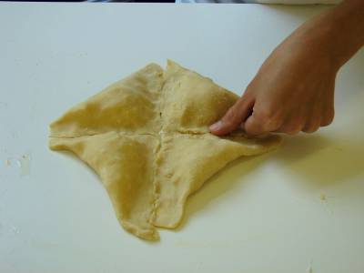
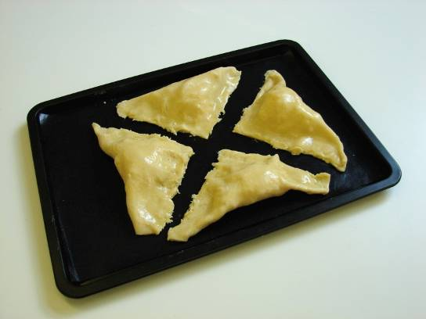
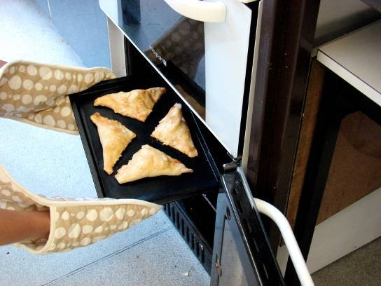
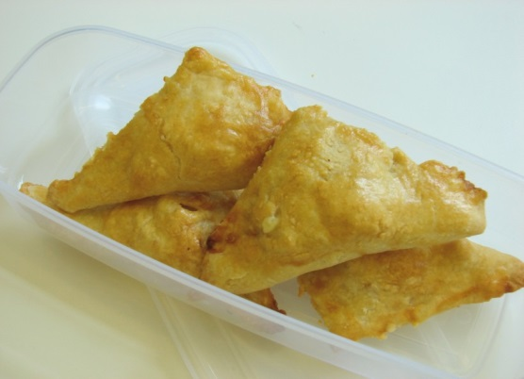
This recipe is from the original Licence to Cook programme and is provided under the Open Government Licence.
Method
Fold over each pasty and pinch them together all the way along.
Transfer them onto the baking tray.
Bake for 20 minutes, until golden brown.
Serve.
© Food – a fact of life 2019
www.foodafactoflife.org.uk

