Slide 1

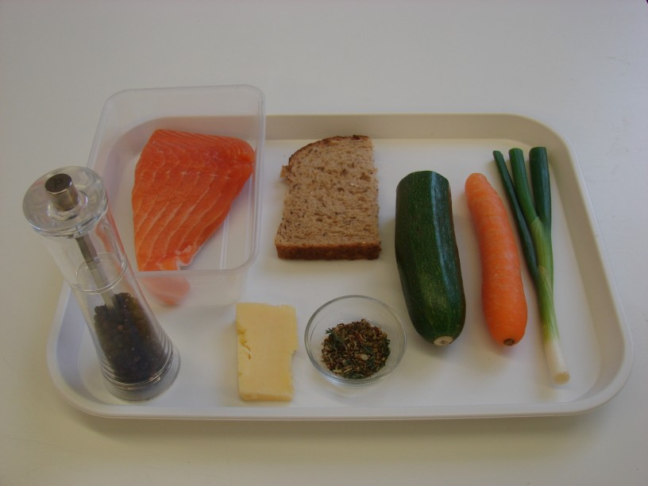
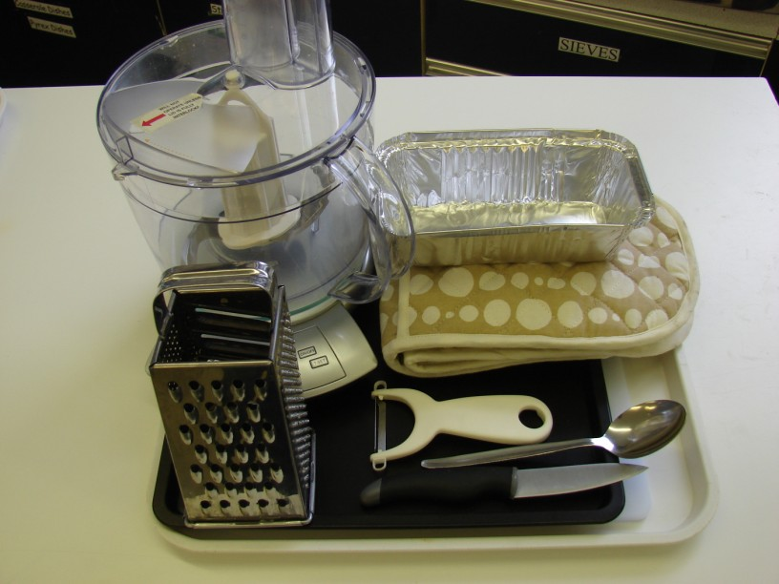
This recipe is from the original Licence to Cook programme and is provided under the Open Government Licence.
Fish and veg stack
Ingredients
1 carrot
½ a courgette
1 piece of fresh fish e.g. salmon (approx. 200g)
25g cheddar cheese
1 spring onion
½ slice bread e.g. granary
1 x 5ml dried mixed herbs
Black pepper
Equipment
Chopping board
Knife
Peeler
Oven proof/foil dish
Baking tray
Food processor
Grater
Spoon
Oven gloves
Weighing scales
© Food – a fact of life 2019
www.foodafactoflife.org.uk

Slide 2
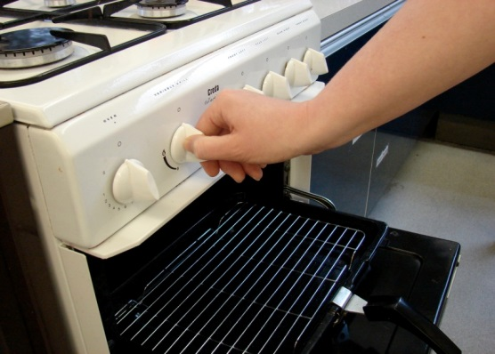
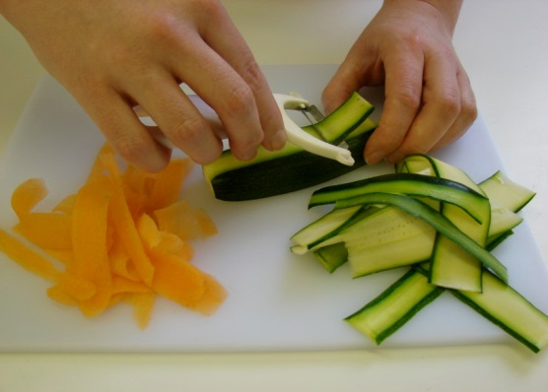
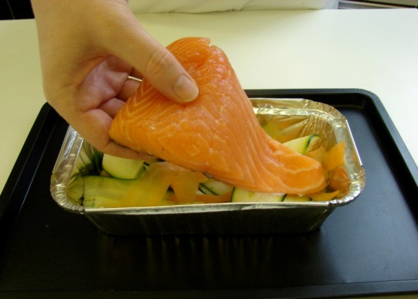
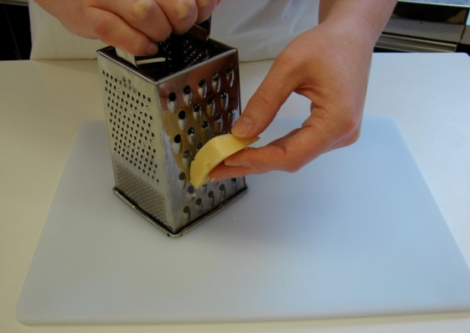
This recipe is from the original Licence to Cook programme and is provided under the Open Government Licence.
Method
Preheat the oven to 200°C or gas mark 6.
Top and tail the carrot and courgette, then run the peeler along each vegetable to make ribbons. Place the ribbons in an oven-proof dish or foil tray on a baking tray.
Lay the fish on top of the vegetables.
Grate the cheese.
© Food – a fact of life 2019
www.foodafactoflife.org.uk

Slide 3
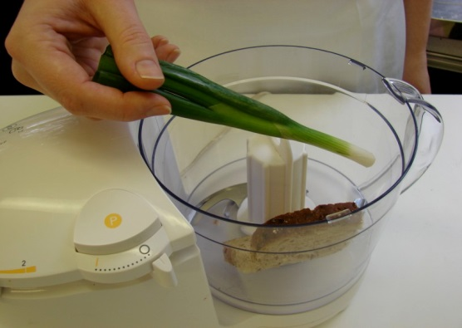
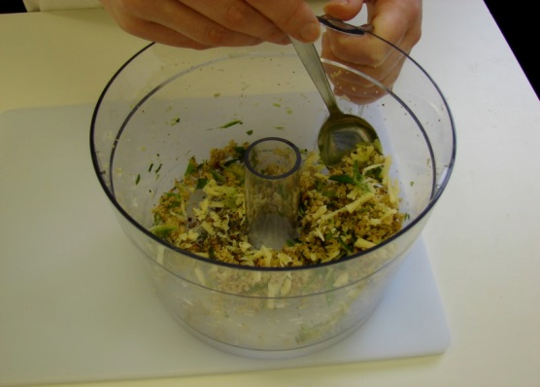
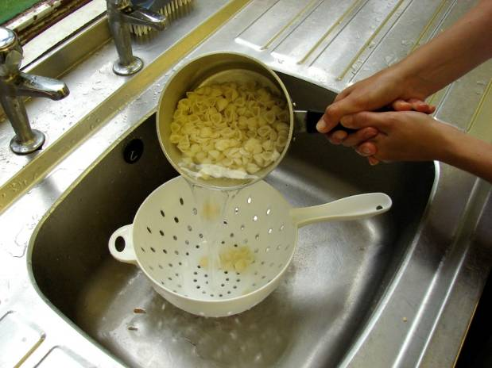
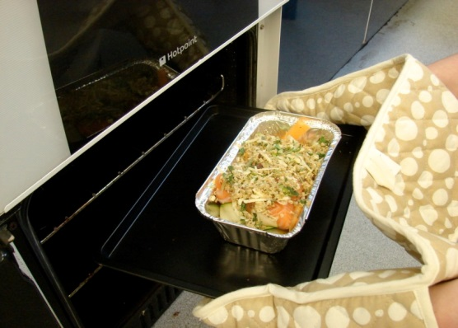
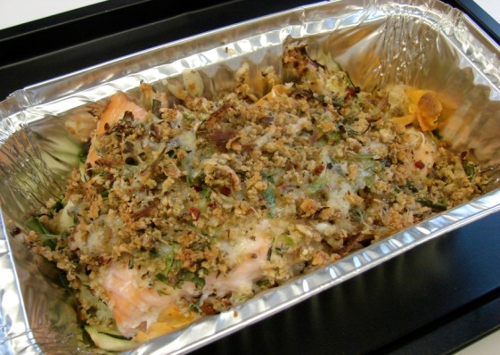
This recipe is from the original Licence to Cook programme and is provided under the Open Government Licence.
Method
Put the spring onion and bread into the food processor and blitz until it resembles breadcrumbs.
Stir in the cheese, herbs and a few twists of black pepper.
Slice the pepper into small strips.
Spoon the mixture on top of the fish and bake in the oven for 20 minutes.
Serve.
© Food – a fact of life 2019
www.foodafactoflife.org.uk

