Slide 1

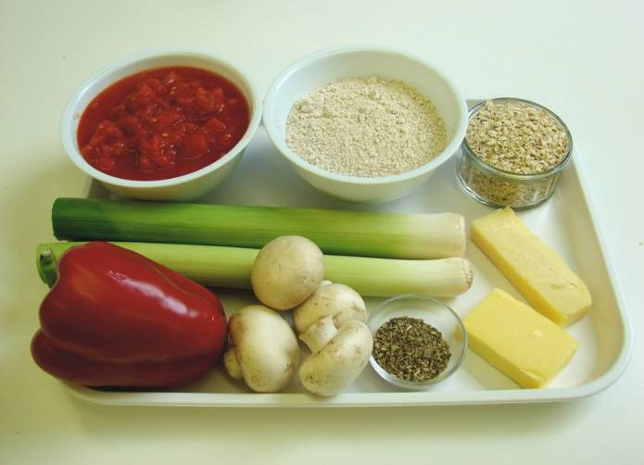
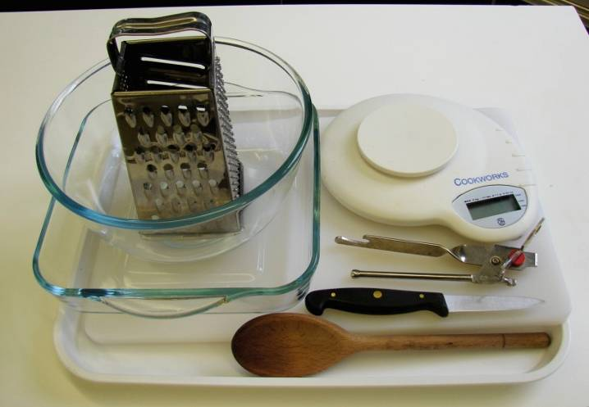
This recipe is from the original Licence to Cook programme and is provided under the Open Government Licence.
Herby veggie crumble
Ingredients
40g butter or baking fat/block
150g wholemeal flour
50g cheese
50g oats
2 x 5ml mixed herbs
2 leeks (small)
1 red pepper
4 mushrooms
1 can chopped tomatoes (400g)
Equipment
Weighing scales
Mixing bowl
Grater
Wooden spoon
Chopping board
Knife
Baking dish (approx. 20cm x 20cm)
Can opener
© Food – a fact of life 2019
www.foodafactoflife.org.uk

Slide 2
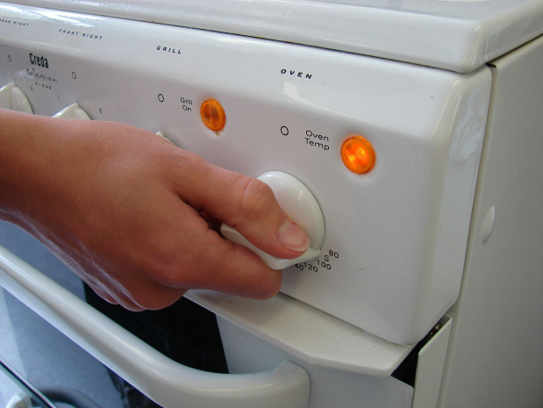
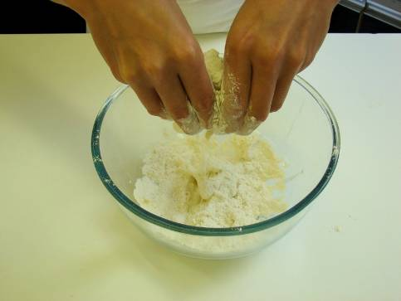
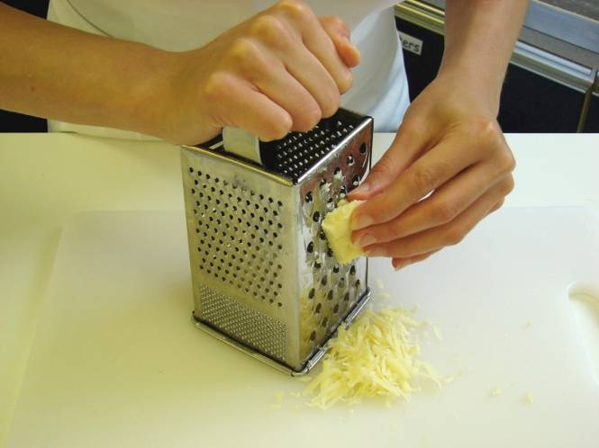
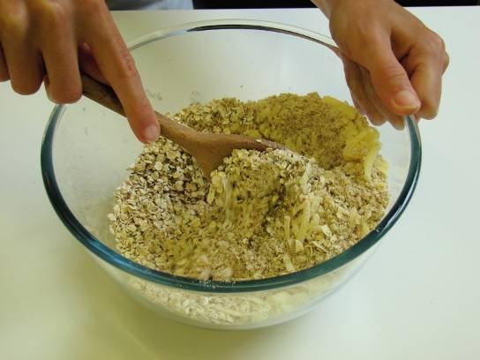
This recipe is from the original Licence to Cook programme and is provided under the Open Government Licence.
Method
Preheat the oven to 200°C or gas mark 6.
Rub in the fat into the flour until it resembles breadcrumbs.
Grate the cheese.
Stir in the grated cheese, oats and 1 x 5ml mixed herbs.
© Food – a fact of life 2019
www.foodafactoflife.org.uk

Slide 3
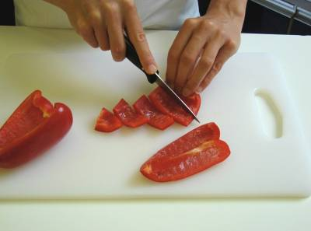
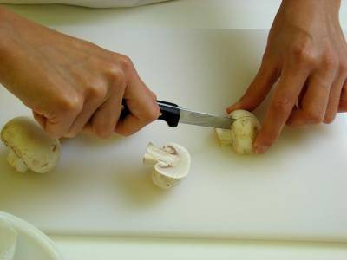
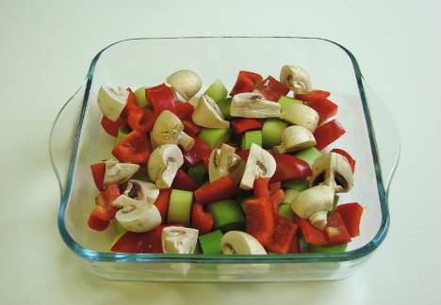
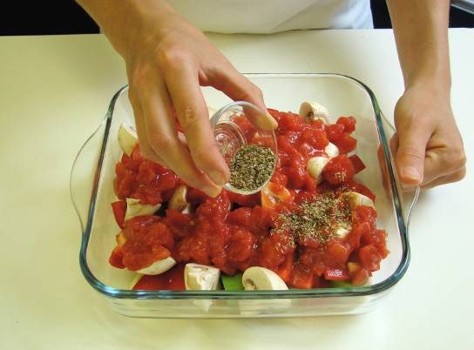
This recipe is from the original Licence to Cook programme and is provided under the Open Government Licence.
Method
Slice the leeks and red pepper.
Quarter the mushrooms.
Arrange the vegetables in a baking dish.
Pour over the canned tomatoes and 1 x 5ml spoon mixed herbs.
© Food – a fact of life 2019
www.foodafactoflife.org.uk

Slide 4
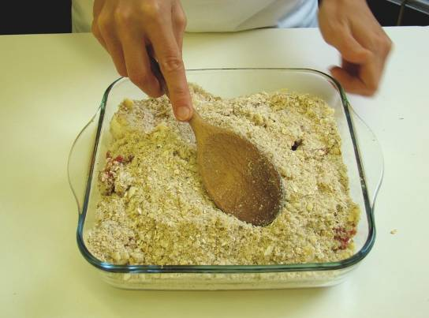
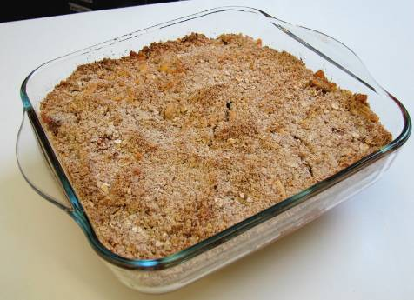
This recipe is from the original Licence to Cook programme and is provided under the Open Government Licence.
Method
Sprinkle the crumble topping over the vegetables.
Bake in the oven for 25-30 minutes, until golden.
© Food – a fact of life 2019
www.foodafactoflife.org.uk

