Slide 1

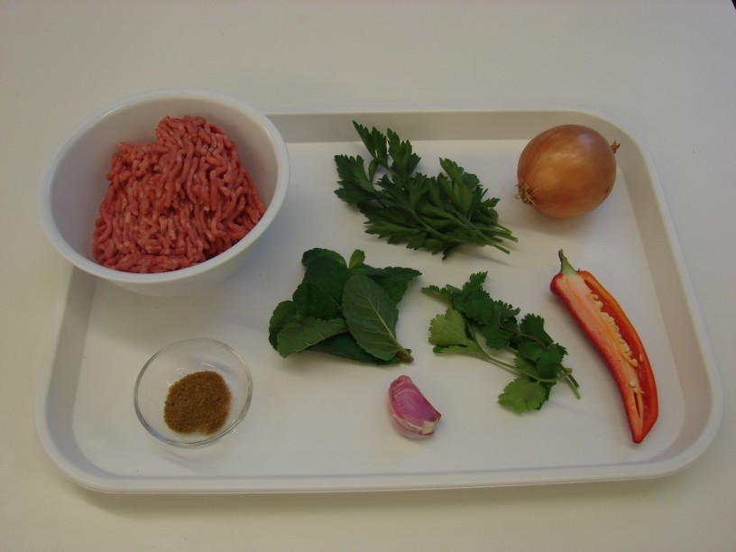
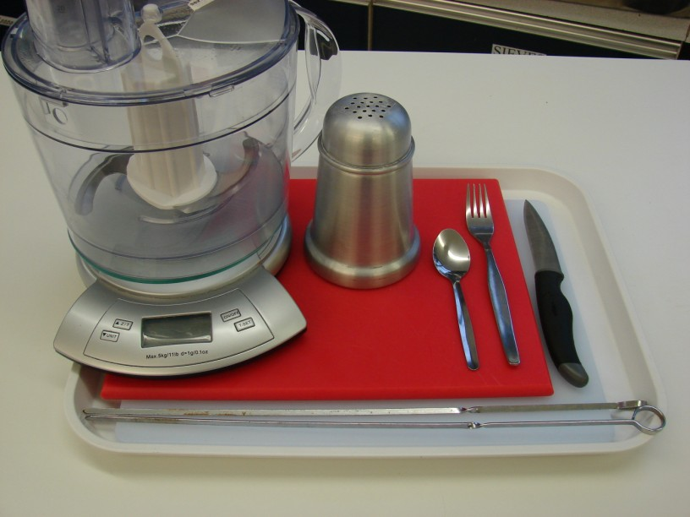
This recipe is from the original Licence to Cook programme and is provided under the Open Government Licence.
Koftas
Ingredients
1 small onion
1 clove of garlic
1/2 red chilli
200g lamb mince
1 x 5ml spoon cumin
1 sprig of parsley, mint and coriander
Equipment
Chopping boards
Knife
Fork
Food processor
Flour dredger
Skewers
© Food – a fact of life 2019
www.foodafactoflife.org.uk

Slide 2
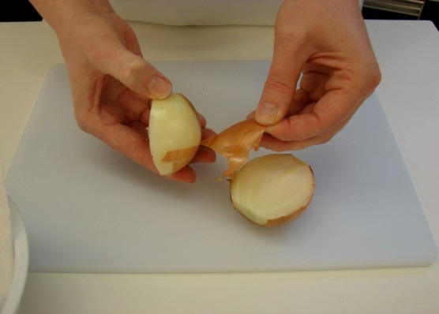
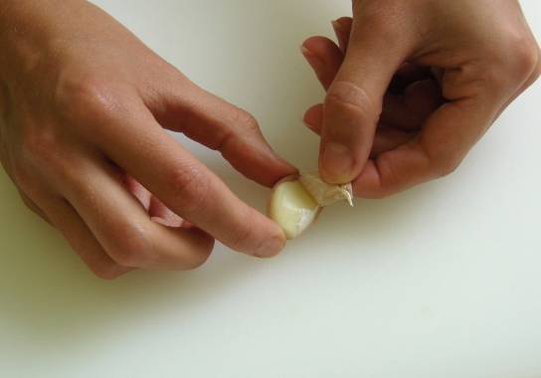
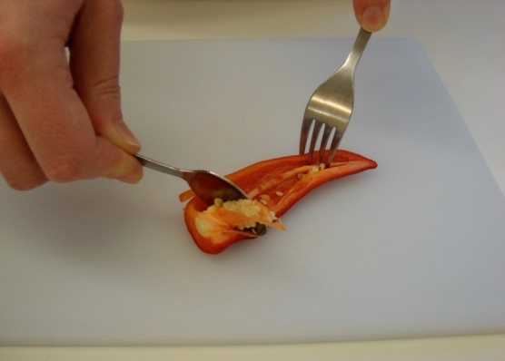
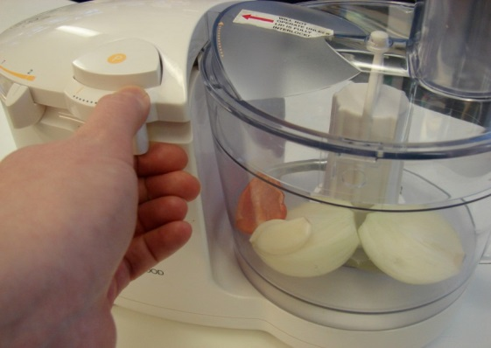
This recipe is from the original Licence to Cook programme and is provided under the Open Government Licence.
Method
Peel the onion and cut in half.
Peel the garlic.
Cut off the top of the chilli and remove the seeds.
Put the onion, chilli and garlic into the food processor and blitz.
© Food – a fact of life 2019
www.foodafactoflife.org.uk

Slide 3
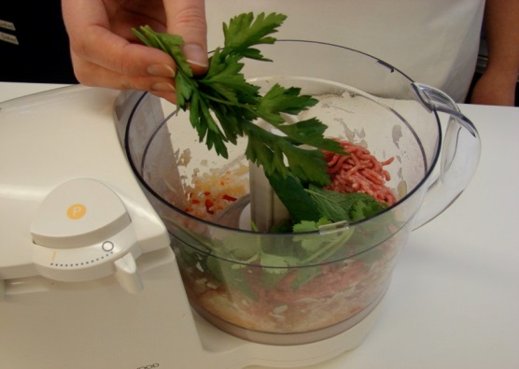
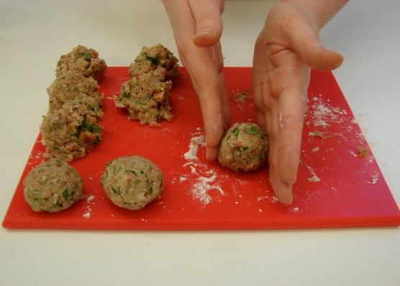
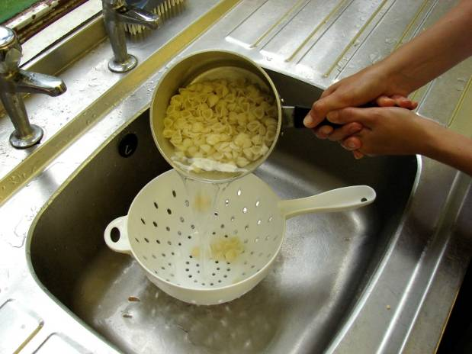
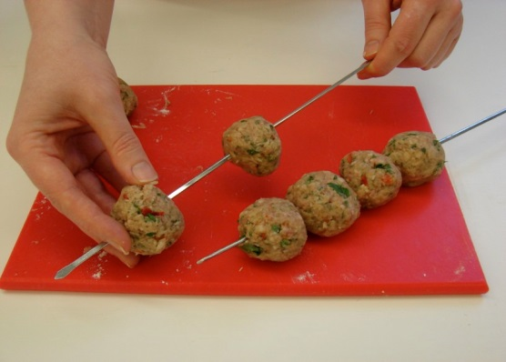
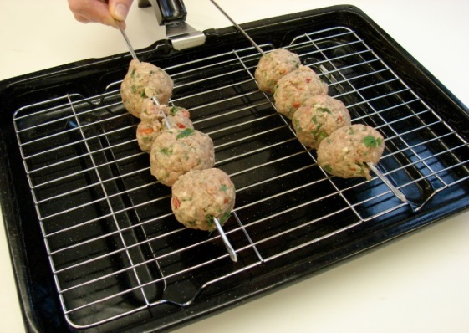
This recipe is from the original Licence to Cook programme and is provided under the Open Government Licence.
Method
Add the mince, cumin and herbs and blitz together.
Sprinkle a little flour onto a chopping board, then divide and shape the mixture into 8 balls.
Slice the pepper into small strips.
Thread the meat balls onto the skewers.
Carefully place the skewers onto a grill pan.
© Food – a fact of life 2019
www.foodafactoflife.org.uk

Slide 4
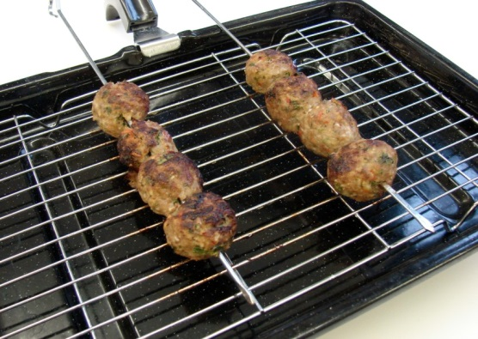
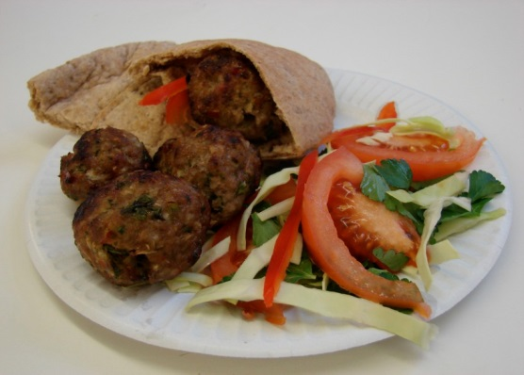
This recipe is from the original Licence to Cook programme and is provided under the Open Government Licence.
Method
Grill for 10-15 minutes, turning occasionally to ensure even cooking. The meatballs should be thoroughly cooked – no pink.
Slice the pepper into small strips.
Serve in a pitta with salad.
© Food – a fact of life 2019
www.foodafactoflife.org.uk

