Slide 1

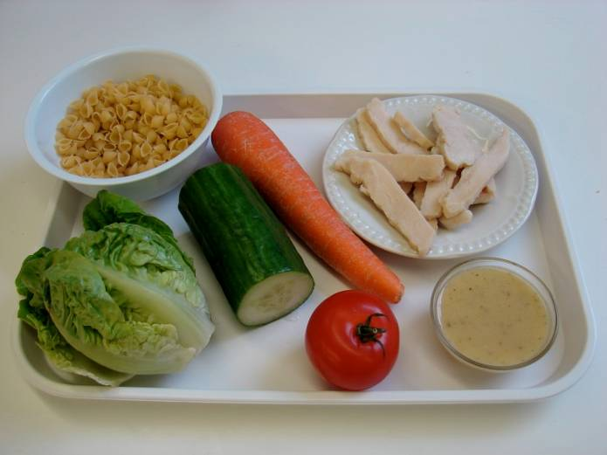
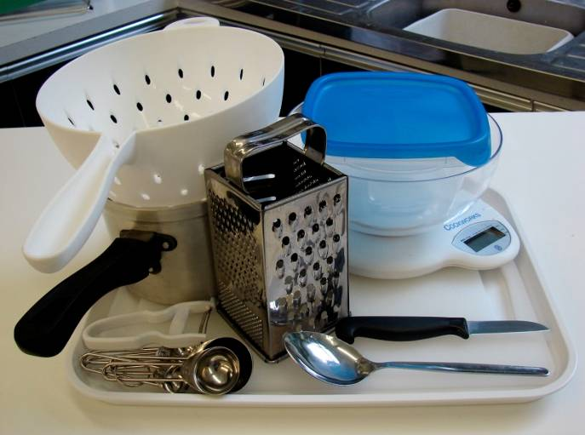
This recipe is from the original Licence to Cook programme and is provided under the Open Government Licence.
Layered pasta salad
Ingredients
100g pasta shapes
1 carrot
100g cooked sliced chicken
1 baby gem lettuce
1 tomato
¼ cucumber
2 x15ml spoons low-fat dressing
Equipment
Weighing scales
Saucepan
Chopping board
Knife
Vegetable peeler
Grater
Measuring spoons
Spoon
Colander
Serving dish
© Food – a fact of life 2019
www.foodafactoflife.org.uk

Slide 2
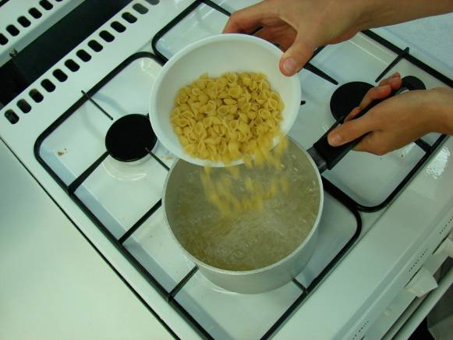
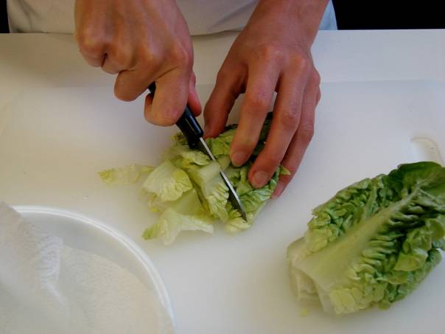
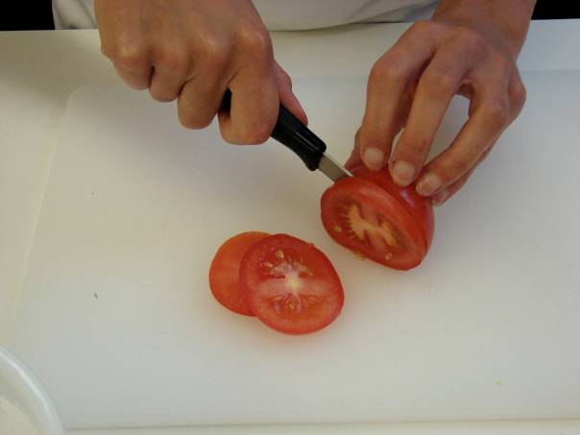
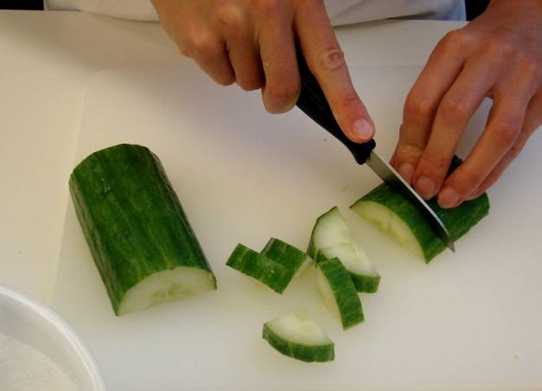
This recipe is from the original Licence to Cook programme and is provided under the Open Government Licence.
Method
Bring a small saucepan of water to the boil, then add the pasta. Simmer for about 8-10 minutes (check the packet instructions).
While the pasta is cooking, prepare the other ingredients:
  shred the lettuce;
  slice the tomato;
  chop the cucumber into small chunks;
© Food – a fact of life 2019
www.foodafactoflife.org.uk

Slide 3
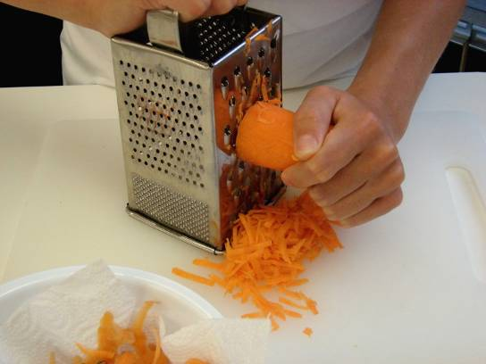
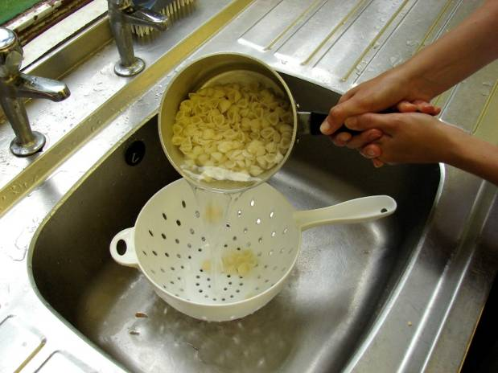
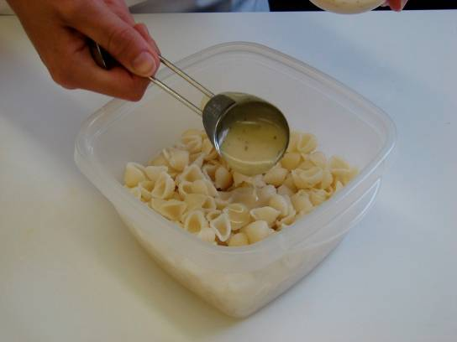
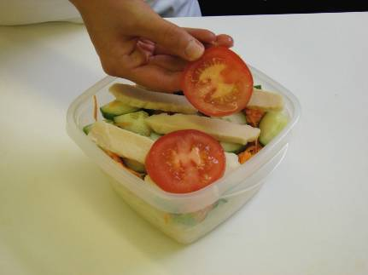
This recipe is from the original Licence to Cook programme and is provided under the Open Government Licence.
Method
  peel and grate the carrot.
Drain the boiling water away from the pasta into a colander in the sink. Cool the pasta by rinsing under a cold tap for a few moments. Drain well.
Place the pasta in the serving dish and stir in 1 x 15ml spoon of dressing.
Assemble the remaining ingredients over the pasta in layers.
© Food – a fact of life 2019
www.foodafactoflife.org.uk

Slide 4
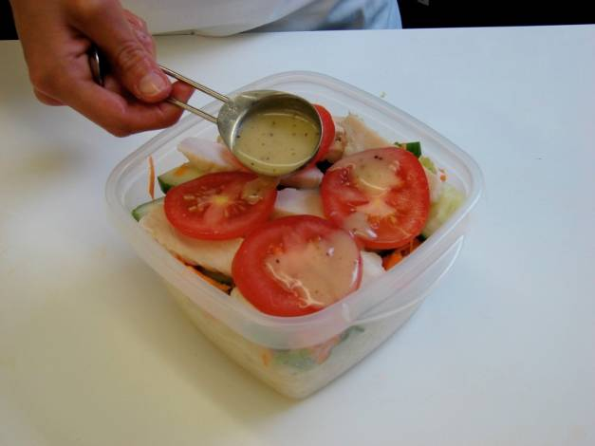
This recipe is from the original Licence to Cook programme and is provided under the Open Government Licence.
Method
Lastly, drizzle over the remaining dressing.
© Food – a fact of life 2019
www.foodafactoflife.org.uk

