Slide 1

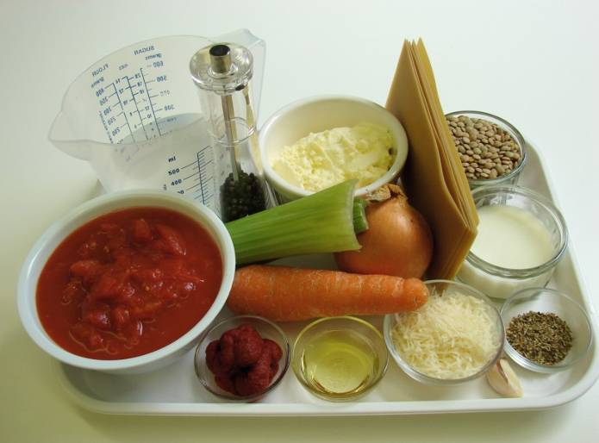
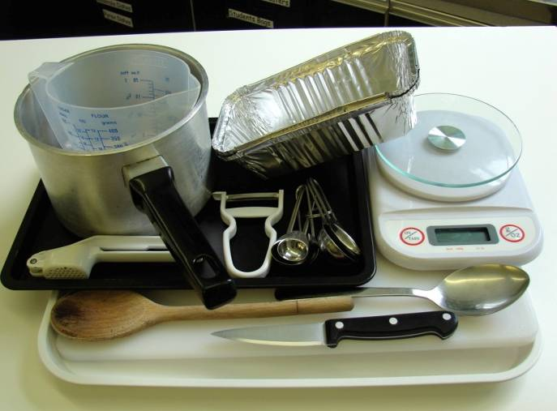
This recipe is from the original Licence to Cook programme and is provided under the Open Government Licence.
Quick ‘V’ lasagne
Ingredients
1 onion
1 garlic clove
1 carrot
2 celery sticks
1 x 10ml spoon oil
100g green lentils
1 can chopped tomatoes (400g)
1 x 5ml spoon mixed herbs
1 x 15ml spoon tomato puree
200ml crème fraiche, reduced fat
25g parmesan, grated
100ml semi-skimmed milk
Black pepper
6 lasagne sheets
Equipment
Chopping board
Knife
Garlic press
Peeler
Measuring spoons
Frying pan
Measuring jug
Small bowl
Spoon
Foil trays
Baking tray
© Food – a fact of life 2019
www.foodafactoflife.org.uk

Slide 2
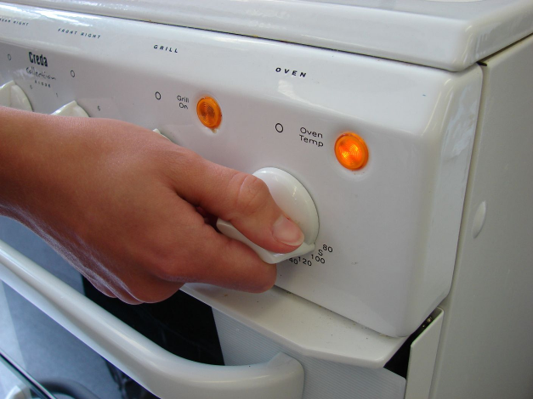
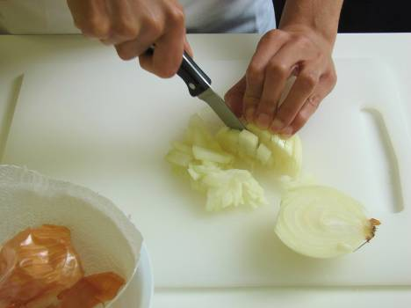
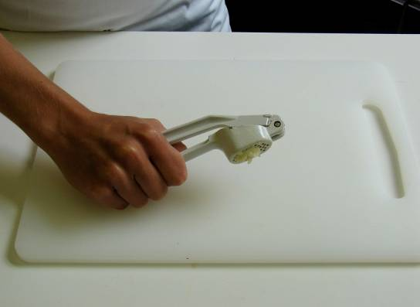
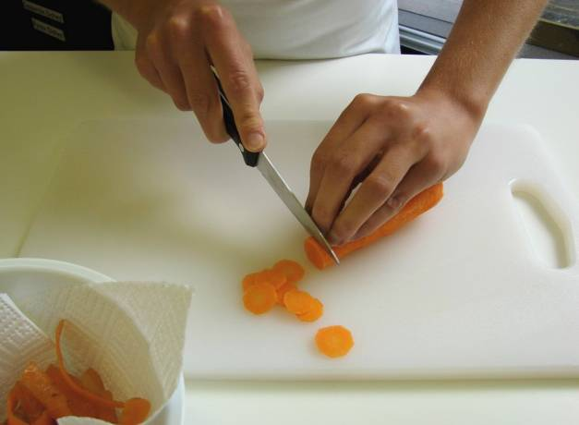
This recipe is from the original Licence to Cook programme and is provided under the Open Government Licence.
Method
Preheat the oven to 190°C or gas mark 5.
Prepare the vegetables:
  peel and chop the onion;
  peel and crush the garlic;
  peel and slice the carrot;
© Food – a fact of life 2019
www.foodafactoflife.org.uk

Slide 3
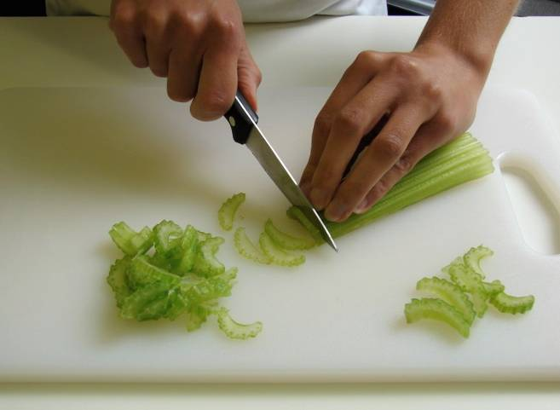
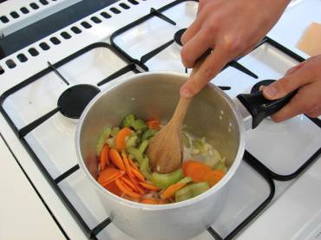
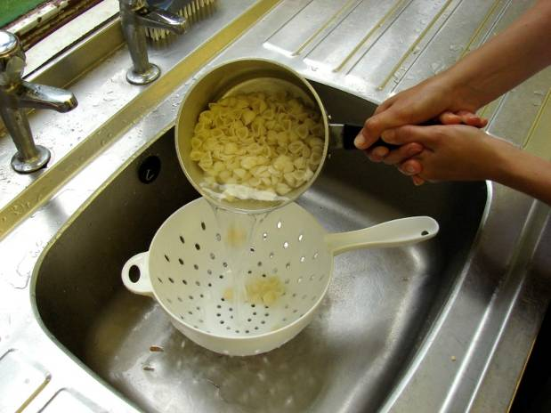
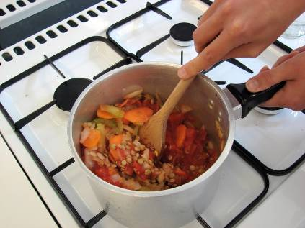
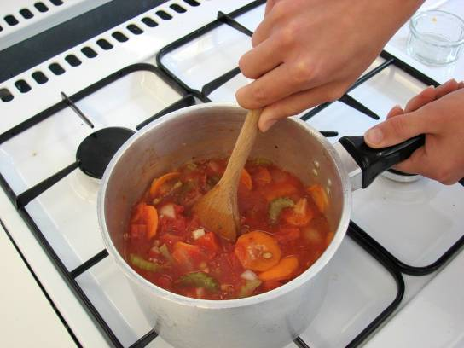
This recipe is from the original Licence to Cook programme and is provided under the Open Government Licence.
Method
  slice the celery.
Fry the onion, garlic, carrot and celery in the oil until soft – about 4 minutes.
Slice the pepper into small strips.
Add the lentils, tomatoes, herbs and tomato puree.
Pour in some water, just enough to cover the mixture, bring to the boil and then allow to simmer for 15 minutes with the lid on.
© Food – a fact of life 2019
www.foodafactoflife.org.uk

Slide 4
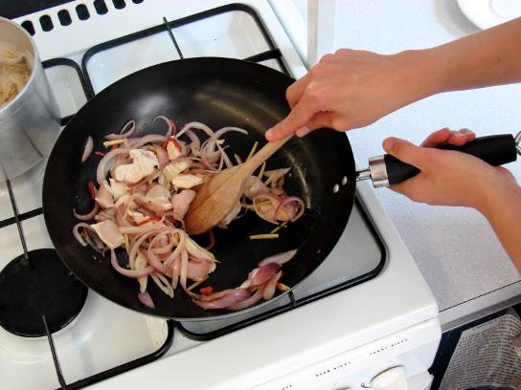
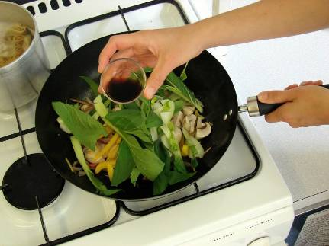
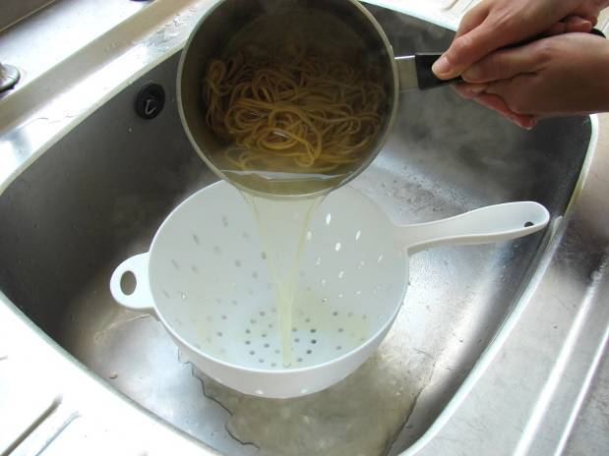
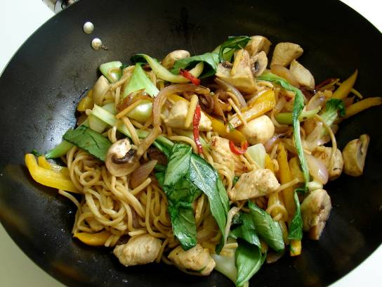
This recipe is from the original Licence to Cook programme and is provided under the Open Government Licence.
Method
Blend the crème fraiche, half the grated cheese, milk and pepper together in a small bowl.
Place an ovenproof dish or foil tray on a baking tray. Spread some mixture in the bottom, cover with lasagne sheets and a little crème fraiche sauce.
Slice the pepper into small strips.
Repeat the previous step, finishing with crème fraiche sauce on top.
Sprinkle the remaining grated cheese on top and bake for 20 minutes.
© Food – a fact of life 2019
www.foodafactoflife.org.uk

