Slide 1

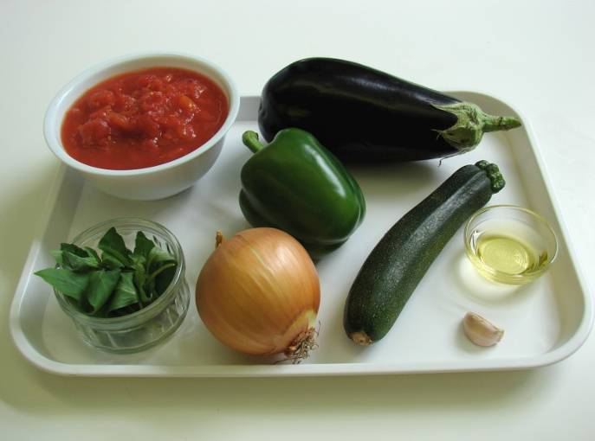
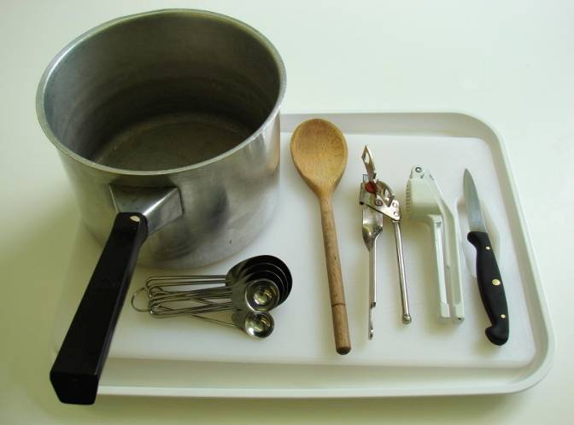
This recipe is from the original Licence to Cook programme and is provided under the Open Government Licence.
Ratatouille
Ingredients
1 onion
1 clove garlic
1 small aubergine
1 green pepper
1 courgette
2 cans chopped tomatoes (800g)
1 x 10ml spoon oil
1 handful fresh basil
Equipment
Chopping board
Knife
Garlic press
Measuring spoons
Saucepan
Wooden spoon
Can opener
© Food – a fact of life 2019
www.foodafactoflife.org.uk

Slide 2
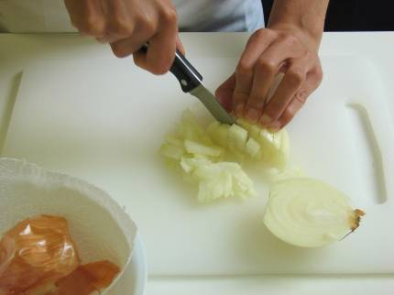
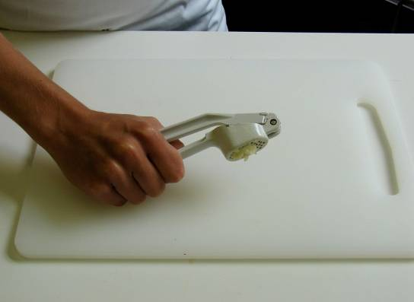
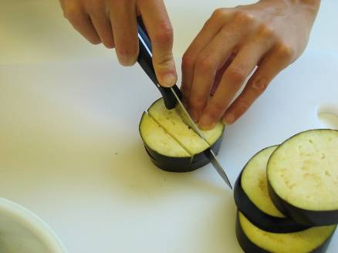
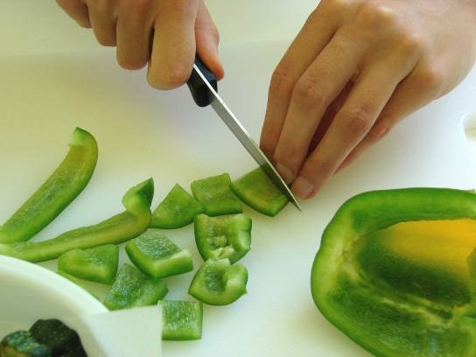
This recipe is from the original Licence to Cook programme and is provided under the Open Government Licence.
Method
Prepare the vegetables:
  peel and chop the onion;
  peel and crush the garlic;
  dice the aubergine;
  de-seed and chop the green pepper;
© Food – a fact of life 2019
www.foodafactoflife.org.uk

Slide 3
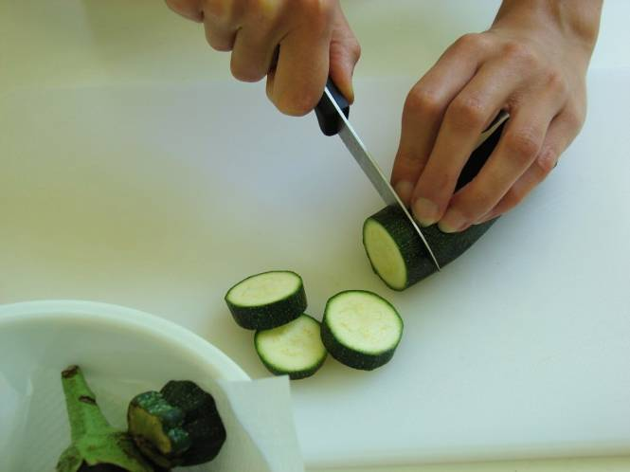
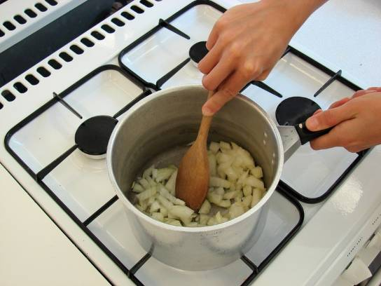
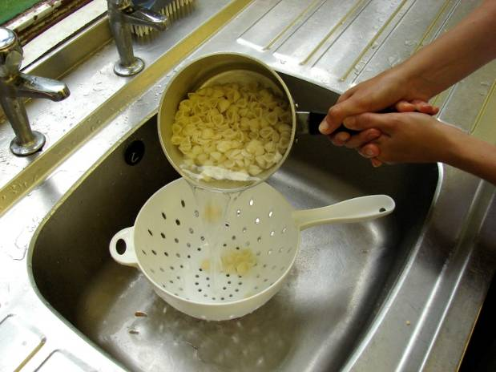
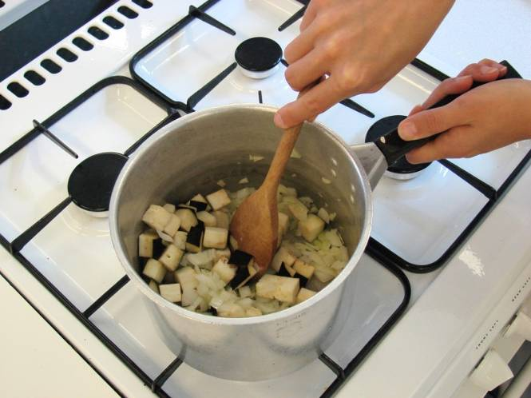
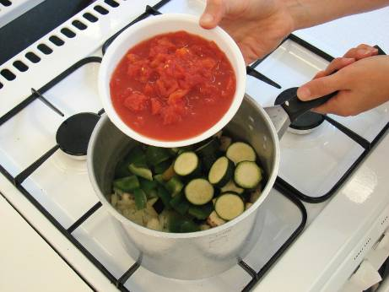
This recipe is from the original Licence to Cook programme and is provided under the Open Government Licence.
Method
  slice the courgette.
Fry the onion and garlic in the oil for 5 minutes.
Slice the pepper into small strips.
Add the aubergine and fry for a further 5 minutes.
Add the pepper, courgette and tomatoes.
© Food – a fact of life 2019
www.foodafactoflife.org.uk

Slide 4
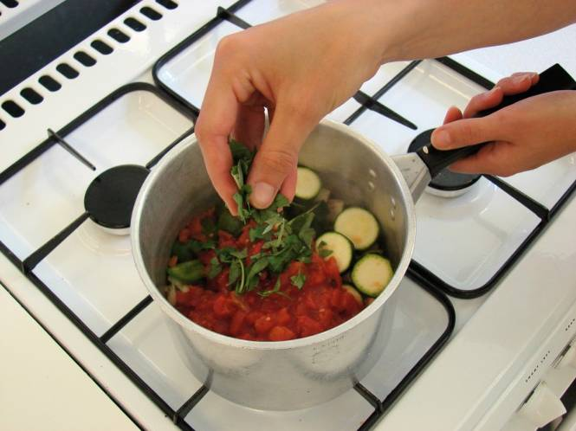
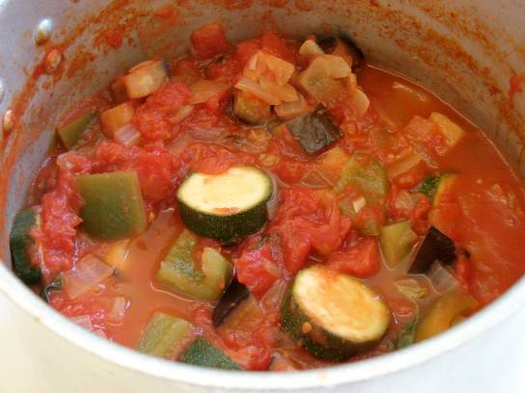
This recipe is from the original Licence to Cook programme and is provided under the Open Government Licence.
Method
Stir in the torn basil leaves.
Bring to the boil and then simmer gently, with the lid on the saucepan, for 20-30 minutes.
Slice the pepper into small strips.
© Food – a fact of life 2019
www.foodafactoflife.org.uk

