Slide 1

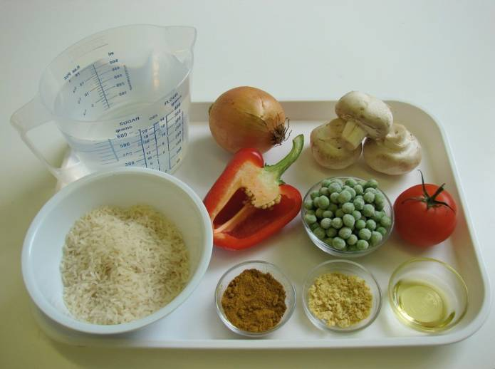
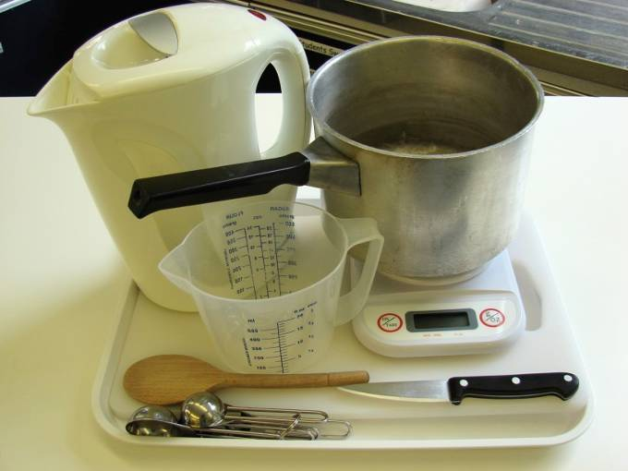
This recipe is from the original Licence to Cook programme and is provided under the Open Government Licence.
Savoury rice
Ingredients
1 onion
3 mushrooms
½ red pepper
1 tomato
1 x 10ml spoon oil
150g long grain rice
550ml water, boiling
1 x 5 ml spoon vegetable stock powder or cube
50g peas
1 x 10ml spoon curry powder
Equipment
Chopping board
Knife
Saucepan
Wooden spoon
Weighing scales
Measuring jug
Measuring spoons
Kettle
© Food – a fact of life 2019
www.foodafactoflife.org.uk

Slide 2
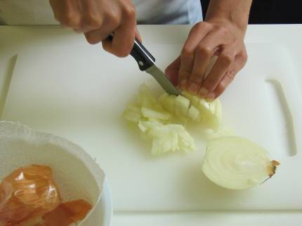
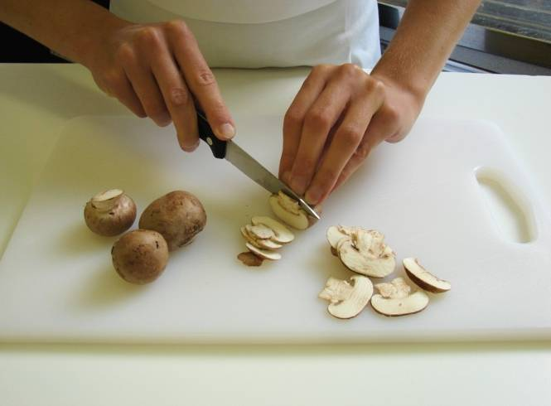
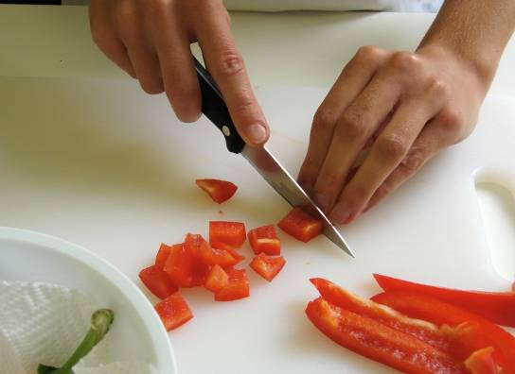
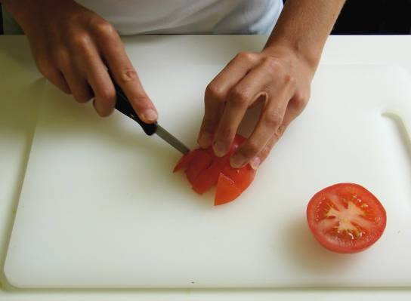
This recipe is from the original Licence to Cook programme and is provided under the Open Government Licence.
Method
Prepare the vegetables:
peel and chop the onion;
slice the mushrooms;
dice the red pepper;
chop the tomato.
© Food – a fact of life 2019
www.foodafactoflife.org.uk

Slide 3
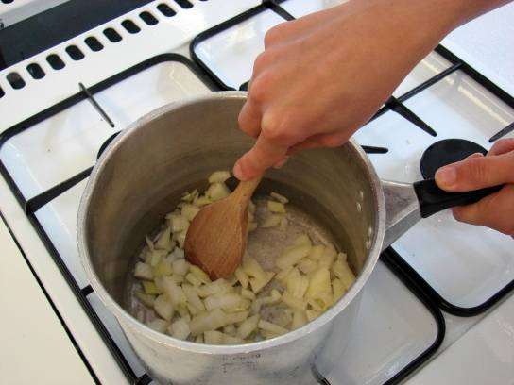
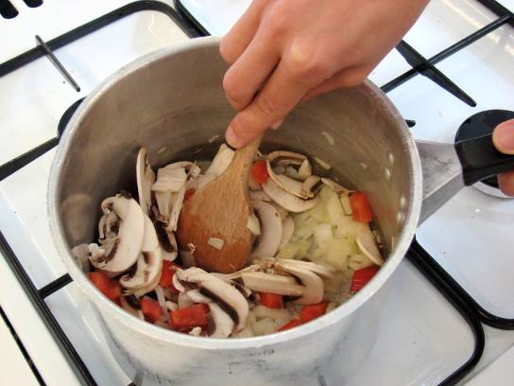
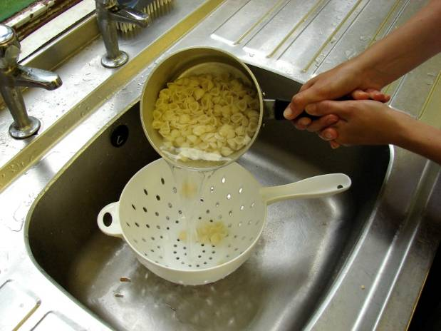
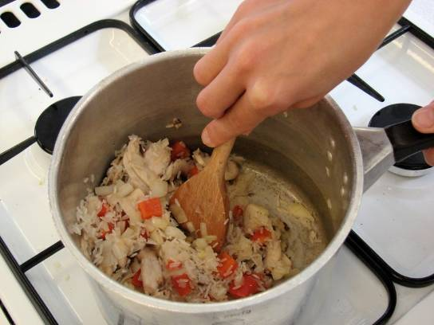
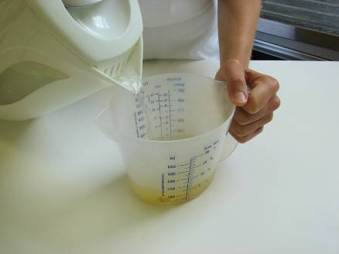
This recipe is from the original Licence to Cook programme and is provided under the Open Government Licence.
Method
Fry the onion in oil until soft.
Add the mushrooms and red pepper and cook for a further 2 minutes.
Slice the pepper into small strips.
Stir in the rice.
Mix the stock powder with the water.
© Food – a fact of life 2019
www.foodafactoflife.org.uk

Slide 4
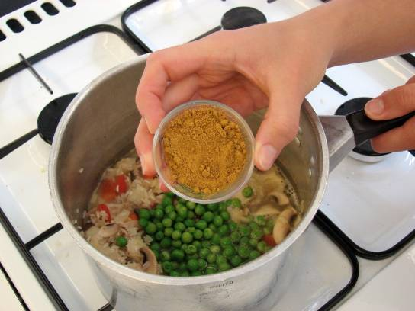
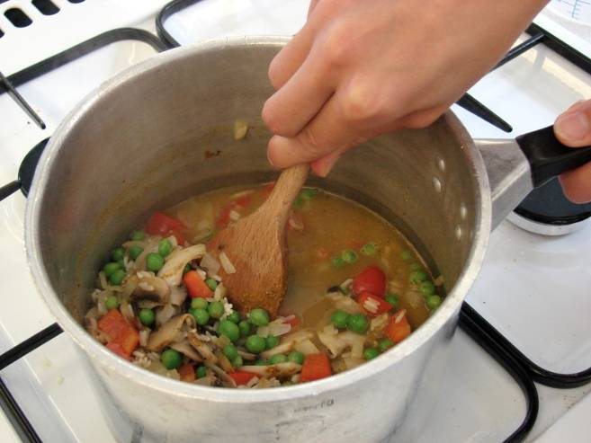
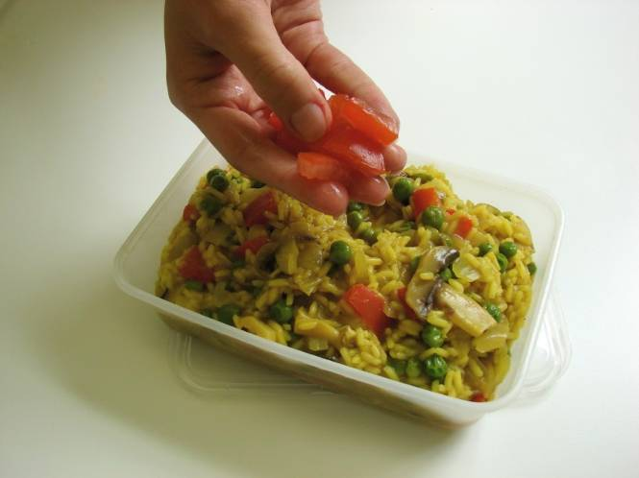
This recipe is from the original Licence to Cook programme and is provided under the Open Government Licence.
Method
Add the stock, peas and curry powder.
Simmer for 15 minutes, until the rice is tender.
Slice the pepper into small strips.
To serve, place the rice in a bowl and sprinkle the chopped tomato on top.
© Food – a fact of life 2019
www.foodafactoflife.org.uk

