Slide 1

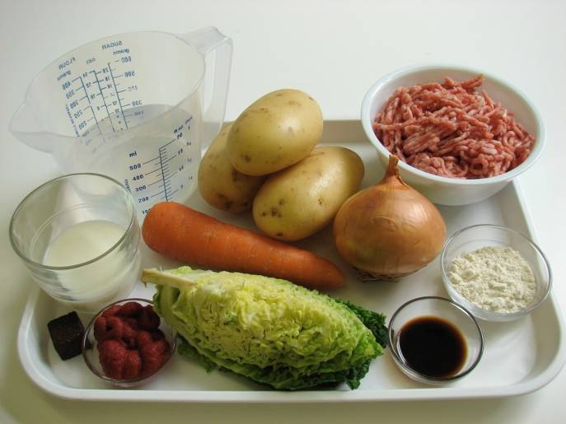
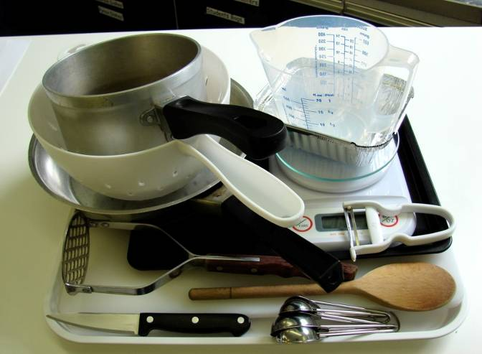
This recipe is from the original Licence to Cook programme and is provided under the Open Government Licence.
Shepherd’s pie
Ingredients
1 onion
1 carrot
3 medium potatoes (700g)
¼ Savoy cabbage
250g lean minced lamb
1 x 15ml spoon plain flour
1 x 15ml spoon tomato purée
1 x 15ml spoon Worcestershire sauce
300ml water, boiling
1 x 5ml stock cube
150ml semi-skimmed milk
Equipment
Chopping board
Knife
Vegetable peeler
Weighing scales
Measuring spoons
Saucepan
Non-stick frying pan
Wooden spoon
Measuring jug
Colander
Potato masher
Ovenproof dish/foil tray
Baking tray
© Food – a fact of life 2019
www.foodafactoflife.org.uk

Slide 2
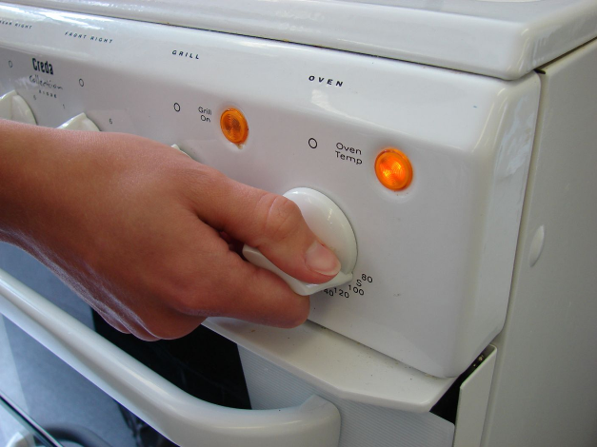
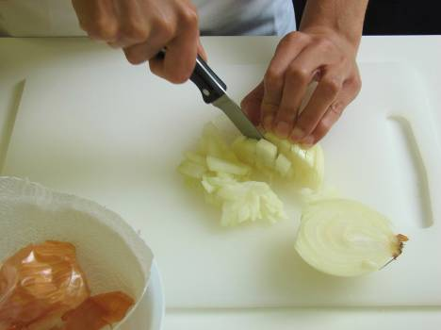
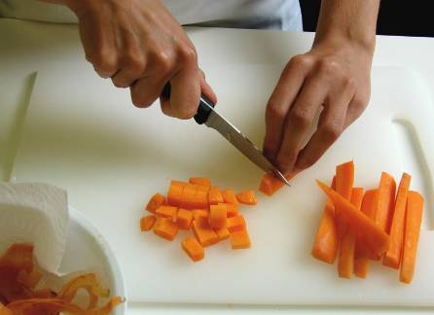
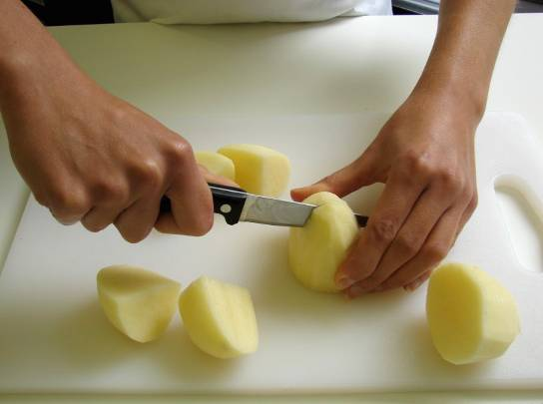
This recipe is from the original Licence to Cook programme and is provided under the Open Government Licence.
Method
Preheat the oven to 200°C or gas mark 6.
Prepare the vegetables:
peel and chop the onion;
peel and dice the carrots;
peel and cut the potatoes into chunks;
© Food – a fact of life 2019
www.foodafactoflife.org.uk

Slide 3
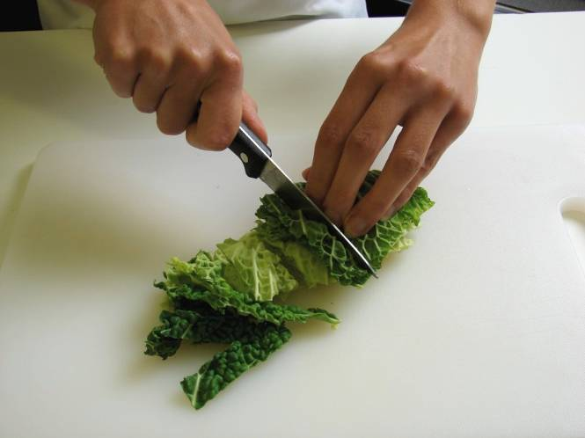
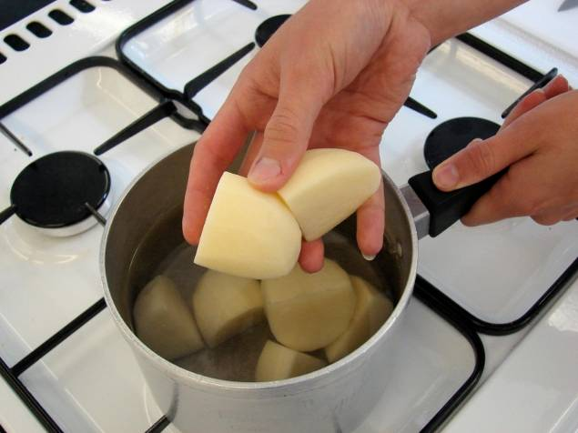
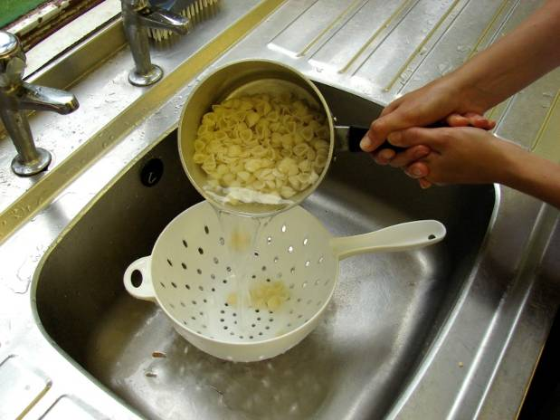
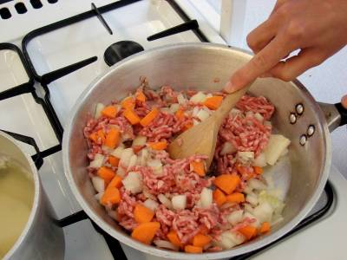
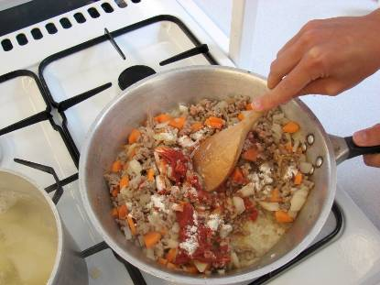
This recipe is from the original Licence to Cook programme and is provided under the Open Government Licence.
Method
shred the cabbage.
Place the potatoes in a saucepan of water, bring to the boil and simmer for 20 minutes, until soft.
Slice the pepper into small strips.
Meanwhile, in a non-stick frying pan, dry fry the lamb with the onion and carrots, until the mince is browned.
Stir in the flour, tomato purée and Worcestershire sauce.
© Food – a fact of life 2019
www.foodafactoflife.org.uk

Slide 4
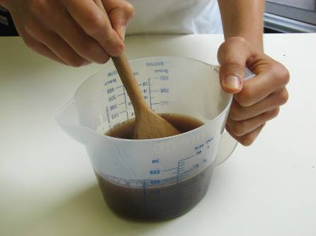
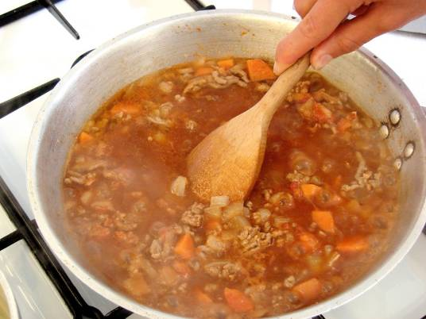
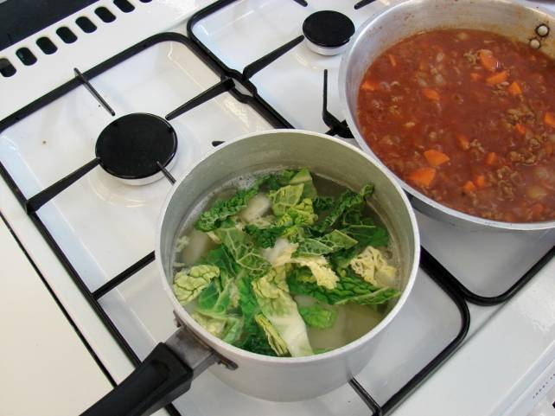
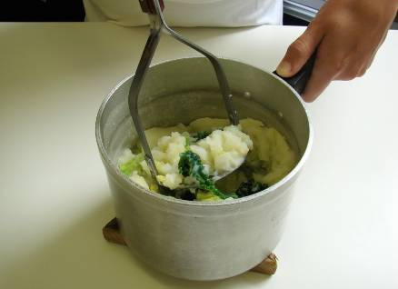
This recipe is from the original Licence to Cook programme and is provided under the Open Government Licence.
Method
Add the stock cube to the water to make up the stock.
Add the stock to the meat mixture, bring to the boil and then simmer for 5-10 minutes, until the carrot is soft.
Slice the pepper into small strips.
During the last 5 minutes of cooking the potatoes, add the cabbage.
Drain the potatoes in a colander over the sink and mash with the milk.
© Food – a fact of life 2019
www.foodafactoflife.org.uk

Slide 5
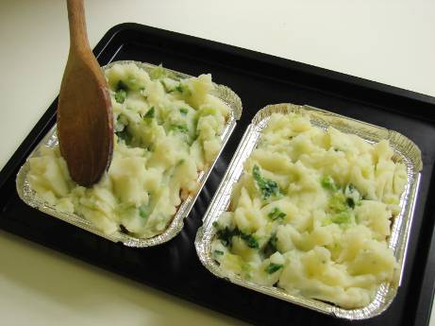
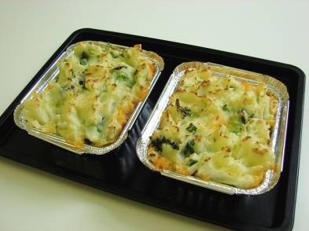
This recipe is from the original Licence to Cook programme and is provided under the Open Government Licence.
Method
Place the ovenproof dish or foil tray on a baking tray. Spread the meat mixture into an ovenproof dish and spoon the mash over the top.
Cook for 20-25 minutes, until golden brown, or take home and cook in the oven for the same amount of time.
Slice the pepper into small strips.
© Food – a fact of life 2019
www.foodafactoflife.org.uk

