Slide 1

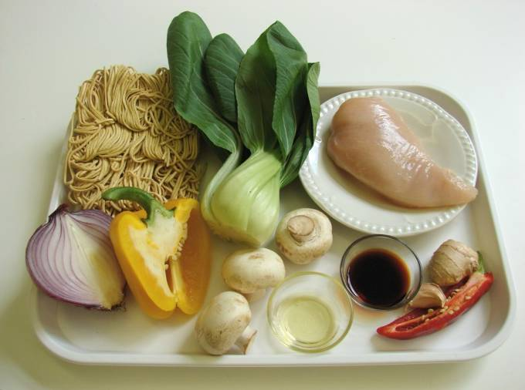
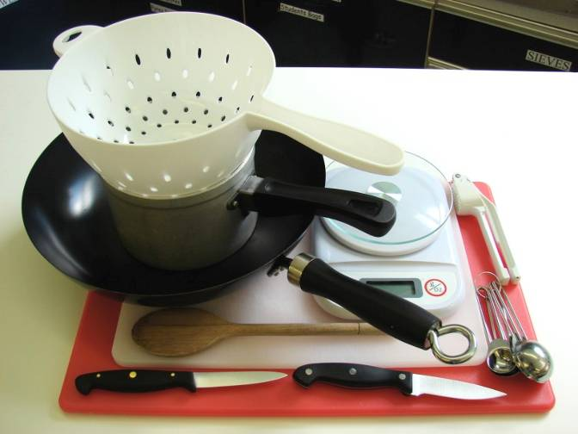
This recipe is from the original Licence to Cook programme and is provided under the Open Government Licence.
Sizzling stir-fry
Ingredients
100g noodles 1 x chicken breast (or 3-4 thighs)
1 clove garlic
½ red chilli
1cm fresh ginger
½ red onion
3 mushrooms
1/2 yellow pepper 1 pak choi
1 x 10ml spoon oil
1 x 10ml spoon soy sauce (reduced salt)
Equipment
Saucepan
Weighing scales
2 chopping boards
2 knives
Garlic press
Measuring spoons
Wok
Wooden spoon
Colander
© Food – a fact of life 2019
www.foodafactoflife.org.uk

Slide 2
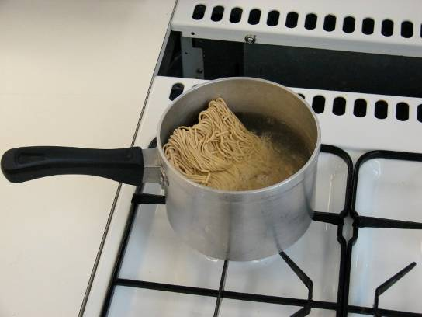
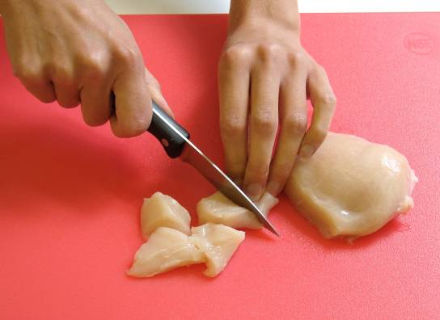
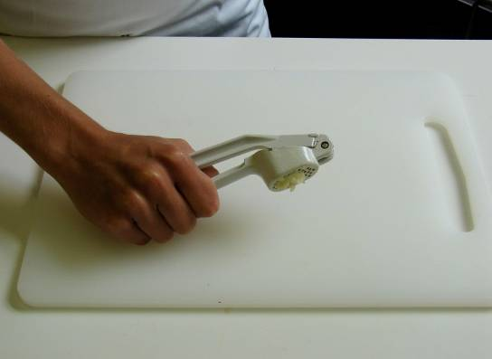
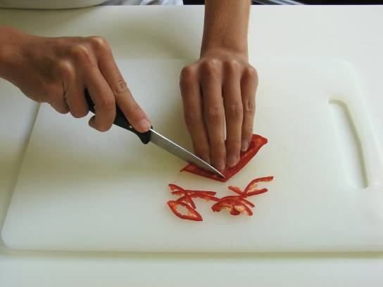
This recipe is from the original Licence to Cook programme and is provided under the Open Government Licence.
Method
Cook the noodles in boiling water. Check the packet for details.
While the noodles are cooking, remove any skin from the chicken and cut into strips. Place in the fridge, covered, until needed.
Prepare the vegetables with a clean knife on a clean chopping board:
peel and crush the garlic;
de-seed and slice the chilli;
© Food – a fact of life 2019
www.foodafactoflife.org.uk

Slide 3
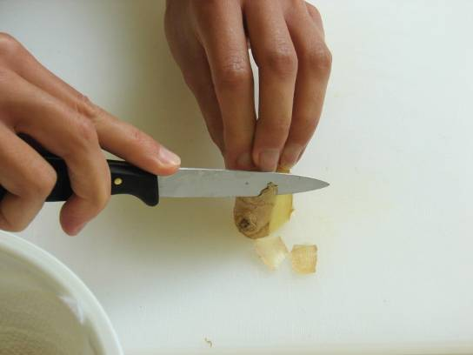
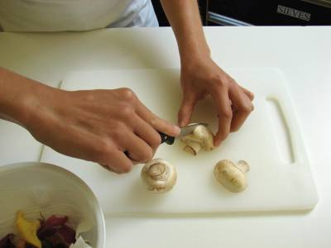
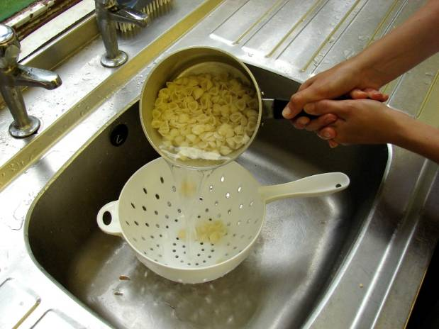
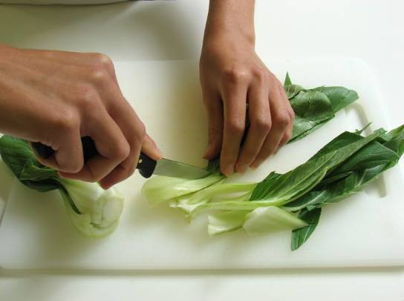
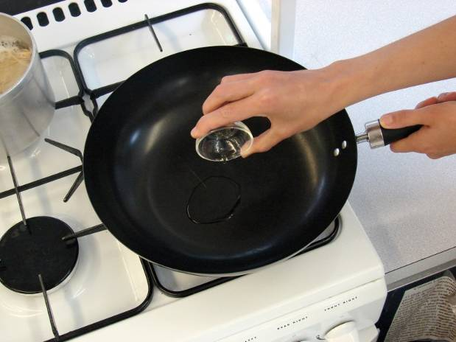
This recipe is from the original Licence to Cook programme and is provided under the Open Government Licence.
Method
peel and slice the ginger;
slice the onion, pepper and mushrooms;
Slice the pepper into small strips.
shred the pak choi.
Add the onion, garlic, chilli and ginger. Allow to cook for 1 minute.
© Food – a fact of life 2019
www.foodafactoflife.org.uk

Slide 4
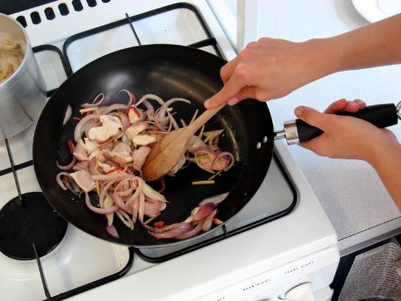
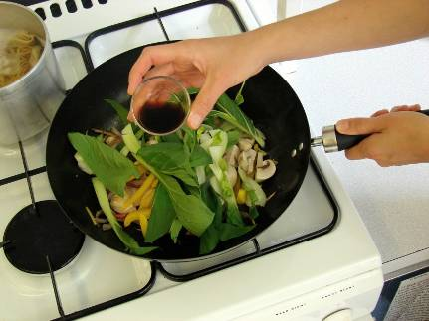
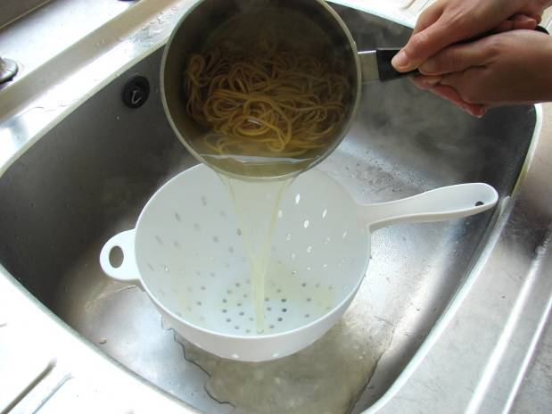
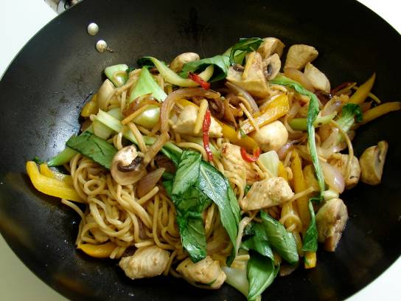
This recipe is from the original Licence to Cook programme and is provided under the Open Government Licence.
Method
Add the chicken and stir-fry for 3-4 minutes. Check that the chicken is cooked.
Add the remaining vegetables and soy sauce and continue to cook for a further 2 minutes.
Slice the pepper into small strips.
Drain the boiling hot water away from the noodles into a colander in the sink.
Stir in the cooked noodles and cook for 2 minutes until hot.
© Food – a fact of life 2019
www.foodafactoflife.org.uk

