Slide 1

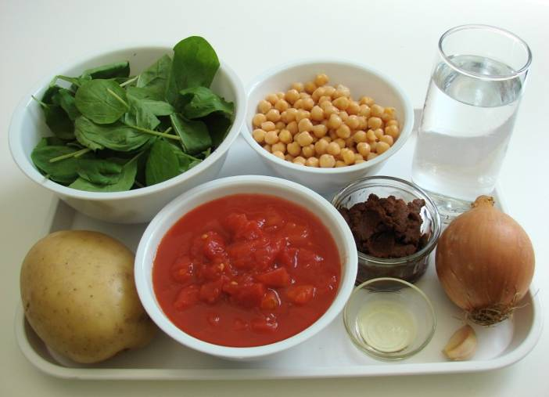
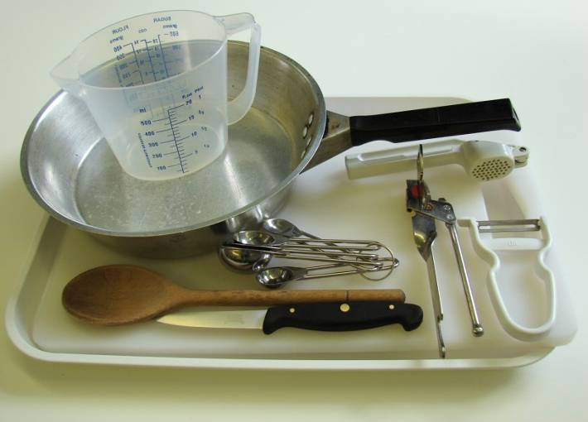
This recipe is from the original Licence to Cook programme and is provided under the Open Government Licence.
Spinach, potato and chickpea curry
Ingredients
1 onion
1 clove garlic
1 large potato
1 x 5ml spoon oil
2 x 15ml spoons curry paste
300ml water
1 can chopped tomatoes (400g)
1 can chickpeas (410g), drained
3 handfuls of fresh spinach
Equipment
Knife
Chopping board
Garlic press
Frying pan
Measuring spoons
Measuring jug
Wooden spoon
Can opener
© Food – a fact of life 2019
www.foodafactoflife.org.uk

Slide 2
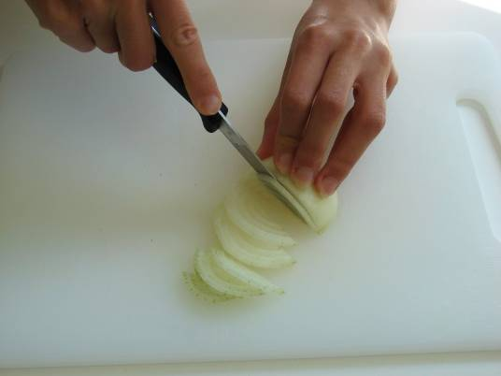
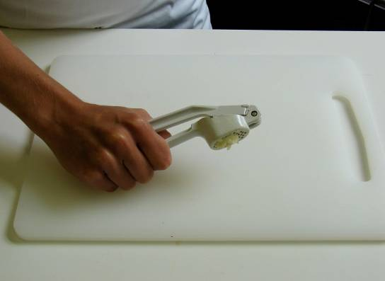
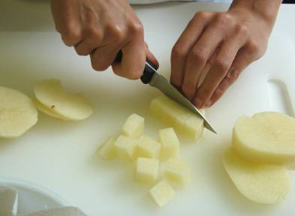
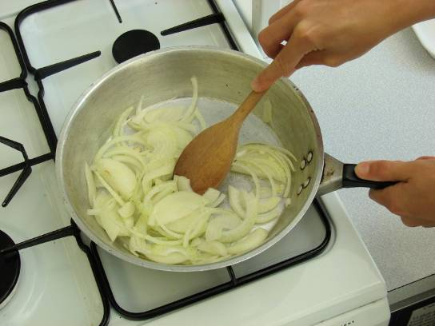
This recipe is from the original Licence to Cook programme and is provided under the Open Government Licence.
Method
Prepare the vegetables:
slice the onion;
peel and crush the garlic;
peel and cut the potatoes into 1cm cubes.
Fry the onion and garlic for 2 minutes in the oil.
© Food – a fact of life 2019
www.foodafactoflife.org.uk

Slide 3
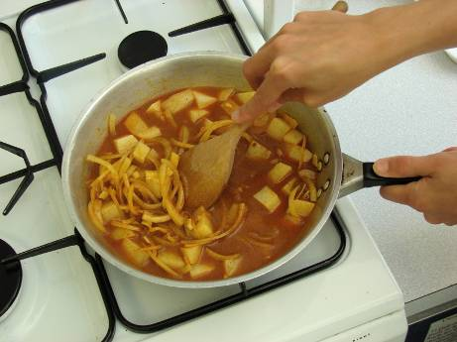
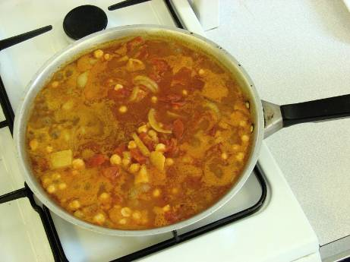
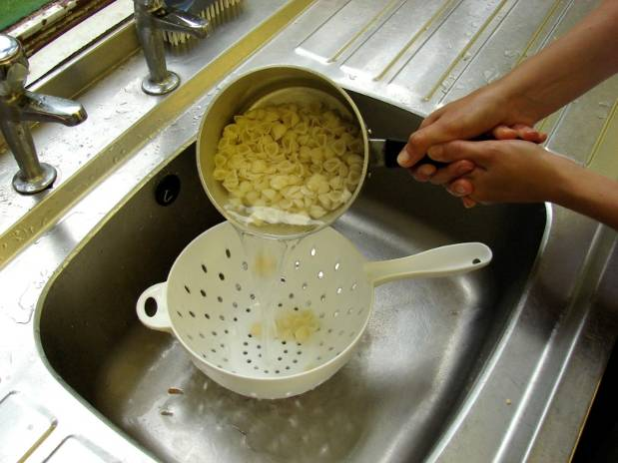
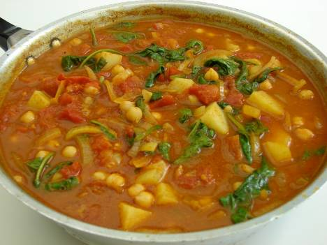
This recipe is from the original Licence to Cook programme and is provided under the Open Government Licence.
Method
Stir in the curry paste, potatoes and water.
Add the tomatoes and chickpeas, then allow to simmer for 20 minutes, until the potato is tender.
Slice the pepper into small strips.
Stir in the fresh spinach, and allow to cook for a further 2 minutes.
© Food – a fact of life 2019
www.foodafactoflife.org.uk

