Slide 1

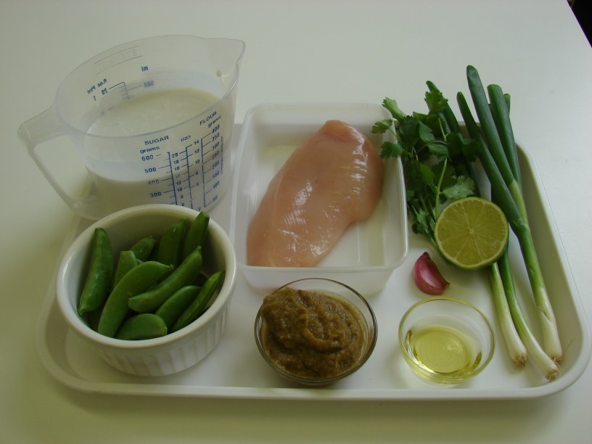
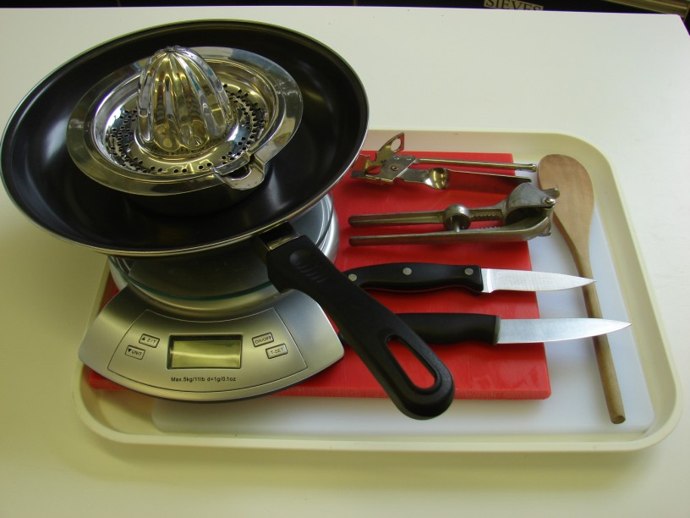
This recipe is from the original Licence to Cook programme and is provided under the Open Government Licence.
Thai green chicken curry
Ingredients
1 x 10ml spoon oil
3 spring onions
1 clove of garlic
80g sugar snap peas
1 small chicken breast
2 x 15ml Thai green curry paste
200ml coconut milk (reduced fat)
1/2 lime
Small bunch of coriander
Equipment
Two chopping boards
Two knives
Garlic press
Frying pan
Weighing scales
Wooden spoon
Can opener
Juicer
© Food – a fact of life 2019
www.foodafactoflife.org.uk

Slide 2
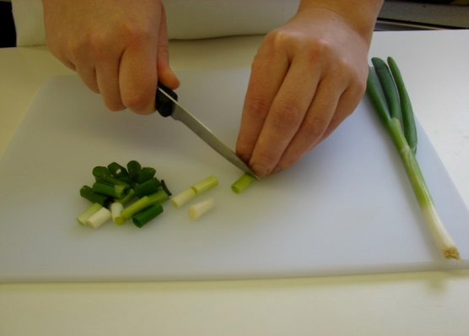
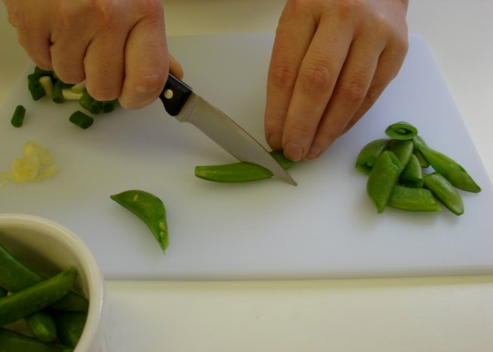
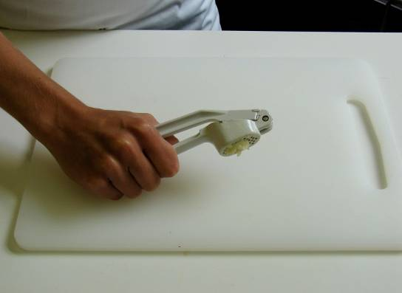
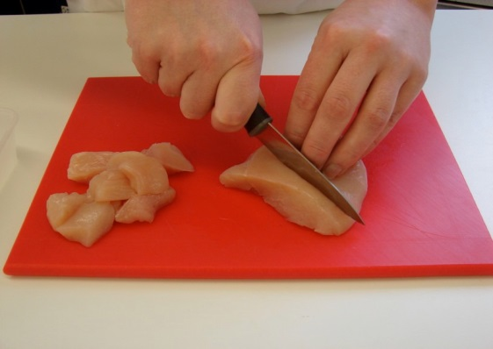
This recipe is from the original Licence to Cook programme and is provided under the Open Government Licence.
Method
Prepare the vegetables:
  slice the spring onions;
  cut the sugar snap peas in half;
  crush the garlic.
On a separate clean chopping board, and using a separate clean knife, cut the chicken into small chunks.
© Food – a fact of life 2019
www.foodafactoflife.org.uk

Slide 3
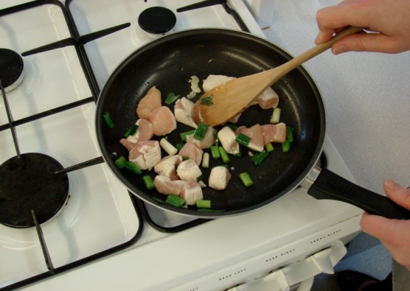
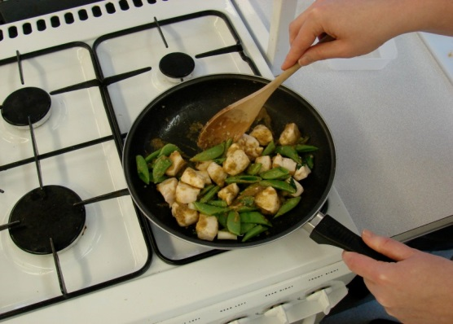
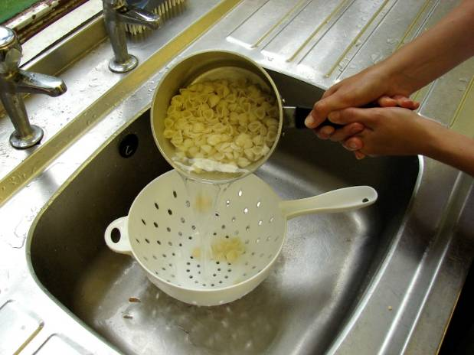
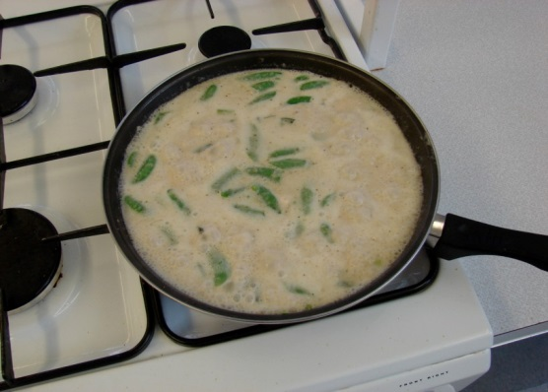
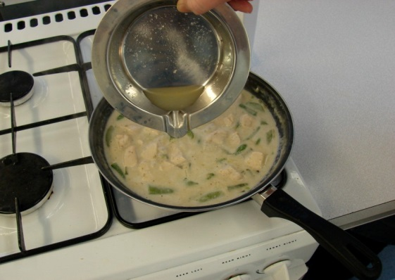
This recipe is from the original Licence to Cook programme and is provided under the Open Government Licence.
Method
Fry the spring onions, garlic and chicken in the oil for 3-4 minutes.
When the chicken has turned ‘white’, stir in the green curry paste, followed by the sugar snap peas.
Slice the pepper into small strips.
Pour in the coconut milk and simmer for 15 minutes.
Squeeze the lime and pour over the curry.
© Food – a fact of life 2019
www.foodafactoflife.org.uk

Slide 4
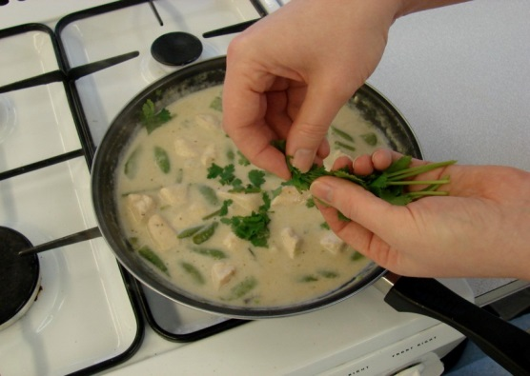
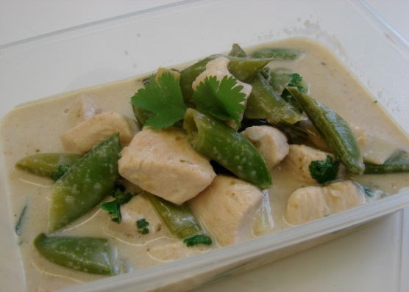
This recipe is from the original Licence to Cook programme and is provided under the Open Government Licence.
Method
Tear the coriander and add to the curry.
Slice the pepper into small strips.
Serve.
© Food – a fact of life 2019
www.foodafactoflife.org.uk

