Slide 1

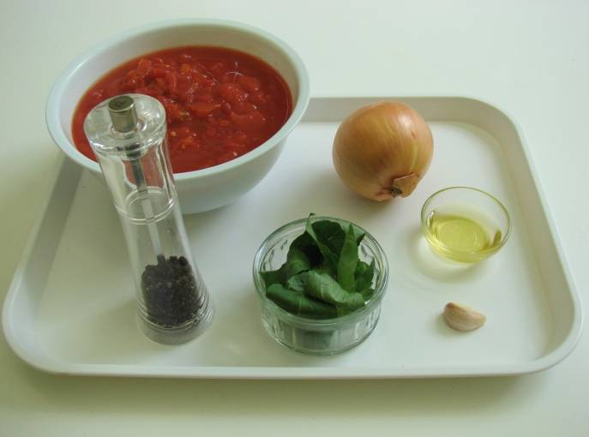
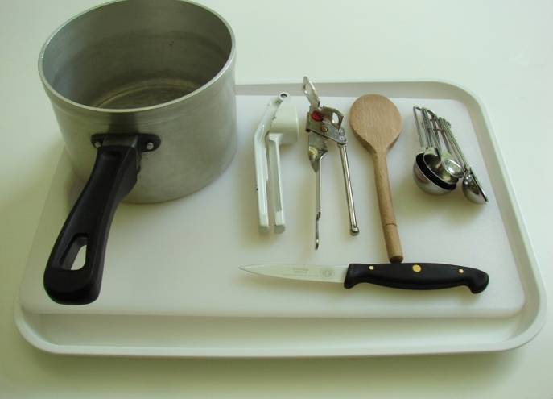
This recipe is from the original Licence to Cook programme and is provided under the Open Government Licence.
Classic tomato ragu
Ingredients
1 onion
1 clove garlic
1 x 15ml spoon oil
2 x 400g canned chopped tomatoes
Handful of fresh basil
Black pepper
Equipment
Knife
Chopping board
Garlic press
Measuring spoons
Saucepan
Wooden spoon
© Food – a fact of life 2019
www.foodafactoflife.org.uk

Slide 2
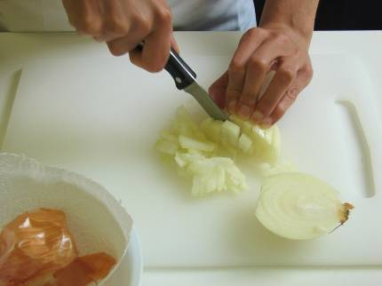
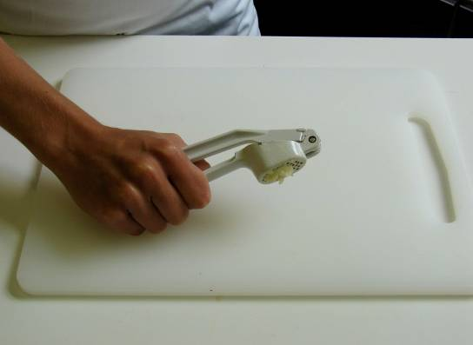
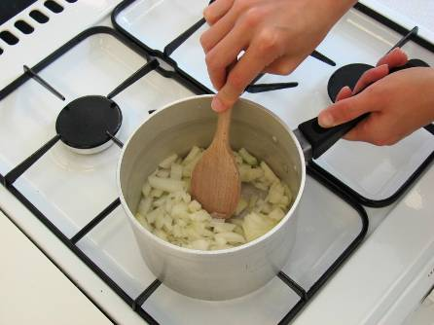
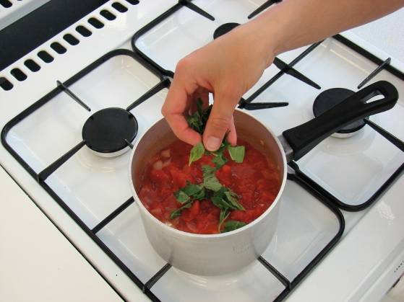
This recipe is from the original Licence to Cook programme and is provided under the Open Government Licence.
Method
Prepare the onion and garlic:
  peel and chop the onion;
  peel and crush the garlic.
Fry the onion and garlic in the oil for 5 minutes, until soft.
Add the tomatoes and tear in the basil leaves.
© Food – a fact of life 2019
www.foodafactoflife.org.uk

Slide 3
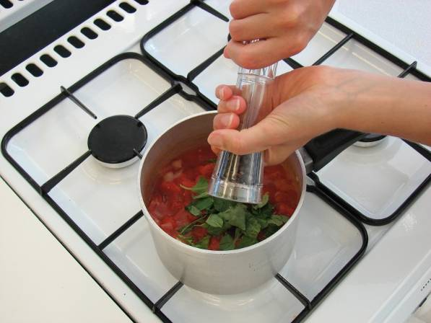
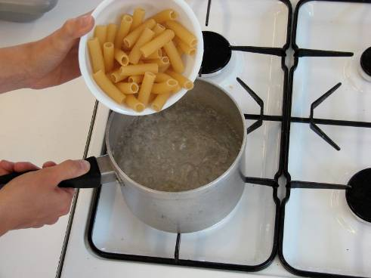
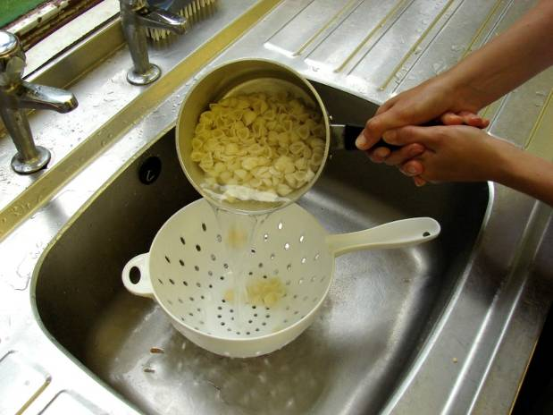
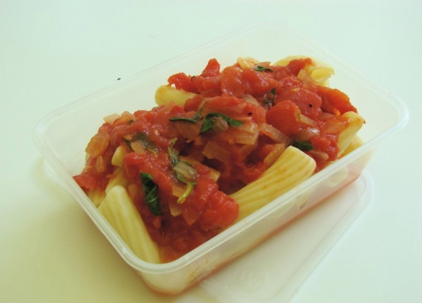
This recipe is from the original Licence to Cook programme and is provided under the Open Government Licence.
Method
Add a few twists of black pepper, then allow to simmer gently for 30 minutes (longer if possible).
If serving with pasta:
  put a saucepan of water on to boil. When boiling, add the pasta and cook for around 10 minutes. Drain.
Slice the pepper into small strips.
Mix the cooked pasta and tomato sauce together.
© Food – a fact of life 2019
www.foodafactoflife.org.uk

