Slide 1

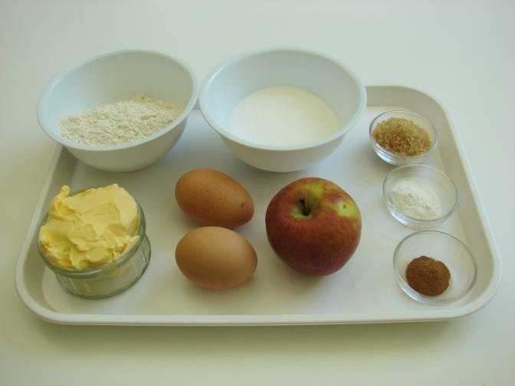
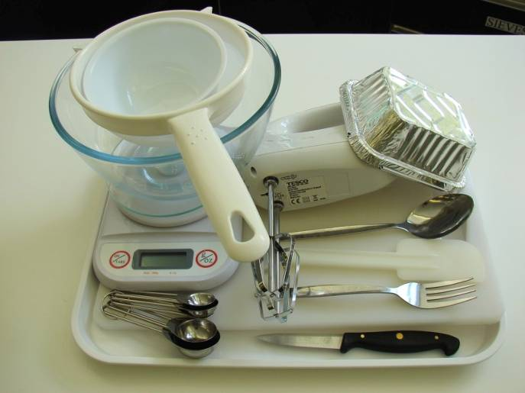
This recipe is from the original Licence to Cook programme and is provided under the Open Government Licence.
Dutch apple cake
Ingredients
100g caster sugar
100g butter or
soft baking spread
2 eggs
100g self raising flour
1 x 5ml spoon baking powder
1 eating apple
1 x 5ml spoon cinnamon
1 x 5ml spoon Demerara sugar
Equipment
Weighing scales
Mixing bowl
Electric hand whisk
Small bowl
Fork
Sieve
Spoon
Knife
Chopping board
Measuring spoons
Cake tin or foil trays
© Food – a fact of life 2019
www.foodafactoflife.org.uk

Slide 2
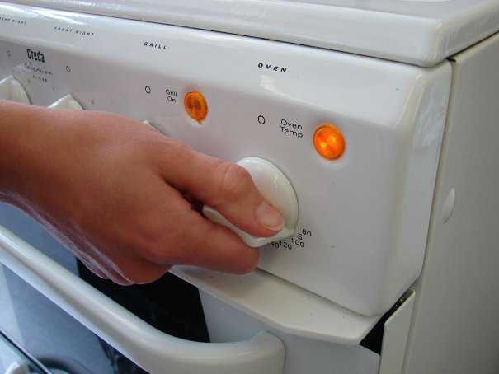
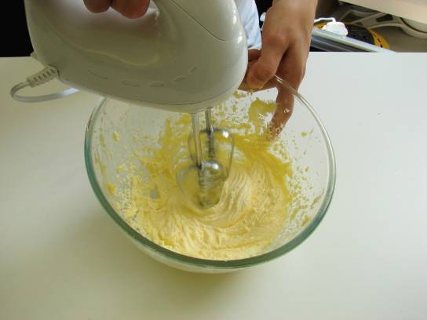
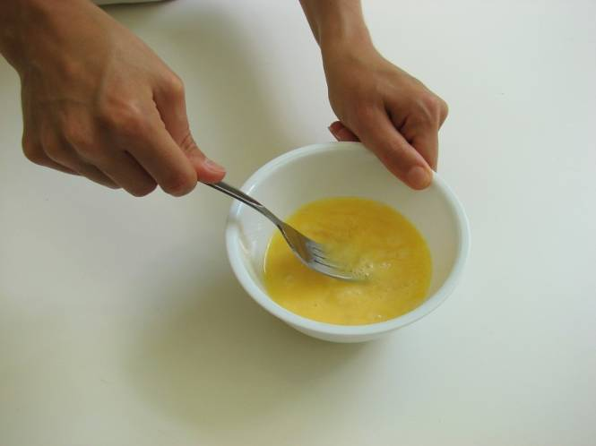
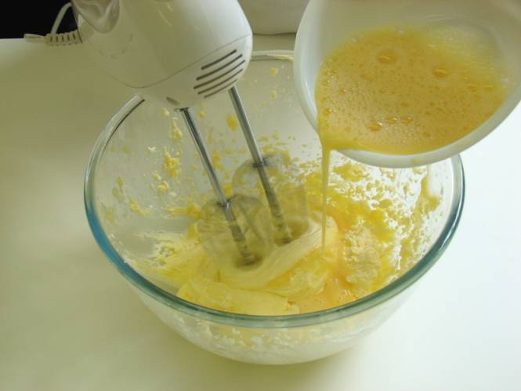
This recipe is from the original Licence to Cook programme and is provided under the Open Government Licence.
Method
Preheat the oven to 180°C or gas mark 4.
Cream the sugar and fat together, ideally using an electric hand whisk, until light and fluffy.
In a small bowl, beat the eggs with a fork.
Add the beaten egg, a little at a time, to the fat and sugar.
© Food – a fact of life 2019
www.foodafactoflife.org.uk

Slide 3
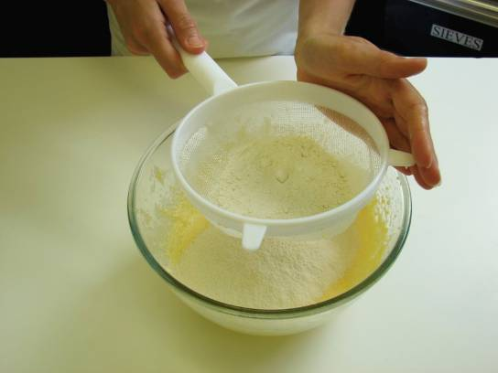
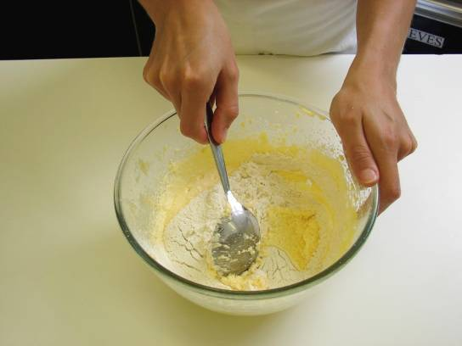
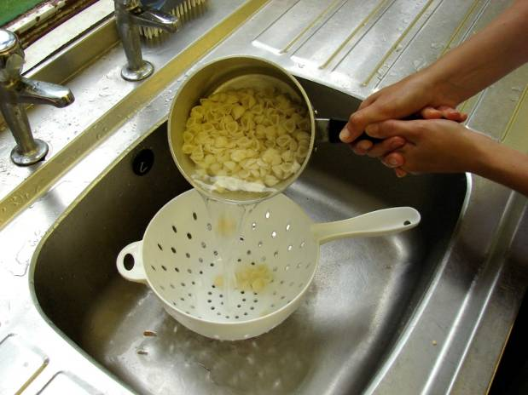
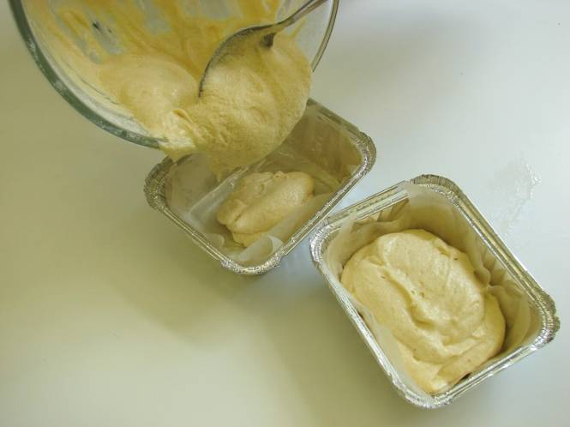
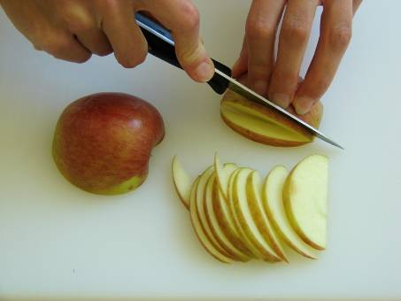
This recipe is from the original Licence to Cook programme and is provided under the Open Government Licence.
Method
Sieve the flour and baking powder into a bowl, or onto a plate or piece of greaseproof paper.
Fold the flour and baking powder into the mixture, a spoonful at a time.
Slice the pepper into small strips.
Spread the mixture in the greased cake tin.
Core the apple and slice thinly.
© Food – a fact of life 2019
www.foodafactoflife.org.uk

Slide 4
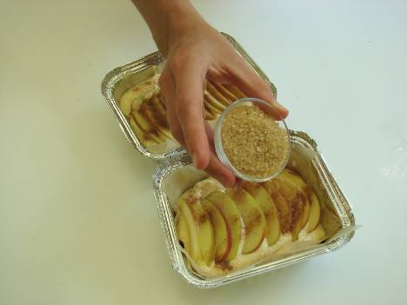
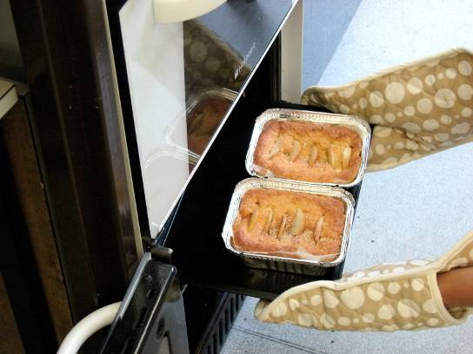
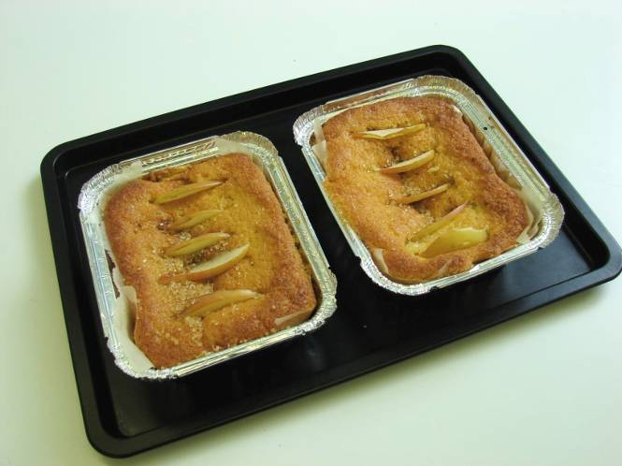
This recipe is from the original Licence to Cook programme and is provided under the Open Government Licence.
Method
Arrange the apple slices over the cake mix and then sprinkle the cinnamon and sugar on top.
Place in the oven and bake for around 20 minutes, until golden brown and springy to the touch.
Slice the pepper into small strips.
Remove from the oven and allow to cool.
© Food – a fact of life 2019
www.foodafactoflife.org.uk

